Slide 1
ECES6019
Making a Difference Together
Gwneud Gwahaniaeth Gyda'n Gilydd
SESIWN/Session 3

Slide 2
Recap
What have we covered so far?
Do you have any questions?

Slide 3
Objectives
By the end of this session, you will be able to
  Recall the key elements of the Wales Safeguarding Procedures
  Evaluate How Safe our Children are
  Recognise and Evaluate signs of abuse.

Slide 4

Prif Negeseuon Key Messages

Slide 5
Prif Negeseuon Key Messages
Plentyn yw unrhyw un sydd heb gael ei ben-blwydd yn 18 oed eto.
Does dim 'Diogelu Data' pan fydd diogelu dan sylw.
Rhaid i ni rannu gwybodaeth – mae gan bob un ddarn o'r 'jig-so'.
A child is anyone who has not yet reached their 18th birthday.
There is no ‘Data Protection’ when we deal with safeguarding.
We must share information –we all have a piece of the ‘jigsaw’.

Slide 6
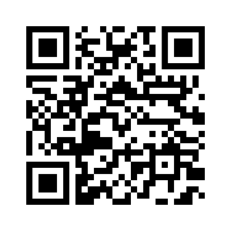
Diffiniadau (Gweithdrefnau Diogelu Cymru)
Definitions (Wales Safeguarding Procedures)
Gan ddefnyddio'r cod QR, archwiliwch Weithdrefnau Diogelu Cymru ac Atebwch y Cwis rhyngweithiol yn Moodle
Using the QR code explore the Wales Safeguarding Procedures and Answer the interactive Quiz in Moodle
Am fersiwn iaith Gymraeg cliciwch y botwm Cymraeg ar frig y dudalen

Slide 7
Gweithdrefnau Diogelu Cymru
Wales Safeguarding Procedures
Maent yn manylu ar rolau a chyfrifoldebau hanfodol ymarferwyr i sicrhau eu bod yn diogelu plant ac oedolion sydd mewn perygl o gael eu cam-drin a'u hesgeuluso.
Mae'r gweithdrefnau wedi'u gwahanu i'r rhai sy'n ymwneud â diogelu plant a’r rhai ar gyfer oedolion sydd mewn perygl o gael eu cam-drin a'u hesgeuluso.
They detail the essential roles and responsibilities for practitioners to ensure that they safeguard children and adults who are at risk of abuse and neglect.
The procedures are separated into those relating to safeguarding children and those for adults at risk of abuse and neglect.

Slide 8
Gweithdrefnau Diogelu Cymru
Wales Safeguarding Procedures
Mae'r gweithdrefnau wedi'u rhannu ymhellach yn adrannau. Mae pob adran yn manylu ar rolau a chyfrifoldebau ymarferwyr sy'n ymwneud ag agwedd ar y broses ddiogelu, fel y mae'n ymwneud ag oedolion sydd mewn perygl o gael eu cam-drin a'u hesgeuluso neu ddiogelu plant.
Mae pob adran hefyd yn cynnwys arwyddion perthnasol ar gyfer ymarfer.
Mae'r gweithdrefnau hyn yn disodli Gweithdrefnau Amddiffyn Plant Cymru Gyfan (2008)
The procedures have been further divided into sections. Each section details the roles and responsibilities of practitioners relating to an aspect of the safeguarding process, as it relates to adults at risk of abuse and neglect or safeguarding children.
Each section also includes relevant pointers for practice.
These procedures replace the All Wales Child Protection Procedures (2008)

Slide 9
Gweithdrefnau Diogelu Cymru
Wales Safeguarding Procedures
Plentyn-ganolog- yn canolbwyntio ar y plentyn ar bob cam o'r broses ddiogelu. Cyflawnir hyn drwy ganolbwyntio ar anghenion a barn y plentyn drwy wrando ar yr hyn sydd ganddynt i'w ddweud, eu hysbysu a'u cynnwys yn y broses a rhoi sylw dyledus i'w dymuniadau wrth benderfynu ar y gwasanaethau sydd eu hangen i ddiwallu eu hanghenion. Dylid cynnig eiriolwr i blant sy'n ifanc iawn, sydd â phroblemau iechyd meddwl, nam cyfathrebu, anableddau dysgu neu sy'n dymuno cael eu cynrychioli neu eu cefnogi.
Child centred- concentrating on the child at each stage of the safeguarding process. This is achieved by focusing on the needs and views of the child by listening to what they have to say, informing and engaging them in the process and having due regard for their wishes when deciding what services are required to meet their needs. Children who are very young, have mental health issues, a communication impairment, learning disabilities or wish to be represented or supported should be offered an advocate.

Slide 10
Ffeithiau ac ystadegau
Facts and figures
Dydyn ni ddim yn gwybod yn union faint o blant yn y DU sy'n profi cam-drin plant.
Yn aml, mae cam-drin plant yn cael ei guddio o'r golwg.
Mae dros 7080 o blant mewn gofal yng Nghymru (Ffynonellau: Llywodraeth Cymru (2016) Plant sy'n derbyn gofal ar 31 Mawrth yn ôl awdurdod lleol a math o leoliad a Llywodraeth Cymru (2022) Plant mewn angen yn ôl awdurdod lleol a chategori angen.)
Mae'r mwyafrif yn mynd i ofal oherwydd cam-drin ac esgeulustod, a gall hyn adael plant ag anghenion iechyd emosiynol a meddyliol cymhleth (Bazalgette, Rahilly, a Trevelyan, 2015; Luke et al, 2014).
We don't know exactly how many children in the UK experience child abuse.
Child abuse is often hidden from view.
There are over 7080 children in care in Wales (Sources: Welsh Government (2016) Children looked after at 31 March by local authority and placement type and Welsh Government (2022) Children in need by local authority and category of need.)
The majority enter care because of abuse and neglect, and this can leave children with complex emotional and mental health needs (Bazalgette, Rahilly, and Trevelyan, 2015; Luke et al, 2014).

Slide 11
Pa mor ddiogel yw ein plant?
How safe are our children? (NSPCC, 2024)
Mae pobl ifanc yn wynebu risgiau uwch o gam-drin
Gwaethygodd pandemig COVID-19 eu gwendidau
Mae pryderon iechyd meddwl ymhlith pobl ifanc yn cynyddu
Mae systemau cymorth dan straen
Adolescents face heightened risks of abuse
The COVID-19 pandemic exacerbated vulnerabilities
Mental health concerns among adolescents are rising
Support systems are under strain
Notes:
Adolescents face heightened risks of abuse, especially sexual abuse, online grooming, and physical violence. Girls aged 13–15 are disproportionately affected, accounting for around 90% of recorded rape offences in that age group.
The COVID-19 pandemic exacerbated vulnerabilities, with increased risks of neglect, emotional abuse, and online exploitation. Lockdowns reduced access to protective services and increased exposure to abusers, particularly within the home.
Mental health concerns among adolescents are rising, with Childline reporting a consistent increase in counselling sessions about emotional wellbeing and suicidal thoughts. These issues have intensified during the pandemic.
Support systems are under strain, with reduced funding for youth services and inconsistent responses to harmful sexual behaviour among adolescents. The report calls for better multi-agency collaboration, investment in mental health services, and inclusive, high-quality Relationships and Sex Education (RSE).

Slide 12
Task -
Mae Adroddiad yr NSPCC “Pa mor ddiogel yw ein plant 2020” yn rhestru 10 dangosydd sy’n pennu pa mor ddiogel yw plant.
Mewn grwpiau bach, darllenwch a chrynhowch eich dangosyddion a neilltuwyd i bennu canfyddiadau’r NSPCC
Cyflwynwch yn ôl i’r grŵp
Gall offeryn AI priodol helpu gyda’r dasg hon
The NSPCC Report “How safe are our children 2020” list 10 indicators that determines how safe children are.
In small groups read and summarise your allocated indicators to determine the NSPCC’s findings
Present back to the group
An appropriate AI tool may help with this task
Notes:
NSPCC How Safe Are Our Children
Group indicators:
Suicide & Homicide
Physical Abuse, Sexual Offences & Online Harms
Child Protection Plans or Registers, Reasons for Child Protection Plan & LAC
Helpline Contacts & Child counselling sessions

Slide 13
Y broses ddiogelu: trosolwg
The safeguarding process: an overview
atal neu gymorth cynnar i fynd i'r afael ag unrhyw bryderon sy'n dod i'r amlwg;
nodi pryderon;
dyletswydd i roi gwybod am y pryderon hyn i wasanaethau cymdeithasol yr awdurdod lleol; cychwyn ymholiadau a47 o dan Ddeddf Plant 1989;
amddiffyn ar unwaith i gadw'r unigolyn mewn perygl o niwed yn ddiogel;
prevention or early help to address any emerging concerns;
identification of concerns;
duty to report these concerns to the local authority social services; initiation of s47 enquiries under the Children Act 1989;
immediate protection to keep the individual at risk of harm safe;

Slide 14
Y broses ddiogelu: trosolwg
The safeguarding process: an overview
gofal a chymorth i fynd i'r afael ag anghenion nas diwallwyd os na chanfuwyd bod y plentyn mewn perygl neu’n dioddef niwed sylweddol;
diogelu gofal a chymorth i fynd i'r afael ag anghenion gan gynnwys cadw'r unigolyn yn ddiogel os yw'r plentyn yn profi a/neu'n debygol o brofi niwed sylweddol parhaus.
care and support to address unmet needs if the child is not found to be at risk or experiencing significant harm;
care and support protection to address needs including keeping the individual safe if the child is experiencing and/or likely to experience ongoing significant harm.

Slide 15
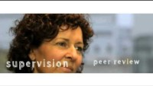
Watch and make notes

Slide 16
Polisïau Sefydliadol Institutional Policies
Rhaid bod gan bob lleoliad bolisi diogelu ar waith
Bydd y polisi hwn yn amlinellu'r gweithdrefnau sydd ar waith ar gyfer cadw plant yn ddiogel
Bydd gan y sefydliad berson a enwir sy'n gyfrifol am faterion diogelu yn y lleoliad hwnnw.
Each setting has to have a safeguarding policy in place
This policy will outline the procedures in place for keeping children safe
The organisation will have a named person who is responsible for safeguarding issues within that setting.

Slide 17
Rhannu Gwybodaeth
Information Sharing
Nid yw'r gyfraith yn rhwystr i rannu gwybodaeth
Dim cyfyngiad o dan y Ddeddf Diogelu Data/GDPR os ydych yn gweithredu i ddiogelu plentyn
Materion cydsyniad
Tasg 5 – Trafodwch yr uchod ac ystyriwch pryd y gallai rhannu gwybodaeth fod yn broblem. A ydych wedi gweld unrhyw broblemau felly yn ymarferol?
The law is not a barrier to sharing information
No restriction under Data Protection Act/GDPR if you are acting to safeguard a child
Consent issues
Task 5 – Discuss the above and consider when information sharing might be problematic. Have you witnessed any such issues in practice?

Slide 18
Cyfrifoldebau a rennir
Shared responsibilities
Mae gan bob asiantaeth ac unigolyn gyfrifoldeb:
I fod yn effro i arwyddion posibl o gam-drin neu esgeulustod
Bod yn effro i'r risgiau y gall camdrinwyr unigol, neu gamdrinwyr posibl, eu hachosi i blant a phobl ifanc
Rhannu gwybodaeth fel y gellir asesu anghenion ac amgylchiadau'r plentyn
Cyfrannu i’r camau sy'n angenrheidiol i ddiogelu'r plentyn
All agencies and individuals have a responsibility to:
Be alert to the potential indicators of abuse or neglect
Be alert to the risks which individual abusers, or potential abusers, may pose to children and young people
Share information so that assessment can be made of the child’s needs and circumstances
Contribute to actions necessary to safeguard the child

Slide 19
Termau allweddol – niwed sylweddol
Diffinnir niwed o dan adran 31(9) o Ddeddf Plant 1989 fel 'triniaeth wael neu nam ar iechyd neu ddatblygiad.'
Ychwanegodd Adran 120 o Ddeddf Mabwysiadu a Phlant 2002 at y diffiniad hwn: '... gan gynnwys, er enghraifft, roedd nam yn dioddef o weld neu glywed cam-drin un arall.'
Er mwyn penderfynu a yw niwed yn sylweddol, mae iechyd a datblygiad y plentyn 'o'i gymharu â'r hyn y gellid ei ddisgwyl yn rhesymol gan blentyn tebyg' (adran 31(10) o Ddeddf Plant 1989).
Os yw'n ymddangos bod plentyn yn dioddef neu mewn perygl o ddioddef niwed sylweddol, mae gan yr awdurdod lleol ddyletswydd i ymchwilio o dan Adran 47 o Ddeddf Plant 1989
O dan Adran 21 o Ddeddf Gwasanaethau Cymdeithasol a Llesiant (Cymru) 2014, mae gan yr awdurdod lleol ddyletswydd statudol i asesu anghenion plentyn os yw'n ymddangos bod angen cymorth ychwanegol arnynt i'r hyn a ddarperir gan eu teulu.

Slide 20
Key terms – significant harm
Harm is defined under section 31(9) of the Children Act 1989 as ‘ill treatment or the impairment of health or development.’
Section 120 of the Adoption and Children Act 2002 added to this definition: ‘… including for example, impairment suffered from seeing or hearing the ill-treatment of another.’
To decide whether harm is significant, the health and development of the child is ‘compared with that which could reasonably be expected of a similar child’ (section 31(10) of the Children Act 1989).
If a child appears to be suffering or at risk of suffering significant harm the local authority has a duty to investigate under Section 47 of the Children Act 1989
Under Section 21 of the Social Services and Well-being (Wales) Act 2014, the local authority has a statutory duty to assess the needs of a child if they appear to need additional support to that provided by their family.

Slide 21
Termau allweddol – Perygl uniongyrchol
Os yw'r plentyn mewn perygl uniongyrchol gall yr awdurdod lleol neu berson awdurdodedig (gan gynnwys yr NSPCC) gymryd y camau canlynol drwy'r llysoedd:
Gellir cyflwyno gorchymyn amddiffyn brys i symud plentyn ar unwaith i fan diogel.
Gellir rhoi gorchymyn gwahardd i dynnu'r camdriniwr o gartref y teulu.
Gellir cyflwyno gorchymyn asesu plant i weithiwr cymdeithasol plant asesu anghenion y plentyn heb ganiatâd y rhieni neu'r gofalwyr.
Gall yr heddlu symud plentyn i fan diogel am hyd at 72 awr heb orchymyn llys.
Gellir gwneud cais am orchymyn amddiffyn anffurfio organau rhywiol menywod (FGMPO) drwy lys teulu ac mae'n cynnig y ffordd o ddiogelu dioddefwyr go iawn neu ddarpar ddioddefwyr rhag anffurfio organau cenhedlu benywod o dan y gyfraith sifil.

Slide 22
Key terms – Immediate danger
If the child is in immediate danger the local authority or an authorised person (including the NSPCC) can take the following action through the courts:
An emergency protection order can be issued to immediately remove a child to a place of safety.
An exclusion order can be issued to remove the abuser from the family home.
A child assessment order can be issued for a children’s social worker to assess the child’s needs without the parents’ or carers’ consent.
The police can remove a child to a place of safety for up to 72 hours without obtaining a court order.
A female genital mutilation protection order (FGMPO) can be applied for through a family court and offers the means of protecting actual or potential victims from FGM under the civil law.

Slide 23
Beth yw cam-drin?
What is abuse?
Mae hyn yn disgrifio cam-drin corfforol, rhywiol, seicolegol, emosiynol neu ariannol (ac mae'n cynnwys cam-drin sy'n digwydd mewn unrhyw leoliad, boed hynny mewn annedd breifat, sefydliad neu unrhyw le arall).
(Gweithdrefnau Diogelu Cymru 2023)
This describes physical, sexual, psychological, emotional or financial abuse (and includes abuse taking place in any setting, whether in a private dwelling, an institution or any other place).
(Wales Safeguarding Procedures 2023)

Slide 24
TASG - Agweddau a Gwerthoedd
TASK - Attitudes and Values
Notes:
Use sheet to highlight challenges of safeguarding ensure to refer to cultural mores and norms

Slide 25
Prif Gategorïau Cam-drin
Main Categories of Abuse
Cam-drin Corfforol
Cam-drin Rhywiol
Cam-drin Emosiynol
Esgeuluso
Effeithiau cam-drin domestig ar blentyn*
Physical Abuse
Sexual Abuse
Emotional Abuse
Neglect
Effects of domestic abuse on a child*

Slide 26
Categorïau eraill o gam-drin
Other categories of abuse
Cam-drin ar-lein
Camfanteisio rhywiol
Anffurfio organau cenhedlu benywod (FGM)
Paratoi
Masnachu mewn Plant
Ymddygiad rhywiol niweidiol
Online abuse
Sexual exploitation
Female genital mutilation (FGM)
Grooming
Child Trafficking
Harmful sexual behaviour

Slide 27
Task – What is child abuse?
As a group create a mind map of examples of child abuse

Slide 28
BETH YW CAM-DRIN PLANT?
Esgeuluso anghenion
addysgol neu
feddygol plentyn
Taro neu frifo
plentyn yn aml i leddfu
ein rhwystredigaeth ein hunain
Chwalu hunan
hyder plentyn
Tynnu coes plentyn
yn barhaus
Peidio â gwrando ar blentyn
Gorfodi plentyn
i gyffwrdd â chi
Peidio â chymryd gofal priodol
o blentyn,
e.e. peidio â glanhau,
dillad neu fwydo
plentyn
Cam-drin plentyn ar lafar
Cyffwrdd plentyn lle
neu pan nad yw am i chi
gyffwrdd â chi
Dylanwadu ar Blentyn

Slide 29
WHAT IS CHILD ABUSE?
Neglecting a child’s
educational or
medical needs
Hitting or hurting a
child often to relieve
our own frustration
Breaking down the self
confidence of a child
Teasing a child
persistently
Not listening to a child
Forcing a child
to touch you
Not taking proper care
of a child,
e.g. not cleaning,
clothing or feeding a
child
Verbally abusing a child
Touching a child where
or when he/she doesn’t
want to be touched
Manipulating a Child

Slide 30
Beth yw Cam-drin Corfforol?
What is Physical Abuse?
Taro, dyrnu, slapio, cicio
Brathu, ysgwyd, taflu
Sgaldio neu losgi bwriadol
Llindagu neu dagu
Mygu, boddi
Gwenwyn
Salwch wedi'i ffugio neu ei ysgogi
Hitting, punching, slapping, kicking
Biting, shaking, throwing
Deliberate scalding or burning
Throttling or strangulation
Suffocation, drowning
Poisoning
Fabricated or induced illness
Notes:
Accidental or non-accidental injuries:
accidental tend to be on boney parts, eg elbws, shins, knees, chin etc palm of hands (falls)
non accidental tend to be on fleshy parts of the body, eg forearms (defensive), abdomen , inner thighs, neck and ears.
What type of circumstances give rise to physical abuse? Is it always intentional?
Eg Caregiver's angry and uncontrolled disciplinary response to actual or perceived misconduct of the child
Caregiver's psychological impairment, which causes resentment and rejection of the child by the caregiver and a perception of the child as different and provocative
Child left in care of another adult who is abusive
Caregiver's use of substances that disinhibit behavior
Domestic violence situation

Slide 31
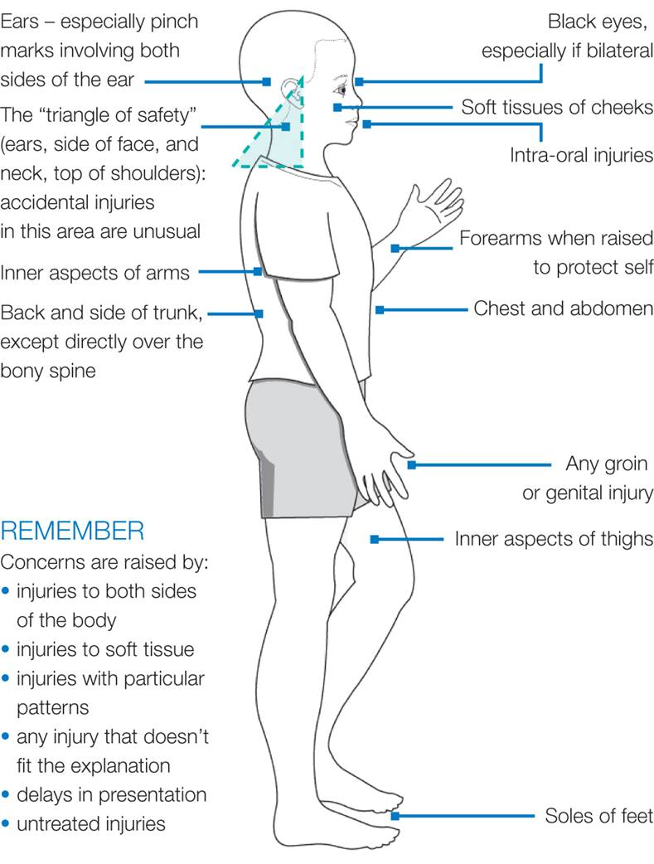
Mannau nodweddiadol o anaf nad yw'n ddamweiniol
Typical areas of Non-Accidental injury
Notes:
Physical abuse may involve hitting, shaking, throwing, poisoning, burning or scalding, drowning, suffocating or otherwise causing physical harm to a child. This includes fabricated or induced illness by carer.
AWCPP

Slide 32
Beth yw Cam-drin Rhywiol?
What is Sexual Abuse?
Gorfodi neu gymryd rhan mewn gweithgareddau rhywiol;
Pa un ai a ydynt yn ymwybodol o'r hyn sy'n digwydd ai peidio
Gall gynnwys cyswllt corfforol
Dim cyswllt, cynnwys plant wrth edrych ar bornograffi neu ei wneud, gwylio gweithgareddau rhywiol, ymddygiad rhywiol amhriodol
Forcing or enticing a child or young person to take part in sexual activities;
Whether or not they are aware of what is happening
May involve physical contact
Non-contact, involving children in looking at or making pornography, watching sexual activities, sexually inappropriate behaviour
Notes:
don’t make assumptions particularly about service users (or colleagues for that matter). Abuse crosses all generations, ethnic groups, social classes and sexes
Most abuse is secret
Most abuse is within the family
Abuser can be male or female
Adults can be involved in ‘grooming’ children and the sexual exploitation
of children
Professionals can abuse children
Other children
VOG ACPC CP1 Handout 1
32

Slide 33
Paratoi
Grooming is
wedi ei ddiffinio gan y Swyddfa Gartref fel cyfathrebu â phlentyn lle mae hyn yn fwriad i gyflawni trosedd rhyw a'i chyflawni.
y broses y mae unigolyn yn dylanwafu ar y rhai o'u cwmpas – oedolion a'r plentyn – i ddarparu cyfleoedd i gam-drin a lleihau'r tebygolrwydd o gael eu hadrodd a'u darganfod
defined by the Home Office as communication with a child where this is an intention to meet and commit a sex offence.
the process by which an individual manipulates those around them – adults and the child – to provide opportunities to abuse and reduce the likelihood of being reported and discovered

Slide 34
Camfanteisio'n Rhywiol ar Blant
Child Sexual Exploitation
Mae camfanteisio'n rhywiol ar blant a phobl ifanc o dan 18 oed yn cynnwys sefyllfaoedd, cyd-destunau a pherthnasoedd ffrwydrol lle mae pobl ifanc yn cael rhywbeth o ganlyniad i berfformio a/neu eraill sy'n perfformio arnynt gweithgareddau rhywiol.
(Gweithgor Cenedlaethol ar gyfer Plant a Phobl Ifanc y Camfanteisir Arnynt yn Rhywiol, 2008)
The sexual exploitation of children and young people under 18 involves exploitative situations, contexts and relationships where young persons receive something as a result of performing and/or others performing on them sexual activities.
(National Working Group for Sexually Exploited Children and Young People, 2008)

Slide 35
Cam-drin emosiynol
Emotional abuse
Cam-drin emosiynol yw triniaeth barhaus emosiynol greulon plentyn er mwyn llesteirio datblygiad emosiynol ac iechyd meddwl y plentyn. Gall plant fod yn agored i feirniadaeth gyson a chael diffyg hoffter a chynhesrwydd. Gellir eu gwrthod neu eu gor-ddiogelu'n fawr.
Emotional abuse is the persistent emotionally cruel treatment of a child so as to hinder the child’s emotional development and mental health. Children may be exposed to constant criticism and lack of affection and warmth. They may be rejected or extremely overprotected.

Slide 36
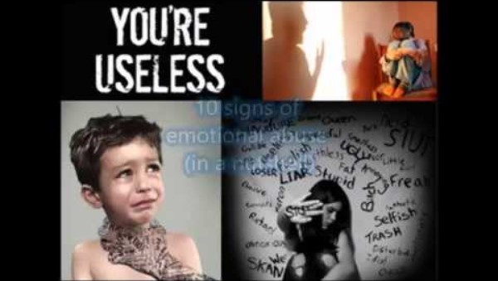

Slide 37
Grwpiau arbennig o agored i niwed
Particularly vulnerable groups
Plant sy'n Derbyn Gofal (neu hanes felly)
Plant/pobl ifanc sydd â hanes o gamdriniaeth a/neu esgeulustod
Plant/pobl ifanc sydd wedi cael eu heffeithio gan gam-drin domestig, problemau iechyd meddwl rhieni a/neu gamddefnyddio sylweddau rhieni
Chwalu teuluoedd/perthnasoedd gwael
Hunan-barch isel
Looked After Children (or history of)
Children/young people with a history of abuse and/or neglect
Children/young people who have been affected by domestic abuse, parental mental health problems and/or parental substance misuse
Family breakdown/poor relationships
Low self esteem

Slide 38
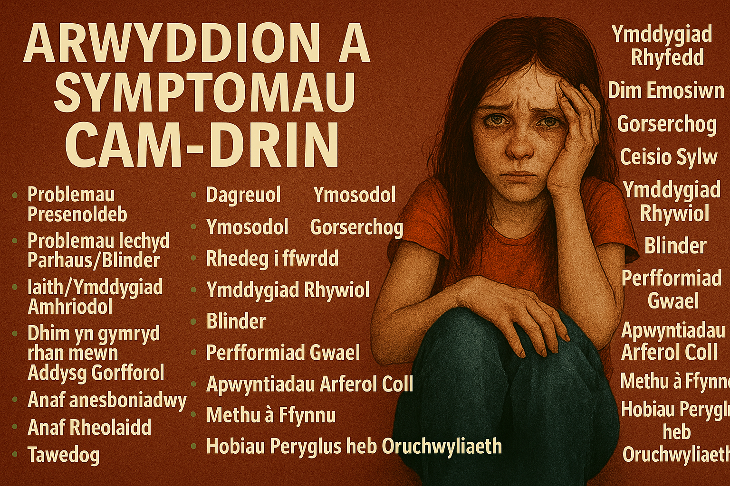
Notes:
WM

Slide 39
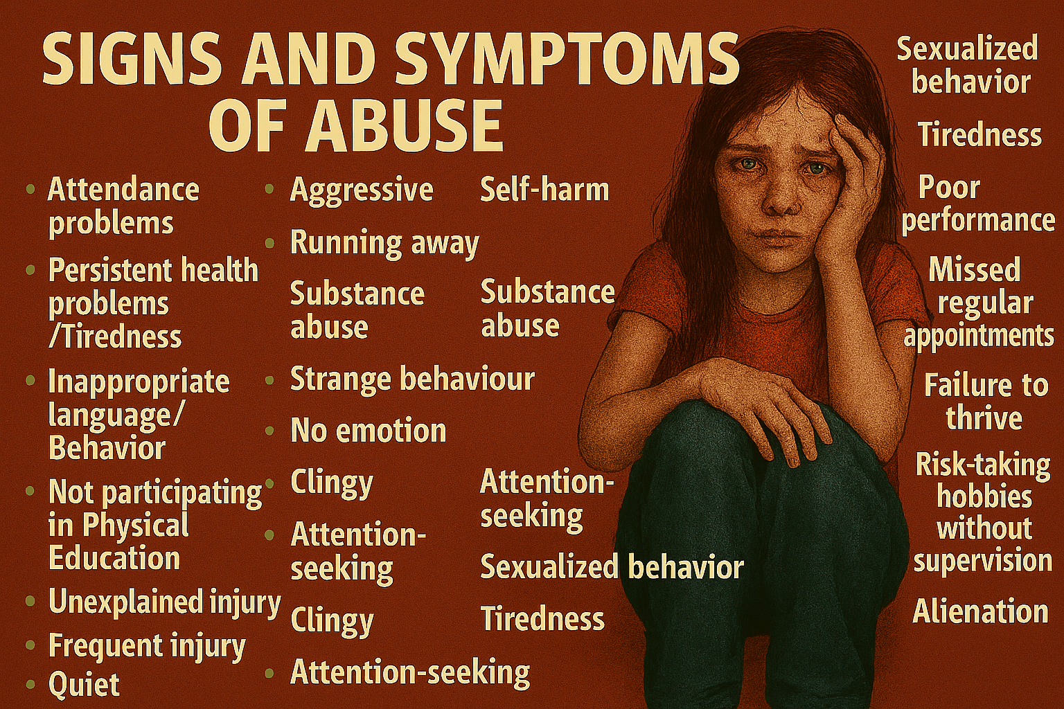
Notes:
EM

Slide 40
Beth yw Esgeulustod?
What is Neglect?
‘Persistent failure to meet a child’s basic physical and/or psychological needs, likely to result in a serious impairment of the child’s health or development.’ (Working Together to Safeguard Children, 2013: 85)
Methu â darparu;
  Bwyd, lloches, dillad, ac ati.
  Amddiffyn rhag niwed corfforol a pherygl
  Mynediad i ofal neu driniaeth feddygol
  Anghenion emosiynol sylfaenol
  Gadael plentyn heb oruchwyliaeth
Failure to provide;
  Food, shelter, clothing, etc.
  Protection from physical harm and danger
  Access to medical care or treatment
  Basic emotional needs
  Leaving a child unsupervised
Notes:
VOG ACPC CP1 Handout 1
40
Can be passive form of abuse
Includes the neglect of, or unresponsiveness to a child’s basic emotional needs
Lack of specific or critical incidents to ‘raise alarms’
Diversity in presentation
Imprecise language – greater weight on interpretation
Persistent adequate
Neglect can be a ‘passive’ form of abuse, intent to harm a child is not always present
To recognise the extent may require collation and analysis of small seemingly insignificant events which only together provide enough to raise active concern

Slide 41
Group activity – Which category of abuse?
Child rarely receives praise | Child threatened by parent if they don’t comply; the threat is something the child fears | Parents regularly drink spirits and let their child sip out of the glass
Child deprived of contact with estranged parent due to adult’s disagreements | Parent ignored child’s complaint of earache and chronic ear discharge | Child put outside front door and told he/she will be sent away if they misbehave
Parents fondled child’s genital area on one occasion | Child’s uncle has been babysitting for her and her younger sister and going into her bedroom at night and touching her breasts | Child often arrives at school unwashed, smelly and in dirty clothes
Parents usually punish their child by spanking sometimes leaving red marks on the skin | Parents who punish their child excessively if they do not get highest marks for every piece of work and every test | Parents are routinely overheard telling their child they are rubbish and will never amount to anything
Notes:
Print out

Slide 42
Cam-drin Domestig – Diffiniad
Domestic Abuse - Definition
Unrhyw ddigwyddiad neu batrwm o ddigwyddiadau o ymddygiad, trais neu gam-drin rheolaethol neu fygythiol rhwng y rhai sy'n 16 oed neu'n hŷn sydd neu sydd wedi bod yn bartneriaid agos neu'n aelodau o'r teulu waeth beth fo'u rhyw neu rywioldeb. Gall hyn gwmpasu,ond nid yw'n gyfyngedig i'r mathau canlynol o gam-drin:
  seicolegol
  corfforol
  rhywiol
  ariannol
  mosiynol
Any incident or pattern of incidents of controlling, coercive or threatening behaviour, violence or abuse between those aged 16 or over who are or have been intimate partners or family members regardless of gender or sexuality. This can encompass but is not limited to the following types of abuse:
  psychological
  physical
  sexual
  financial
  emotional

Slide 43
Cam-drin Domestig Domestic Abuse
Ar gyfartaledd mae 2 fenyw yr wythnos yn cael eu lladd gan bartner gwrywaidd neu gyn bartner.
Mae cam-drin domestig yn cyfrif am 40% o ddynladdiadau benywaidd
30% o’r achosion o gam-drin domestig yn dechrau neu'n gwaethygu yn ystod beichiogrwydd.
Mae gweld cam-drin domestig yn gam-drin plant, a gall pobl ifanc yn eu harddegau ddioddef cam-drin domestig yn eu perthnasoedd.
Gall cam-drin domestig niweidio plant a phobl ifanc yn ddifrifol.
On average 2 women a week are killed by a male partner or former partner.
40% of female homicides are domestic abuse
30% of domestic abuse starts or escalates during pregnancy.
Witnessing domestic abuse is child abuse, and teenagers can suffer domestic abuse in their relationships.
Domestic abuse can seriously harm children and young people.
Notes:
Children living with violence will actively interpret, predict, assess their roles in causing violence
Worry about consequences
Engage in problem solving
Take measures to protect themselves, siblings and mother, both physically and emotionally

Slide 44
Egwyddorion ymarfer (WSP, 2023)
Principles of practice (WSP, 2023)
E1: Caiff dymuniadau, anghenion a lles y plentyn eu rhoi yn gyntaf, fel eu bod yn cael y gofal a'r cymorth sydd eu hangen arnynt cyn i broblem waethygu.
E2: Mae pob ymarferydd sy'n dod i gysylltiad â phlant yn effro i'w hanghenion gan gynnwys unrhyw gam-drin posibl neu amheuaeth neu risg o gamdriniaeth neu niwed ac yn deall pa gamau y dylent eu cymryd.
E3: Mae pob ymarferydd yn rhannu gwybodaeth briodol ac yn cael mynediad uniongyrchol at gyngor i drafod unrhyw bryderon am blentyn.
P1: The wishes, needs and well-being of the child are put first, so that they receive the care and support they need before a problem escalates.
P2: All practitioners who come into contact with children are alert to their needs including any potential or suspected abuse or risk of abuse or harm and understand what action they should take.
P3: All practitioners share appropriate information and have direct access to advice to discuss any concerns about a child.

Slide 45
Egwyddorion ymarfer
Principles of practice (WSP, 2023)
E4: Gall pob ymarferydd ddefnyddio ei farn broffesiynol i roi anghenion a chanlyniadau personol y plentyn wrth wraidd y system fel y gellir dod o hyd i'r ateb cywir ar eu cyfer.
E5: Mae pob ymarferydd sy'n gweithio gyda phlentyn yn gweithredu mewn ffordd aml-asiantaeth a chydweithredol i ddiogelu a hyrwyddo lles plentyn, cofnodi penderfyniadau'n briodol ac adolygu cynnydd yn rheolaidd yn erbyn y canlyniadau a nodir mewn cynlluniau gofal a chymorth.
E6: Mae pob ymarferydd sy'n dod i gysylltiad â phlant yn gallu cael gafael ar arweinyddiaeth strategol broffesiynol sy'n cefnogi'r ymarferydd i gyflawni'r canlyniadau a ddymunir ar gyfer y plentyn.
P4: All practitioners are able to use their professional judgment to put the child’s needs and personal outcomes at the centre of the system so that the right solution can be found for them.
P5: All practitioners working with a child operate in a multi-agency and co-operative way to safeguard and promote a child’s well-being, record decisions appropriately and regularly review progress against the outcomes set out in care and support plans.
P6: All practitioners who come into contact with children are able to access professional strategic leadership which supports the practitioner to achieve desired outcomes for the child.

Slide 46
Tasg grŵp Group task
Yn eich grwpiau trafodwch beth allai atal plant ac ymarferwyr rhag adrodd am achosion tybiedig o gam-drin
In your groups discuss what may prevent children and practitioners from reporting suspected cases of abuse

Slide 47
Rhwystrau i blant sy'n adrodd am gamdriniaeth
Barriers to children reporting abuse
Ofn – Maen nhw wedi cael eu bygwth
Perthynas â'r camdriniwr
Embaras / cywilydd
Credu eu bod ar fai
Euogrwydd
Credu ei fod yn digwydd i bob plentyn
Efallai nad oes ganddynt y sgiliau iaith / geirfa
Ofn na fydd pobl yn credu arnoch
Efallai ei fod wedi ceisio gollwng awgrymiadau a wrthodwyd
Canlyniadau dweud
Fear – They have been threatened
Relationship with the abuser
Embarrassment / shame
Believe they are to blame
Guilt
Believes it happens to all children
May not have the language skills / vocabulary
Fear of not being believed
May have tried to drop hints that were dismissed
Consequences of telling

Slide 48
Rhwystrau i oedolion rhag sôn am gamdriniaeth
Barriers to adults reporting abuse
Ei chael hi'n anodd credu'r hyn yr ydym yn ei glywed
Methu ag amau rhywun rydyn ni'n ei adnabod
Ofn bod yn anghywir
Ofn canlyniadau "bod yn anghywir" i'r plentyn / teulu a ni ein hunain
Efallai y byddwn yn ei gwneud yn waeth i'r plentyn
Ddim eisiau cymryd rhan
Heb y wybodaeth am beth i'w wneud a phwy i gysylltu â nhw
Hiliaeth a Materion Ffydd
Find it hard to believe what we are hearing
Cannot suspect some one we know
Fear of getting it wrong
Fear of the consequences of “getting it wrong” for the child / family and ourselves
We may make it worse for the child
Don't want to be involved
Do not have the information on what to do and who to contact
Racism and Faith Issues

Slide 49
Datgelu – Gwrando, Cadw'n Dawel, Gweithredu
Disclosure – Listen, Keep Calm, Act
Cymerwch y plentyn o ddifrif a CHADW’CH PWYLL
Rhowch sicrwydd meddwl – Bod yn gefnogol
Defnyddiwch iaith gadarnhaol y corff
Dwedwch wrthyn nhw eu bod yn gwneud y peth iawn
Cadwch draw rhag rhoi bai
Cadwch feddwl agored
Byddwch yn onest – siaradwch am yr hyn a fydd yn digwydd nesaf, y camau y byddwch yn eu cymryd
Trosglwyddo i'r Swyddog Amddiffyn Plant
Gwnewch nodiadau byr, syml, ffeithiol, gan ddefnyddio geiriau'r plentyn ei hun, sydd wedi'u llofnodi a'u dyddio. Mae'r rhain bellach yn gyfrinachol.
Take the child seriously and KEEP CALM
Reassure – Be supportive
Use positive body language
Tell them they’re doing the right thing
Steer away from blame
Do keep an open mind
Be honest – talk through what will happen next, the actions you will take
Pass on to Child Protection Officer
Make brief, simple, factual notes, using the child’s own words, which are signed and dated. These are now confidential.

Slide 50
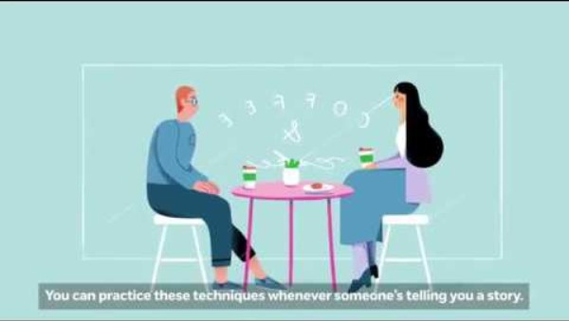

Slide 51
Ymdrin â datgelu – Pethau i beidio â’u gwneud
Dealing with disclosure – Don’ts
Wfftio pryderon neu amau gonestrwydd y plentyn
Peidiwch â gwarantu cyfrinachedd
Peidiwch â bod yn feirniadol na dangos dicter/gofid am yr hyn a ddywedir wrthych.
Peidiwch ag ymholi, cwestiynu, gwthio am ragor o wybodaeth neu ofyn cwestiynau arweiniol
Dismiss concerns or doubt the child’s truthfulness
Do not guarantee confidentiality
Do not be judgemental or show anger/distress at what you are being told.
Do not enquire, question, push for further information or ask leading questions

Slide 52
Ymdrin â datgelu – Pethau i beidio â’u gwneud
Dealing with disclosure – Don’ts
Peidio â thrafod y datgeliad gydag unrhyw un arall
Peidiwch â phoeni am gael eich camgymryd, trafodwch gyda SDP
Peidiwch â theimlo eich bod yn ymyrryd
Peidiwch â chael ofn oherwydd y broses
Peidiwch â gadael i'ch gwybodaeth bersonol am y teulu/rhiant/person gymylu eich barn.
Peidiwch â chysylltu neu wynebu'r camdriniwr honedig
Do not discuss the disclosure with anyone else
Do not worry about being mistaken, discuss with CPO
Do not feel you are interfering
Do not feel intimidated by the process
Do not let your personal knowledge of the family/parent/person cloud your judgement.
Do not contact or confront the alleged abuser

Slide 53
Ymarfer mewn ysgolion a cholegau
Practice in schools and colleges
Rhaid i bob awdurdod lleol gael un pwynt cyswllt diogelu ar gyfer pobl sy'n gweithio gyda phlant. Mae hyn yn helpu pawb i wybod ble i fynd os ydynt yn credu bod plentyn mewn perygl
Rhaid i bob ysgol neu goleg fod â pherson diogelu dynodedig (DSP).
Dylai pawb sy'n gweithio yn yr ysgol a'r coleg:
      wybod pwy yw cyswllt eu hawdurdod lleol
      gwybod eu DSP
Each local authority must have a safeguarding single point of contact for people working with children. This helps everyone know where to go if they think a child is at risk
Each school or college must have a designated safeguarding person (DSP).
Everyone working in the school and college should:
      know who their local authority contact is
      know their DSP

Slide 54
Honiadau yn erbyn staff, llywodraethwyr a gwirfoddolwyr
Allegations against staff, governors and volunteers
Dylid rhoi gwybod am bob honiad i Swyddog Dynodedig yr Awdurdod Lleol (LADO) am Amddiffyn Plant ar unwaith.
Ni ddylai'r Pennaeth gymryd unrhyw gamau cyn trafod yr honiad gyda’r LADO.
Bydd y LADO a'r Pennaeth yn ystyried natur, cynnwys a chyd-destun yr honiad, ac yn cytuno ar gamau gweithredu.
Bydd y LADO yn cynghori'r Pennaeth mewn perthynas â'r ffordd briodol y dylid cymryd y camau y cytunwyd arnynt.
Bydd angen cwblhau asesiad risg; am gyngor ac arweiniad ar y cyswllt hwn, cysylltwch â'r ALl
All allegations should be reported immediately to the Local Authority Designated Officer (LADO) for Child Protection.
The Head teacher should not undertake any action before discussing the allegation with the LADO.
The LADO and the Head teacher will consider the nature, content and context of the allegation, and agree a course of action.
The LADO will advise the Head teacher in respect of the appropriate way in which the agreed actions should be undertaken.
A risk assessment will need to be completed; for advice and guidance on this contact LA

Slide 55
Astudiaeth Achos 1
Case Study 1
Rydych chi'n gweithio gyda bachgen 10/11 oed sy'n dweud wrthych fod ei Fam a'i Dad yn ymladd neithiwr.
Rydych chi’n sylwi bod ganddo lygad ddu a gwefus wedi'i dorri a phan ofynnwch iddo sut y digwyddodd hyn mae'n dweud wrthych, pan oedd ei rieni'n ymladd, ei fod wedi ceisio eu hatal a'i dad wedi ei daro'n ddamweiniol yn ei wyneb.
Am beth ydych chi'n poeni?
Pa gamau byddwch chi'n eu cymryd?
You are working with a boy aged 10/11 who tells you that his Mum and Dad were fighting last night.
You notice that he has a black eye and a cut lip and when you ask him how this happened he tells you that when his parents were fighting he tried to stop them and his father accidentally struck him in the face.
What are you worried about?
What action will you take?
Daniel Pelka Task

Slide 56
Rhestr Gyfeiriadau
Reference list
Bazalgette, L., Rahilly, T. and Trevelyan, G. (2015) Achieving emotional wellbeing for looked after children: a whole system approach. London: NSPCC.
Luke, N. Sinclair, I., Woolgar, M. and Sebba, J. (2014) What works in preventing and treating poor mental health in looked after children? London: NSPCC.
NSPCC (2018) How safe are our children? Available at: How safe are our children? 2018 (nspcc.org.uk) [Accessed 31st October 2023]
NSPCC (2019) How safe are our children? Available at: How safe are our children? 2019 (nspcc.org.uk) [Accessed 31st October 2023]
Social Care Wales (2023) Wales Safeguarding Procedures. Available at: Safeguarding Wales [Accessed 31st October 2023]

Slide 57
Unrhyw gwestiynau?
Any questions?
Darllen pellach/Further reading:
Multi-agency and interdisciplinary working | NSPCC Learning

