Slide 1

My academic and employabillty skills
Nicoleta Cristina Carbunaru - 2023706

Slide 2

Background:
In the next presentation, I will explain what I mean by academic and employability skills

Slide 3
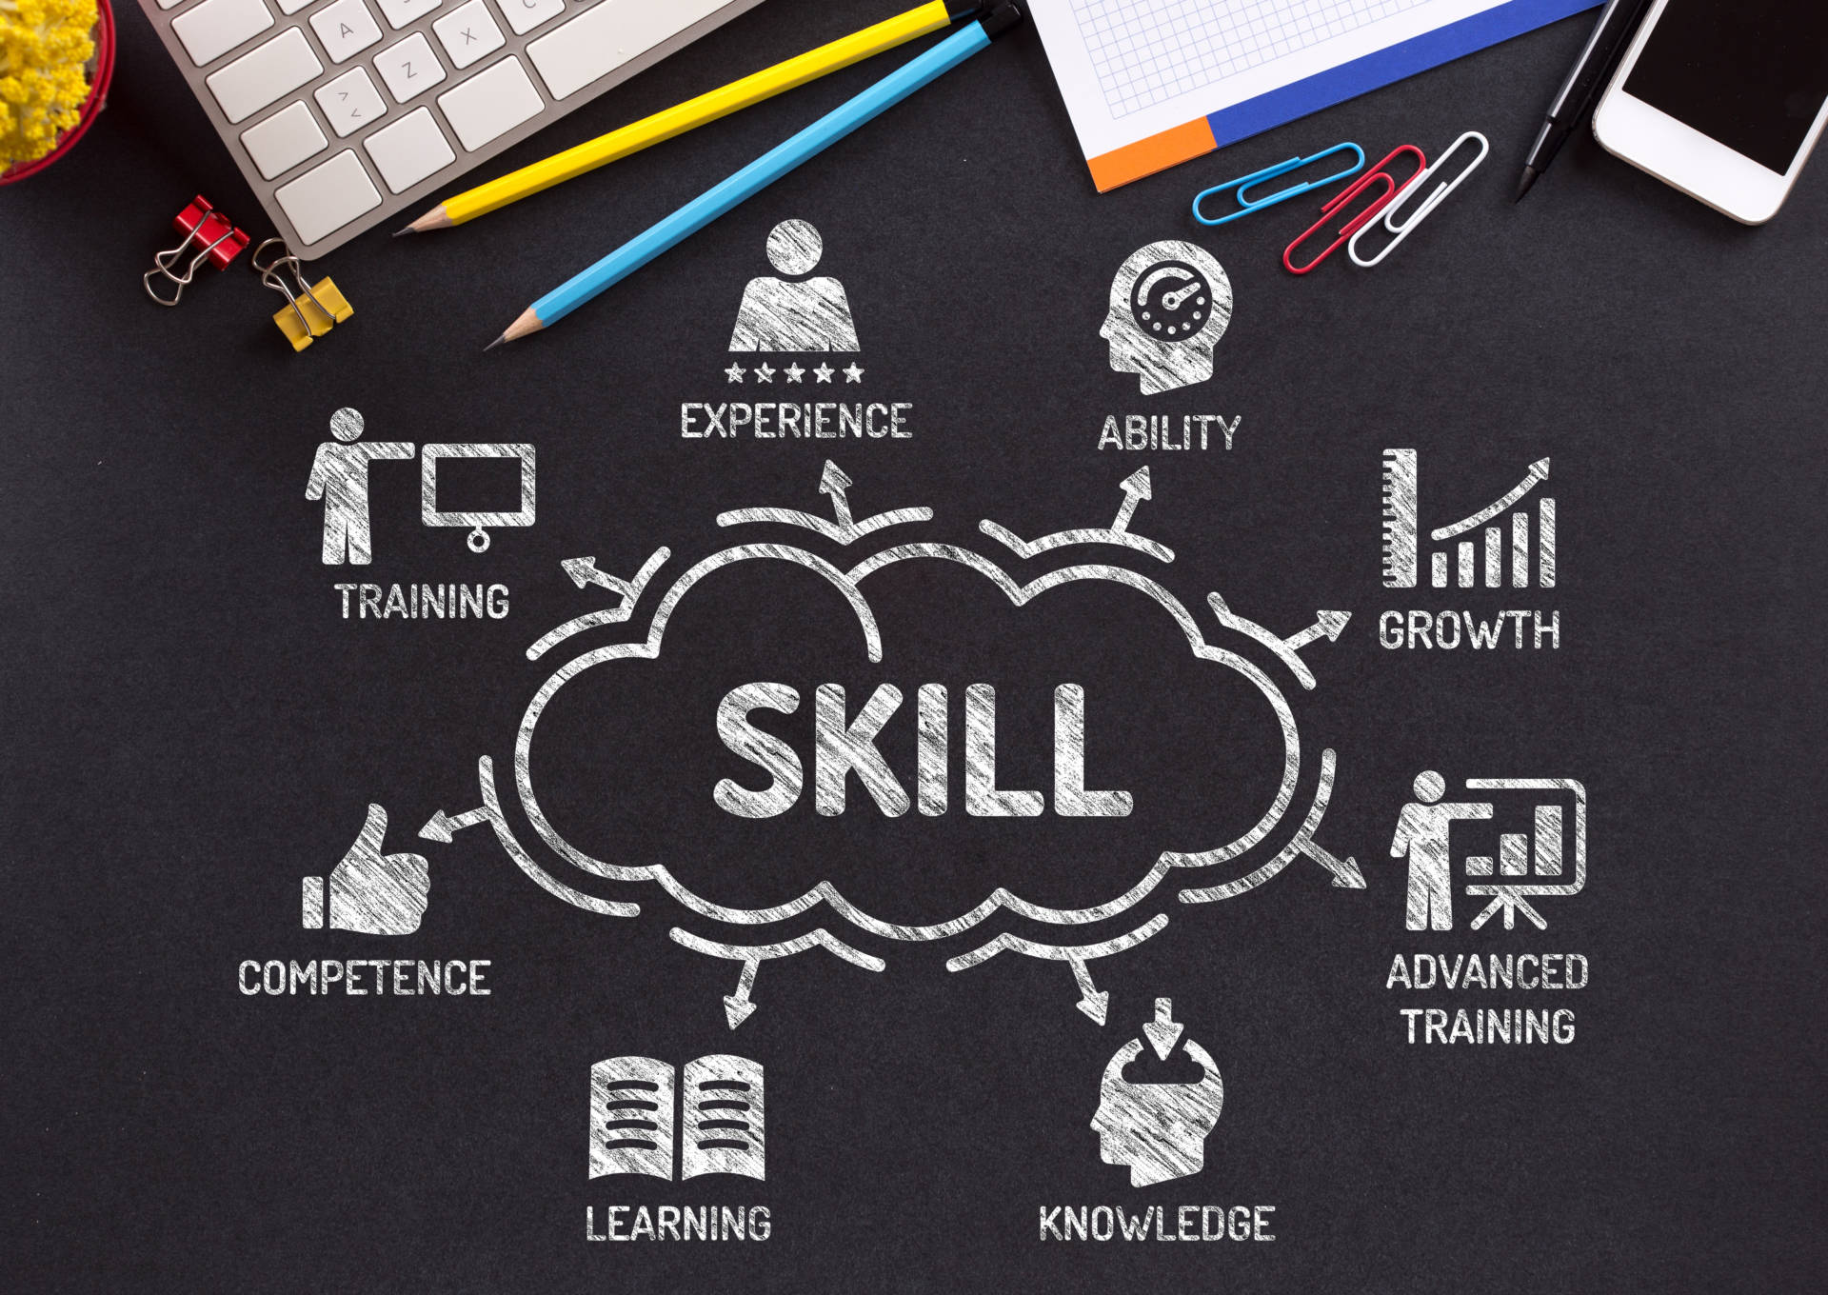
A skill is the learned ability to perform an action with determined results with good execution often within a given amount of time, energy, or both. Skills can often be divided into domain-general and domain-specific skills. For example, in the domain of work, some general skills would include time management, teamwork and leadership, self-motivation and others, whereas domain-specific skills would be used only for a certain job. Skill usually requires certain environmental stimuli and situations to assess the level of skill being shown and used.

Slide 4

The most required employment skills:
Self-motivation ability
Teamwork & good communication skills
Organization and prioritization skills

Slide 5

Conclusion:
For success both in your career and in everyday life, you must pay attention to what you do and respect what you do, these skills are created to help you and be successful in what you set out to do.
Thank you for attention !

