Slide 1

The skills and qualities for an effective peadiatric nurse
Angel K
This Photo by Unknown author is licensed under CC BY-SA.

Slide 2

What is included in the presentation
Academic skills for a paediatric nurse
Professional skills in a paediatric nurse/ why professional skills matter?
Personal values in a paediatric nurse
Ideal personal values
Commitment to professional practice
NMC Compentencies and code of conduct
References
Conclusion

Slide 3
Academic skills of a paediatric nurse & the benefits
Critical thinking is important because it enables nurses to analyse information and make informed decisions and provide essential and effective care to young patients. The benefits come with accurate assessment, clinical judgement, problem solving, evidence based practice and continuous learning. (AMN, n.d.)
Research skills is a crucial academic skill to have as a paediatric nurse because it contributes to accurate diagnosis, effective treatment and overall improvement in patient care. The benefits of research skills are, diagnostic accuracy, treatment efficiency, informed decision making, patient education and other more. (Northeastern State University, 2017)
Presentation skills are valuable because they contribute to effective communication, collaboration and patient education. The benefits of research skills is that there's clear communication with others, educating patients and families, addressing situations.

Slide 4

Professional skills required in a paediatric nurse & why
Team work is essential in a paediatric nurse because of the multifaced nature of caring for children. It is a crucial for several reasons such as being able to handle emergencies, sharing specialised knowledge, emotional support for patient and families and coordination of care. (Faubion, 2023)
Communication/verbal skills are required because it gives an understanding child development, educating parents and care givers, handling emotional situations, teaching and health promotion, documenting and reporting etc. (Ali, 2017)
Technological skills is increasingly vital contributing to enhanced patient care, improved efficiency, and the ability to keep pace with advancements in healthcare. This skill is required because it helps naviagate electronic health records, medical devices and equipment, medication administration technology, health apps and software and continuing research.
Attention to detail is a fundemental skill to provide high quality care. Attention to detail gives an accuracy with medication, monitoring vital signs, patient safety etc.

Slide 5


Why professional skills matter ?
Professional skills are the foundation of competent and compassionate paediatric nursing. They enable nurses to deliver specialised care, ensure patient safety, communicate effectively, collaborate within healthcare teams and make ethical decisions which contributes to the overall wellbeing of children and their families.
(Coursera, n.d.)
This Photo by Unknown author is licensed under CC BY-ND.
This Photo by Unknown author is licensed under CC BY-SA-NC.

Slide 6
Personal values in a paediatric nurse
Patience – plays a important role in building trust with young patients and families ad its essential for building rapport with children, listening and understanding, handling emotional responses, establishing a comfortable enviroment. (The Custom Group Of Companies, 2020)
Compassion – is an important personal value because it provides emotional support allowing the family to trust, understanding the individual's needs, helping crisis and trauma responses and building long term relationships.
Empathy - is also crucial because it responds to peoples emotions and perspectives. You also get to understand and acknowledge young patients and their families building trust and supportive environment. Showing empathy provides builds a connection, understands emotional states, relieving fear and anxiety, promoting family involvement. (NHS, 2016)

Slide 7
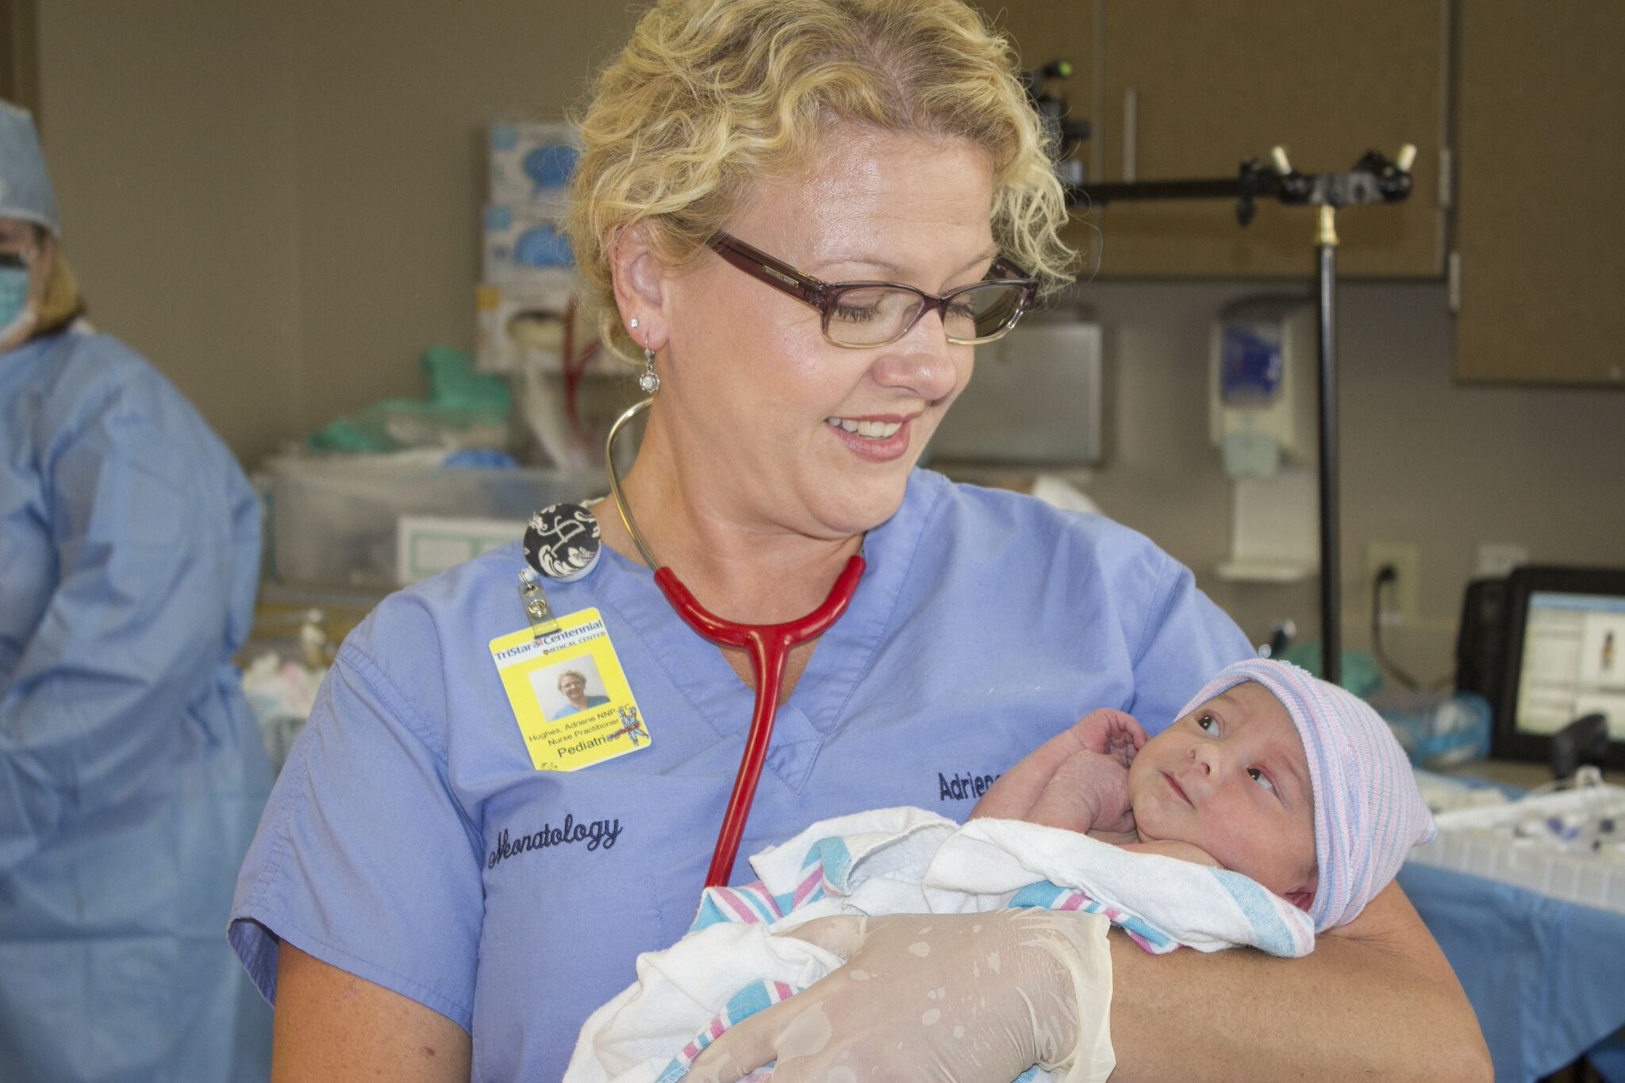
Commitment to professional practice
Ongoing education and training is crucial for career development across various professions including the healthcare sector. Continuous learning contributes significantly to professional growth and effectiveness. Networking and evaluating provides opportunity, career advancement opportunities and will enhance skills.
Having commitment in nursing provides high quality care and underpins the values of the nursing profession.
(Sibandze and Scafide, 2017)
This Photo by Unknown author is licensed under CC BY-SA.

Slide 8

Nursing Midwifery Council competencies & code of conduct
The nursing and midwifery council (NMC) is the nursing and midwifery regulator for England, Scotland, Wales and Northern Ireland. The competence applies to all fields of nursing, the 4 main areas of professional practice are
Professional values
Communicaton and interpersonal skills
Nursing practice and decision making
4. Leadership, management and teamworking
The code of professional standards of practice and behaviours for nurses are
Prioritise people
Practice effectively
Preserve safety
Promote professionalism and trust
(Nursing and Midwifery Council (NMC), 2018) (Nursing and Midwifery Council, 2018)

Slide 9

Conclusion
This presentation has delved into the multifaced world of paediatric nursing focusing on the skills and qualities that are crucial for the effective practice. Exploring the academic skills and emphasising their benefits and overall patient care. The discussion then extended to personal values and the commitment required in this field, highlighting the importance of building trust with young patients and families. The NMC competencies and professional codes of conduct was also included in the presentation. Beyond these aspects critical thinking, research skills and other skills were explored and how it contributes to paediatric nursing.

Slide 10
References
Ali, M. (2017). Communication skills 1: benefits of effective communication for patients. [online] Nursing Times. Available at: https://www.nursingtimes.net/clinical-archive/assessment-skills/communication-skills-1-benefits-of-effective-communication-for-patients-20-11-2017/.
Coursera. (n.d.). Professional Skills: What They Are and How to Use Them. [online] Available at: https://www.coursera.org/articles/professional-skills.
Faubion, D. (2023). Importance of Teamwork in Nursing + 15 Tips to Improve. [online] www.nursingprocess.org. Available at: https://www.nursingprocess.org/teamwork-in-nursing.html#:~:text=5%20Reasons%20Why%20Teamwork%20Is%20So%20Important%20In.
NHS (2016). Personal characteristics and skills required (child nursing). [online] Health Careers. Available at: https://www.healthcareers.nhs.uk/explore-roles/nursing/roles-nursing/childrens-nurse/personal-characteristics-and-skills-required-child-nursing.
Nursing and Midwifery Council (NMC) (2018). The Code Professional Standards of Practice and Behaviour for Nurses and Midwives Nursing and Midwifery Council. [online] Nursing and Midwifery Council. London: Nursing and Midwifery Council. Available at: https://www.nmc.org.uk/globalassets/sitedocuments/nmc-publications/nmc-code.pdf.
Nursing and Midwifery Council (2018). Standards for competence for registered nurses. [online] Nursing and Midwifery Council. Nursing and Midwifery Council. Available at: https://www.nmc.org.uk/globalassets/sitedocuments/standards/nmc-standards-for-competence-for-registered-nurses.pdf.
Northeastern State University (2017). Why Do Nurses Need Research? [online] Northeastern State University Online. Available at: https://nursingonline.nsuok.edu/degrees/rn-to-bsn/why-nurses-need-research/.
Sibandze, B.T. and Scafide, K.N. (2017). Among nurses, how does education level impact professional values? A systematic review. International Nursing Review, 65(1), pp.65–77. doi:https://doi.org/10.1111/inr.12390.
The Custom Group Of Companies. (2020). Patience is Key to a Successful Career in Healthcare | Job Seekers. [online] Available at: https://customgroupofcompanies.com/patience-key-healthcare-career/.
www.amnhealthcare.com. (n.d.). 7 Reasons Critical Thinking in Nursing is Important | AMN Healthcare. [online] Available at: https://www.amnhealthcare.com/blog/nursing/travel/7-reasons-critical-thinking-in-nursing-is-important/#:~:text=7%20Reasons%20Critical%20Thinking%20In%20Nursing%20Is%20Important [Accessed 28 Nov. 2023].

