Slide 1
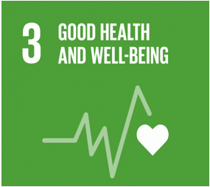
Health and Wellbeing and Sustainable Development
BMHP6030
Component 1: Presentation
Name: Tahira Yasmeen
Student Number: 2236533
Lecturer: Parase Ahmed

Slide 2
Introduction
This presentation examines the 17 sustainable goals introduced by United Nations, particularly focusing on Sustainable Development Goals 3 (SDG3), that is good health and well-being. It critically evaluates UK legislations and policy framework in relation to the SDG3 within the context of health and social care.
Furthermore, presentation will evaluate the Covid-19 vaccination, an initiative implemented by UK government in response of Covid-19 pandemic. How Covid-19 vaccination programme demonstrated the integration of health, well-being and sustainable development in the UK.

Slide 3
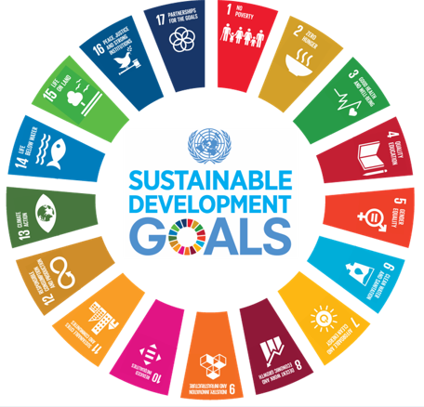
17 Sustainable Goals
The 17 sustainable goals were introduced by the United nations in 2015.
The purpose of these goals is to end poverty, protect the planet, and promote well-being for all by 2030 (United Nations, 2025).
Sustainability is the key concept underlying all 17 goals.
Sustainable development means development that meets the needs of the present without compromising the ability of future generations to meet their own needs (IISD, 2026).
In health and social care, by reducing waste and energy, efficient use of resources to provide long-term services.
This presentation will focus on SDG3 good health and well- being emphasising equal and equitable services for all.
(United Nations,2015)

Slide 4
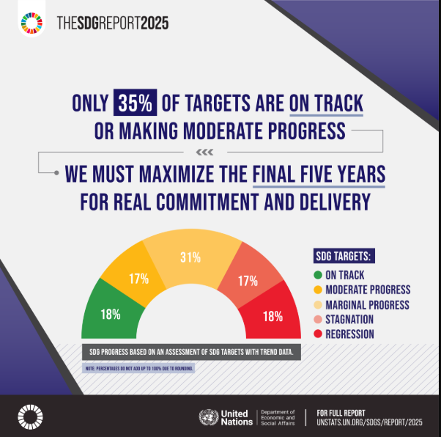
The SDG Report
(United Nations, 2025)

Slide 5
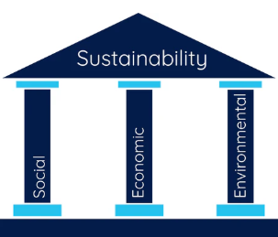
Sustainable Development
Sustainable development is, meeting the needs of the present, while considering future generations so they have enough resources to meet their own needs as well. For example, reducing, reusing and recycling.
The 3 dimensions or pillars of sustainability require a balance between economic growth, environmental protection, and social well-being ( Purvis et al., 2019).
This includes maintaining financial stability without compromising future generations promoting equality and ensuring high- quality of life.
(Thakur,2022)

Slide 6
SDG3
Good health and well-being is a United Nations goal to ensure healthy lives and promote well-being for everyone and has access to quality healthcare. It is a global approach to reduce health inequalities.
There has been progress to meet the goals, such as 133 countries has met the SDG3 target on under-5 mortality.
However, insufficient progress has been made in maternal mortality. 260,000 women died during pregnancy and childbirth in 2023 ( United Nations, 2025)

Slide 7
Health
According to WHO ‘health’ is not just absence of disease but a complete physical, mental and social well- being (Svalastog et al., 2017).
This definition has been criticised for utopianism and idealistic ignoring that health is a dynamic and cannot be perfect state of living ( Schramme, 2023).

Slide 8
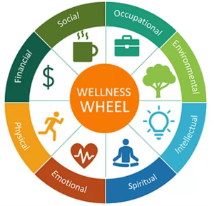
well-being
Well-being is a broader concept includes health, life satisfaction and overall quality of life experienced by individuals and societies. It is determined by social, environmental and economic factors ( WHO, no date).
8 aspects of well-being
Objective well-being
measurable
income
health status
housing
Subjective well-being
personal perception of life.
stress
Overall life satisfaction
(Kroll, 2023)

Slide 9
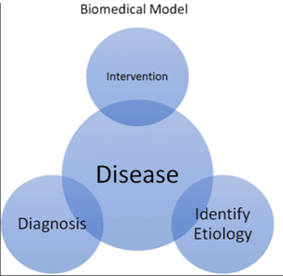
Theories
Models of health help professionals to assess health needs, to plan and deliver care, and for health promotion and prevention.
Biomedical Model:
This model defines health as the absence of disease by emphasising diagnosis, treatment and cure.
This model focuses on the individual as a patient, completely dependent on medical intervention.
This model completely ignores social, environmental and psychological factors. For example, chronic illnesses (diabetes, obesity and cardiovascular diseases) requires not just medication but social and psychological interventions (Rocca and Anjum, 2020).
(Leeper, 2019)

Slide 10
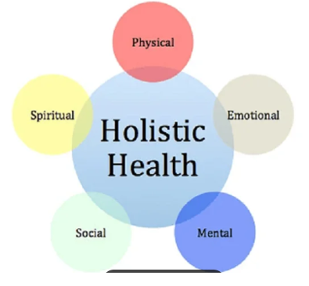
Holistic Model
Holistic model is a comprehensive model treats the whole person(mind, body and soul) emphasising physical, mental, emotional and spiritual aspects of an individual for optimal well- being.
This model promotes health and person-centred care ideal for palliative and end of life care.
Barriers like limited resource and practical challenges in implementation and cannot be replaced for conventional medical approaches ( Ernst, 2007).
(Senthil, 2024)

Slide 11
Sustainability Developments in the UK
There are many policies and practices are in place in the Uk that align with SDG3
SDG3 (Target 3.8) aims at providing Universal Health Coverage (UHC) for all and for all ages (United nations,2015).
NHS provides universal health coverage generally free at the point of delivery since its creation in 1948.
However, these services are facing significant challenges because of the funding crises, shortages of staff. Additionally, health inequalities due to geographical and socioeconomic status, ethnicities disparities are contributing to these crisis (The King’s Fund, 2023).

Slide 12
Equality Act 2010:
Equality Act 2010 protects from direct and indirect discrimination based on 9 protected characteristics including age, disability, race. Everyone has right to equal access to health and social care services (SCIE,2011)
For example, NHS provides universal health coverage for all that aligns with SDG3 Target 3.8 ( United Nations, 2015). However continuous health inequalities persist in ethnic minorities and lower socioeconomic backgrounds. These people have lower access to healthcare and 10 years lower life expectancy than people living in least deprived areas (Marmot et al., 2020).

Slide 13
Health and Care Act 2022:
This Act promotes Integrated Care System for better health, quality and sustainable resources. It aims to remove bureaucratic barriers by integrating health and social care services and working collaboratively with local governments to address health inequalities (Department of Health and Social Care, 2022).
However, funding pressure, workforce shortage and deep-rooted social determinant of health need further attention.

Slide 14
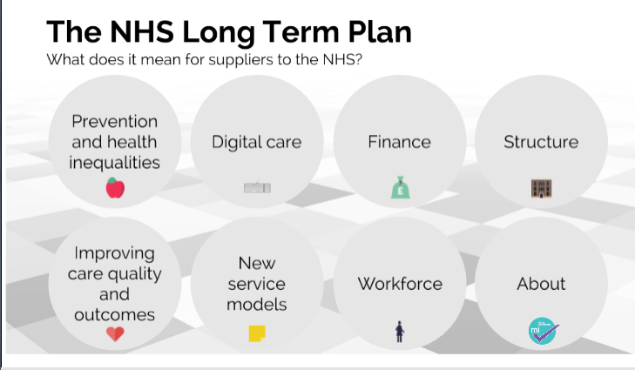
NHS Long Term Plan 2019:
(Medical Industry Limited,2019)

Slide 15
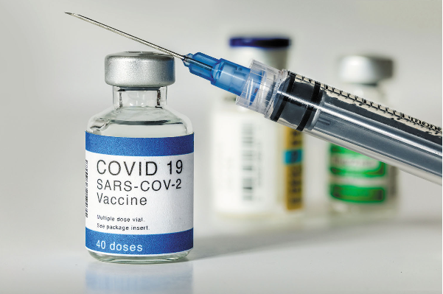
Covid-19 Vaccination Programme
Covid-19 vaccination programme was a significant initiative that demonstrated the integration of health, well-being and sustainable development. It aligns with SDG3 goal ensuring healthy lives and promote well-being for all at all ages by reducing mortality rate.
Different measures were introduced to safeguard and continuity of healthcare services (Mikula, et al., 2024).
SDG3 (Target 3.3) End epidemics/ communicable diseases
SDG3 (Target 3.8) Universal Health Coverage
Uk was first country to launch its Covid-19 vaccination programme. Successes such as high uptake rates saved 123,000 lives in England (Public health England, 2021).
However, significant lower vaccination rates among certain ethnic minorities groups pregnant women and people in the most deprived areas were reported (The King’s Fund,2022)
(Health. Harverd 2021)

Slide 16
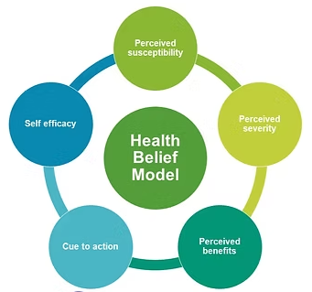
Health Belief Model
Health Belief model explains people’s health behaviour. People will only take action if they feel threats to their health that disease is serious and action will help them (Alyafei and Easlon-Carr, 2024).
There was high rate of vaccine hesitancy against Covid-19 vaccine among ethnic minorities and lower socioeconomic population( Limbu et al.,2022).
(The Aspiring Medics, 2022)

Slide 17

Impact of Social Media on Covid-19 Vaccine.
During the pandemic, social media spread the misinformation about vaccine’s safety, efficacy, ingredients, side effects and purpose.
1 in 3 people say that they have seen or heard discouraging messages for Covid-19 vaccine.
Facebook is at the top source for this kind of information. 1 in 5 people in the Uk seen this kind of content on the Facebook (Duffy, 2020).
On the other hand, social media platforms used for public awareness regarding vaccine and safety.
(Pagecreative.co.uk)

Slide 18
Social determinant of Health and
Health Inequalities
Social determinant of health influence the health inequalities for instance, education, employment, housing, access to healthcare and environment.
Life expectancy for people living in the deprived areas is more likely to be shorter and higher disability rate (Marmot et al., 2010).
According to Marmot Review 2020, life expectancy fell among women up to 10% and health inequalities has widened in the most deprived areas (Marmot et al., 2020)

Slide 19
Recommendations
Despite the progress towards SDG3, UK has faced challenges in health inequalities. Addressing the social determinants of health is essential for reducing health inequalities such as education, employment, housing, access to healthcare and the environmental conditions. Structural interventions in these areas is essential for achieving equitable progress towards Sustainable Development Goal 3.

Slide 20
References:
Alyafei, A. and Easton-Carr, R. (2024) ‘The health belief model of behavior change’, StatPearls. Available at: https://www.ncbi.nlm.nih.gov/books/NBK606120/ (13 February 2026).
Department of Health and Social Care (2022) Health and Care Act 2022. Available at: https://assets.publishing.service.gov.uk/media/6363d911e90e0705a8c35457/health-and-care-act-2022-summary-and-additional-measures-impact-assessment.pdf (Accessed: 12 February 2026).
Duffy, B.(2020) Coronavirus: vaccine misinformation and the role of social media. Available at:
https://www.kcl.ac.uk/policy-institute/assets/coronavirus-vaccine-misinformation.pdf (accessed: 14 February 2026).
Ernst, E. (2007) ‘Holistic health care?’, The British Journal of General Practice, 57(535), p.162. Available at: https://pmc.ncbi.nlm.nih.gov/articles/PMC2034187/ (Accessed: 7 February 2026).

Slide 21
Harvard Health Publishing (2021) Answering your questions about the Covid-19 vaccine. Available at: https://www.health.harvard.edu/diseases-and-conditions/answering-your-questions-about-the-covid-19-vaccine (Accessed: 13 February 2026).
https://pagecreative.co.uk/5-benefits-of-social-media-for-your-business/
IISD (2026) Sustainable Development. Available at: https://www.iisd.org/mission-and-goals/sustainable-development (Accessed: 6 February 2026).
Kroll, M.M. (2023) Do You Know the 8 Dimensions of Wellness and What They Say about Your Well-being? . Available at: https://extension.unh.edu/blog/2023/05/do-you-know-8-dimensions-wellness-what-they-say-about-your-well-being (Accessed: 14 February 2026).
Leeper, H. (2019) Description of the Biomedical and Biopsychosocial Models of Healthcare. Available at: https://www.researchgate.net/figure/Depiction-of-the-biomedical-and-biopsychosocial-models-of-healthcare_fig1_337218628 (Accessed: 14 February 2026).

Slide 22
Limbu, Y.B., Gautam, R.K. and Pham, L. (2022) ‘The health belief model applied to COVID-19 vaccine hesitancy: a systematic review’, Vaccines, 10(6), p.973. Available at: doi: 10.3390/vaccines10060973.
Marmot, M., Allen, J., Goldblatt, P., Boyce, T., McNeish, D., Grady, M. and Geddes, I. (2010) Fair society, healthy lives: The Marmot Review. London: Institute of Health Equity. Available at: https://www.instituteofhealthequity.org/resources-reports/fair-society-healthy-lives-the-marmot-review (Accessed: 12 February 2026).
Marmot, M., Allen, J., Boyce, T., Goldblatt, P. and Morrison, J. (2020) Health equity in England: The Marmot Review 10 years on. London: Institute of Health Equity. Available at: https://www.health.org.uk/publications/reports/the-marmot-review-10-years-on (Accessed: 14 February 2026).
Medical Industry Limited (2019) NHS Long Term Plan. Available at: https://prezi.com/p/arydnpzs3mcy/nhs-long-term-plan/ (Accessed: 12 February 2026).

Slide 23
Mikuła, A., Raczkowska, M. and Utzig, M. (2024) ‘Implementation of Sustainable Development Goal 3: Good Health and Well-Being in European Union Countries in the Context of the COVID-19 Pandemic’, Sustainability, 16(18), p.7921. Available at: https://doi.org/10.3390/su16187921.
Public Health England (2021) Covid-19 Vaccine Surveillance report published. Available at: https://www.gov.uk/government/news/covid-19-vaccine-surveillance-report-published#: (accessed: 13 February 2026).
Purvis, B., Mao, Y. and Robinson, D. (2019) ‘Three pillars of sustainability: in search of conceptual origins’, Sustainability science, 14(3), pp.681-695. Available at: https://link.springer.com/article/10.1007/s11625-018-0627-5 (Accessed: 6 February 2026).

Slide 24
Rocca, E. and Anjum, R.L. (2020) ‘Complexity, reductionism and the biomedical model’, In Rethinking causality, complexity and evidence for the unique patient: A CauseHealth resource for healthcare professionals and the clinical encounter. (pp. 75-94). Cham: Springer International Publishing. Available at: https://link.springer.com/chapter/10.1007/978-3-030-41239-5_5 (Accessed: 14 February 2026).
Schramme, T. (2023) ‘Health as complete well-being: The WHO definition and beyond’, Public Health Ethics, 16(3), pp.210-218. Available at: doi: 10.1093/phe/phad017.
SCIE (2011) Personalisation and the Equality Act 2010. Available at: https://www.scie.org.uk/providing-care/personalised-and-person-centred-care/personalisation-and-the-equality-act-2010/ (Accessed: 11 February 2026).
Senthil, S. (2024) Explaining the Holistic Approach to Health. Available at: https://www.linkedin.com/pulse/exploring-holistic-approach-health-sharmiladevi-senthil-zff8c (Accessed: 14 February 2026).

Slide 25
Svalastog, A.L., Donev, D., Kristoffersen, N.J. and Gajović, S. (2017) ‘Concepts and definitions of health and health-related values in the knowledge landscapes of the digital society’, Croatian medical journal, 58(6), p.431. Available at: doi: 10.3325/cmj.2017.58.431.
Thakur, A. (2022) Understanding the Concept: The Three Pillars of Sustainability. Available at: https://www.northmist.com/blogs/news/understanding-the-concept-the-three-pillars-of-sustainability (Accessed: 14 February 2026).
The Aspiring Medics(2022) Health Promotion. Available at: https://www.theaspiringmedics.co.uk/post/public-health-health-promotion (Accessed: 13 February 2026).
The King’s Fund (2023) The NHS in crisis – evaluating the radical alternatives. Available at:
https://www.kingsfund.org.uk/insight-and-analysis/long-reads/nhs-crisis-evaluating-radical-alternatives (Accessed: 11 February 2026).

Slide 26
The King’s Fund (2022) The Covid-19 vaccination programme: trials, tribulations and successes. Available at: https://www.kingsfund.org.uk/insight-and-analysis/reports/covid-19-vaccination-programme# (Accessed: 13 February 2026).
United Nations (2015) The 17 Goals. Available at: https://sdgs.un.org/goals (Accessed:8 February 2025).
United Nations (2025) The Sustainable Development Goals. Available at: https://www.un.org/sustainabledevelopment/development-goals/ (Accessed: 6 February 2026).
United Nations (2025) Goal 3: Ensure healthy lives and promote well- being for all at all ages. Available at: https://www.un.org/sustainabledevelopment/health/ (Accessed: 7 February 2026).
WHO (no date) Promoting Well-being. Available at: https://www.who.int/activities/promoting-well-being (Accessed: 7 February 2026).

