Slide 1
Reflexology

Slide 2
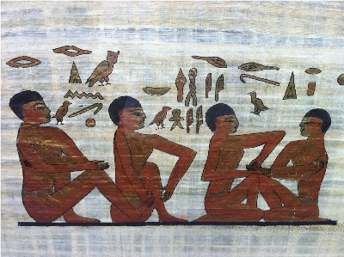
There have been references to working on the feet, hands and ears in many civilisations throughout history. An early Egyptian tomb drawing depicts what looks like a modern day Reflexology session and the fact that it was found in the Physician's tomb seems really relevant. The hieroglyphics read "Please do not hurt me" and the reply is "I shall act so you praise me".

Slide 3
What is reflexology?
Reflexology is a non-intrusive complementary health therapy, based on the theory that different points on the feet, lower leg, hands, face or ears correspond with different areas of the body.
Reflexologists work holistically with their clients and aim to work alongside allopathic healthcare to promote better health for their clients.

Slide 4
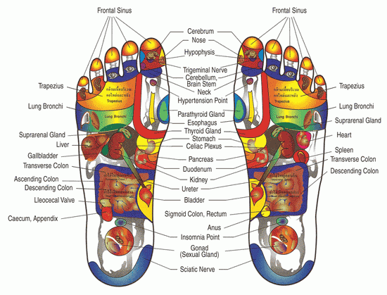

Slide 5
Well trained reflexologists do not claim to cure, diagnose or prescribe.
Reflexology is a very individual treatment which is tailored to you as a whole person, taking into account both physical and non-physical factors that might be affecting your wellbeing. Some people find it works for them - some don't. The best way to find out is to try it!

Slide 6
What does it claim to do ?
Reflexology helps the body to restore its balance naturally. Usually, after a treatment your tension may be reduced and you might feel relaxed. You might also notice yourself sleeping better and find your mood and sense of wellbeing improving. You may also find that other aspects improve too; however, this happens on an individual basis.

Slide 7
Benefits of reflexology
Some of the benefits of reflexology include its ability to stimulate nerve function, increases energy, boosts circulation, induces a deep state of relaxation, eliminates toxins, stimulates the central nervous system, prevents migraines, cleans up urinary tract conditions, speeds recovery after injury or surgery, to name a few.

Slide 8
Contraindications
Acute inflammation of the circulatory or lymphatic system (for risk of triggering a thrombus)
Ischemic heart disease (angina pectoris, thrombosis, myocardial infarction, etc.)
Acute rheumatic fever
Diseases of the veins (phlebitis, varicose veins, deep vein thrombosis, renal vein thrombosis)

Slide 9
Contraindications
Diseases of the vessels and lymph nodes (lymphomas, infections, etc.)
Aneurysms (for the risk involved the heart work at a more forced)
Pregnancies at risk of abortion
Persons with foreign bodies lodged near vital organs.
Injuries to the foot of such wounds, fractures, strains, sprains or other problems that make it hard to work directly on it.

Slide 10
How much research is there supporting reflexology?
There have been some positive research projects carried out with reflexology; however, as yet, there is not a large enough body of evidence for us to make clinical claims of effectiveness.
Your task is to find literature on the effectiveness or ineffectiveness of reflexology be prepared to feedback.

