Slide 1

Teaching Strategies
ECPT5001 & ECPT6003

Slide 2
Learning Outcomes
Consider teaching strategies available to you in Post-16 education
Explore why teaching strategies are important
Consider appropriate strategies to the subject and group you are teaching

Slide 3
What is a Teaching Strategy?
“A combination of student activities supported by the use of appropriate resources to provide a particular learning experience and/or bring about the desired learning”. (Reece & Walker, 2002)
Selecting the most appropriate teaching strategy is an important aspect of lesson planning – done for the benefit of the learner.

Slide 4
Examples of Teaching Strategies
Lecture
Group Work
One to One
Demonstration
Team Teaching
Discussion
Debate
Question & Answer
Video/Lecture Casts
Seminar/Plenary
Laboratory or Workshops
Gaming/Quiz
Buzz Groups
Field Trip
Role Play
Ice Breaker
Simulation
Case Study
Project/Assignment
Tutorial
Brainstorming
Open or Distance Learning
Online and Digital Learning Technologies

Slide 5
Activity 1
Working in pairs, you will be given two teaching strategies to explore further.
Consider:
    What the strategy is?
    When it may be an appropriate choice?
    What are the possible strengths and weaknesses to using this strategy?
    How could you use it within your subject or setting?
You will be asked to feedback your findings.

Slide 6

Teaching & Learning Cycle
Teaching is a process, where do you think teaching strategy comes in?
Teaching and Learning strategies are an important aspect of teaching the planned teaching cycle
A well-chosen strategy facilitates effective learning
Effective learning is about achieving the expectations of the learner, the teacher and the wider educational context.
This Photo by Unknown Author is licensed under CC BY-NC-ND

Slide 7
Instructional Design Process
(Carraway, 2014)
Preconstruction
Determine learning content and outcomes
Design the learning sequence
Laying the foundation
Preview the learning and objectives
Link to existing knowledge
Knowledge construction
Select learning strategies
Implement and guide practice
Reconstruction
Reflection
Application activities
Reflect on learning
Provide feedback
Evaluate the design of the learning

Slide 8
How Do We Choose Teaching Strategies?
Decide on your learning objectives
Align your teaching strategies to achieving these objectives
Align your assessment strategies to measuring success againt these objectives

Slide 9
What Might Influence the Strategy you
Would Use?
Your objectives and the group size are your
two driving considerations.
Learning objectives
Group size
Skill level
Knowledge
Attitudes
Level of study
Subject matter

Slide 10
Choosing a Teaching Strategy Based on the Objectives your Learners Need to Achieve
Objectives are central to you achieving requisite teaching and learning.
The domain of learning you are working within and the level of objective you set within this domain, should logically inform the teaching strategy that you decide to utilise to help you achieve your objectives.
For example:
  To learn a motor skill, demonstration and practice is considered appropriate
  To gain knowledge and understanding, a lecture or question and answer may be appropriate
  To develop attitudes, a discussion might be the most appropriate

Slide 11
Activity 2
In your groups, work together to find out as much as you can about the following domains of learning and the different Taxonomies within each:
Cognitive
Affective
Psychomotor
Are there any, “rules” to be followed within the Domain you are looking at?

Slide 12
Learning Domains and Teaching Strategies
The three domains of learning:
Psychomotor – predominantly physical tasks e.g. actively doing something
Cognitive – require thought process, thinking skills e.g. explaining something
Affective – dealing with feelings and emotions e.g. concerned with attitudes
Teaching in each of these domains often requires different teaching and learning approaches.
Therefore, the levels (taxonomies), or degrees of difficulty, within each domain are important considerations when planning learning.

Slide 13
Taxonomies of Learning
Each Domain of Learning is constructed using different levels of difficulty, these levels are referred to as Taxonomies.
Taxonomies of learning are useful tools to help you design and structure learning opportunities.
Arranging your objectives using these levels helps you to sequence your learning from the simple to the more complex.
It is important that you understand the entry behaviour of your learners, so that you can plan your sequential learning steps in order to achieve your overall objective for the learning session.

Slide 14
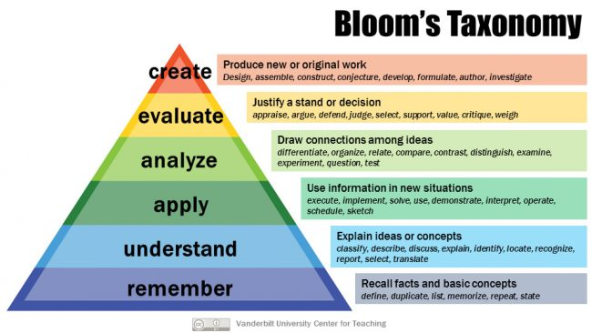
Major Categories in the Cognitive Domain
(Bloom, 1960)
Increasing Difficulty
Objectives at the lower level needs to be achieved first

Slide 15
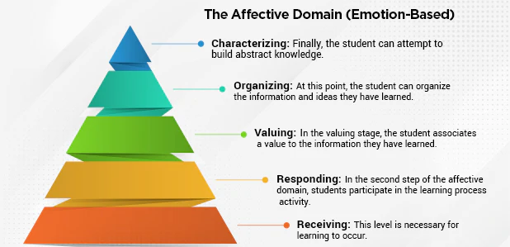
Major Categories in the Affective Domain (Krathwohl, 1964)
Each level involves more internalisation of the information received.

Slide 16
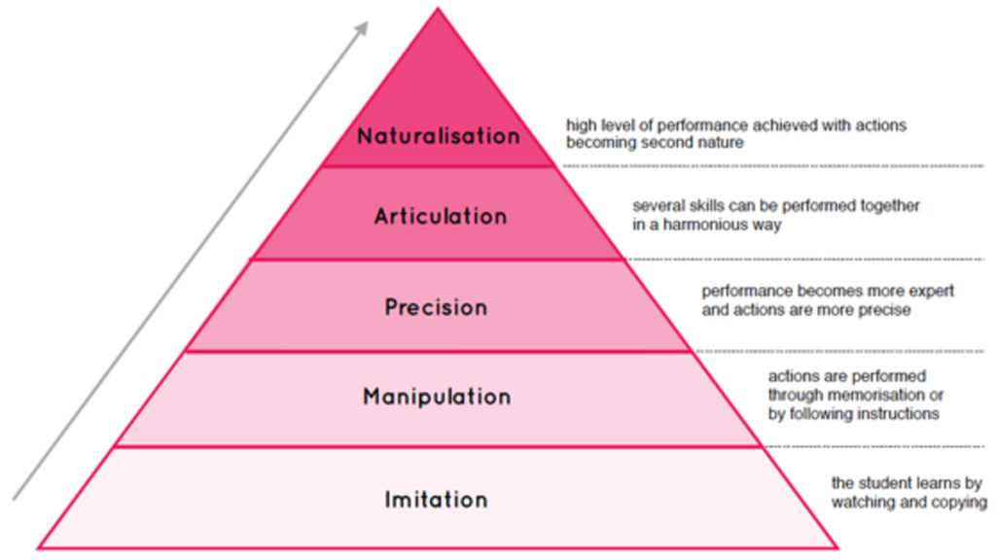
Major Categories in the Psychomotor Domain (Dave, 1975)
It progresses from the simple to the more complex.

Slide 17
Choosing a Teaching Strategy Based on your Learner Group Size
Is group size important?
A group may consist of:
  One learner
  A small group – between 5 and 20 learners
  A large group – Greater than 20 learners
Which strategies, do you think, might be considered most appropriate to apply within each of these cohorts?

Slide 18
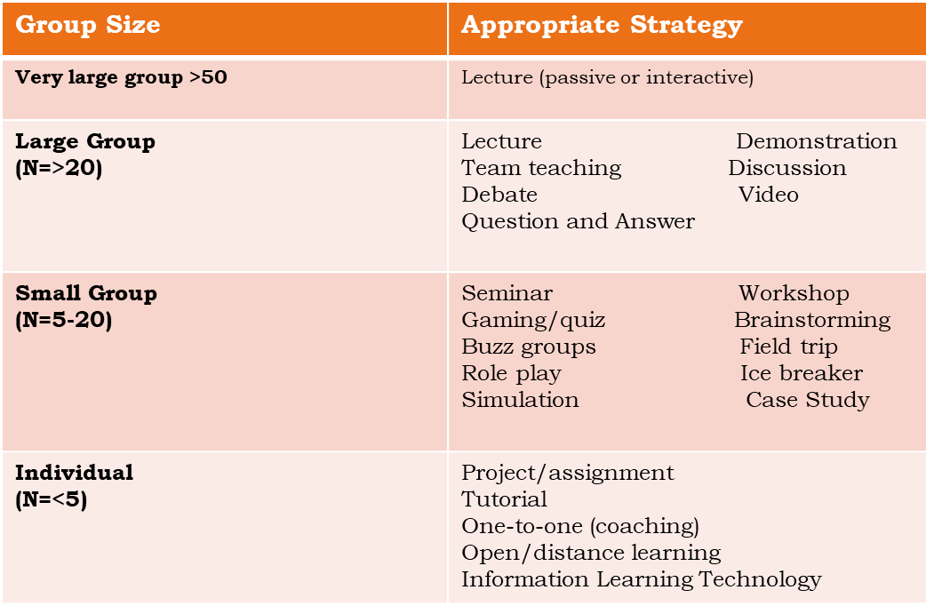
Teaching Strategies Based on Group Size?

Slide 19
Choosing a Teaching Strategy Based on the Learning Styles of your Learners?
Consolidation : Click on the links to read about these Top Ten Teaching Strategies (please report any broken links to the programme team)
1 | Group work
2 | Games and Quizzes
3 | Simulation
4 | Self directed (includes open or distance learning)
5 | Project and Assignments
6 | Discussions
7 | Buzz Groups
8 | Lectures
9 | Case study
10 | Field Trip
Activists – enjoy the present, like immediate experiences and respond to short term issues
Reflectors – prefer to think about things and explore all aspects before coming to a conclusion
Theorists – like principles, theories, models and systems. Logic.
Pragmatists – look for new ideas and are keen to experiment.

Slide 20
Choosing a Teaching Strategy Based on the Ability of your Learners
Getting to know your learners and developing an appreciation of their ability will influence the teaching strategies you employ.
ALN will be covered in detail in your coming modules, but it is a good idea to start your wider reading to develop your understanding in relation to learning.
Key at this stage, is that you consider the general learner level and maturity of your group and adopt strategies that last for a duration appropriate to their general make up. In general, lower-level learners or less mature learners will generally benefit from activities that last for approximately 15 minutes at a time.

Slide 21
In Summary
Aspect Related to Choice | Points to Note
Objective to be achieved | Both the domain and the level within the domain need to be considered
The size of the group | Different methods are more appropriate to different class sizes
The needs and characteristics of students | Students needs and the characteristics os students need to be considered.
The ability of the student | Ability needs to be considered
The motivation of the student | Appropriate strategies can motivate an individual to learn
(Adapted from Reece & Walker)

Slide 22
Teaching Strategy and Level of Participation
Strategy | Level of Participation
Lecture | Low
Demonstration | Low/High
Team Teaching | Low
Discussion | High
Debate | High
Question & Answer | Medium
Video | Medium
Seminar | Medium
Workshop | Medium
Gaming/Quiz | Medium
Strategy | Level of Participation
Brainstorming | High
Buzz Group | High
Field Trip | Medium
Role Play | High
Ice Breaker | High
Simulation | High
Case Study | Medium
Assignment/Project | High
One-to-One/Tutorial | High
Distance Learning | High

Slide 23
Variety, variety, variety
Students learn in different ways, what works for one may not be appropriate for another.
Understanding this is important to ensuring that you design lessons that provide a variety of learning opportunities for your learners.
For example:
  Start the session by telling
  Then set a group activity
  And finally provide an individual application activity
This approach allows you to utilise a range of different strategies in one session, which will hopefully ensure that all learners have the opportunity to learn in a way that best suits them.

Slide 24
References
  Reece & Walker (2007) ‘Teaching Training and Learning ; A practical BEP guide’
  Chapter 3 provides guidance on some key teaching strategies
  Petty (2009) ‘Teaching today’ Nelson Thornes
  Part 2 provides a comprehensive guide to a range of teaching strategies
  Arend & Davis (2013) ‘Facilitating seven ways of learning : A resource for more purposeful , effective and enjoyable teaching ‘ Stylus
  Carraway K (2014) ‘Transforming Your Teaching ,Practical Classroom Strategies Informed by Cognitive Neuroscience’ Norton Professional Books
  Skinner D (2011) ‘Effective Teaching and Learning on Practice’ Bloomsbury

