Slide 1
Module Name : Embedded C
Module Code : ACDA 4013
Topic : Programs on Chaser,
Switching & Virtual Terminal
Lecture : 11
Lecture By,
Mrs. Jenifer Prince Devaraj,
Lecturer - Embedded Electronics,
Faculty of Applied Computing,
UWTSD
Email:j.prince-devaraj@uwtsd.ac.uk

Slide 2
Counters using LED
LED with Virtual Terminal
Exercise 3
Demonstrate UART-based LED control using a push button by considering the following conditions:
When the push button is pressed, the system should turn ON the LED connected to RB0 and send the message "LED ON" to the virtual terminal through UART configured at 9600 baud.
When the push button is released, the system should turn OFF the LED connected to RB0 and send the message "LED OFF" to the virtual terminal through UART configured at 9600 baud.
UWTSD Lectures / ACDA4013 – Embedded C

Slide 3
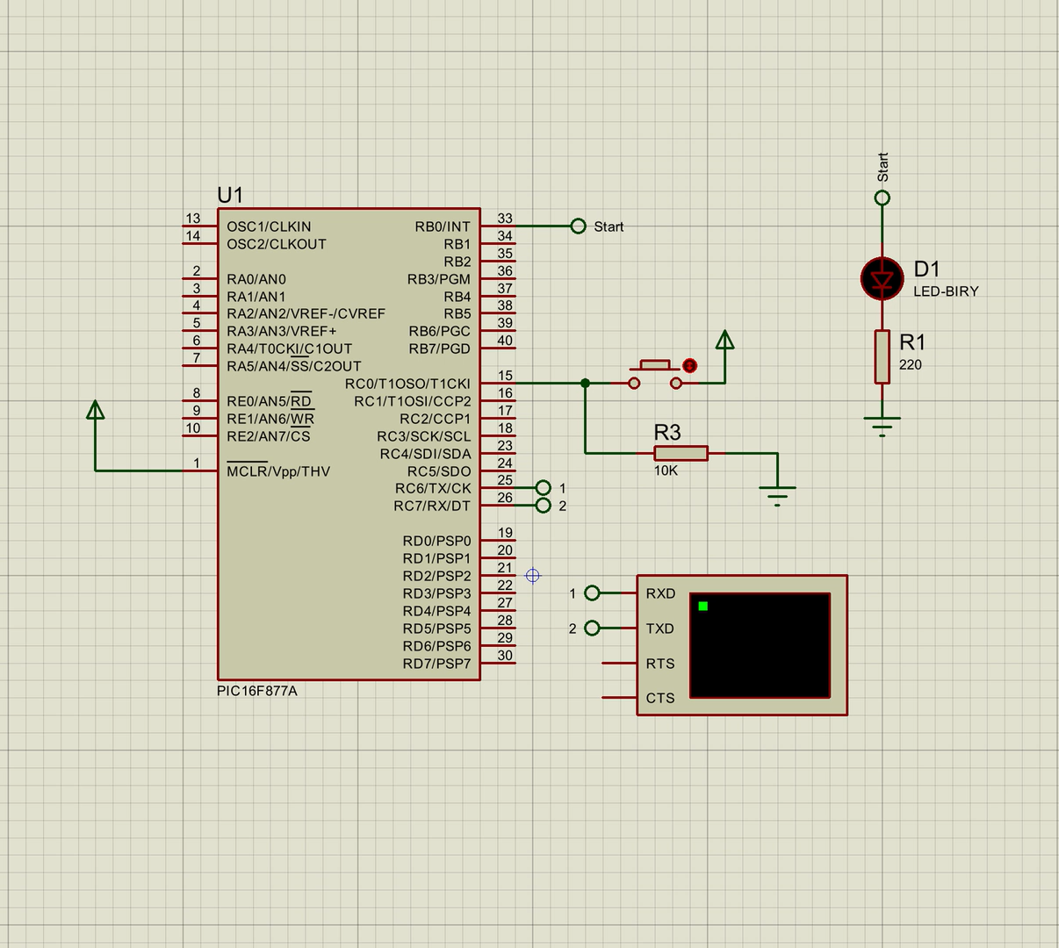
Counters using LED
LED with Virtual Terminal
UWTSD Lectures / ACDA4013 – Embedded C

Slide 4
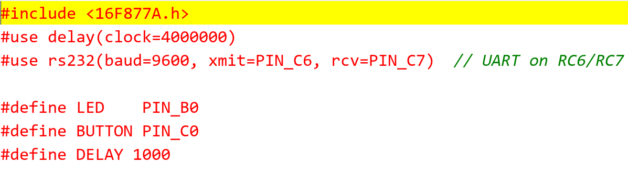
Counters using LED
LED with Virtual Terminal
Header File
UWTSD Lectures / ACDA4013 – Embedded C

Slide 5
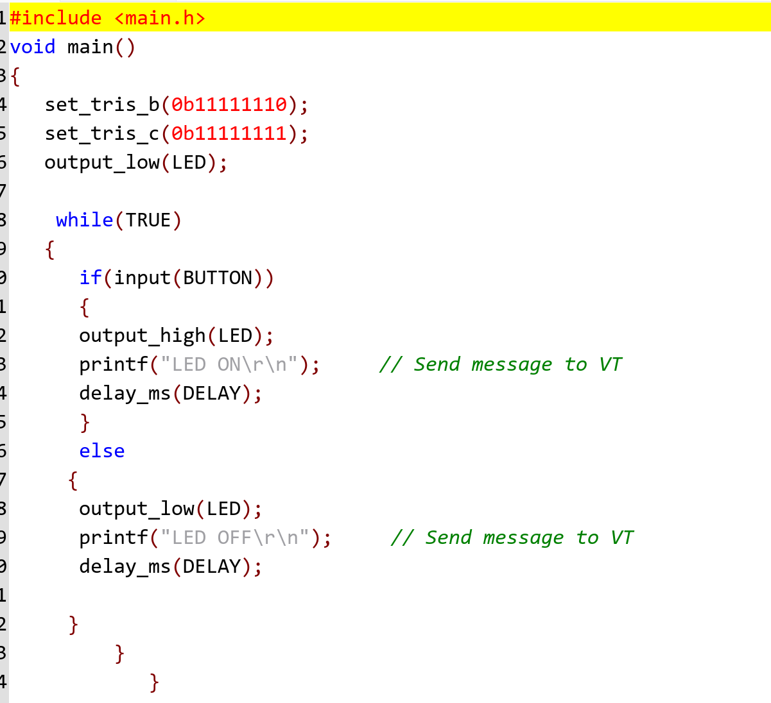
Counters using LED
LED with Virtual Terminal
C File
UWTSD Lectures / ACDA4013 – Embedded C

Slide 6
Thank You

