Slide 1


Good afternoon!
Module: Digital Skills for Personal Development and Business Growth

Slide 2

Digital skills
Why are they important?
Increases employability
Understanding technology
Enhances academic performance
Advances critical thinking
Develops problem-solving

Slide 3
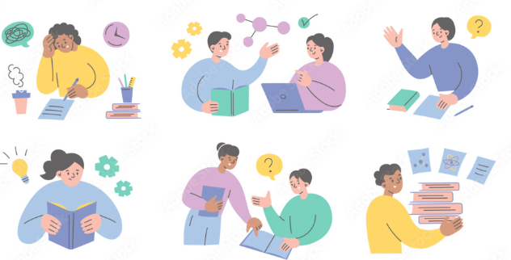
What I have learnt…
How to use outlook email more efficiently and effectively to help with my studies and future work and family life
How to create a professional LinkedIn account and linked in learning to complete courses
How to use excel and PowerPoint to a higher standard
How to self reflect on myself throughout the module

Slide 4
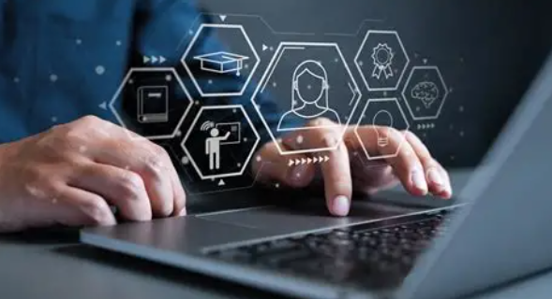
How I have implemented my skills…
Using collaborative skills inside and outside of class on different platforms
When completing research for my assignments
Creating useful spreadsheets and graphs to help with real life problem solving
Using creative skills for things like Canva and PowerPoint

Slide 5
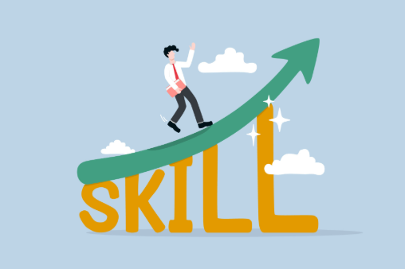
How my skills have improved and developed…
I have gained confidence in many of my digital skills
I have grown greater understanding of my personal skills including my own strengths and weaknesses

Slide 6
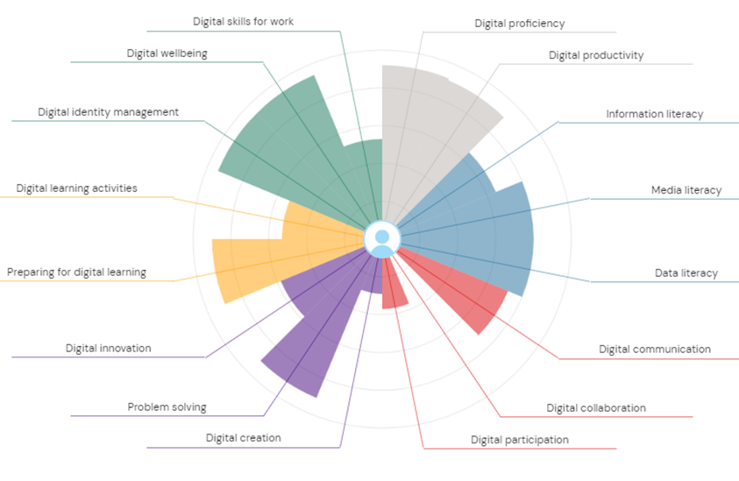
JISC Digital Capability assessment
Strengths
Digital skills for work
Digital productivity
Weaknesses
Digital collaboration
Digital participation

Slide 7
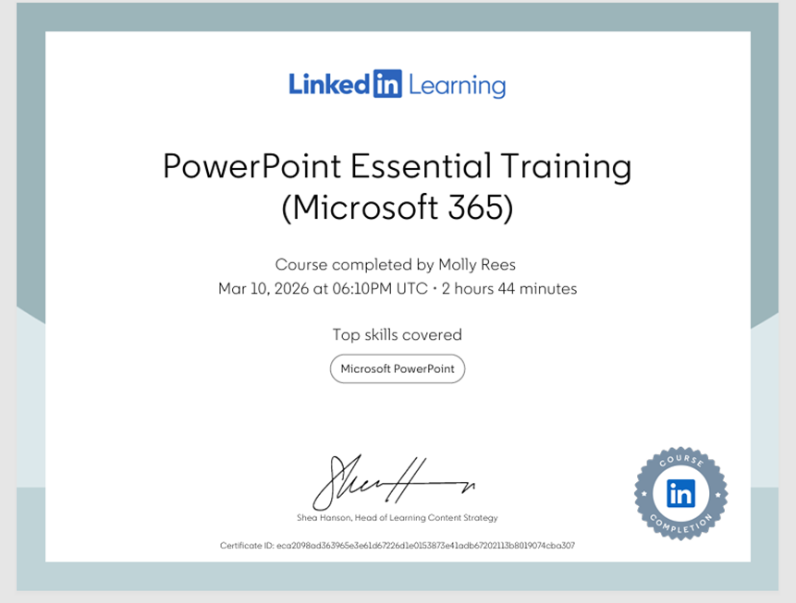
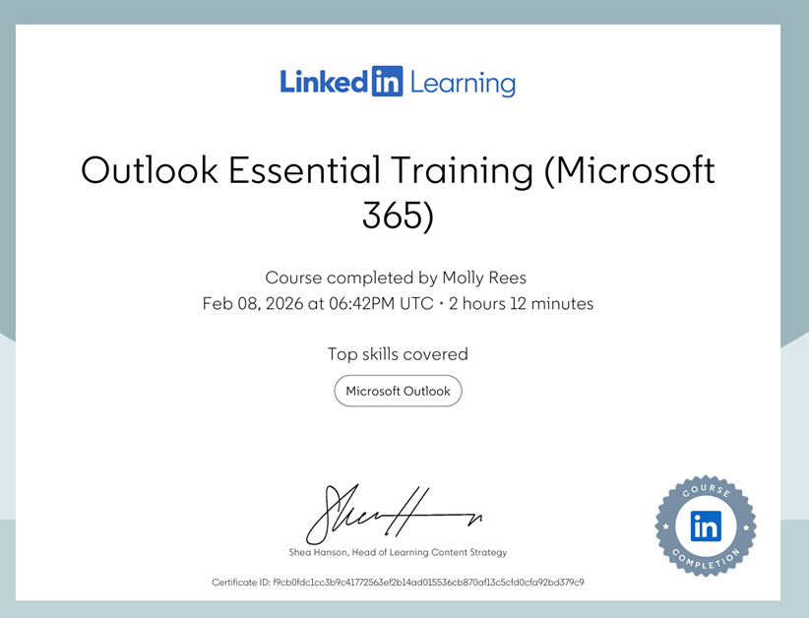
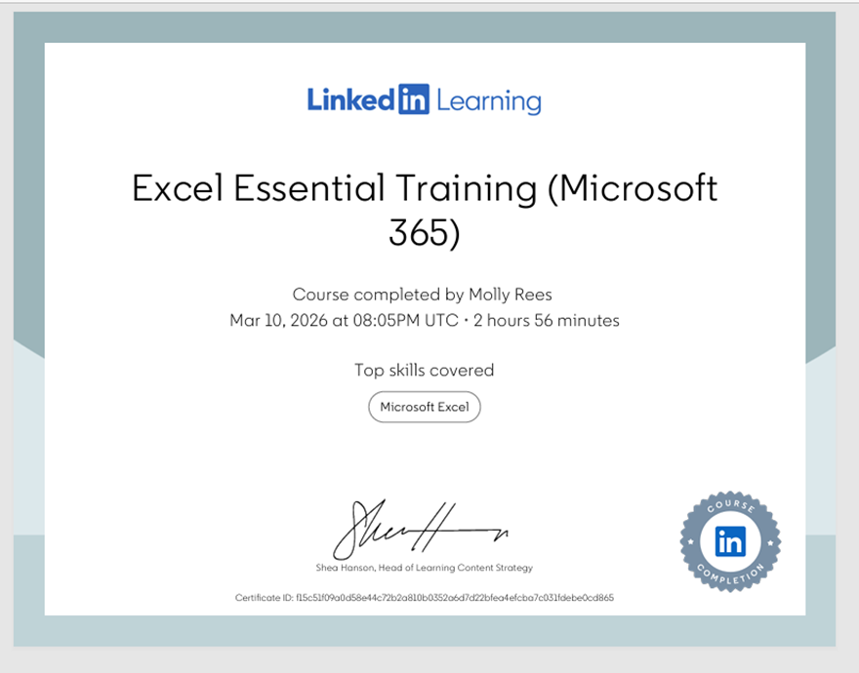
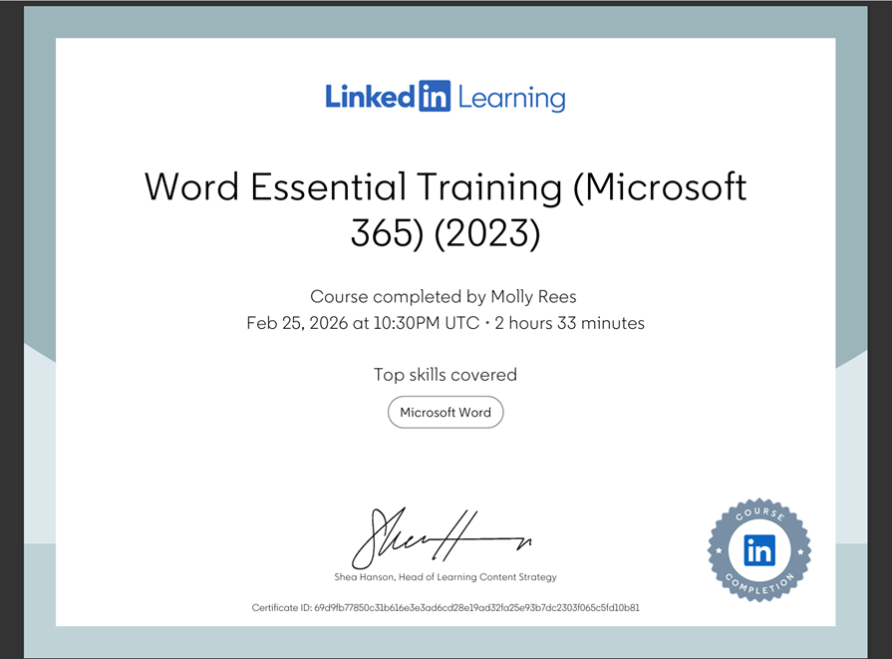
LinkedIn Learning Office 365 certificates

Slide 8
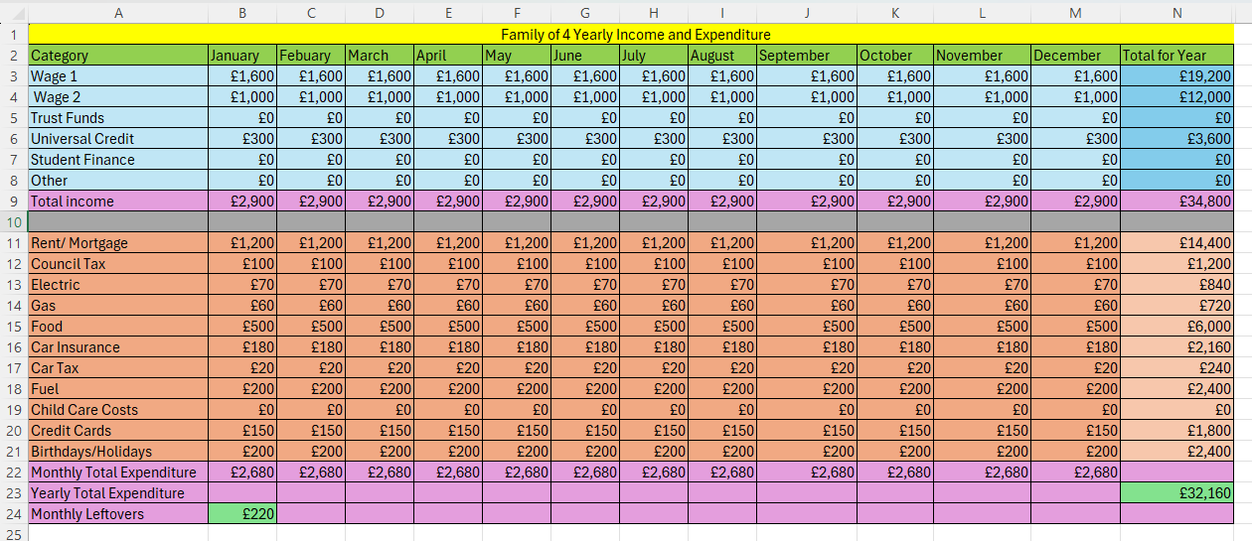
Excel essay and spreadsheet
More advanced knowledge of excel
More confidence when using excel
New ideas of ways to use excel across many aspects in life

Slide 9
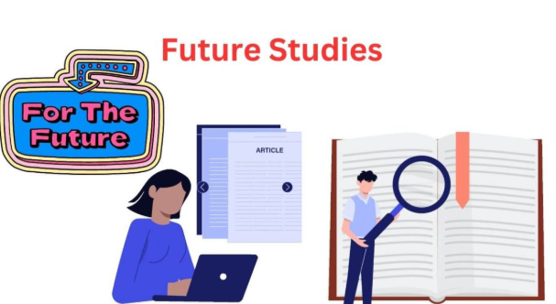
How I will apply my skills in future studies and careers…
Many of the different skills I have learnt throughout this module will be very beneficial in my future studies and careers after I finish university.
The module has enabled me to analyse date more efficiently including researching, data analysis and evaluating sources.
I also feel like I have made progress with how to tackle writing and completing assignments to the best of my ability
My time management and organisation has gotten better towards the end of the module especially when working under a lot of pressure

Slide 10
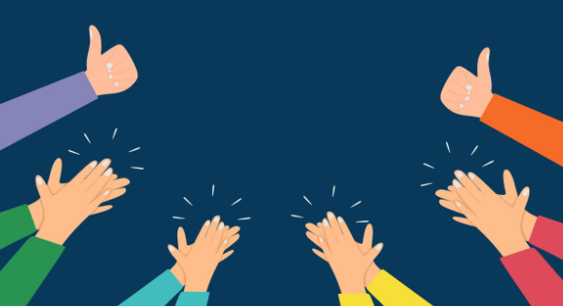
Thankyou for listening!

