Slide 1

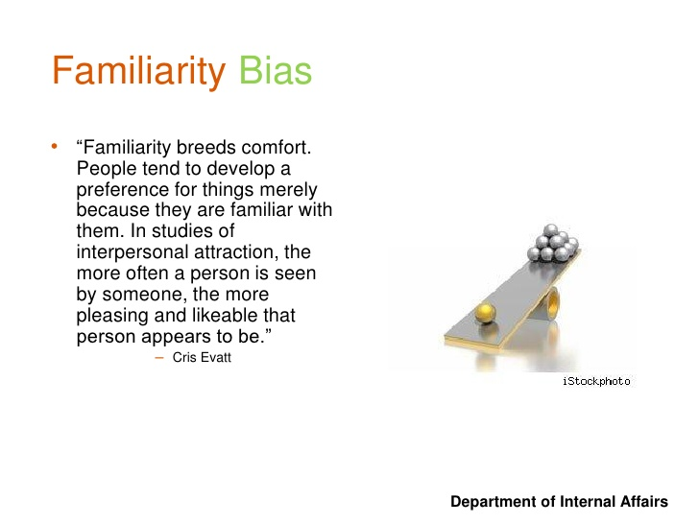
Can familiarity lead to attraction?
Rhodes et al (2001discovered that individual faces are regarded as more likeable when repeat viewing.
Average familiar faces are deemed more attractive.) Rhodes et al 2001)
The familiarity effect is also linked to the mere exposure effect which we will later go in to it was first linked to zajonc, 1968).
Harrison(1968); Martin(1970) says that the more and more time that we spend with a person the more that it is likely we will like them more.
When you fell similar with someone and are comfortable around them you feel more secure and safe .

Slide 2
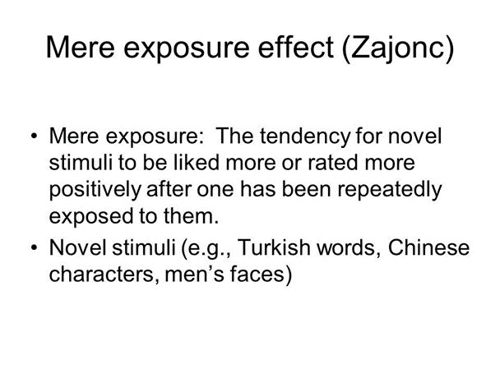
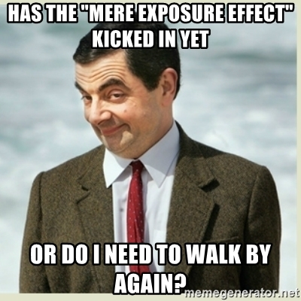
Mere exposure can influence attraction under different conditions (Mooreland and Zajonc).
The Mere Exposure Effect is said to be viewed as a classical
conditioning( Zajonc,2001).
learning the more time we spend with some one the more
attracted we can then get to them.
Its like when we hear a song but hate it but over time you
keep hearing it and in the end its stuck in your head and you
have ended up loving it.
We have a habit of liking things more when it is around us more making it more likely to become familiar and trust this person leading to a relationship.
Knowing each other over time you may find that you have more in common than you first thought.
Argyle (1983) said the more to people interact the better the attitudes with
each other usually having a greater liking for the other person.
People favour faces that look familiar to their own (Little & Perrett, 2002.)
This not only happens in relationships but in daily life e.g. food, music.
Data shows that it is more effective if there is a delay between interactions
wtffunfact.com/post/153889335392/mere-exposure-effect-wtf-fun-fact

Slide 3
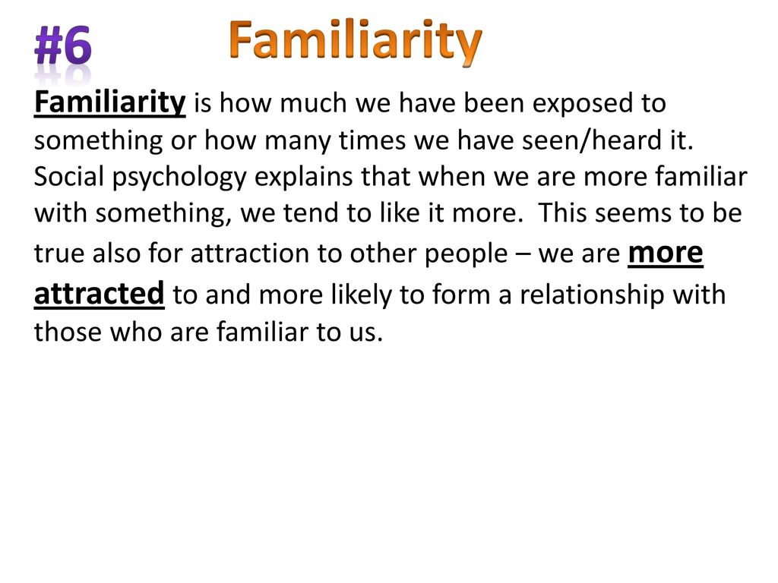
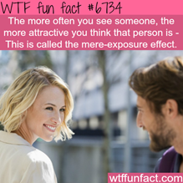
Another classic study within psychology area is Mooreland and Beach(1992) study.
They got four females to attend and enter a class room in a viable ,manner to other students.
Each entered either 0, 5, 10 or 15 times over a semester.
After the semester the normal students were asked to rate the confederate on various dimensions.
The more the student has been seen the more positive they rated that girl.
Conclusion
to conclude this presentation studies have shown that we do can get more attracted to this person the more rime we see or spend with them and the more familiar we are the more secure and safe we can feel can lead to a friendship and then a long term relationship but I have also found that it can have a opposite effect too and can lead you to dislike a person less through "mere" exposure is meant a condition making the stimulus accessible to the individual' s perception .

Slide 4
Mishra, S.,& Umesh, N and Donald,E. (1993). Antecedents of the attraction Effect: An information- processing approach. Journal of marketing research.
Zajonc, R,B. (1968. Attitudinal effects of mere exposure.Journal of personality and social psychology monograph supplement.
Zajonc, R,B. mere exposure: agateway to the subliminal.
Zajonc.R,B &Moreland, R,L. (1980). The exposure effects in person perception:familiarty,similarity and attraction
http://www.youbeauty.com/love/familiarity-breeds-attraction/
https://www.google.co.uk/search?q=FAMILIARITY+PSYCHOLOGY&rlz=1C1GCEB_enGB788GB788&source=lnms&tbm=isch&sa=X&ved=0ahUKEwjt8Pn66onbAhVoI8AKHYtBCFwQ_AUICigB&biw=1034&bih=722#imgrc=bdTBuen69VqxzM:
https://memegenerator.net/instance/68058683/mr-bean-has-the-mere-exposure-effect-kicked-in-yet-or-do-i-need-to-walk-by-again
http://slideplayer.com/slide/12790484/

