Slide 1
MARKETING MANAGEMENT
Student id : 2244538
Name : Nishwa jatinbhai patel
Subject : Marketing Management
University name : University of Wales Trinity Saint David

Slide 2

INTRODUCTION
British Airways, a leading airline organisation, also faced technological issues, marketing issues and sustainability issues in the post-pandemic situation.
Social responsibility issues mostly impact the business organisation during the post-pandemic era
Notes:
High competition in the market, changing consumer behaviours, challenges regarding digitisation and sustainability issues impacts different business sectors in the post-pandemic situation. British Airways, a leading airline organisation, also faced technological issues, marketing issues and sustainability issues in the post-pandemic situation. As argued by Dangol et al. (2020), social responsibility issues mostly impact the business organisation during the post-pandemic era. The market competition in this era is increasing gradually and the lack of information technology (IT) raises major challenges for the company to manage its marketing operations.

Slide 3
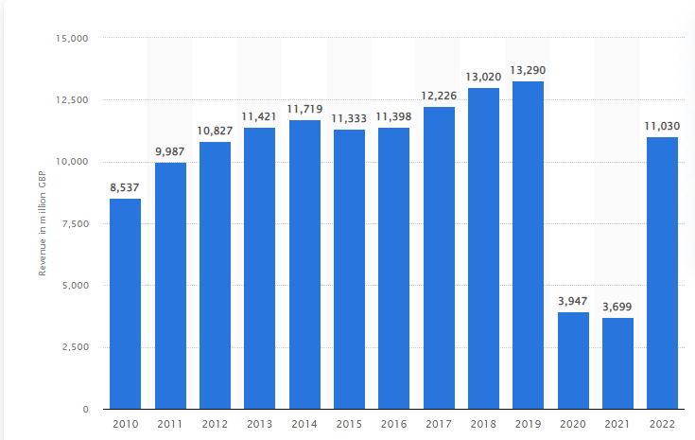
ANALYSING KEY FACTORS WITHIN THE BUSINESS ENVIRONMENT CONTRIBUTES TO ITS MARKETING FAILURE
British Airways (BA) did not meet the expectation of consumers during the post-pandemic situation which is a major reason for market failure.
British Airways (BA) did not meet the expectation of consumers during the post-pandemic situation.
The management of BA forcibly pulled a large number of advertisements due to labour shortage.
Notes:
British Airways (BA) did not meet the expectation of consumers during the post-pandemic situation which is a major reason for market failure. Expensive ticket price is also a major reason for the market failure of this company whereas other companies like Easyjet and Ryanair offer good quality airline services at lowest cost for consumers (Sarah, 2020). The BA faced challenges in maintaining brand promise towards the customers and raised major marketing challenges effectively.

Slide 4
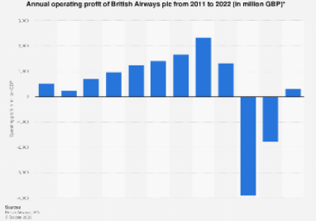
ANALYSING KEY FACTORS WITHIN THE BUSINESS ENVIRONMENT CONTRIBUTES TO ITS MARKETING FAILURE (CONTD..)
Labour shortage issues and created delays in passenger services resulting in a major market failure (campaignlive.co.uk, 2022).
During the post-pandemic situation, BA faced major financial issues to maintain its marketing operations.
This airline organisation also faced technological issues in the post-pandemic situation that also negatively impacted the brand reputation.
Notes:
The management of BA forcibly pulled a large number of advertisements due to labour shortage issues and created delays in passenger services resulting in a major market failure (campaignlive.co.uk, 2022). During the post-pandemic situation, BA faced major financial issues to maintain its marketing operations to recover from all the issues. BA faced huge financial issues and conflicts with its own staff that raised the negative brand reputation of this company (Theo, 2020). This airline organisation also faced technological issues in the post-pandemic situation that also negatively impacted the brand reputation. BA faced computer issues and cancelled thousands of tickets that dispute the plan of a large number of travellers. It indicates the digitization challenges of this company create a major reason behind the market failure.

Slide 5
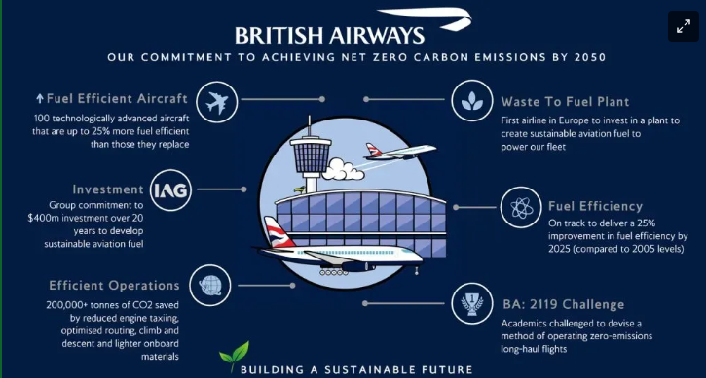
ANALYSING KEY FACTORS WITHIN THE BUSINESS ENVIRONMENT CONTRIBUTES TO ITS MARKETING FAILURE (Contd..)
British Airways produces around 230,000 tonnes of CO2 a year (mediacentre.britishairways.com, 2022).
This high pollution rate increases the environmental concern and CSR challenges for this airline company.
Notes:
During the post-pandemic period, consumers' perception is rapidly changing towards sustainable business products and services. British Airways produces around 230,000 tonnes of CO2 a year which negatively impacts environmental sustainability (mediacentre.britishairways.com, 2022). This high pollution rate increases the environmental concern and CSR challenges for this airline company in this competitive market. Around 84% of consumers blamed consumer behaviour after the pandemic situation has been changed (Erick, 2022). The changing consumer behaviours also negatively impact the marketing strategies of BA during this crisis.

Slide 6
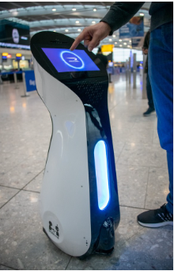
STRATEGY TO ALLOCATE RESOURCES FOR MITIGATING CURRENT CHALLENGES
Allocation of resources including human resources, and technological resources play a crucial role in business organisations.
BA introduced robotic technology to give proper guidance to consumers within the airport (mediacentre.britishairways.com, 2019).
Notes:
Allocation of resources including human resources, and technological resources play a crucial role in business organisations to cope with the marketing challenges during this post-pandemic situation. As argued by Tong and Kwan (2022), allocating resources is a major concern to mitigate the cyber security issues in the airline industry. Technology advancement strategy is important for BA to mitigate all technical issues faced by the company during covid and post-pandemic situations. The management of BA introduced robotic technology to give proper guidance to consumers within the airport (mediacentre.britishairways.com, 2019). This technological resource will help to increase brand reputation, customer satisfaction and sustainable business practices. BA also introduced smart biometric technologies to allow customers to travel without showing their passports (mediacentre.britishairways.com, 2022). This technological resource can help BA to give better satisfaction for customers to recover their brand reputation challenges faced during a pandemic.

Slide 7
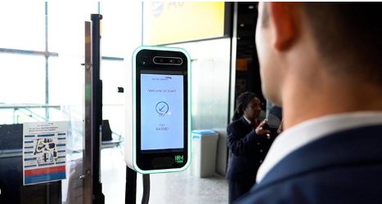
STRATEGY TO ALLOCATE RESOURCES FOR MITIGATING CURRENT CHALLENGES (Contd..)
The HR management of BA introduced strict human resource policies within the organisation instead of focusing on the flexibility of employees (Jessica, 2020).
The management of BA announced an investment of around £6.5bn in the future to provide premium quality cabin menus to offer luxury experiences ((mediacentre.britishairways.com, 2019))
Notes:
Allocation of human resources is also important for BA to minimise the conflicts between labourers and the shortage of labours. The HR management of BA introduced strict human resource policies within the organisation instead of focusing on the flexibility of employees (Jessica, 2020). BA implemented strict policies for improving the customer experience and reducing the brand reputation issues faced during the post-pandemic situation.
The management of BA announced an investment of around £6.5bn in the future to provide premium quality cabin menus to offer luxury experiences for customers (mediacentre.britishairways.com, 2019). Therefore, the allocation of financial resources gives advantages to this company to mitigate all the blame regarding customer services during the post-pandemic situation. Managing technological resources and financial resources helps to improve the R&D of BA to deliver good quality customer service for achieving competitive advantages among other competitors like Easyjet and Ryanair.

Slide 8
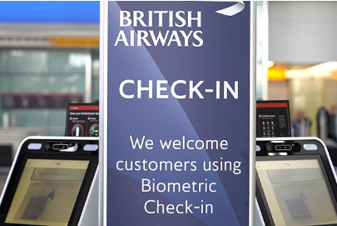
ANALYSING COMPETITIVE STRATEGIES TO GAIN COMPETITIVE ADVANTAGES
Management of this airline organisation implemented the technology advancement strategies by introducing robotic technology.
Biometric technology with a facial recognition system will help BA to complete the broadening process (Ioannou et al. 2020).
Notes:
The competitive strategies of British Airways should be focusing on customer service, which is a key factor in the aviation industry for achieving a good competitive advantage. Management of this airline organisation implemented the technology advancement strategies by introducing robotic technology, and biometric technology to gain high competitive benefits within the aviation industry. The introduction of biometric technology with a facial recognition system will help BA to complete the broadening process of around 400 passengers in 20 minutes (Ioannou et al. 2020). This gives a greater competitive advantage and reduces the waiting time of customers to give them a better customer experience after the pandemic situation.

Slide 9
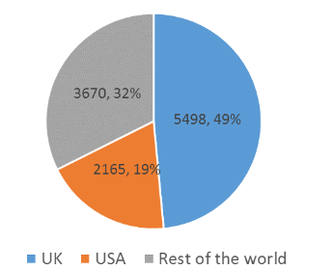
ANALYSING COMPETITIVE STRATEGIES TO GAIN COMPETITIVE ADVANTAGES (Contd..)
The sustainability strategy of BA also allows them to gain competitive advantages during the post-pandemic period.
British Airways create a road map and strategies to improve customer experience that will help to achieve competitive advantages.
Notes:
The sustainability strategy of BA also allows them to gain competitive advantages during the post-pandemic period where the majority of consumers become environmentally concerned. The management of BA is highly aimed to reduce carbon emissions and achieve a net zero mission by 2050. British Airways also invested in introducing modern aircraft that are 40% more efficient than old aircraft regarding the emission of CO2 (britishairways.com, 2023). The company is also invested to purchase “sustainable aviation fuel” (SAF) to maintain its commitment towards environmental sustainability effectively.
British Airways create a road map and strategies to improve customer experience that will help to achieve competitive advantages effectively. The competition in the aviation market is high therefore it is important to improve customer experience to gain competitive advantages. The management of BA makes effective plans to increase customer experience including refunding ticket prices after cancellation, reducing flight cancellation, and meeting the needs of consumers. As argued by Pei et al. (2020), the application of advanced technologies will help to provide a unique and differentiated customer experience. Therefore, it is necessary to focus on customer service, infrastructure, and technological support to gain competitive advantages.

Slide 10
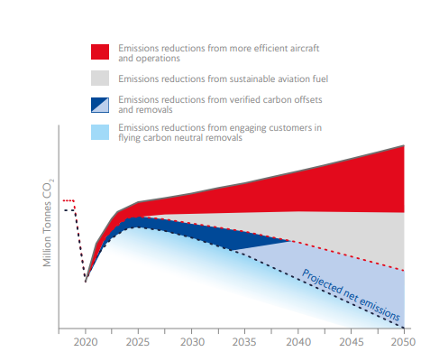
ASSESSING THE CORPORATE AND SOCIAL RESPONSIBILITY STRATEGY AND GREEN MARKETING STRATEGY TO MITIGATE THE CHALLENGES WITHIN THE BUSINESS ENVIRONMENT
The management of BA has a charity (Flying Start) that helps to support community people in the world.
Reducing carbon emissions by 80% and achieve net zero emissions by 2050 (britishairways.com, 2021)
Notes:
Developing sustainable strategies is important to maintain the corporate social responsibilities (CSR) of an organisation. As cited by Pei et al. (2020), CSR indicates several sustainable practices of a brand that place social good over interests of the firm. Maintaining CSR and green marketing strategies helps to reduce the impacts on the environment and achieve sustainable development goals. The management of BA has a charity (Flying Start) that helps to support community people in the world. BA invested around £26 million to support disadvantaged young people in the UK. This airline organisation is committed to increasing the number of senior representatives by 40% by 2025 to mitigate gender discrimination (britishairways.com, 2021). Mitigating gender discrimination within the organisation is an important strategy for maintaining corporate strategy.
The management has an effective strategy to introduce SAF in replacing traditional fuel to reduce carbon emissions by 80% and achieve net zero emissions by 2050 (britishairways.com, 2021). This strategy can help to protect the environment and allows marketers to move forward towards green marketing.

Slide 11
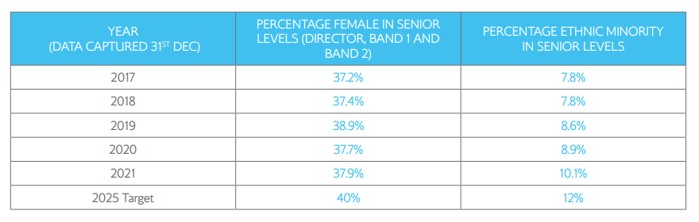
ASSESSING THE CORPORATE AND SOCIAL RESPONSIBILITY STRATEGY AND GREEN MARKETING STRATEGY TO MITIGATE THE CHALLENGES WITHIN THE BUSINESS ENVIRONMENT (Contd)
The reduction of carbon footprint and supporting community people is a major strategy for BA to improve their green marketing significantly.
This strategy can help to protect the environment and allows marketers to move forward towards green marketing.
Notes:
The reduction of carbon footprint and supporting community people is a major strategy for BA to improve their green marketing significantly. BA is the first airline company that offers volunteers for their carbon footprint project to customers (Çabuk et al. 2019). The marketers of BA are also investing in the digital market campaign on different social media platforms which indicates a positive move towards the green marketing approach.

Slide 12
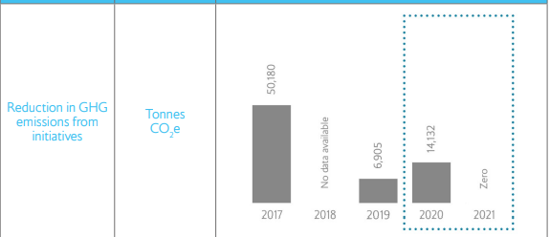
RECOMMENDATIONS
It has been recommended to replace 99% of wide-body aircraft and introduce modern aircraft .
British Airways needs to implement advanced technologies like AI and IoT.
Management needs to improve the employee management policies and HR strategies.
Notes:
It has been recommended to replace 99% of wide-body aircraft and introduce modern aircraft to offer better customer service and reduce carbon emissions.
It is important to invest in modern aircraft to achieve sustainable business practices. Modern aircraft reduce carbon emissions and help to develop the company's CSR strategies (britishairways.com, 2021). Introducing modern aircraft can help the BA to improve customer experience and safety measures for passengers.
The management of British Airways needs to implement advanced technologies like AI and IoT to improve the poor information management system and deliver a positive customer experience.
Implementing advanced technology like AI, and IoT can help to recover the challenges regarding the information management system. The implementation of IoT helps to improve inflight communication and better management of cabin crew (Kaushik and Thakur, 2022). It can help BA to achieve competitive advantages over other competitors.
Management needs to improve the employee management policies and HR strategies to reduce conflict, strikes of employees and shortage of labourers during the post-pandemic situation.
Implementing employee management policies helps BA to reduce the conflicts between employees. It can allow the HR management to reduce the labour shortage issues for delivering good customer service.

Slide 13
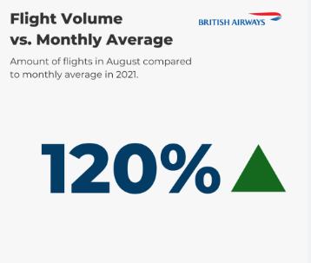
CONCLUSION
British Airways faced technical issues, service-related issues and sustainability issues.
Labour shortage and poor relationships with employees raised a major concern behind the marketing failure of BA.
Notes:
British Airways faced technical issues, service-related issues and sustainability issues. Mining technological resources, financial resources and human resources are important for the company. Labour shortage and poor relationships with employees raised a major concern behind the marketing failure of BA. Allocation of financial resources is also important to develop the quality of airline services for minimising the impacts of poor brand reputation and customer expectations.

Slide 14
References
britishairways.com, (2021), sustainability report (2021), Available at: https://www.britishairways.com/cms/global/pdfs/information/sustainability-report-((2021)).pdf [Accessed on: 3rd July, 2023]
britishairways.com, (2023), ba better world, Available at: https://www.britishairways.com/en-gb/information/about-ba/ba-better-world/planet#:~:text=As%20an%20industry%20leader%2C%20we,to%20further%20reduce%20our%20emissions. [Accessed on: 3rd July, 2023]
Çabuk, S., Güreş, N., Hilal, İ.N.A.N. and Arslan, S., (2019). A survey on the attitudes of passengers towards Green Airlines. Yaşar Üniversitesi E-Dergisi, 14(55), pp.237-250.
campaignlive.co.uk, (2022), forced pull ads face staff shortage, Available at: https://www.campaignlive.co.uk/article/ba-forced-pull-ads-face-staff-shortage-problems/220413 [Accessed on: 3rd July, (2023)]
Dangol, J., Chitrakar, S. and Yoo, K.S., (2020). Impact of COVID-19 on Nepalese small and medium enterprises. Journal of Business and Social Sciences Research, 5(2), pp.1-14.
Erick, Salas., (2022), changes travel habit post pandemic, Available at: https://www.statista.com/statistics/1191975/changes-travel-habits-post-pandemic/ [Accessed on: 3rd July, (2023)]
Ioannou, A., Tussyadiah, I. and Lu, Y., (2020). Privacy concerns and disclosure of biometric and behavioral data for travel. International Journal of Information Management, 54, p.102122.
Jessica, Bird., (2020), british airways employee experience, Available at: https://employeebenefits.co.uk/exclsuive-british-airways-employee-experience/#:~:text=Overall%2C%20British%20Airways'%20employee%20strategy,and%20an%20improved%20consumer%20experience. [Accessed on: 3rd July, 2023]
Kaushik, R. and Thakur, A.K., (2022). A Brief Review on IoT, its Applications, Challenges & Future Aspects in Aviation Industry. International Journal of Current Science, 12(2), pp.909-914.
mediacentre.britishairways.com, (2019), british airways introduce robotic technology, Available at: https://mediacentre.britishairways.com/pressrelease/details/11921 [Accessed on: 3rd July, 2023]
mediacentre.britishairways.com, (2019), british airways investment, Available at: https://mediacentre.britishairways.com/pressrelease/details/10495 [Accessed on: 3rd July, 2023]
mediacentre.britishairways.com, (2022), british airways introduce smart technology trial, Available at: https://mediacentre.britishairways.com/pressrelease/details/14300 [Accessed on: 3rd July, 2023]
mediacentre.britishairways.com, (2022), sustainability at british airways, Available at: https://mediacentre.britishairways.com/factsheets/details/86/Factsheets-3/217?category=1&pgck=L2ZhY3RzaGVldHM- [Accessed on: 3rd July, (2023)]
Pei, X.L., Guo, J.N., Wu, T.J., Zhou, W.X. and Yeh, S.P., (2020). Does the effect of customer experience on customer satisfaction create a sustainable competitive advantage? A comparative study of different shopping situations. Sustainability, 12(18), p.7436.
Sarah, Vizard., (2020), british airways brand reputation nosedives wake meltdown, Available at: https://www.marketingweek.com/british-airways-brand-reputation-nosedives-wake-meltdown/ [Accessed on: 3rd July, (2023)]
Theo, Leggett., (2020), british airways breakdown in trust, Available at: https://www.bbc.com/news/business-53023563 [Accessed on: 3rd July, (2023)]
Tong, L. and Kwan, M., (2022). ENSURING CYBER SECURITY IN AIRLINES TO PREVENT DATA BREACH. Computer Science & IT Research Journal, 3(3), pp.66-73.

