Slide 1
Financial Markets

Slide 2
Three Sets of Players in the Financial Markets
Within the financial markets, there are three principal sets of players that interact:
  Borrowers (individuals and businesses)
  Savers (mostly individual investors)
  Financial Institutions (Intermediaries)
  (ex. Commercial banks)

Slide 3
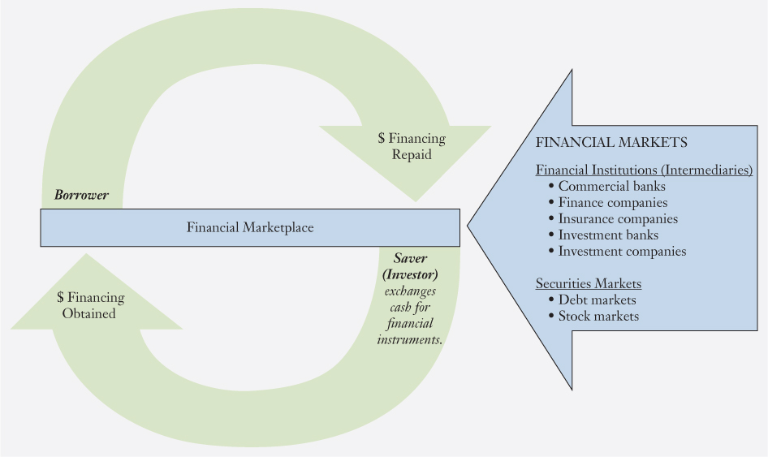
Figure 2-1 Financial Markets, Institutions, and the Circle of Money

Slide 4
Financial Intermediaries
Financial institutions like commercial banks, finance companies, insurance companies, investment banks, and investment companies are called financial intermediaries as they help bring together those who have money (savers) and those who need money (borrowers).

Slide 5
Money Market versus Capital Market
Money market - markets for short-term debt instruments, with maturities of one year or less (such as Treasury bills, Commercial paper).
Capital market - markets for long-term debt and equity instruments (such as Common stock, Preferred stock, Corporate bond, U.S. Treasury bond).

Slide 6
Commercial Banks: Everyone’s Financial Marketplace
Commercial banks collect the savings of individuals as well as businesses and then lend those pooled savings to other individuals and businesses. They earn money by charging a rate of interest to borrowers that exceeds the rate they pay to savers.
The 4 largest commercial banks in the US are JPMorgan Chase & Co., Bank of America Corp., Wells Fargo Bank, and Citigroup, Inc.

Slide 7
Non—Bank Financial Intermediaries
These include:
  financial services corporations, such as GE Capital Division;
  insurance companies, such as Prudential;
  investment banks, such as Goldman Sachs;
  investment companies, including mutual funds, hedge funds, and private equity firms.

Slide 8
Financial Services Corporations
Financial services corporation are in the lending or financing business, but they are not commercial banks.
  For example: GE capital – it provides commercial loans, financing programs, commercial insurance, equipment leasing, and other services in over 35 countries. It also provides credit services to more than 130 million customers. In 2015, GE announced that it will be selling off most of GE capital over the following two years.

Slide 9
Insurance Companies
Insurance companies sell insurance to individuals and businesses to protect their investments. They collect premium and hold the premium in reserves until there is an insured loss and then pay out claims to the holders of the insurance contracts.
The reserves are deployed in various types of investments, including loans to individuals and businesses.

Slide 10
Investment Banks
Investment banks are specialized financial intermediaries that help companies and governments raise money and that provide advisory services to client firms when they enter into major transactions such as buying or merging with other firms.

Slide 11
Investment Companies: Mutual Funds
Mutual funds are professionally managed according to a stated investment objective. Through mutual funds individuals can invest in virtually all of the securities offered in the financial market.
Individuals can invest in mutual funds by buying shares in the mutual fund at the net asset value (NAV).

Slide 12
Investment Companies: Exchange Traded Funds (ETFs)
An exchange-traded fund (ETF) is similar to a mutual fund except that the ownership shares in the ETF can be bought and sold on the stock exchange throughout the day. Most ETFs track an index, such as S&P 500.
Mutual funds and ETFs provide a cost-effective way to diversify, which reduces risk – a great benefit for the small investor.

Slide 13
Investment Companies: Hedge Funds
Hedge funds are similar to mutual funds but are less regulated, take more risk, and are generally open only to high net worth investors (typically $1 million and above). Management fees are higher for hedge funds; they typically run at about 2 percent of the assets and include an incentive fee (typically 20% of profits) based on the fund’s overall performance.

Slide 14
Investment Companies: Private Equity Firms
Private equity firms is a financial intermediary that invests in equities that are not traded on the public capital markets. Two types of private equity firms dominate this group:
Venture capital (VC) firms; and
Leveraged buyout (LBO) firms.

Slide 15
Private Equity Firms: Venture Capital Firms
Venture capital firms raise money from investors (wealthy people and other financial institutions), which they then use to provide the initial financing for private start-up companies.

Slide 16
Private Equity Firms: Leveraged Buyout
Leveraged buyout (LBO) firms acquire established firms that typically have not been performing well with the objective of making them profitable again and then selling them. An LBO typically uses debt to fund the purchase of a firm.

Slide 17
Security
A security is a negotiable instrument that represents a financial claim. It can take the form of ownership (stock) or a debt agreement (bond).
The public securities markets allow businesses and individual investors to trade the securities issued by public corporations.

Slide 18
Primary versus Secondary Market
Primary market – a market in which securities are bought and sold for the first time. The firm selling securities receives the money raised that they can then use to finance their businesses.
Secondary market – a market for subsequent trading of previously issued securities. The issuing firm does not receive any new money, as the securities are simply being transferred from one investor to another.

Slide 19
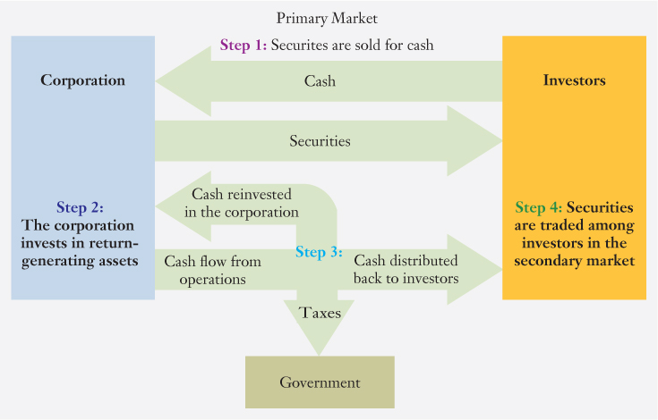
Figure 2.2 Security Markets Provide a Link between the Corporation and Investors

Slide 20
Types of Securities: Debt Securities
Debt Securities: Firms borrow money by selling debt securities in the debt market.
Debt is classified based on maturity period: Less than one year (issued in money market), one to ten years (called Note, issued in capital market), more than 10 years (called bond, issued in capital market)

Slide 21
Types of Securities: Equity Securities
Equity securities represent ownership of the corporation. There are two major types of equity securities: common stock and preferred stock. When you buy equity securities, you are making an investment that you expect will generate a return.

Slide 22
Types of Securities: Common Stock
Common stock is a security that represents equity ownership in a corporation, provides voting rights, and entitles the holder to a share of the company’s success in the form of dividends and any capital appreciation in the value of the security.
Investors who purchase common stock are the residual owners of the firm.

Slide 23
Types of Securities: Preferred Stock
Preferred stock is an equity security. It gives preference, relative to common stockholders, with regard to dividends and claim on assets. Thus preferred shareholders receive their dividends before any dividends are distributed to the common stockholders.

Slide 24
Other Financial Instruments
Provides a list of different financial instruments used by firms to raise money, beginning with the shortest-maturity instruments (U.S. Treasury bills) that are traded in the money market and moving through to the longest-maturity instruments (common stock) that are traded in the capital market.

Slide 25
Characteristics of Different Financial Instruments
Money Market Debt For the Borrower:
Good way of inexpensively raising money for short periods of time.
Rates tend to be lower than long-term rates.
Can borrow money to match short-term needs.
If interest rates rise, the cost of borrowing will immediately rise accordingly.
For the Investor:
Very liquid—investors have access to their money when they
need it.
Safe—generally invested in high-quality investments for brief periods.
Low returns—rates tend to be close to the rate of inflation.

Slide 26
Characteristics of Different Financial Instruments
Long-Term Debt and Fixed-Income Securities For the Borrower:
Interest rates are locked in over the entire life of the debt.
Has a tax advantage over common stock in that interest payments are tax deductible, whereas dividend payments are not.
For the Investor:
Can be used to generate dependable current income.
Some bonds produce tax-free income.
Long-term debt tends to produce higher returns than short-term debt.
Less risky than common stock.
Investors can lock in an interest rate and know the future returns (assuming the issuer does not default on its payments).

Slide 27
Table Characteristics of Different Financial Instruments
Preferred Stock For the Issuer:
Dividends can be omitted without the risk of bankruptcy.
Has the disadvantage that dividends are not tax deductible for the issuer, whereas interest payments from debt are tax deductible.
For the Investor:
For corporate investors, it has a tax advantage because at a minimum 70 percent of dividends received are tax-free.

Slide 28
Table Characteristics of Different Financial Instruments
Common Stock For the Issuer:
The issuing firm is not legally obligated to make payments.
Does not have a maturity date.
Issuance of common stock increases creditworthiness because the firm has more investor money to cushion the firm in the case of a loss.
Has a tax disadvantage relative to debt; whereas debt interest payments are deductible for tax purposes, common stock dividends are not.
For the Investor:
Over the long run, common stock has outperformed debt-based financial assets.
Along with the increased expected return comes increased risk.

Slide 29
Financial Markets and the Financial Crisis
Beginning in 2007, US experienced its most severe financial crisis since the Great Depression of the 1930s. As a result, some financial institutions collapsed, while the government bailed others out; unemployment skyrocketed; the stock market plummeted, the country entered into a recession, and it spread world wide.
Although many factors contributed to the financial crisis, the most immediate cause has been found to be the collapse of the real estate market and the resulting real estate loan (mortgage) defaults.

Slide 30
Securitization Process (1 of 2)
Securitization Process
Homebuyers borrow money by taking out a mortgage loan
Lender sells the mortgage to another firm or financial institution.
That financial institution pools together and creates a portfolio of mortgages. The purchase of that portfolio is financed through sale of MBS.

Slide 31
Securitization Process (2 of 2)
These MBSs are sold to investors who can
hold them as investments or resell them to
other investors.
Since the original lender gets the money back quickly and does not have to worry about repayment, it may not adequately screen the loan applicants. Financial crisis began with poor screening and spread worldwide through sale of MBSs.

