Slide 1




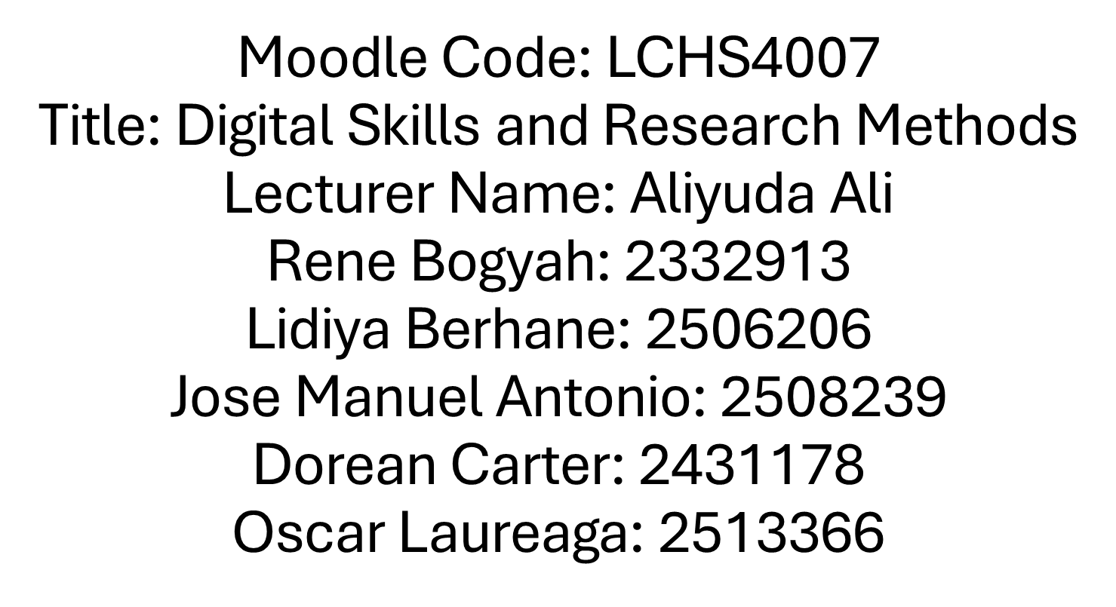



Slide 2


SUNRISE RESIDENTIAL CARE HOME
Sunrise residential care home is a medium-sized facility providing long-term care forolder adults, many of whom live with dementia, mobility issues, or long-term healthconditions. The care home has around 35 residents and a team of nurses, careworkers, administrators, and visiting health professionals. In recent years, Sunrise hasbegun introducing digital tools to improve the quality and efficiency of care. Thehome has access to the Microsoft 365 suite, but staff are still developing confidencein using its full range of applications.

Slide 3


MICROSOFT EXCEL
At Sunrise Residential Home the best MS 365 application was Microsoft Excel, to assist the staff and organizing data and important information. It was very crucial to the residents to monitor their vital signs, Health Records and medication schedules. By Microsoft Excel Spreadsheet it can be easily to the nurse to log each residence health records. It also easily recognize or some alteration in residents condition.​
​

Slide 4
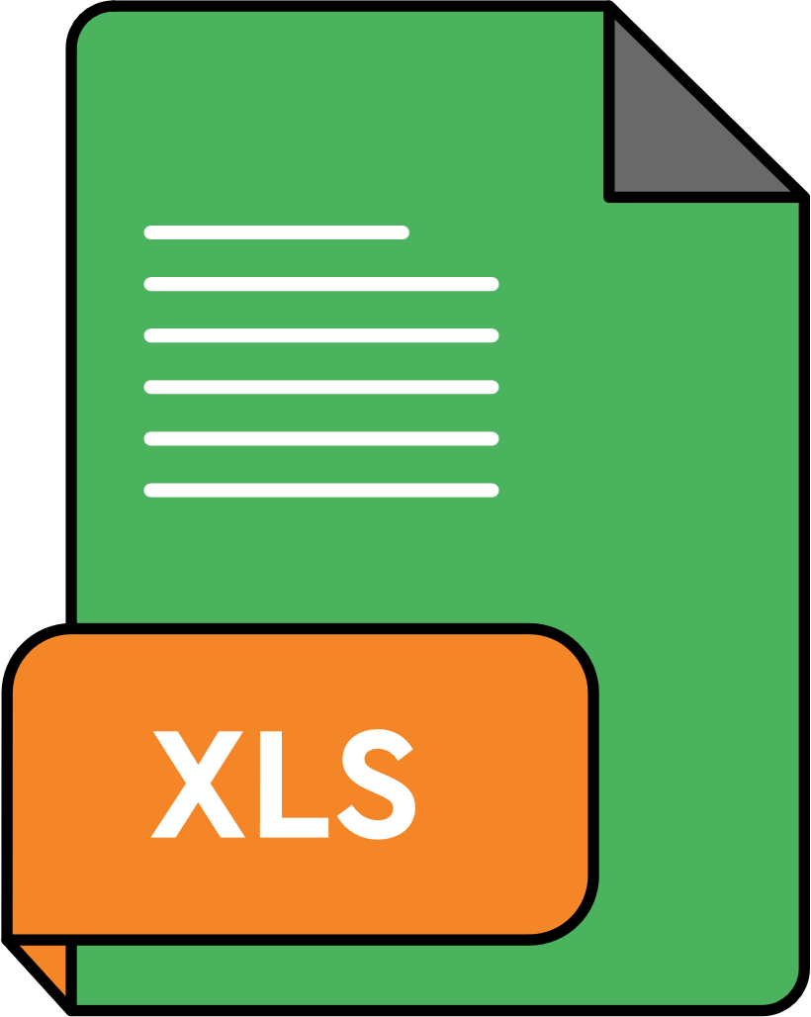
BENEFITS
Excel speeds up tasks especially in healthcare areas it enables all staff in institutions to store data, organize and even easily analyze the data. By this it can be minimized human errors and save time in automatically calculation. It also enhance the communication with the healthcare team by sharing the spreadsheet to them and instantly view the updated data or small information.

Slide 5


LIMITATIONS
Some staffs are lack confidence in utilizing Excel's advanced features, which may lead to errors or hold-ups. To ensure data accuracy and security, the system needs regular updates and appropriate training.And also it was really hard for them to use it since they didn’t have proper training. Unstable internet connection also was the biggest hindrance in using this application.

Slide 6


MS TEAM
Microsoft Teams is the ultimate messaging app for your organizationaL workspace for real-time collaboration and communication, meetings, file and app sharing, and even the occasional emoji! All in one place, all in the open, all accessible to everyone.

Slide 7


BENEFITS
The usage of MS team in sunrise residential care home allows care workers to send quick messages without walking on the offices. It was easy to conduct virtual meeting in healthcare team.It also less needs to use paper notes in every documentation in each patient or residents they also has a shared access in care plan by residents history, vital signs, medications schedule and the continuity of care.

Slide 8
LIMITATIONS
Some workers, especially those unfamiliar on technology. They feel intimidated by this new applications and also by using those tools you need a strong internet connection and consistent devices.Lastly, Changing established workflows (paper, face-to-face meetings) takes time.

Slide 9
IMPACT OF LIMITED DIGITAL SKILLS
In today’s environment, digital technology was a plays of critical roles in promoting health in everyone to improve quality of care and easy access in healthcare teams in institution. At Sunrise Residential Care Home, digital tools such as electronic care records, online communication platforms, and digital medication systems are being introduced to enhance care delivery. however some staff was limited in digital literacy that has biggest affect to render care. They find it difficult in inputing the data that can be lead in delayed documentation.To address this issues Sunrise Residential care home should provide digital literacy training and user friendly systems.

Slide 10



CHECKLIST
SECURITY LOGINS
☐ Log in with your own credentials every time; do not share your passwords.
☐ Create strong passwords
☐ Update passwords in routine basis
EMAIL SECURITY
☐ Verify the sender’s address prior to opening any email
☐ Avoid clicking on links from sources that are unknown or suspicious.
☐ Refrain from exchanging patient details or private information via email.

Slide 11
CHECKLIST
DOCUMENT STORAGE
☐ Save files exclusively in the care home’s approved.
☐ Ensure devices are locked when not in use.
PATIENT CONFIDENTIALITY
☐ Refrain from discussing details about residents in public
☐ Make sure that when you are looking at digital records, screens cannot be seen by other people.

Slide 12
REFERENCES
CFI Team. “Excel Definition.” Corporate Finance Institute, 24 Nov. 2022, corporatefinanceinstitute.com/resources/excel/excel-definition-overview/.
Microsoft. “What Is Microsoft Teams?” Support.microsoft.com, Microsoft, 2022, support.microsoft.com/en-us/topic/what-is-microsoft-teams-3de4d369-0167-8def-b93b-0eb5286d7a29.

Slide 13

THANK
you

