Slide 1
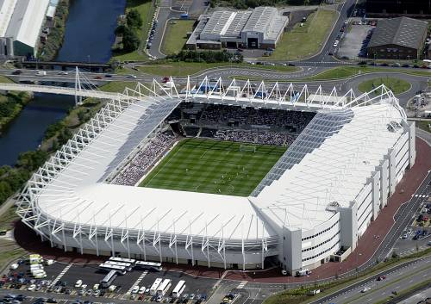

Liberty Stadium - 2005

Slide 2
Learning outcomes
Understanding sports venues
What they do.
How they get revenue.

Slide 3
What is Liberty Stadium
Sports Stadium
Wedding Venue
Major Events
Conferences
Live Music/ Concerts
Parties – Birthday/ Christmas/ Proms
Life Celebration (Ashes – Chaplin)
Commercial Enterprise
Signature Facility Leisure, Events, Tourism and Sport

Slide 4
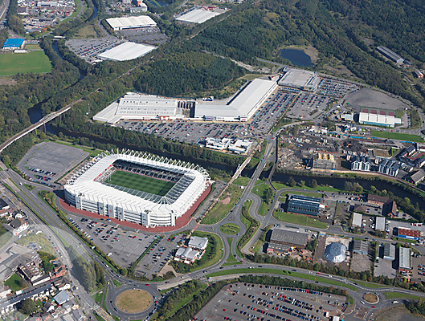
Liberty Stadium Location

Slide 5
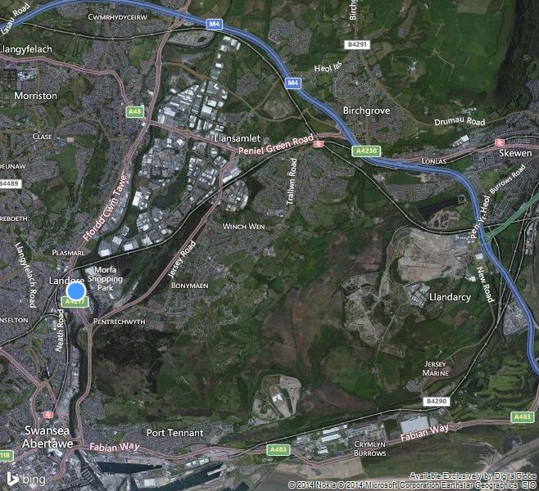
Liberty Stadium Location

Slide 6
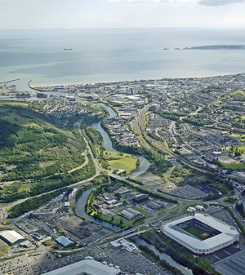
Liberty Stadium - Congestion
£1.5m WG Transport Fund

Slide 7
Liberty Stadium Facts - £27m
The upper floors and roof structure will be supported by 2,500 tonnes of structural steelwork
= 300 average sized African elephants or 1,400 Ford Focus cars.
There are over 420 doors throughout the stadium.
There are 26 sets of stairs.
There are 12 lifts.
There are 30 number turnstiles.
There are 250 WC’s.
There are 200 wash hand basins.
There are 5,000 light fittings.
There are over 10,000 tress and shrubs in the landscaped areas.
The pitch contains 10.1 million metres of ‘Desso’ nylon inserts.

Slide 8
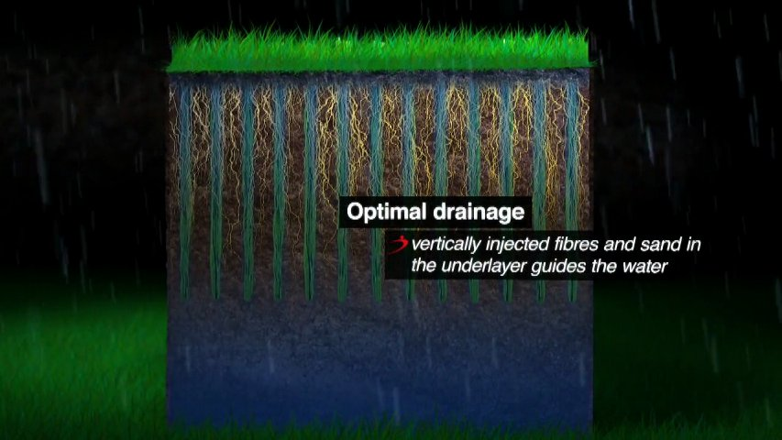
Liberty Stadium Surface
Desso’ nylon inserts

Slide 9
Liberty Stadium Structure
Ospreys Rugby Swansea City FC
FMC – Facility Management Company (Compass Group £1.8b)
Baileys Maintenance Services – Electrical Contractor
SSMC – Swansea Stadium Management Company

Slide 10
Liberty Stadium – SSMC (Original Management Structure)
Board Structure – 2 x representatives (Swans, Ospreys, Council)
FMC - Joint Venture Agreement
General Manager
Operations Manager Customer Service Manager Building Services Manager
Match Day Safety Premier Club Manager Maintenance Supervisor
Admin Staff Ticket Office Manager Baileys Engineer
Admin Staff

Slide 11
Liberty Stadium (Current Management Structure)
Board Structure – Swansea City AFC (No Swans or Council Representatives)
Catering - Joint Venture Agreement
Marketing and Sales Manager
Online
Chairman and Chief Executive
Operations Manager Customer Service Manager Building Services Manager
Match Day Safety Premier Club Manager Multiple Sites
Training Admin Staff Ticket Office Manager
Admin Staff

Slide 12
Conclusions from this Structural Change?
In groups suggest a rationale and likely future developments?
Is this model seen in other places?

Slide 13
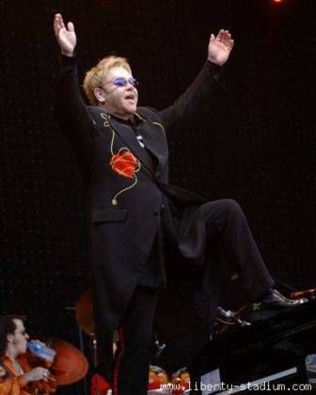
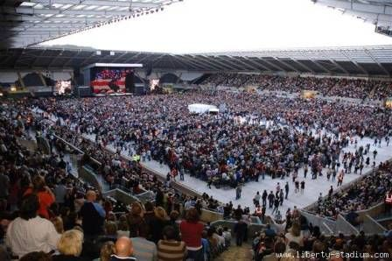
Elton John 2008

Slide 14
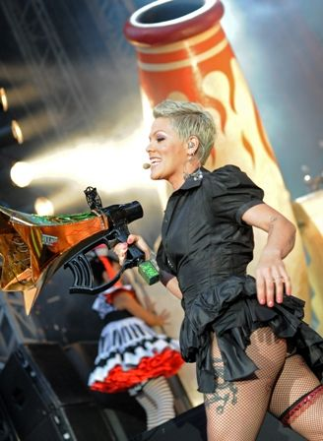
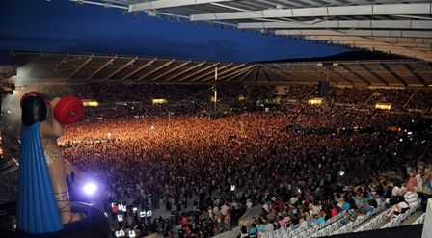
Pink 2010

Slide 15
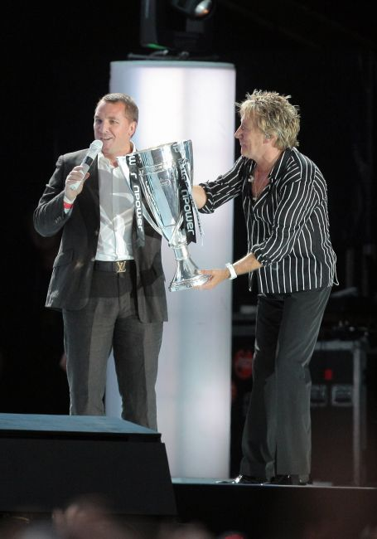
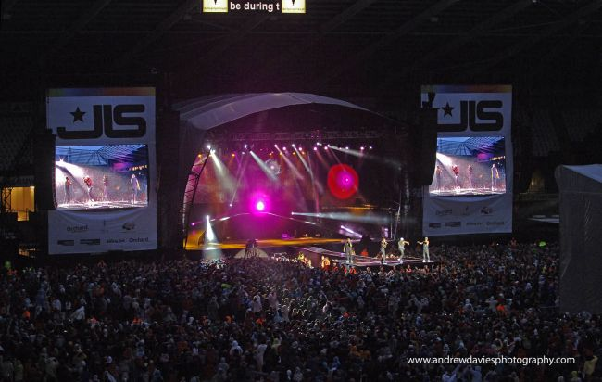
Rod Stewart & JLS 2011

Slide 16
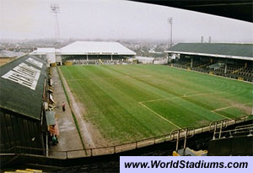
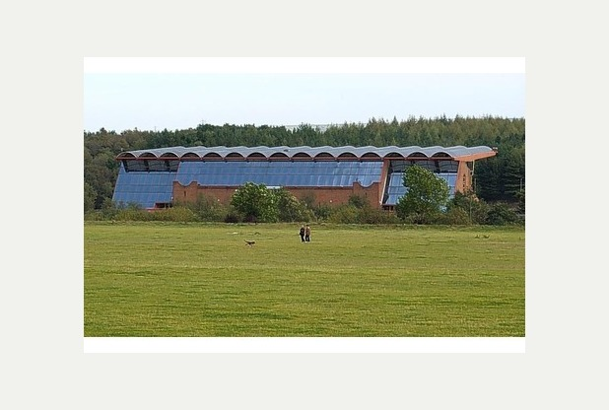
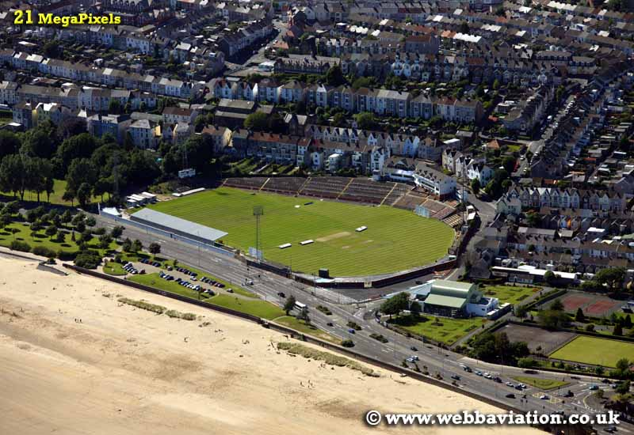
Liberty Stadium - PAST
The Vetch - 1912
Morfa Stadium - 1980
St Helens - 1873

Slide 17
Factors that Influence - Liberty Stadium Financial Concerns
SWANSEA Council has been asked to explain the funding arrangements at the
Liberty Stadium by the European Commission over Irregular public funding.
2. Stadium expansion 11,000 extra seats, phased approach
Peppercorn rent to a loss-making management company, 50 year lease
Rent payable of 30% distribution profits from SSMC, incurs all costs
Annual profit and loss cycles for SSMC of around £150,000
Economy, competition, Relegation, TV Rights, Maintenance/ Upgrade

Slide 18
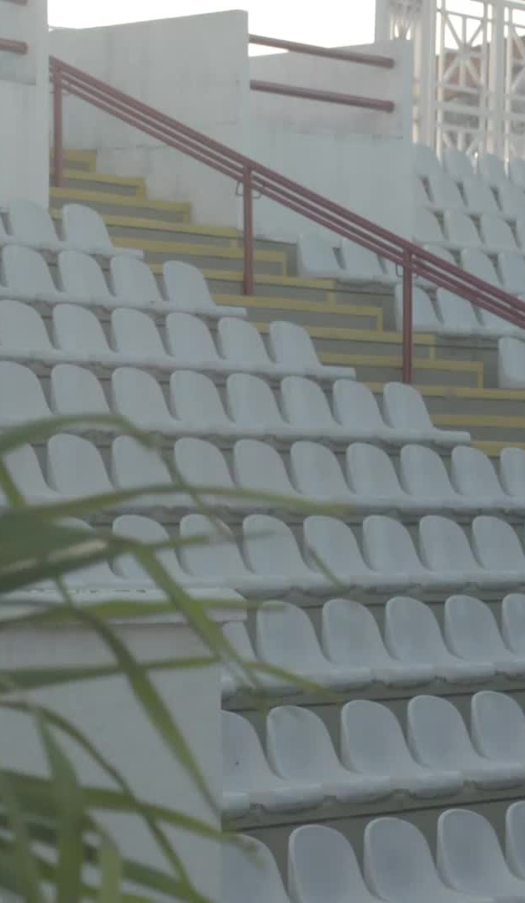
Name change
Swansea. Com stadium
Went into partnership with the ospreys
Plans to increase capacity to 40,000 making it possible for international fixtures

Slide 19
Naming rights
Task find out:
Why did the name change?
Who has the naming rights?
What benefits do they get from the change in name?

Slide 20
Swansea.com
Investment company.
Seven investment groups.
Real estate
Hospitality
Sport

Slide 21
Current investers of Swansea.com
Morgans hotel.
The Georgian Swansea.
Cwmdu Parc.
Parc Teifi.
Jaxx Bay LTD.
GCS chartered serveyors.
Swansea city AFC.
PureSwansea Academy.
2B Enterprising.
Marine Power Systems.

Slide 22
Swansea.com to Swansea city AFC
7 figure deal.
10-year deal, longer than other sponsorship deals.
Secures financial backing for the club.
Creates jobs for local people.
Plans for stadium exspansion.

Slide 23
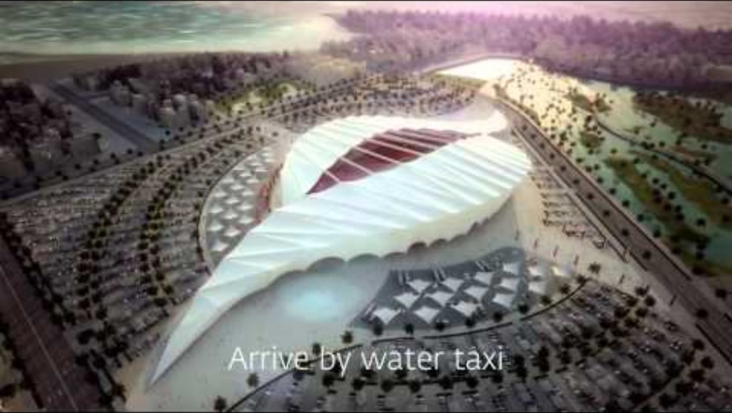
Modern Stadium - The Future
Qatar 2022 World Cup stadiums
http://www.youtube.com/watch?v=oM0Je0MLVI0

