Slide 1

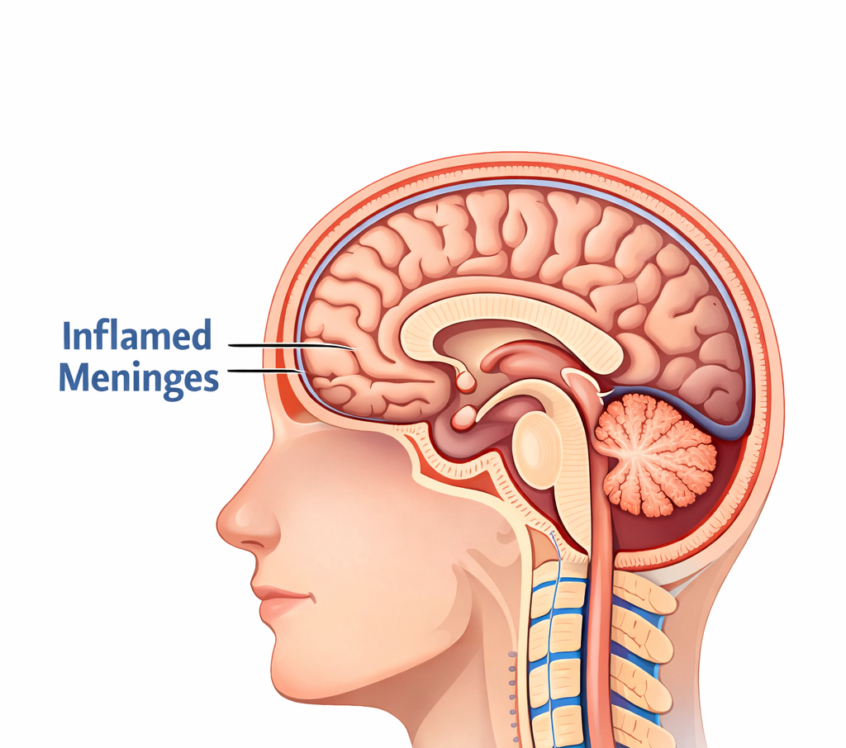
MENINGITIS
Brenda S R Marciano 2509114
fABIULA DOS reis 2513854
Gabriela Alves Harissis 2509668
GALAUS, MALIBIRAN ANNIEVER 2508028

Slide 2
Understanding The
Condition:
Definition and
Demographics:
Pathophysiology and Risk Groups
What is the Condition?
Meningitis is the inflammation of the meninges, the protective membranes surrounding the brain and spinal
cord.
It is primarily caused by bacterial or viral infections, though fungal and non-infectious causes exist. Bacterial
meningitis is a medical emergency requiring immediate intervention.
Who Gets the Disease More Often? (Target Demographics)
Infants and Toddlers: Their immune systems are still developing, making them the most vulnerable age group.
Adolescents and Young Adults: High transmission rates are seen in this group due to social behaviours and living
in close proximity (e.g., college dorms, boarding schools).
The Immunocompromised: Individuals with underlying health conditions or those lacking a functional spleen
are at significantly higher risk.
Level of Incidence:
Incidence varies globally; however, "outbreaks" are most common in crowded environments where respiratory
Gabriela Alves Harissis 2509668

Slide 3
Clinical Strategy and Prevention
Measuring Impact & The Role of Vaccination
Hospital Data and Surveillance:
Hospitals track "door-to-treatment" times to ensure rapid antibiotic delivery.
Data is used to monitor incidence levels and identify potential clusters or outbreaks in real-time.
The Importance of Morbidity Data:
Morbidity refers to the long-term illness or disability caused by the disease.
Tracking this is vital because survivors often face life-altering complications, including hearing loss, neurological damage, or limb
loss. This data helps healthcare systems plan for long-term rehabilitation needs.
Vaccine Efficacy:
High Protection: Conjugate vaccines (like MenACWY) are highly effective, preventing disease in over 90% of vaccinated individuals.
Herd Immunity Strategy: By vaccinating the "carriers" (mostly adolescents), the vaccine protects the wider community—
including infants and the elderly—by stopping the bacteria from circulating.
Gabriela Alves Harissis 2509668

Slide 4
Main Approaches and Strategies to Monitor an Infectious Disease Outbreak
Monitoring an infectious disease outbreak like meningitis requires a coordinated approach to track the spread, identify high-risk populations, and ensure prompt intervention. The key strategies include:
1. Surveillance Systems
Real-time Data Collection: Establish surveillance systems in healthcare settings, schools, and communities to track new cases of meningitis. This includes reporting suspected and confirmed cases to local health authorities.
Epidemiological Investigations: Conduct regular analysis to determine the geographic spread and demographic patterns of the disease. This can help identify any outbreaks early and understand who most at risk is.
2. Reporting Systems
Mandatory Reporting: Require healthcare professionals to report cases of meningitis to local public health authorities. This helps authorities to monitor the incidence rate and assess the severity of the outbreak.
Electronic Health Records: Utilize electronic health record systems to track patient cases, identify patterns, and alert public health agencies in case of a sudden increase in meningitis cases.
3. Laboratory Testing
Rapid Diagnostics: Implement rapid diagnostic tests in hospitals and clinics to confirm cases of meningitis. Early detection is crucial for effective intervention.
Pathogen Surveillance: Monitor the types of pathogens causing meningitis, such as Neisseria meningitidis, Streptococcus pneumoniae, and Haemophilus influenzae. This can help identify trends and anticipate outbreaks of specific strains.
4. Contact Tracing
Identifying Close Contacts: Identify and trace individuals who have come into close contact with infected patients. Offer vaccination or prophylactic antibiotics to prevent further spread, especially for bacterial meningitis.
FABIULA DOS REIS 2513854

Slide 5
Main Approaches and Strategies to Control an Infectious Disease Outbreak
Controlling an outbreak of meningitis involves a combination of medical interventions, public health measures, and community engagement to reduce transmission and manage the disease's spread.
1. Vaccination Programs
Targeted Vaccination: Vaccinate high-risk populations (e.g., infants, adolescents, and people in close living conditions like college dorms or military barracks) with meningitis vaccines (MenACWY, MenB, and Hib) to reduce the likelihood of future cases.
Mass Vaccination Campaigns: In the event of an outbreak, initiate mass vaccination campaigns in affected areas to quickly reduce the number of new infections.
2. Antibiotic Prophylaxis
Post-exposure Prophylaxis: For bacterial meningitis, administer antibiotics like rifampicin or ciprofloxacin to close contacts of infected individuals to prevent the spread of the disease.
Treatment for Suspected Cases: Ensure that individuals with suspected meningitis receive immediate antibiotic treatment, particularly for bacterial meningitis, to reduce mortality and complications.
3. Public Health Education
Raise Awareness: Educate the public, especially in schools and colleges, about the symptoms of meningitis (fever, headache, stiff neck, nausea, vomiting) and the importance of seeking prompt medical attention.
Promote Hygiene Practices: Encourage handwashing, covering coughs, and avoiding sharing personal items to reduce the transmission of meningitis-causing pathogens.
FABIULA DOS REIS 2513854

Slide 6
Main Approaches and Strategies to Control an Infectious Disease Outbreak
4. Isolation and Quarantine
Isolation of Infected Individuals: Ensure that individuals diagnosed with meningitis, especially bacterial types, are isolated to prevent further spread of the disease.
Quarantine Measures: In the case of a widespread outbreak, consider quarantining areas (e.g., school dormitories or other communal living spaces) to control transmission.
5. Healthcare System Preparedness
Strengthen Healthcare Capacity: Ensure that healthcare facilities are equipped to handle an increase in meningitis cases by having adequate staff, equipment, and treatment protocols in place.
Training and Support for Healthcare Workers: Train healthcare workers to recognize meningitis symptoms early, apply appropriate treatment, and manage an outbreak effectively.
6. Coordinated Government Response
Collaboration with Local Health Authorities: Work closely with local and regional health departments to coordinate responses, disseminate information, and implement control measures.
Public Health Alerts: Issue public health alerts and guidelines for managing and controlling the outbreak to ensure consistent action across communities.
FABIULA DOS REIS 2513854

Slide 7
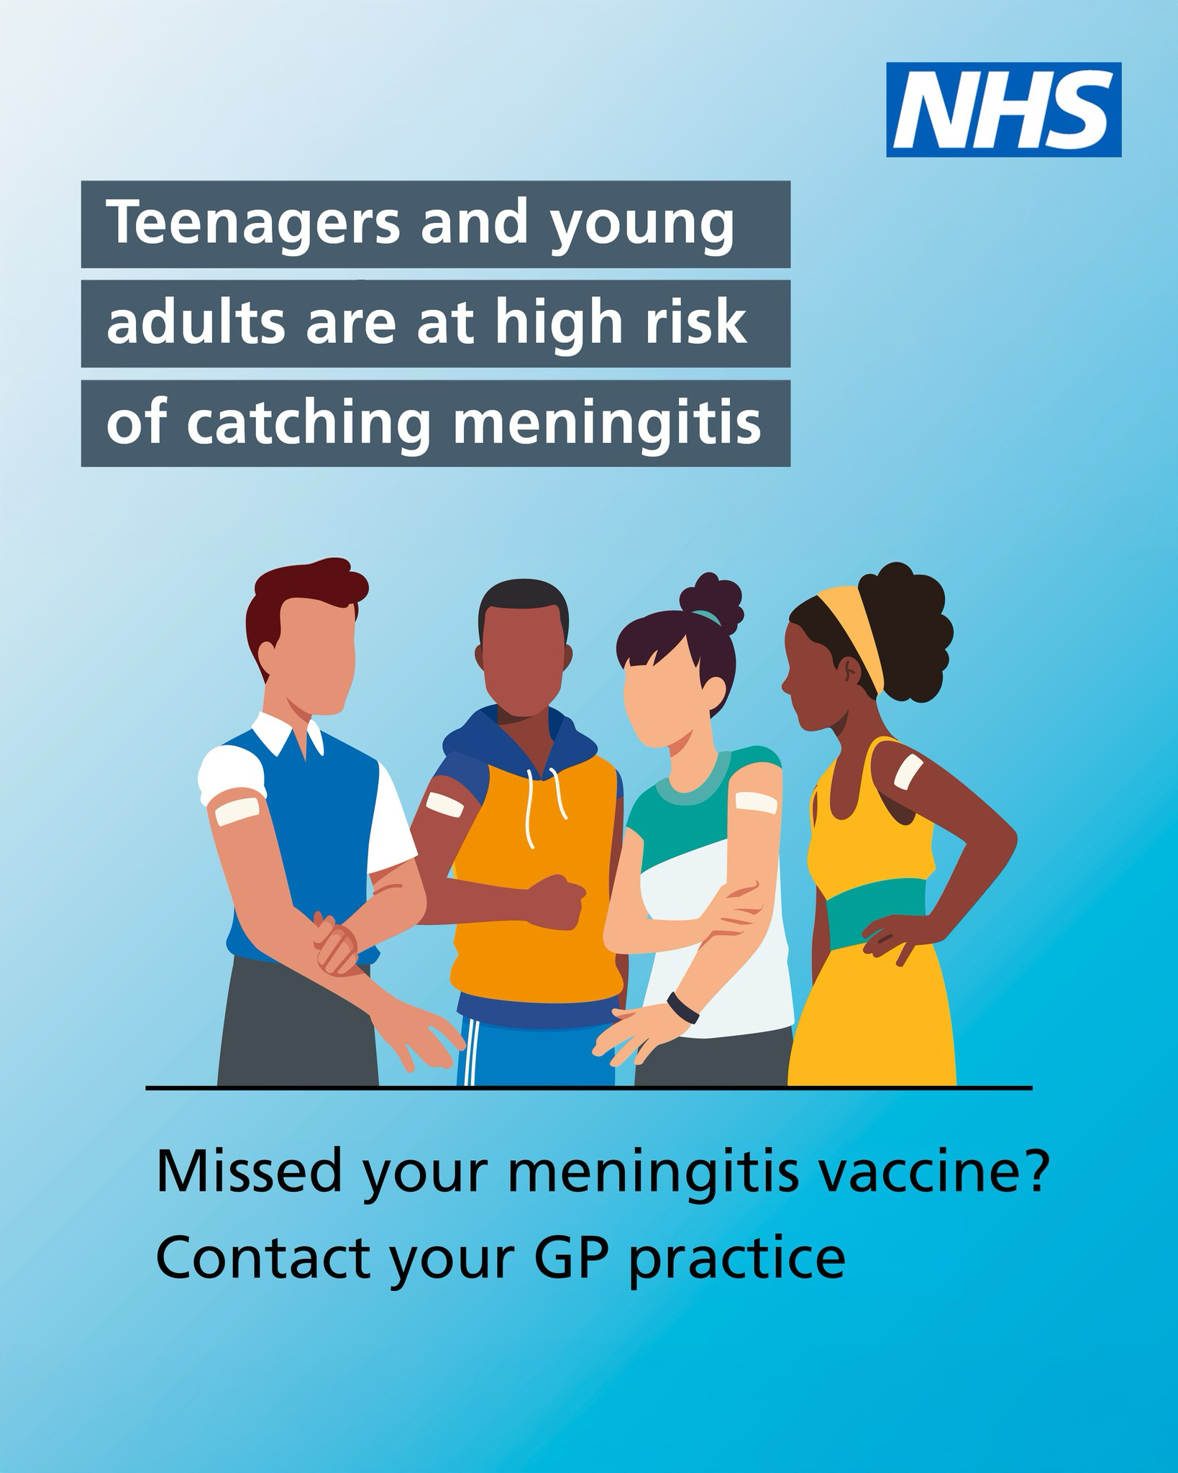
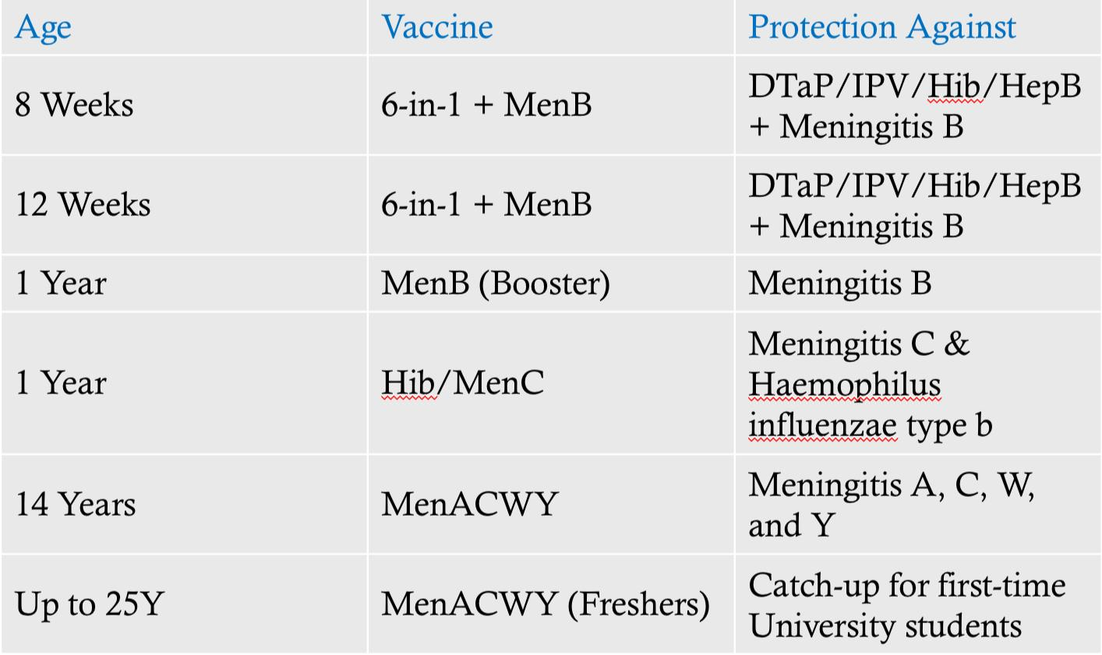
Uk policy and strategies about meningitis
Brenda S R Marciano 2509114

Slide 8
FACTORS INFLUENCING AND
WELL BEING
Biological factors
Children under the age of five are at higher risk for meningitis because their immune systems are not yet fully developed. Additionally, bacterial meningitis occurs more frequently in individuals under 20 years of age (Mayo Clinic, 2024).
Environmental factors
Living in crowded environments, such as college dormitories or military barracks, increases the likelihood of developing meningitis (Centres for Disease Control and Prevention, 2024).
Social factors
Early recognition of meningitis is crucial because its symptoms can be non-specific. Family members and caregivers play an important role in observing and identifying these early signs (NICE, 2024, as summarized in BMJ).
healthcare access is an important factor.
Access to timely diagnostics, including laboratory testing and cranial imaging, along with prompt treatment, is essential for effective meningitis care. Vaccination is emphasized as a key preventive measure against bacterial meningitis (World Health Organization, 2023).
GALAUS, MALIBIRAN ANNIEVER 2508028

Slide 9
HEALTH EDUCATION IN SCHOOL TO TEACH IN SCHOOL
Hygiene practices
Maintaining good hygiene, such as regular handwashing and cleaning of shared environments, is recommended to reduce the transmission of infectious diseases, including meningococcal infections (UK Health Security Agency, 2023).
Educational materials
The UKHSA provides leaflets and posters, such as “Meningitis: signs and symptoms,” to help teenagers and young adults, particularly new university students, recognize symptoms early (UK Health Security Agency, 2023).
Vaccination Awareness
“Vaccination is the key public health action to reduce the risk of infection” (NHS Scotland, 2024).
GALAUS, MALIBIRAN ANNIEVER 2508028

Slide 10
Reference List
Centers for Disease Control and Prevention (2024). Bacterial Meningitis.
Mayo Clinic, 2024
(NICE) (2024) Meningitis
NHS (2023). Meningitis.
NHS Scotland, 2024
(UKHSA) (2023)
World Health Organization (2023) Meningitis

