Slide 1
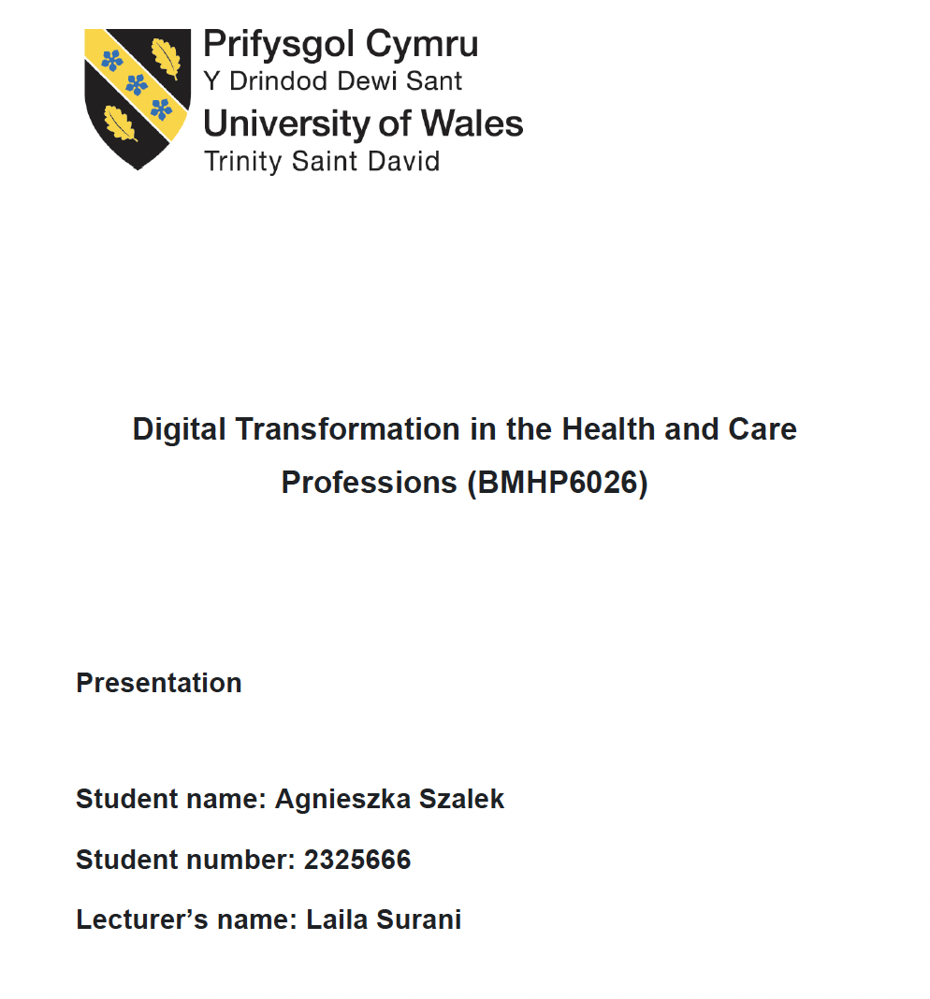

Slide 2
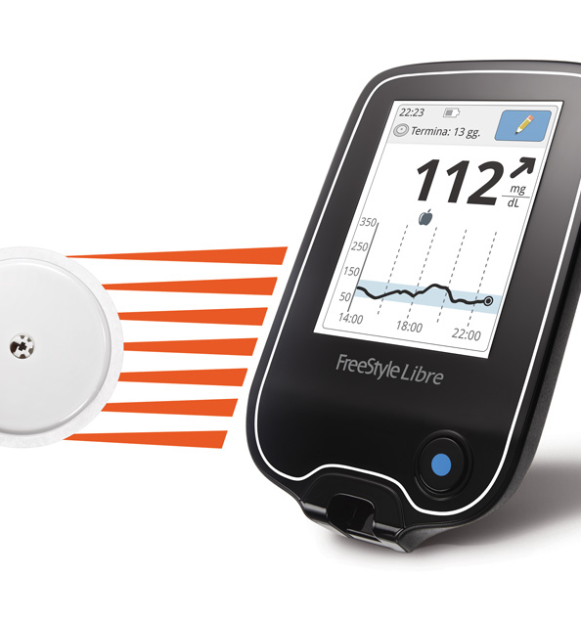
Introduction
The FreeStyle Libre is a flash glucose monitoring system that allows people with diabetes to continuously track their glucose levels using a small sensor worn on the upper arm.
4.3 million people in the UK have diabetes (Diabetes UK, 2023)
Finger-prick testing: painful and inconsistent
FreeStyle Libre: small sensor worn on the upper arm
Scans glucose levels instantly, no needles
Available on NHS since 2017 for Type 1 diabetes (NHS England, 2021)
This Photo by Unknown Author is licensed under CC BY-NC-ND

Slide 3

Impact on Workforce
Positives
Challenges
DSNs now interpret glucose trends, not just single readings
GPs receive richer data via LibreView reports
Pharmacists expanded their clinical role in diabetes care
Remote consultations became more focused and effective
No national training programme at rollout (Lawton et al., 2018)
Staff in Wales and northern England felt unsupported
DSNs managing hundreds of patients, no extra staffing
Technology used to increase workload, not improve care
Source: MS PowerPoint, 2026

Slide 4

Impact on Service Delivery
Positives
Challenges
Shifted care from reactive → proactive model
Continuous monitoring replaced 3–6 monthly HbA1c checks
Remote consultations improved with 2 weeks of trend data
Reduced outpatient backlogs (NHS England, 2021)
Vital during COVID-19 when face-to-face was restricted
LibreView not integrated with NHS patient records
Poor data sharing between primary and secondary care
Type 2 patients initially excluded, visible inequality in clinics
Sensor inaccuracies (e.g. affected by paracetamol)
No system for quick sensor replacements (Ajjan et al., 2019)
Source: MS PowerPoint, 2026

Slide 5

Impact on Patients
Positives
Challenges
Replaced up to 8 finger-prick tests per day
Patients felt empowered and in control
Better understanding of how food, stress and exercise affect glucose
Reduced fear of hypoglycemia
Patients became active in managing their own care
Older/less digitally confident patients struggled with the app
Many patients self-taught, no structured education
Skin reactions led some patients to stop using the device
Type 2 patients excluded from NHS prescription
Contradicts NHS principle of universal access (Diabetes UK, 2023)
Source: www.nhs.uk, 2026

Slide 6
Impact on Community
Fewer emergency admissions for hypoglycemia (Leelarathna et al., 2022)
Parents monitored children's glucose remotely via Libre Link app
Long-term: delays serious complications (retinopathy, nephropathy)
Rural patients received devices without adequate support
Deprived communities less likely to engage with digital tools (Kasturi et al., 2022)

Slide 7
Challenges of the Innovation
Rapid rollout without operational preparation
Assumed digital literacy not all patients have
No community or patient involvement in design (top-down approach)
Benefits not equally distributed across the population

Slide 8

Introduce national staff training before future rollouts
Expand eligibility to include Type 2 diabetes patients
Integrate LibreView with NHS digital systems
Provide patient education for less digitally confident users
Involve patients and communities from the start

Slide 9

FreeStyle Libre genuinely improved diabetes care and quality of life
Benefits were unequal, implementation was the problem, not the technology
NHS must plan workforce, equity, and engagement before rolling out future innovations

Slide 10

Question
&
Answer

Slide 11
References
Ajjan, R., Slattery, D. and Wright, E. (2019) 'Continuous glucose monitoring: a brief review for primary care practitioners', Advances in Therapy, 36(3), pp. 579–596.
Alfarwan, N., Alrasheed, A. and Almoayad, F. (2025) 'Demographic and socioeconomic disparities in telemedicine utilisation among individuals with Type 2 diabetes in primary care: systematic review and meta-analysis', Journal of Medical Internet Research, 27, e73113.
Bolinder, J., Antuna, R., Geelhoed-Duijvestijn, P., Kröger, J. and Weitgasser, R. (2016) 'Novel glucose-sensing technology and hypoglycaemia in Type 1 diabetes: a multicentre, non-masked, randomised controlled trial', The Lancet, 388(10057), pp. 2254–2263.
Cavan, D., Laughton, S. and Lalic, N. (2020) 'Digital health and diabetes: opportunities and challenges', Diabetes Research and Clinical Practice, 162, pp. 1–9.
Charleer, S., Mathieu, C., Nobels, F. and Gillard, P. (2018) 'Effect of continuous glucose monitoring on glycemic control, acute admissions, and quality of life: a real-world study', Journal of Clinical Endocrinology and Metabolism, 103(3), pp. 1224–1232.
Diabetes UK (2023) How many people in the UK have diabetes? Available at: https://www.diabetes.org.uk/about-us/about-the-charity/our-strategy/statistics (Accessed: 14 March 2026).
Haak, T., Hanaire, H., Ajjan, R., Hermanns, N., Riveline, J. and Rayman, G. (2017) 'Flash glucose-sensing technology as a replacement for blood glucose monitoring for the management of insulin-treated Type 2 diabetes', Diabetes Therapy, 8(1), pp. 55–73.
Kasturi, R., Tan, G., Knighton, P., Bashir, M. and Kar, P. (2022) 'The impact of socio-economic deprivation on access to diabetes technology in adults with Type 1 diabetes', Diabetic Medicine, 39(11), e14919.
Khunti, K., Aroda, V., Bhatt, D., Aschner, P. and Grunberger, G. (2021) 'The impact of the COVID-19 pandemic on diabetes services and glycaemic outcomes', Diabetes Care, 44(10), pp. 2182–2189.
Lawton, J., Blackburn, M., Allen, J., Campbell, F., Elleri, D., Leelarathna, L. and Rankin, D. (2018) 'Patients' and caregivers' experiences of using continuous glucose monitoring to support diabetes self-management: qualitative study', BMC Endocrine Disorders, 18(1), pp. 1–10.
Leelarathna, L., Evans, M.L., Neupane, S., Rayman, G., Lumley, S., Berthier, C. and Wilmot, E.G. (2022) 'Intermittent-scanned continuous glucose monitoring for Type 1 diabetes in routine clinical care: the FLASH-UK randomised controlled trial', The Lancet, 400(10352), pp. 610–620.
Maiorino, M., Signoriello, S., Maio, A., Chiodini, P., Bellastella, G., Scappaticcio, L. and Esposito, K. (2020) 'Effects of continuous glucose monitoring on metrics of glycemic control in diabetes: a systematic review with meta-analysis of randomized controlled trials', Diabetes Care, 43(5), pp. 1146–1156.
NHS Digital (2022) National diabetes audit. Available at: https://digital.nhs.uk/data-and-information/publications/statistical/national-diabetes-audit (Accessed: 14 March 2026).
NHS England (2021) Flash glucose monitoring — frequently asked questions for commissioners. Available at: https://www.england.nhs.uk/diabetes/digital-innovations-to-support-diabetes-outcomes/flash-glucose-monitoring/faqs-commissioners/ (Accessed: 14 March 2026).
Winter, G. (2019) 'Pharmacists' role in improving diabetes care', Journal of Prescribing Practice, 1(9), pp. 430–433.

