Slide 1
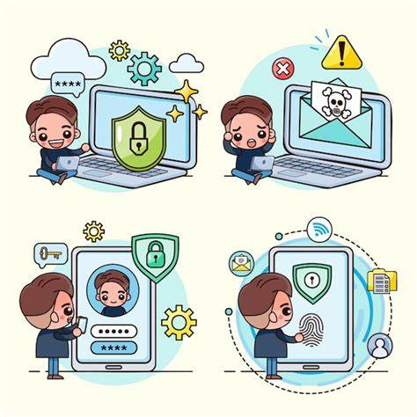
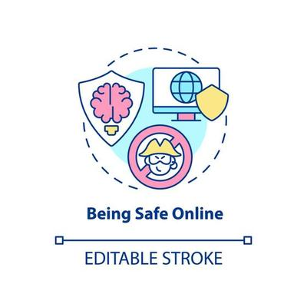
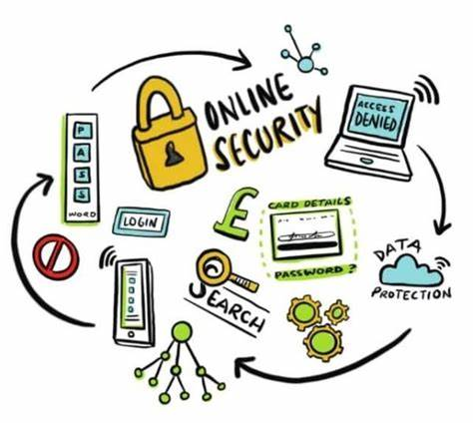
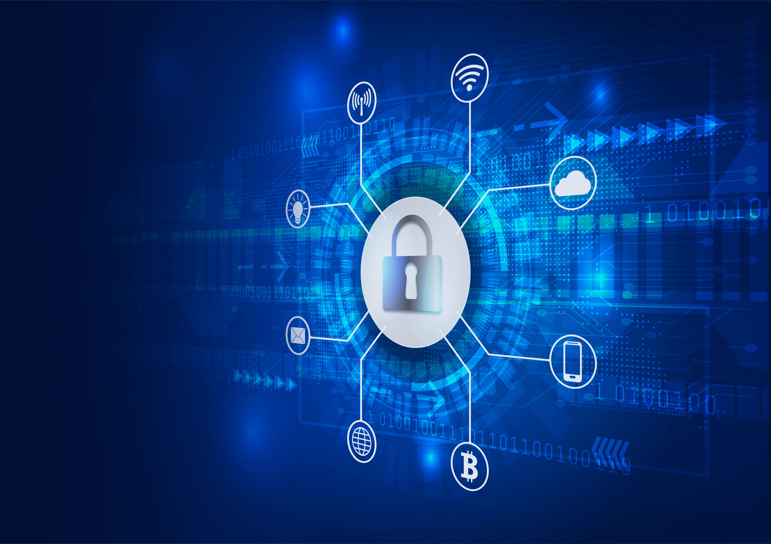
NAME : Sonia Lenuta Vinturache
SUDENT ID :2312687
MODULE NAME: Digital skills
MODULE CODE: LCLM 4002
LECTURER’S NAME :Koushik Modak
BASIC DIGITAL SAFETY
Basic digital is protecting yourself, your personal information, and your devices when using the internet or any digital technology, using like.
strong passwords
keeping software updated
Careful with links and email
Secure with Wi-Fi
Backing up your data
Protecting personal information
Using antivirus and firewalls
Strong passwords- is creating unique passwords with letters, numbers and symbol's to using the same passwords everywhere.
Keeping software updated-is to install, update for your apps, antivirus, and operating system to protect.
Careful with links and email- to don’t click on suspicious links or open attachments from unknown senders
Secure Wi-Fi -using public Wi-Fi without protection like a VPN, because its easy for hackers to spy on you
Backing up your data- regular save copies of important files to a secure location.
Protecting personal information- share only necessary information online and check privacy settings on social media
Using antivirus and firewalls- these tools help block harmful software and keep your devise safe.

