Slide 1

Working in team
Student name: Jovanny Herrera Cortes
Student ID: 2439224
Module name: Profressional Career Development withing Health and Social Care
Module code: LCHS 4009 LON
Lecturer name Dr. Amitave Banik

Slide 2
Acknowledgement of the use of AI
I confirm that I have not used any form of AI in my assignment. I confirm I have copies of my drafts, notes, and other resources I have used to prepare my assignment.

Slide 3

introduction
The Necessity of Collaboration: In modern practice, no single professional possesses the exhaustive range of expertise required to address every facet of a service user’s wellbeing.
A Holistic Framework: Effective teamwork facilitates a seamless partnership between nurses, social workers, and allied professional, which the primary driver for delivering person centred care.
Standardising Safety: By prioritising transparent communication and shared objectives, teams actively mitigate clinical risk and uphold the continuity of care championed by NHS England (2019).

Slide 4

Patient Care: Effective teamwork ensures that patients and service users receive coordinated, comprehensive care, reducing errors and improving outcomes.
Enhances Communication: Teamwork fosters clear communication among healthcare professionals, which is critical for sharing important information and making informed decisions.
Supports Multidisciplinary Collaboration: Health and social care often involve diverse professionals (nurses, doctors, social workers), and teamwork enables them to combine expertise for holistic care.
Importance of Teamwork in Health and Social Care
Improves Reduces Stress and Workload: Sharing responsibilities and supporting each other helps prevent burnout and ensures tasks are completed efficiently.
Promotes Learning and Development: Working in a team allows professionals to learn from each other, improving skills and fostering professional growth.

Slide 5
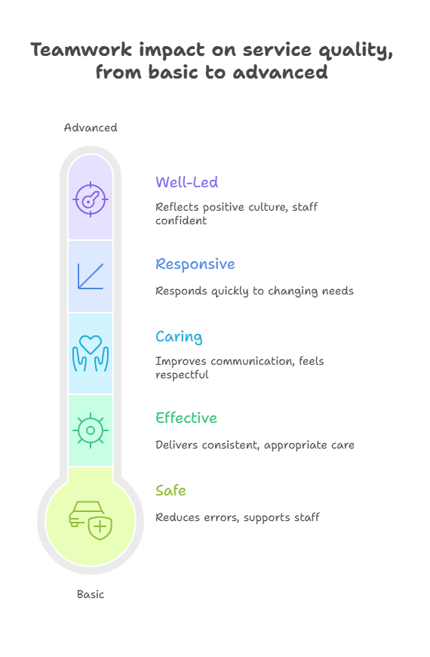
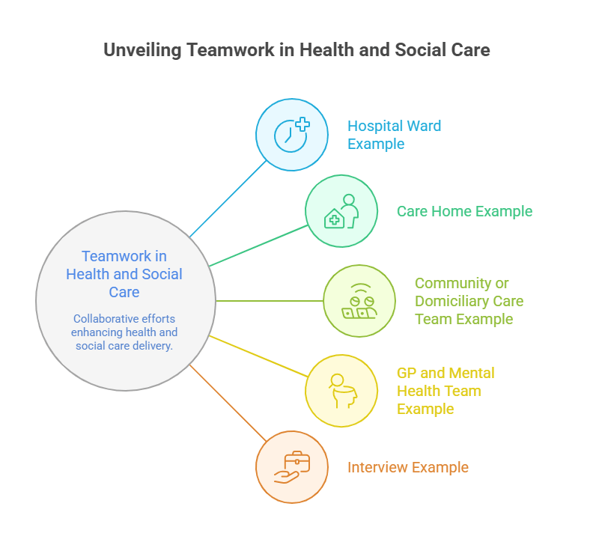
r
ROYAL OPEN COLLEGE ( January 9 2026 )

Slide 6
Practical example
Imagine a patient with chronic conditions. An effective MDT brings together GPs, district nurses, and social workers. According to the Social Care Institute for Excellence (SCIE, 2022), this collaboration generates a shared identity. It allows professionals to trust each other’s expertise and provide constructive feedback. This 'joined-up' approach ensures the patient receives person-centred care that addresses both their medical and social needs simultaneously, rather than as separate, disconnected services."

Slide 7
Conclusion
Fundamental Basis : Effective teamwork serves as the primary cornerstone for a modern, integrated Health and Social Care system.
Key Outcomes: Collaborative efforts are essential for ensuring patient safety, driving innovation and maintaining a person-centred approach.
Regulatory alignment: As the Care Quality Commission (CQC) implements it’s a new inspection framework, multi agency collaboration is considered “mission critical” for all services providers.
Multi- Disciplinary Approach: Effective team often consist of diverse professionals (doctors, social workers, occupational therapists) this diversity allows for a holistic view of a service user’s needs rather than just treating a single medical symptom.

Slide 8
Tuckman’s Model
This work is based on the working model of psychologist Bruce Tuckman developed in 1965, in which he describes the 5 steps to form a work group such as Forming, Storming, Norming, Presenting, and Adjourning.

Slide 9
References
NHS England: Working in partnership with the people and communities: available at: https://www.england.nhs.uk/long-read/working-in-partnership-with-people-and-communities-statutory-guidance/ (accessed: 18 February 2026).
Social care institute for excellence: Multidisciplinary Teams: available at https://www.scie.org.uk/integrated-care/multidisciplinary-teams/ (accessed: 18 February 2026)
Health and Fitness: The Roll of the Teamwork in Delivering effective Health and Social Care services: available at: https://uk.hfonline.org/the-role-of-teamwork-in-delivering-effective-health-and-social-care-services/ (accessed: 18 February 2026).
CQC’s new inspection framework: Collaboration, clarity, and the path forward: available at: https://www.vwv.co.uk/insights/articles/cqc-s-new-inspection-framework-collaboration-clarity-and-the-path-forward/ (accessed: 18 February 2026)
ROYAL OPEN COLLEGE: Teamwork in Health and Social Care: available at: https://royalopencollege.org/blog/health-and-social-care/teamwork-in-health-and-social-care/ (accessed: 18 February 2025)
NHS Wirral University Teaching Hospital: available at: https://www.wuth.nhs.uk/about-us/wuth-strategies/ (accessed at: 18 February 2026).
Notes:
9

Slide 10
References
NHS England (2019) The NHS Long Term Plan. London: NHS England. Available at: https://www.longtermplan.nhs.uk (Accessed: 23 February 2026).
Barton, G. and Bruce, A. (2015) Teaching interprofessional working in health and social care: A guide for educators and learners. London: SAGE. Available at: https://uk.sagepub.com/ (Accessed: 23 February 2026).
What is the team development: Causera enterprise: available at: https://www.coursera.org/enterprise/articles/team-development?msockid=2e18bcf08c0d6fe62b11aad58d2a6eb4 (Accessed 10 March 2026).
The 5 stages of Team development: Tuckman’s Model: Available at: https://instituteprojectmanagement.com/blog/the-5-stages-of-team-development/ (Accessed: 10 March 2026).

