Slide 1
COMMUNITY CARE AND DEVELOPMENT PROJECT
Student Name: Mabel Tiwaah Ankomah
Student ID: 1905514
Module Title: BMHP6022
Assessment title: Assessment Component 1 Viva Voce
Lecturer Name: Chizoba Esio-Bassey

Slide 2
INTRODUCTION
What is a community: It is a group of people living in the same area or setting (geographical or virtual) with a common interest such as social or health (NICE, 2017).
Community development is a process when individuals act together on their priorities (SCDC,2022).
Importance of community project: It enhances the quality of life, reduces crime and boost the economy (Straza, 2018).

Slide 3
LAMBETH COMMUNITY
1/2
FOCUS COMMUNITY
Lambeth is a London borough located in South London, England.
Lambeth's population increased by 4.8% between 2011 and 2021, from 303,100 to 317,600(Office of the National Statistics, 2022).
Lambeth is a densely populated area and classified as the 11th poorest borough in London.
Crime rate is high, Lambeth is one of London's top ten most dangerous boroughs (CrimeRate, 2022).
Lambeth has a diverse population; 63% of the population is non-White British; 150 languages are spoken as a first language (Crompton, 2022).

Slide 4
LAMBETH COMMUNITY
2/2
Young people make up 61% of the population and over 60 is 13% (Crompton, 2022).
Average life expectancy in Lambeth is 80 years .Females have life expectancy of 83 and 78 years for males (Varbes, 2021).
23 % of residents in the most deprived areas of Lambeth suffer from different long-term health conditions (Impact on Urban Health., 2021).
Dementia is the main cause of death in the UK. (Alzheimer Research UK, 2021).

Slide 5
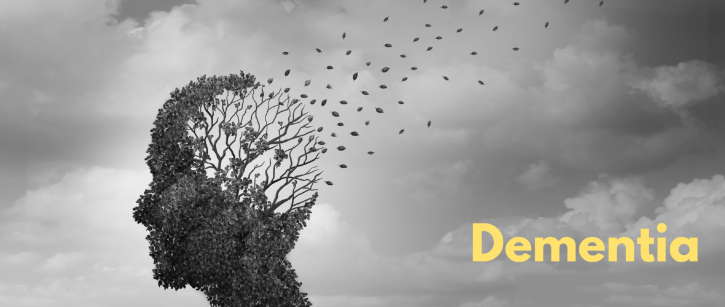
Dementia 1/2
Dementia is a general term for a range of progressively conditions that affect the brain.
Each kind of dementia affects a person's capacity to remember, think, and communicate by preventing certain brain cells (neurons) from functioning normally.
Memory loss, confusion, understanding problems and mood fluctuations are common dementia symptoms.
Dementia can affect anyone, but it is more common after 65 years.
Dementia has 200 subtypes: Alzheimer's, vascular, Lewy body, frontotemporal, and mixed dementia are the most common. (Dementia UK, 2021).
(Age exchange, 2022)

Slide 6
DEMENTIA 2/2
Prevalence :
Currently,900,000 people have dementia in the UK estimated to rise to 1.6million by 2040 (Alzheimer's Society, 2021b).
About 2000 dementia patients live in Lambeth borough (Lambeth Council, 2022).
Ageing is a risk factor for dementia; As individuals age, their risk of dementia increases (Alzheimer's Society, 2021a).
The annual cost of dementia in UK £34.7 billion on dementia care Estimated to climb to £94.1 billion by 2040 (Alzheimer's Society, 2019b).

Slide 7
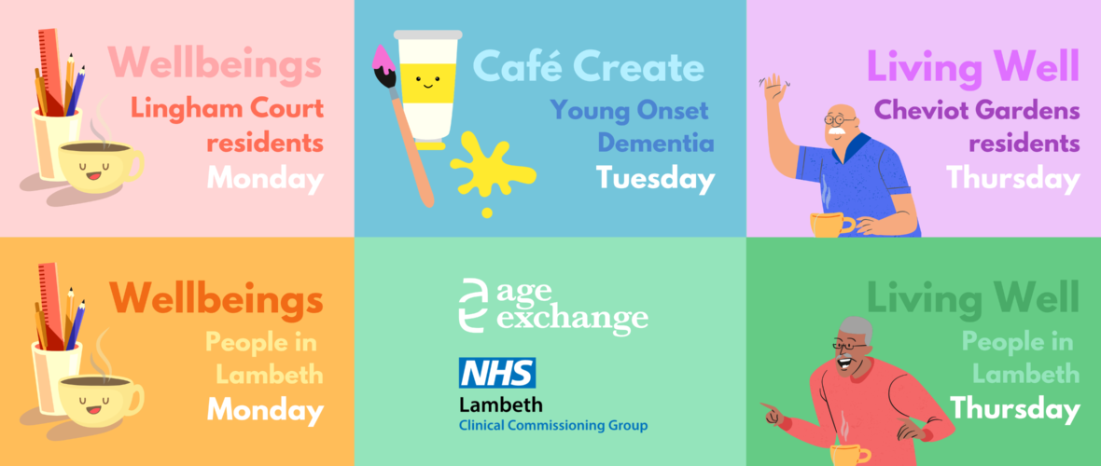
LAMBETH DEMENTIA PROJECT
The project is an awarded contract to Age exchange charity organization in 2019 (Age Exchange, 2022b).
Age Exchange is a UK's first reminiscence and intergenerational arts charity, created in 1983 (Age Exchange, 2022c).
The project was Funded by Lambeth Clinical Commissioning Group ( NHS, 2022).
Aims:
To enhance the quality of life and care for elderly and dementia patients.
To minimize loneliness and isolation. To aid caregivers in maintaining their own health and wellness (Age Exchange, 2022c).

Slide 8
AGE EXCHANGE LAMBETH SERVICES
Activities:
Wellbeing: It offers dementia patients and their caregivers with support, interaction, and activities.
Living well: People with dementia and their caregivers participate in pleasant reminiscence arts activities.
Café Create: the third service provided by Lambeth, is for persons with young-onset dementia and their caregivers. Cafe create provide young people affected by dementia with the opportunity to interact with others in a similar situation (age-exchange, 2022).

Slide 9
POLICIES
Care Act 2014 : Safeguarding -Due to the nature of their disease, dementia patients may be vulnerable to physical, financial or neglect abuse (SCIE, 2020).
Equality Act 2010: People with disabilities are frequently shunned by their community and excluded from many services (GOV.UK, 2010; Humanity-Inclusion, 2022).
Data Protection Act 2018 – Personal data of participants must not be shared to third parties (Alzheimer’s society,2022a; GOV.UK, 2018).
The Human Rights Act 1998 : Freedom of expression and freedom of assembly gives the right of associating (Equality and Human Rights Commission, 2018).

Slide 10
THEORIES
Abraham Maslow's hierarchy of needs
Maslow's hierarchy of needs is a theory of motivation that asserts that
five kinds of human needs determine an individual's actions (Cherry, 2022).
Physiological needs- Dementia patients need good nutrition and environment
Security and safety needs- Good healthcare, financial support and monitoring devices to prevent falls and injuries.
Love and belonging needs- Dementia patients are dependent and so need love and acceptance by others as social beings.
Esteem needs- They need respect and dignity to feel that they are valued by others.
Self-actualization- With good treatment and care, they can live comfortably (Cherry, 2022).

Slide 11
DISCRIMINATION FOR DEMENTIA PATIENTS
People with dementia can be treated unfairly or in ways that go against their human rights due to their condition.
Lack of ability to question and report incidents
Sometimes discrimination is entrenched in the design and delivery of community care and support services (Alzheimer's Society, 2010).
When a person is diagnosed with dementia, he or she may experience stigma or prejudice, with others treating him or her differently, and sometimes poorly (Dementia UK, 2022).

Slide 12
TECHNOLOGY & SOCIAL MEDIA
Email, internet services such as Skype, and social media are affordable and advantageous alternatives for persons with dementia and their caregivers to connect with loved ones (SCIE, 2017).
Age exchange use Instagram, Facebook and Twitter – to raise funds and give updates of their activities (Age Exchange, 2022e).
Assistive technology devices helps dementia patients to do many things like monitoring, prompting and remembrance (Alzheimer's society, 2019e).

Slide 13
SUSTAINABILITY
Contract with Lambeth Clinical Commissioning Group ( NHS, 2022).
Donations from different organizations and sponsorship from the Lambeth council can sustain the project.
Affiliated with the NHS, Amazon and Alzheimer’s society.
Campaigns by many volunteers.
Fundraisers (Age Exchange, 2022e).

Slide 14
BARRIERS AND CHALLENGES
Communication : Language barriers – Lambeth is mixed culture or divers’ population residents might find it difficult to communicate with people who have difficulty to speak due to their condition (Crompton, 2022).
Lack of infrastructure: Dementia patients need a conducive place with no distractions so they can concentrate.
Political Instability: It can affect the funding of the project because policies and regulations are often affected by a rampant change of government (Hussain, 2014).

Slide 15
CONCLUSION
Community is a group of people with a common goal
Community development is beneficial to both the nation and individuals
There is a higher prevalence of dementia with about 200 residents being affected in Lambeth.
Age Exchange projects activities can enhance the quality-of-life of dementia patients.
There are policies and theories designed to protect vulnerable people from the community.

Slide 16
THANK YOU.
Any questions?

Slide 17
References
Age Exchange (2022a) Dementia | Age Exchange [Online]. Available at https://www.age-exchange.org.uk/who-we-are/dementia/ (Accessed 2 August 2022).
Age Exchange (2022b) Services for People Living with Dementia in Lambeth | Age Exchange [Online]. Available at https://www.age-exchange.org.uk/lambeth-services/ (Accessed 2 August 2022).
Age Exchange (2022c) Our Story | Age Exchange [Online]. Available at https://www.age-exchange.org.uk/who-we-are/ (Accessed 2 August 2022).
Age Exchange (2022d) Age Exchange | Team London [Online]. Available at https://www.london.gov.uk/what-we-do/volunteering/search/age-exchange (Accessed 1 August 2022).
Age Exchange (2022e) Support Us | Age Exchange [Online]. Available at https://www.age-exchange.org.uk/support-us-update/ (Accessed 3 August 2022).
age-exchange (2022) Services for People Living with Dementia in Lambeth | Age Exchange [Online]. Available at https://www.age-exchange.org.uk/lambeth-services/ (Accessed 2 August 2022).
Alzheimer Research UK (2021) Deaths Due to Dementia [Online]. Available at https://www.dementiastatistics.org/statistics/deaths-due-to-dementia/#:~:text=Dementia%20is%20the%20leading%20cause (Accessed 1 August 2022).

Slide 18
References
Alzheimer's Society (2010) Alzheimer’s Society’s View on equality, discrimination, and Human Rights [Online]. Available at https://www.alzheimers.org.uk/about-us/policy-and-influencing/what-we-think/equality-discrimination-human-rights (Accessed 3 August 2022).
Alzheimer's Society (2019a) How Many People Have Dementia and What Is the Cost of Dementia care? [Online]. Available at https://www.alzheimers.org.uk/about-us/policy-and-influencing/dementia-scale-impact-numbers (Accessed 20 July 2022).
Alzheimer's Society (2019b) Facts for the Media [Online]. Available at https://www.alzheimers.org.uk/about-us/news-and-media/facts-media.
Alzheimer's Society (2019c) What Is Assistive technology? [Online]. Available at https://www.alzheimers.org.uk/get-support/staying-independent/what-assistive-technology (Accessed 3 August 2022).
Alzheimer's Society (2021aa) What Can Increase a person’s Risk of dementia? [Online]. Available at https://www.alzheimers.org.uk/about-dementia/risk-factors-and-prevention/what-can-increase-persons-risk-of-dementia (Accessed 1 August 2022).
Alzheimer's Society (2021b) How Many People Have Dementia in the UK? | Alzheimer’s Society [Online]. Available at https://www.alzheimers.org.uk/blog/how-many-people-have-dementia-uk (Accessed 5 August 2022).
Alzheimer's Society (2022a) Legal Information | Alzheimer’s Society [Online]. Available at https://www.alzheimers.org.uk/legal-information (Accessed 14 July 2022).
Alzheimer's Society (2022e) Dementia Support Lambeth | Alzheimer’s Society [Online]. Available at https://www.alzheimers.org.uk/support-services/Lambeth+Local+Services/Dementia+Support+Lambeth/regional?gclid=Cj0KCQjw0JiXBhCFARIsAOSAKqBV5VmOscDKb6WrxN3JBjbet9SRT8QaLv-nhrkpZMa1vU-nhn1T1aUaAl5BEALw_wcB&gclsrc=aw.ds (Accessed 31 July 2022).

Slide 19
References
Cherry, K. (2022) The Five Levels of Maslow’s Hierarchy of Needs [Online]. Available at https://www.verywellmind.com/what-is-maslows-hierarchy-of-needs-4136760 (Accessed 4 August 2022).
CrimeRate (2022) Lambeth Crime and Safety Statistics [Online]. Available at https://crimerate.co.uk/london/lambeth#:~:text=Crime%20and%20Safety%20in%20Lambeth&text=Lambeth%20is%20among%20the%20top (Accessed 31 July 2022).
Crompton, J. (2022) Summary -Lambeth Population, [Online]. Available at https://moderngov.lambeth.gov.uk/documents/s135820/Appendix%201%20Scrutiny_COVID19_Inequalities_22022022.pdf (Accessed 31 July 2022).
Dementia UK (2021) What Is dementia? [Online]. Available at https://www.dementiauk.org/about-dementia/dementia-information/what-is-dementia/ (Accessed 31 July 2022).
Dementia UK (2022) Dealing with Stigma and Discrimination against People Affected by Dementia [Online]. Available at https://www.dementiauk.org/get-support/living-with-dementia/dealing-with-stigma/ (Accessed 1 August 2022).
Equality and Human Rights Commission (2018) The Human Rights Act | Equality and Human Rights Commission [Online]. Available at https://www.equalityhumanrights.com/en/human-rights/human-rights-act (Accessed 28 July 2022).
GOV.UK (2010) Equality Act 2010 [Online]. Available at https://www.legislation.gov.uk/ukpga/2010/15/contents (Accessed 31 July 2022).
GOV.UK (2018) Data Protection Act [Online]. Available at https://www.gov.uk/data-protection (Accessed 20 July 2022).

Slide 20
References
GOV.UK (2018) Data Protection Act [Online]. Available at https://www.gov.uk/data-protection (Accessed 20 July 2022).
humanity-inclusion (2022) Disability rights [Online]. Available at https://humanity-inclusion.org.uk/en/action/disability-rights?gclid=Cj0KCQjwuaiXBhCCARIsAKZLt3n8jaE1u8fGQAkPqaJMk1MCX_WDoDn4tffQ_eHyq9yFxy_N1le9R68aAlHoEALw_wcB (Accessed 3 August 2022).
Hussain, Z. (2014) Can Political Stability Hurt Economic growth? [Online]. Available at https://blogs.worldbank.org/endpovertyinsouthasia/can-political-stability-hurt-economic-growth (Accessed 3 August 2022).
Impact on Urban Health. (2021) Health Inequity in Lambeth [Online]. Available at https://urbanhealth.org.uk/insights/reports/health-inequity-in-lambeth#:~:text=Multiple%20long%2Dterm%20conditions%20are%20an%20inequity%20issue&text=More%20than%20one%20in%20five (Accessed 3 August 2022).
Lambeth Council (2022) Dementia | Lambeth Council [Online]. Available at https://beta.lambeth.gov.uk/adult-social-care-and-health/adults-and-older-people/living-disability-or-illness/dementia (Accessed 30 July 2022).
National Health Service (2022) Lambeth CCG [Online]. Available at https://myhealth.london.nhs.uk/ccg/lambeth-ccg/ (Accessed 2 August 2022).

Slide 21
References
National Institute for Health and Care Excellence (2017) Quality Statement 1: Identifying Local Priorities | Community engagement: Improving Health and Wellbeing | Quality Standards | NICE [Online]. Available at https://www.nice.org.uk/guidance/qs148/chapter/Quality-statement-1-Identifying-local-priorities#definitions-of-terms-used-in-this-quality-statement (Accessed 31 July 2022).
Office of the National Statistics (2022) How the Population Changed in Lambeth, Census 2021 - ONS [Online]. Available at https://www.ons.gov.uk/visualisations/censuspopulationchange/E09000022/ (Accessed 31 July 2022).
Pinkus, R. T. (2020) ‘Love and Belongingness Needs’, Encyclopedia of Personality and Individual Differences, pp. 2694–2697 [Online]. DOI: 10.1007/978-3-319-24612-3_1487.
Scottish Community Development Centre (2022) What Is Community development? [Online]. Available at https://www.scdc.org.uk/who/what-is-community-development#:~:text=Community%20development%20is%20a%20process (Accessed 31 July 2022).

Slide 22
References
Social Care Institute for Excellence (2017) Dementia: Using Technology to Keep in Touch - SCIE [Online]. Available at https://www.scie.org.uk/dementia/support/technology/keep-in-touch?gclid=Cj0KCQjwuaiXBhCCARIsAKZLt3mHfnwgKS3Ve3wzDZJZqEcteHAl-k7ma3YmHSnQXSR1bwlG7AIV0FsaAn4wEALw_wcB (Accessed 3 August 2022).
Social Care Institute for Excellence (2020) Safeguarding People with Dementia - SCIE [Online]. Available at https://www.scie.org.uk/dementia/after-diagnosis/support/safeguarding.asp?gclid=Cj0KCQjw852XBhC6ARIsAJsFPN3nkrPmWMG3bFiVC6NGJu2e8po3VuxLsz4eY-ueMkgJ3p1sHpraS8EaApKvEALw_wcB (Accessed 28 July 2022).
Straza, M. (2018) Community Development: What it is, its Importance, and How to Contribute in Your City [Online]. Available at https://www.consultstraza.com/community-development-what-it-is-its-importance-and-how-to-contribute-in-your-city/#:~:text=When%20community%20development%20is%20effective (Accessed 28 July 2022).
Varbes (2021) Lambeth Demographics | Age, Ethnicity, Religion, Wellbeing [Online]. Available at https://www.varbes.com/demographics/lambeth-demographics (Accessed 30 July 2022).

