Slide 1

The Future is Human
Unit 2 of Contemporary Challenges: Making a Difference

Slide 2

The Future is Human
In this unit you will focus on developing the uniquely human skills that will allow you to remain relevant in the future of work, in the face of increasing automation.

Slide 3

Human Skills
In 'Rise of the Machines' you considered how the future may look as machines and AI are integrated into the workplace.
In Unit 2 and Unit 3 we will look at some of the skills that will differentiate humans in the future of work. Bursting the Bubble - Critical thinking
Getting to Yes - Negotiating and Influencing
Why are we Yelling? -Conflict management
Critical thinking
The Red Pill or the Blue Pill - Decision making
Change by Design - Complex problem solving (unit 3)

Slide 4

Topic 2 – Why are we Yelling
Conflict management is an umbrella term for the way we identify and handle conflicts fairly and efficiently.
The goal is to minimize the potential negative impacts that can arise from disagreements and increase the odds of a positive outcome.

Slide 5
What is conflict?
A clash between individuals arising out of a difference in thought process, attitudes, understanding or interests.
  Not all conflict is negative - creative solutions and new ideas can often emerge from debate
  Conflict is often destructive. This can have an adverse effect on performance. If ignored, conflict can escalate or spread to affect others. E.g. negative emotions may be stirred up, bad atmosphere, undermining morale, creating stress and destroying workplace relationships

Slide 6
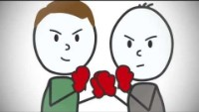

Slide 7
Conflict
Can be costly in terms of time and money. It is therefore vital to manage conflict constructively.
May be expressed openly, but it may also be hidden, in the form of irritation, resentment, loss of morale and lack of commitment.
  Hidden conflict is easy to miss and therefore can be particularly damaging. If nothing is done to address the underlying issues, conflict may escalate.
Consequences can often be prevented by taking early action to address conflict issues.

Slide 8
Where is conflict likely to occur in a business setting?
Discuss some scenarios where conflicts could occur.
Share your thoughts with the group.

Slide 9
Where is conflict likely to occur in a business setting?
Differences of opinion, dissatisfaction with working conditions or remuneration, excessive workloads, lack of recognition or promotion, perceptions of discriminatory or unfair treatment, feelings of insecurity, fear of redundancy, clashes of personality, misunderstandings or breakdowns in communication and differing expectations of what constitutes appropriate behaviour - to name but a few.

Slide 10
Consequences of Conflict
Conflicts inevitably pop up when you spend time with other people, whether at work or home. However, when conflicts aren’t resolved, they can lead to various negative consequences. These include:
Hurt feelings
Resentment and frustration
Loneliness and depression
Passive aggression and communication issues
Increased stress and stress-related health problems
Low morale
Reduced productivity
Staff turnover

Slide 11
Conflict Management
Disagreements can be unpleasant, and not every dispute calls for the same response.
To enhance your employability skills you can learn to choose the right conflict management style, and you'll be better able to respond constructively whenever disputes arise.

Slide 12
What is conflict management?
Conflict management refers to the way that you handle disagreements.

Slide 13
Class Task
Think of a recent example of a conflict situation you faced
What was the conflict about?
How did you manage the conflict?
Did you resolve the conflict?
What techniques did you use?

Slide 14
Conflict Management Styles
Everyone develops their own approach to conflict - their ‘conflict management style’
Our conflict management style is based on:
  Our personality
  Our early life experiences
  Our level of authority
  The relationship situation
  It is reinforced through our life experiences

Slide 15
Conflict Management Styles
Most people rely on a preferred conflict management style
  This can be a strength because we have experience with it
  But, it can also be weakness if we don’t use the appropriate management conflict style for a situation
There is no BEST way to deal with conflict – different situations and people will require different approaches
As a business manager you will need to develop good a conflict management style

Slide 16
Conflict Management Styles
It's human to deal with conflict by defaulting to what's comfortable.
Most people take one of two approaches to conflict management, assertiveness or cooperativeness (Thomas & Kilmann, University of Pittsburgh)
From these approaches come five modes or styles of conflict management:

Slide 17
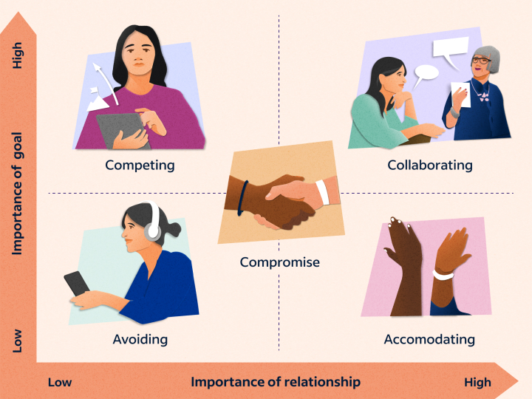
Thomas, Kilmann Conflict Management Styles

Slide 18
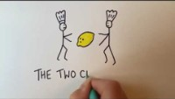
Task: Two chefs are fighting over the last lemon in the kitchen. Both need the lemon to make their dish. How could the conflict be solved using each of the Thomas, Kilmann Conflict Management Styles?

Slide 20
Two Chef’s and a Lemon
https://www.youtube.com/watch?v=7YuJPYlsz30

Slide 21
1. Avoiding Style
When avoiding, you try to bypass or delay resolving a conflict. You might physically separate the opposing parties or remove yourself from the situation altogether.
Often, the deliberate delay will cause unresolved conflict to cause resentment and frustration among employees.
Conversely, in other situations, it can give both parties time to potentially readjust their attitudes and perspectives and the conflict could resolve on its own.

Slide 22
1. When to consider using the Avoiding Style
When you’re undecided on how to proceed and need time to think through the disagreement
When you don’t have the resources to devote immediately
When involved parties are experiencing high tension
When it has caused distraction from team productivity
When you have more pressing problems to deal with first.
When the risks of confronting a problem outweigh the benefits.
Example: Josh and Allison disagree on the best plan for implementing a new advertising campaign. They have tried to find a compromise, but their disagreement is becoming angrier and more distracting each minute.
Their supervisor tells them to set the campaign aside and work on other projects for the rest of the day. Taking a break from the project gives both Josh and Allison time to work through the conflict on their own. They continued working on the campaign the next morning with more positive and collaborative attitudes.

Slide 23
2. Competing Style
When you use a competitive conflict management style, you put your own needs and desires over those of others.
The goal of the competing style is to end the conflict as quickly as possible.
While the competing style may get fast results, it can also be detrimental to the morale and productivity of a team. If you always compete with others rather than compromise, you may stifle helpful input from your co-workers and damage your workplace relationships.
Sometimes needed when you are in a higher position of power than other parties and need to resolve a dispute quickly.

Slide 24
2. When to Consider Using the Competing Style
When another conflict management approach has not been successful
When no positive change has occurred after some time
Example: Peter has worked at the Swansea Electric company for sixteen years. He’s good at his job and rarely needs input from his supervisors. Jack is a recent hire and has needed extensive training.
While Peter is showing a process to Jack, Jack suggests an alternate method. Instead of considering Jack’s idea or taking the time to explain the logic behind the current method, Peter ends the conversation abruptly and tells Jack to just follow his instructions. Jack has done nothing technically wrong, but he now feels belittled and ignored.

Slide 25
3. Accommodating Conflict Management Styles
The opposite of the competing style, it resolves the conflict by giving in to the opposing party.
When you use this style, you resolve the disagreement by sacrificing your own needs and desires for those of the other party. You might need to use an accommodating conflict style when interacting with someone with a strong personality.
This management style might benefit your work when conflicts are trivial and you need to move on quickly or to avoid damaging a relationship
Acknowledging and accepting someone else’s views or perspectives is an important part of teamwork, especially when the other party is an expert or more experienced than you. However, it is also crucial for you to know when accommodating someone else might be detrimental to you or your team’s best interest.

Slide 26
3. When to consider using the Accommodating Style
When you can’t come to a resolution
When your peer is more concerned with the conflict than you
When you’re mistaken or your peer is more experienced
When productivity has been affected negatively by the conflict
Example: Jill loves working at her local fitness centre. She enjoys her job and gets along with all her co-workers except for one. Maddie has a strong personality and does not like to be told “no.” Maddie tries to take advantage of Jill’s accommodating personality by pressuring her into swapping shifts. Jill does not appreciate Maddie’s actions, but she also does not want to introduce additional tension into her workplace. She agrees to swap with Maddie to keep the peace.

Slide 27
4. Compromising Conflict Management Styles
Compromising demands moderate assertiveness and cooperation from all parties involved.
With this type of resolution, everyone gets something they want or need but also make sacrifices so neither side gets exactly what they want .
Ideally, after compromising on one or more minimal issues, both parties could then agree on the larger issue. This can foster short-term productivity, but it rarely completely solves the underlying problems.
Because of time constraints, compromising isn't always as creative as collaborating, and some parties may come away less satisfied than others.

Slide 28
4. When to consider using the Compromising Style
When you need an immediate solution that may be temporary
When productivity starts to be impaired by the time the conflict is taking
When there is no solution both will be happy with
When you want to promote more team collaboration
Example: The profits from Everett and Brian’s pet shop business have grown significantly in the last six months. They disagree on how to make the best use of their newly increased savings. Everett wants to expand the pet shop’s inventory by 20 percent, while Brian wants to increase the budget for local advertising by 15 percent.
After arguing for several days, Brian suggests that they increase both budgets by just 10 percent. Neither party is particularly satisfied with this option, but they compromise to quickly move past the conflict.

Slide 29
5. Collaborating Conflict Management Styles
Needs a high level of cooperation from all parties involved.
As opposed to the compromising style’s “lose-lose” solutions, the collaborating style seeks to produce “win-win” results. The collaborating style tries to find a solution that truly satisfies everyone involved. If you want to use collaborating style, you will need to listen and communicate with both parties involved in the conflict.
After taking the time to understand both sides of the issue, you will need to facilitate both parties negotiating a solution together. Implementing this style can often be time and labour-intensive, but it frequently produces the most satisfying long-term results. The collaborating style is an important asset if you are seeking to create and maintain successful professional relationships.

Slide 30
5. When to consider using the Collaborating Style
When several people will be impacted by the resolution
When all parties have the same power level
When it involves an important relationship
When you have time
When the interests of all involved parties need to be considered
Example: Maggie owns a ballet studio that is managed by her best friend Pat. Maggie and Pat usually agree on almost all business-related decisions. However, Pat disagrees with Maggie regarding which job applicant they should hire as the new dance teacher.
As the owner, Maggie has the authority to overrule Pat’s opinion. However, she chooses to sit down with Pat and discuss a solution that will please them both. After several weeks of negotiation and open communication, they hire two of the applicants for a trial period.

Slide 31
Choosing a Conflict Management Styles
The key to successfully managing conflict is choosing the right style for each situation. For instance, it might make sense to use avoidance or accommodation to deal with minor issues, while critical disputes may call for a more assertive approach, like a competitive conflict management style.
When you're wondering which method of conflict management to choose, ask yourself the following questions:
  How important are your needs and wants?
  What will happen if your needs and wants aren't met?
  How much do you value the other person/people involved?
  How much value do you place on the issue involved?
  Have you thought through the consequences of using differing styles?
  Do you have the time and energy to address the situation right now?

Slide 32
Class Task
Think of your personal conflict example from earlier
Could you have found a better solution by adopting a different conflict management style?
Which style do you think would have worked best?

Slide 33
Strategies for Conflict Management
Techniques below aim to help managers to understand the complexities of conflict management. –
The Chartered Management Institute (CMI)
1. Be aware of conflict
2. Take a considered and rational approach to conflict
3. Investigate the situation
4. Decide how to tackle the conflict
5. Let everyone have their say
6. Identify options and agree on a way forward
7. Implement what has been agreed
8. Evaluate how things are going
9. Consider preventative strategies for the future

Slide 34
Class Task
What skills you would need to develop your conflict management capabilities?
Discuss with the class

Slide 35
Skills that can help you become better at managing conflict in the workplace:
Communication skills
Communication skills: Your word choice, your tone of voice and how attentive you are as a listener will impact how effective you are at managing conflict.
Communication skills also involve nonverbal communication. The way you stand, the gestures you use and your facial expressions also affect how others perceive you. If you show yourself to be genuine, considerate and competent through your body language, others will be more likely to work with you toward resolving conflict.

Slide 36
Skills that can help you become better at managing conflict in the workplace:
Negotiating skills
One of the most critical parts of conflict management is knowing how to negotiate. Negotiating involves talking, listening and finally, finding the middle ground between opposing parties.
To negotiate a solution acceptable for both sides, the parties must be willing to consider all perspectives. You may need to encourage communication, research additional information or call on an objective observer to help productive negotiations.

Slide 37

Unit 2 Assessment
Based on your learning from Unit 2, evaluate the skills you will need to be successful in your chosen field. Identify those you think are the most significant and justify your selection.

