Slide 1


Assignment 2 – Presentation
By Valentin Borisov (2219028)
International Business Communications (LCBB6001)
Lecturer: Afzal Munna

Slide 2
Cross Cultural Negotiations
Octopus Energy & China State Construction Engineering Corporation (CSCEC)

Slide 3
Presentation Outline
01
What is Culture?
02
Octopus Energy & CSCEC
03
Hofstede’s Cultural Dimensions
04
Business Etiquette
05
Challenges and Solutions
06
Guanxi (Relationship and Network)
07
Language Barrier
08
Time Zone and Geographical Barriers
09
Decision-Making
10
Successful Negotiation Strategy
11
Conclusion
12
References

Slide 4
What is Culture?
Values & Beliefs
Food
Religion
Education
Language
Appearance
Social Structure
Art
(Minkov, 2013)

Slide 5


Octopus Energy & CSCEC
UK Based Company (2015)
Specialized in Renewable Energy
Aims to accelerate the transition to cleaner and affordable energy
Service provider for customers and businesses
China Based Company (1957)
One of the largest construction and engineering companies in the world
Specialized in urban development, infrastructure, and real estate
Focused on sustainable building and smart city technologies
(Ingrams, 2024)
(Lawson, 2022)
(King, 2024)

Slide 6
Hofstede’s Cultural Dimensions
Cultural Dimensions | UK Index | CHINA Index
Power Distance | 35 | 80
Individualism vs. Collectivism | 89 | 20
Masculinity vs. Femininity | 66 | 66
Uncertainty Avoidance | 35 | 30
Long-term vs. Short-term Orientation | 51 | 87
Indulgence vs. Restraint | 69 | 24
(Hofstede, 2019)
(Hofstede, 2024)

Slide 7



Chinese Business Etiquette
Cultural Norms
Respect the Hierarchy
‘’Loss of Face’’
Business Cards
Gift-Giving
Meeting Protocols
Matching the Hierarchy
Always address the Senior Executives
Avoid Public Criticism
Possitive Language
Show Aknowledgement
(Garst, 2023)

Slide 8
Challenges and Solutions

Slide 9
Guanxi (Relationships and Networks)
CHINA | UK
Personal Relationship | Transactional
Building Trust | Focusing on Contracts & Deliverables
Repeated Interactions | Efficiency Orientated
Mutual Obligations | Individual Contributions
(Verot, 2023)
Challenge: The UK’s focus on efficiency may clash with China’s relationship-building approach.
Solution: Invest time in fostering trust through face-to-face meetings, social interactions, and honoring unwritten agreements.

Slide 10
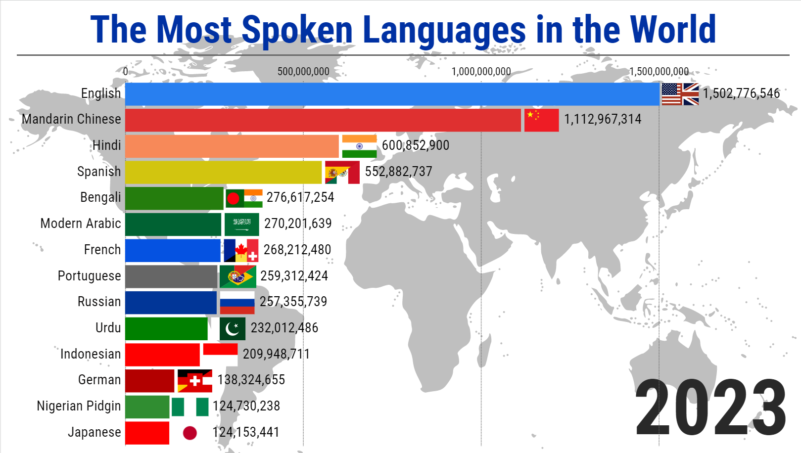
Language Barrier
Challenge: Miscommunication may arise in technical discussions or negotiations. Translation of key documentation is required.
Solution: Use of professional translators for discussions/negotiations and documentations. Providing summaries in both languages and using technology for real-time translation.
(Simon, 2024)

Slide 11
Time Zone and Geographical Barriers
8Hours
Greenwich Mean Time (GMT)
British Summer Time (BST, GMT+1 during daylight savings).
China Standard Time
(CST, GMT+8)
Challenge: Limited overlap in working hours (UK morning overlap Chinese evening). Communication Delays.
Solution: Use flexible working hours. Use of asynchronous communication tools for updates outside of live meetings.
(Kristjánsdóttir and Guðlaugsson, 2019)
(Mangan and Lalwani, 2016)

Slide 12
Decision-Making
UK | CHINA
Collaborative | Hierarchical
Speed, Agility, Immediate Result | Planning, Analysis, Caution
Risk-Taking & Innovation | Risk-Averse, Proven Methods
Autonomous decisions | Strong Governmental influence
Focused on innovations and market competitiveness | Focused on national interest and needs
Challenge: Misalignment in expectations. Delays in taking decisions. Perceived inefficiency from the UK. Hesitation from CSCES to adopt unproven methods. Divergence in priorities can lead to disagreements on investment allocation.
Solutions: Respect the hierarchical structure. Agree on realistic timelines. Present data-backed case studies. Involve regulatory experts. Negotiate compromises
(Crookes and Farnell, 2019)
(Verot, 2023)

Slide 13
Successful Negotiation Strategy
‘’Guanxi’’ Orientated
Build Strong Relationship
Flexibility and Adaptability
Respect the Hierarchy
(Crookes and Farnell, 2019)
(Cainey, 2023)
(Liu, Lu and Zhan, 2021)

Slide 14
Thanks!
Do you have any questions?
2219028@student.uwtsd.ac.uk
+44 7400 20 38 30

Slide 15
References
Cainey, A. (2023). Six Principles for a More Dynamic and Effective UK–China Strategy. [online] Rusi.org. Available at: https://www.rusi.org/explore-our-research/publications/policy-briefs/six-principles-more-dynamic-and-effective-uk-china-strategy [Accessed 1 Dec. 2024].
Crookes, P.I. and Farnell, J. (2019). The UK’s Strategic Partnership with China beyond Brexit: Economic Opportunities Facing Political Constraints. Journal of Current Chinese Affairs, 48(1), p.186810261985878. doi:https://doi.org/10.1177/1868102619858783.
Garst, D. (2023). Chinese Business Etiquette: Essential Tips for Success. [online] Daniel Garst - China Consultant. Available at: https://danielgarst.com/chinese-business-etiquette-tips-for-success/.
Hofstede, G. (2019). Geert Hofstede and Gert Jan Hofstede on culture. [online] Geert Hofstede. Available at: https://geerthofstede.com/.
Hofstede, G. (2024). Hofstede’s globe Hofstede’s Globe. [online] Geert Hofstede. Available at: https://geerthofstede.com/hofstedes-globe/.
Ingrams, S. (2024). Octopus Energy. [online] Which? Available at: https://www.which.co.uk/reviews/energy-companies/article/energy-company-reviews/octopus-energy-aESDM2a8ISWP.
King, C. (2024). China State Construction: The Globe’s Largest Contractor. [online] constructiondigital.com. Available at: https://constructiondigital.com/articles/china-state-construction-the-globes-largest-contractor.

Slide 16
Kristjánsdóttir, H. and Guðlaugsson, Þ.Ö. (2019). Cultural and geographical distance: effects on UK exports. Applied Economics Letters, 27(4), pp.275–279. doi:https://doi.org/10.1080/13504851.2019.1613495.
Lawson, A. (2022). Octopus Energy’s Greg Jackson: ‘Climate change is no longer this vague thing’. The Guardian. [online] 11 Jun. Available at: https://www.theguardian.com/business/2022/jun/11/octopus-energys-greg-jackson-climate-change-is-no-longer-this-vague-thing.
Liu, C., Lu, J. and Zhan, Y. (2021). Cultural differences in business negotiations between China and the UK’ (from the 6th International conference on modern management and education technology, Hunlunbuir. Advances in Social Science, Education and Humanities Research, [online] 582, pp.433–437. Available at: https://hau.repository.guildhe.ac.uk/id/eprint/17763/1/Chuanqi%20Liu%20Cultural%20differences%20UPLOAD.pdf.
Mangan, J. and Lalwani, C. (2016). Global Logistics and Supply Chain Management. [online] Google Books. John Wiley & Sons. Available at: https://books.google.co.uk/books/about/Global_Logistics_and_Supply_Chain_Manage.html?id=5BsWCgAAQBAJ&redir_esc=y.

Slide 17
Minkov, M. (2013). Cross-Cultural Analysis The Science and Art of Comparing the World’s Modern Societies and Their Cultures. [online] Google.co.uk. Available at: https://www.google.co.uk/books/edition/Cross_Cultural_Analysis/CU2BXnffuFoC?hl=en&gbpv=0 [Accessed 1 Dec. 2024].
Simon (2024). How Language Barriers Affect Business Communication. [online] Simonandsimon.co.uk. Available at: https://www.simonandsimon.co.uk/blog/how-language-barriers-affect-business-communication.
Verot, O. (2023). The role of guanxi in Chinese business culture - Marketing China. [online] GMA. Available at: https://marketingtochina.com/the-role-of-guanxi-in-chinese-business-culture/.

