Slide 1

Employee Engagement
Student name: Raluca Istrate
Student ID: 2120535
Module: Operating Hotel Facilities (BMIH4006)
Lecturer: Lisa Bassler

Slide 2
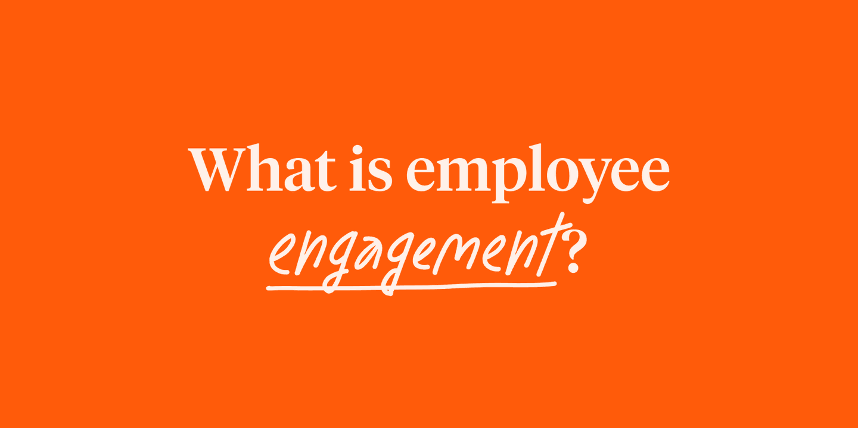
Employee engagement is the emotional commitment the employee has to the organization and its goals.

Slide 3

Types of Employees
ENGAGED – 15% of the workforce: employees work with devotion and feel a profound connection with their organisation, team members and goals.
NOT ENGAGED – 67% of the workforce: employees are happy and satisfied in their role
DISENGAGED – 18% of the workforce: employees undermine the efforts of engaged employees

Slide 4

The employee engagement pyramid: Zinger model

Slide 5

Importance of employee engagement
Improve customer relations
Reduce staff turnover
Greater productivity
Increase revenue

Slide 6

Ways to improve employee engagement
Provide feedback and praise
Focus on direct managerial relationships
Enable career development
Make clear values
Use technology

Slide 7

Employee engagement survey
+16% fewer guest problems
+11% more productivity
+28% lower turnover

Slide 8
REFERENCES:
Bakker A. and Leiter M. (2010) Work Engagement: A Handbook of Essential Theory and Research, Publisher: Psychology Press, Place of Publication: New York
Boyen, F. (2019) Getting the Go-To Lowdown on Luxury at the Forbes Travel Summit [online]. Available at https://www.travelpulse.com/news/travel-agents/getting-the-go-to-lowdown-on-luxury-at-the-forbes-travel-summit.html (Accessed on 29.11.2022)
Briger, E. (2018) Employee engagement: a practical introduction, Edition: Second Edition, Publisher: KoganPage, Place of Publication: London
Croswell, L.(2022) What is employee engagement? [online] Available at https://www.cultureamp.com/blog/what-is-employee-engagement (Accessed on 28.11.2022)
Gleeson, B. (2017) Five powerful steps to improve employee engagement [online]. Available at: https://www.forbes.com/sites/brentgleeson/2017/10/15/5-powerful-steps-to-improve-employee-engagement/?sh=4fa21ef0341d (Accessed on: 28.11.2022)
Kruse, K. (2015) Employee Engagement Definition [online]. Available at: https://kevinkruse.com/employee-engagement-definition/ (Accessed on: 28.11.2022)
Leppla, A. (2016) Marriott International Shares Its Secret To Driving Employee Engagement [online]. Available at: https://www.linkedin.com/business/talent/blog/talent-engagement/marriott-international-shares-secrets-to-driving-employee-engagement (Accessed on 29.11.2022)
Marriott (2022) Core Values and Heritage [online] Available at: https://www.marriott.com/culture-and-values/core-values.mi (Accessed on: 01.12.2022)
Sharma, N. (2019) Management Techniques for employee engagement in contemporary organizations, Publisher: IGI Global, Place of Publication: Hersey, Pennsylvania
Zinger, D. (2011) The employee engagement pyramid [online]. Available at: http://www.davidzinger.com/the-employee-engagement-pyramid-12712/ (Accessed on: 28.11.2022)

