Slide 1
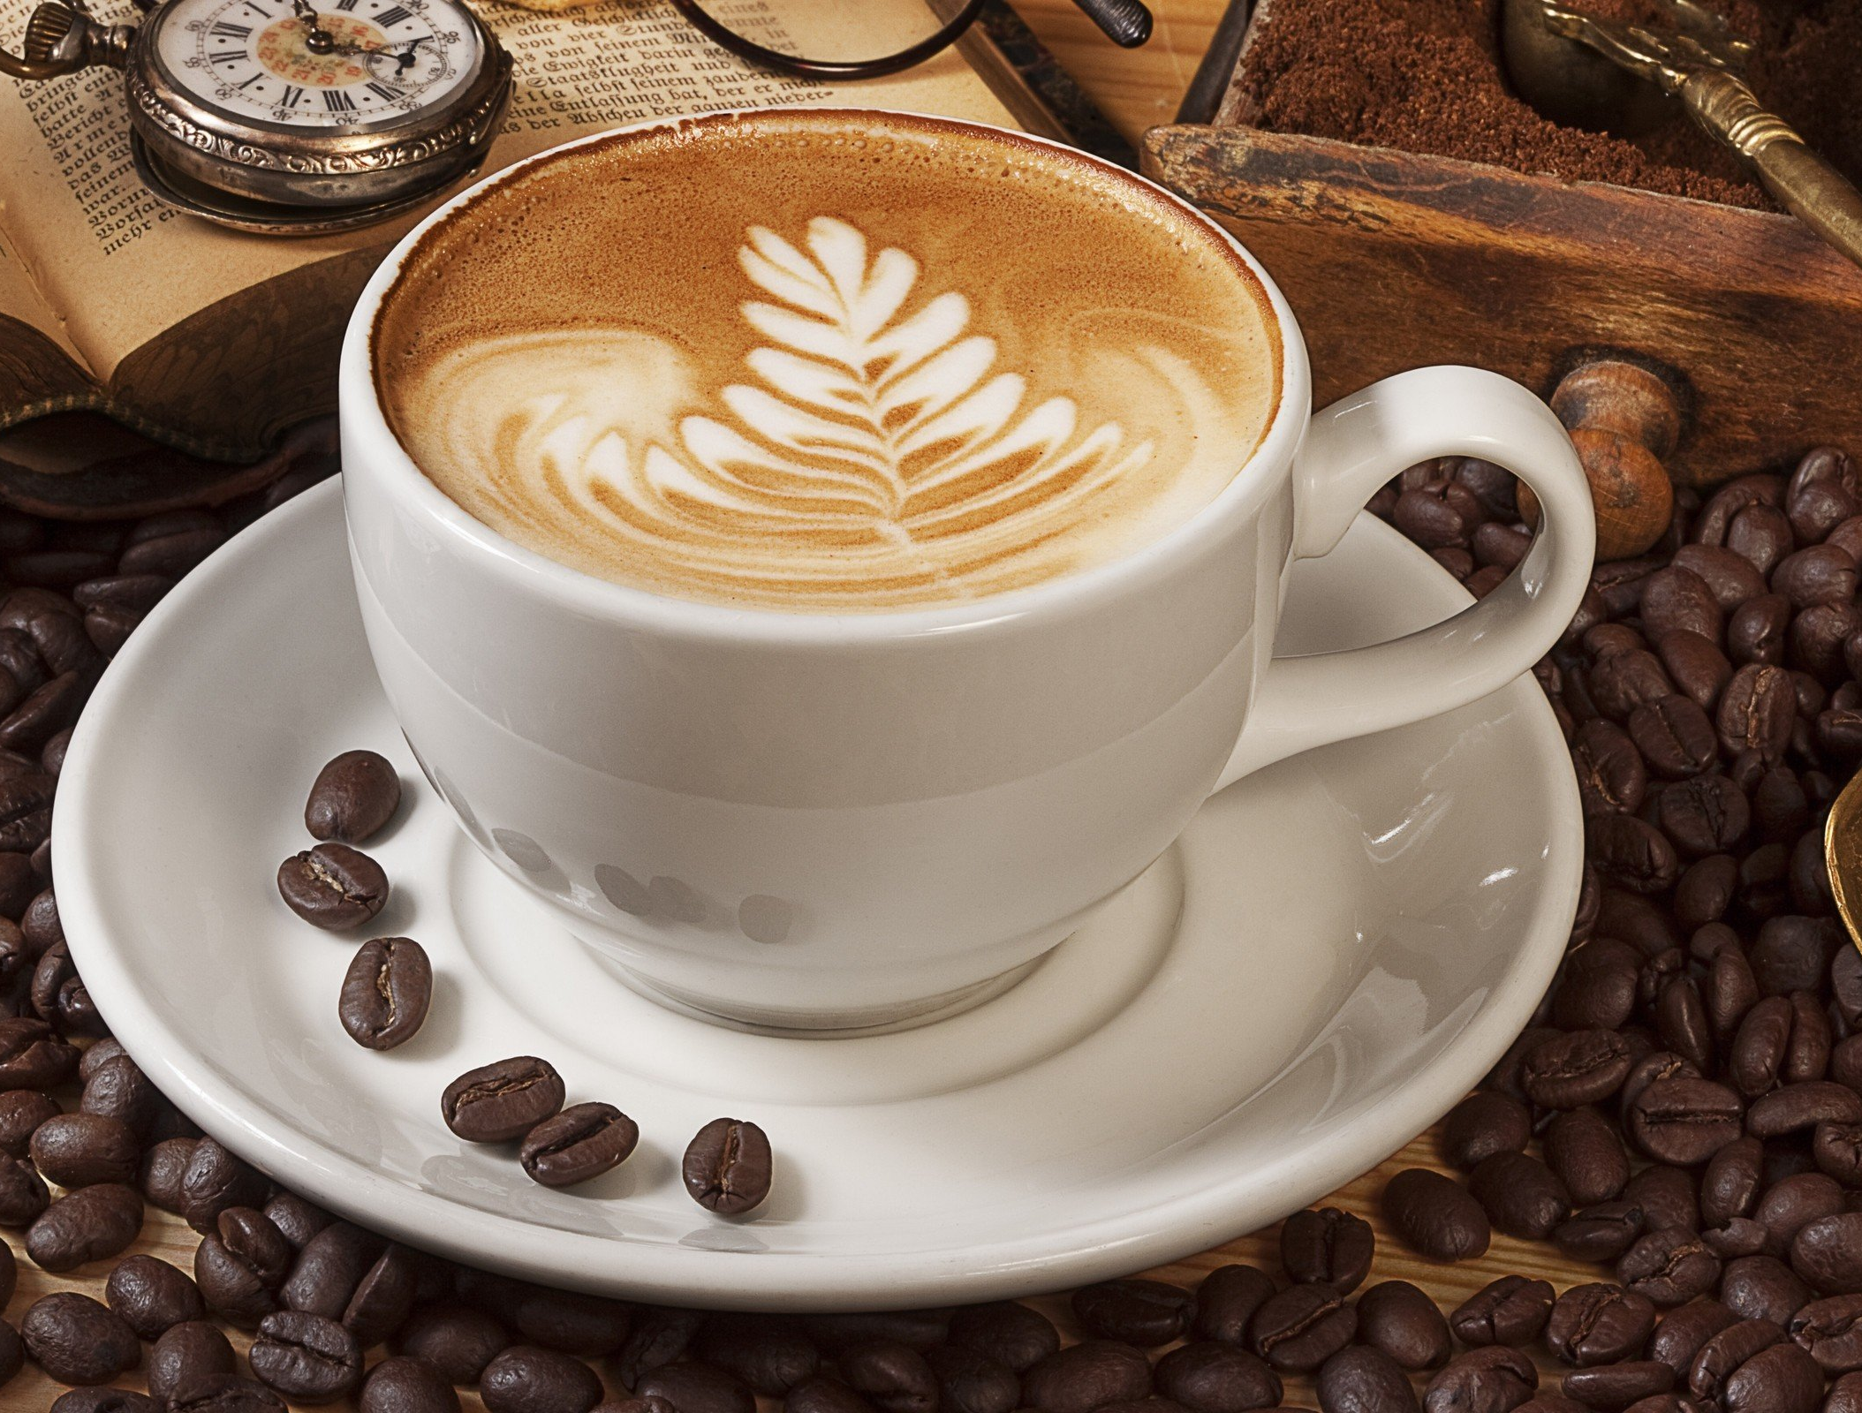
BUSINESS PLAN
Title: The Friendly Bean
Name : Ivana Desevova
Student ID : 2027510
Module: Entrepreneurship
Lecturer Name: Vasilios Tavlaridis

Slide 2
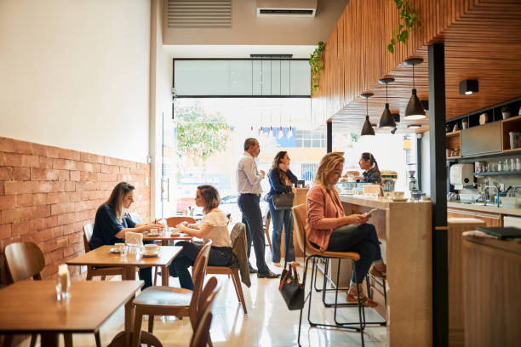
Company Overview
The Friendly Bean
The friendly bean is a coffee shop that offers quality coffee experiences to the customers along with other drinks such as tea, smoothies, seasonal drinks, etc. The company is expected to expand to 10 outlets within three years of opening. The company will be a private company and it will be a partnership between two owners.
Notes:
My business is….. CALL COFFEE SHOP FRIENDLY BEEN
As you can see from the picture….THE COMPANY IS EXPECTED TO EXPAND
The products will be ….NOT ONLY COFFEE WHAT WE WOULD OFFER ,ASLO DRINKS . TEA , SEASONAL DRINKS

Slide 3
Market Size
In 2008,70M
Cups of coffee were
consumed every day
(Voora et al., 2019)
In 2018 it became,95M
Cups of coffee consumption per day (Voora et al., 2019)
$5.4B
Market Size
(Bisson et al., 2020)
Notes:
PREDICTED PROFIT APPROXIMTELY IN MARKET SIZE .

Slide 4

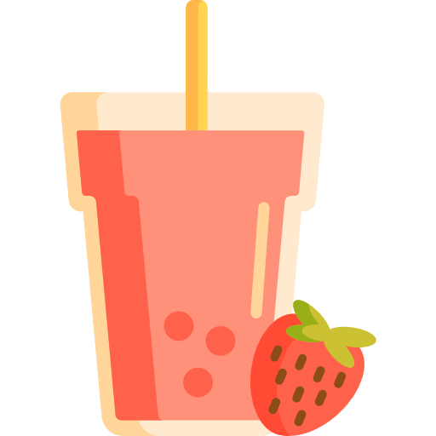


Product
Product Line
Coffee
Tea
Smoothie
Seasonal drinks
Notes:
PRODUCT WE ARE GOING TO OFFER

Slide 5
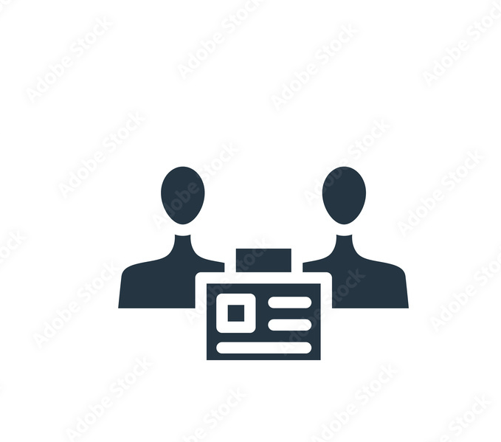

Ownership and Legal format
Legal Entity
The Friendly Bean offers “limited liability”. In this type of ownership, there are no chances of growing personal liabilities over the invested capital (Bishop, 2022).
Ownership
The Friendly Bean is a private company that will be limited by shares (Armstrong and Kotler, 2022).
Notes:
PRIVATE COMPANY , LIMITED BY SHARES ,INTETATION AND REGISTERED WITH OFFERING LIMITED LIABILITY

Slide 6
Management
Two directors
Mr. Adam
Business Management Graduate.
Mr. Bunty
Processing and Maintenance Department
Four Employees
One manager
Two waiters
One security guard
Besides, the company will take consultancy from a consultancy firm two or three times every year to secure its operational progress.
Notes:
STAFF WHAT WE PLANING TO HIRE

Slide 7




SWOT Analysis
Strengths
S
Weaknesses
Policy of supply chain system
Profuse market industry (Parsons, 2022).
W
Chief price
Common market
Opportunities
O
Growing nature of the market industry (Mindtools, 2022).
Huge demand
Threats
T
Huge competition
Financing problem
Notes:
AS WEKNESSES , THREATS , STRENGHTS, AND OPPORTUNITIES

Slide 8
4Ps of marketing mix.
Product: This is the most important variable in the marketing mix because, if customers don't offer something they want to buy, no matter how well a company does other reasons, it will be almost impossible to succeed because no one wants to buy it. Therefore, the company must bring something to the new market, it improves the competition that can be easy for customers to use, and is also useful. In this coffee shop, the products are special because it’s qualitative at a cheap price.
Place: It refers to the geographical area where the company wants to sell its products and services. Geographical location is very important in the marketing strategy. As the company operates in London from the very first, the place will also help the business to flourish (Weis, 2018).
Notes:
PRUDUCT – cheap price , PLACE –LOCATION

Slide 9
4Ps of marketing mix.
Price: The price is always decisive. Every company can put its price on its products, but her company is talking about a very competitive factor because the competition also analyzes it and sometimes offers something cheaper or something more lucrative. In this case, the price must be sufficient so that costs are covered and there is also some benefit. This can have a negative or positive effect on customers (Rahmani et al., 2015). They may like it or reject it as expensive. And it's not always good to offer products with low prices, sometimes the key issue of balance (Study.com, 2022).
Promotion: Finally, promotion comes, it is the actions that a company must do so that its product becomes familiar. It's usually called advertising. If a company doesn't invest in it, no matter what place it put the product in many places, people won't be interested if they haven't heard of it (Antonella, 2017). A company needs to sell it, and for that, it must ensure effective promotion(Teoli, 2022).
Notes:
PROMOTION ,

Slide 10



Target market and marketing strategies
Target Market
people aged 18-55
Demographic
Urban people
Psychological
Active, early riser, routined life
Notes:
SERVE PEOPLE FROM 18-55, PEOPLE LIVING IN CITY IN TOWN ,

Slide 11



Target market and marketing strategies
Marketing Goal
The goal is to increase brand reputation and recognition through promotion(Perreault et al., 2011).
Digital Marketing
The best way to reach a broader audience is to promote the brand through digital platforms.
Influencer Marketing
Influencer marketing plays a crucial role in attracting customers and building brand awareness.
Notes:
Goals by price and promoction , promote brand through digital platform ,

Slide 12
References
Armstrong, G. and Kotler, P., (2022). Marketing. Harlow: Pearson Education, Limited.
Bishop, E., (2022). 5 legal aspects you should check before starting a business. [online] Available at: &lt;https://marketbusinessnews.com/legal-aspects-starting-
business/196803/&gt; [Accessed 2022].
Bisson, M., Palmieri, S., Ianniello, A. and Memo, F., (2020). A new idea of coffee: the concept of cocktail cappuccino. In EDULEARN20 12th International Conference on Education and New Learning Technologies July 6th-7th, 2020 (pp. 7110-7115). IATED Academy.
Jang, H. and Lee, S., (2019). Applying Effective Sensory Marketing to Sustainable Coffee Shop Business Management. Sustainability, 11(22), p.6430
Mindtools, (2022). SWOT Analysis Model and Examples - Business Strategy Skills. [online] Available at: &lt;https://www.mindtools.com/pages/article/newTMC_05.htm&gt;
[Accessed 2022].
Parsons, N., (2022). What Is a SWOT Analysis and How to Do It Right (With Examples). [online] Available at: &lt;https://www.liveplan.com/blog/what-is-a-swot-analysis-and-how-to-do-it-right-with-examples/&gt; [Accessed 2022].
Perreault, W., McCarthy, E. and Cannon, J., (2011). Basic marketing. Boston: McGraw-Hill.
Study.com, (2022). Business Characteristics &amp; Examples | What is a Business? - Video.... [online] Available at: &lt;https://study.com/academy/lesson/what-is-a-business-
defintion-characteristics-examples.html&gt; [Accessed 2022].
Teoli, D., (2022). SWOT Analysis - StatPearls - NCBI Bookshelf. [online] Available at:&lt;https://www.ncbi.nlm.nih.gov/books/NBK537302/&gt; [Accessed 2022]. Weis, H., (2018). Marketing. Herne: Kiehl.
Voora, V., Bermúdez, S. and Larrea, C., (2019). Global market report: Coffee.

