Slide 1

BMNS4014. Living well: A Life course approach to Health and Wellbeing
Lecture one. w/c 26th January 2026. A life course approach: context and background
Dr Ben Duxbury.
ben.duxbury@uwtsd.ac.uk

Slide 2
Today
Assessments
Living well and the life course
Understandings of health and wellbeing across the life course
The meaning of ‘life course’
‘Life course approach’: background/context/meaning
Life course approach and ‘wider determinants of health’
Factors impacting on health
(An aside on the use of theory/models/frameworks)
The meaning of health and wellbeing
Life trajectories and transitions

Slide 3
Assignment 1
Individual Presentation (w/c 16th March, 2026)
Students will deliver a 10-minute presentation to show a holistic understanding of the life course approach and its implications for health and wellbeing. Your presentation should:
  Demonstrate a clear understanding of the life course approach to health and wellbeing.
  Include key concepts such as the impact of early life, lifestyle choices, and social determinants on long term health.
  Discuss how health and wellbeing evolve throughout different life stages.

Slide 4
Assignment 2
Research report (23.55, Friday 27th March, 2026)
Students will write an individual research report of 1500 words.
The report should critically analyse how lifestyle choices at various life stages impact long term health and wellbeing, utilising the life course approach.
The report will require students to explore the connections between early life experiences, lifestyle factors such as diet, physical activity, mental health and social determinants of health

Slide 5
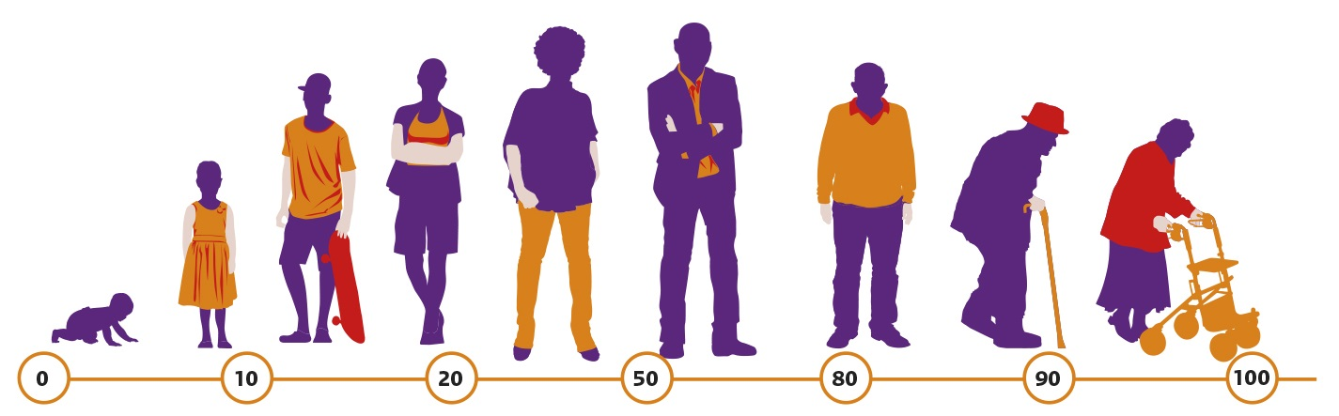
The life course approach
(See Picavet et al, 2017; Verschuren et al., 2008)

Slide 6



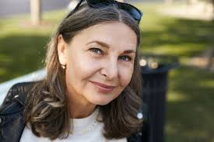
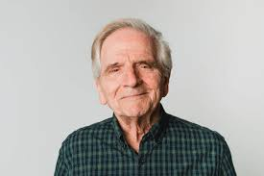
Living well and the life course
What does it mean to live well?
What do we need to do this?
What do we need to be healthy and to thrive as individuals and communities?
How can we be healthy and achieve wellbeing as we move through our lives (through our ‘life course’)?
Do our ideas about being healthy (and having wellbeing) change as we grow older?

Slide 7
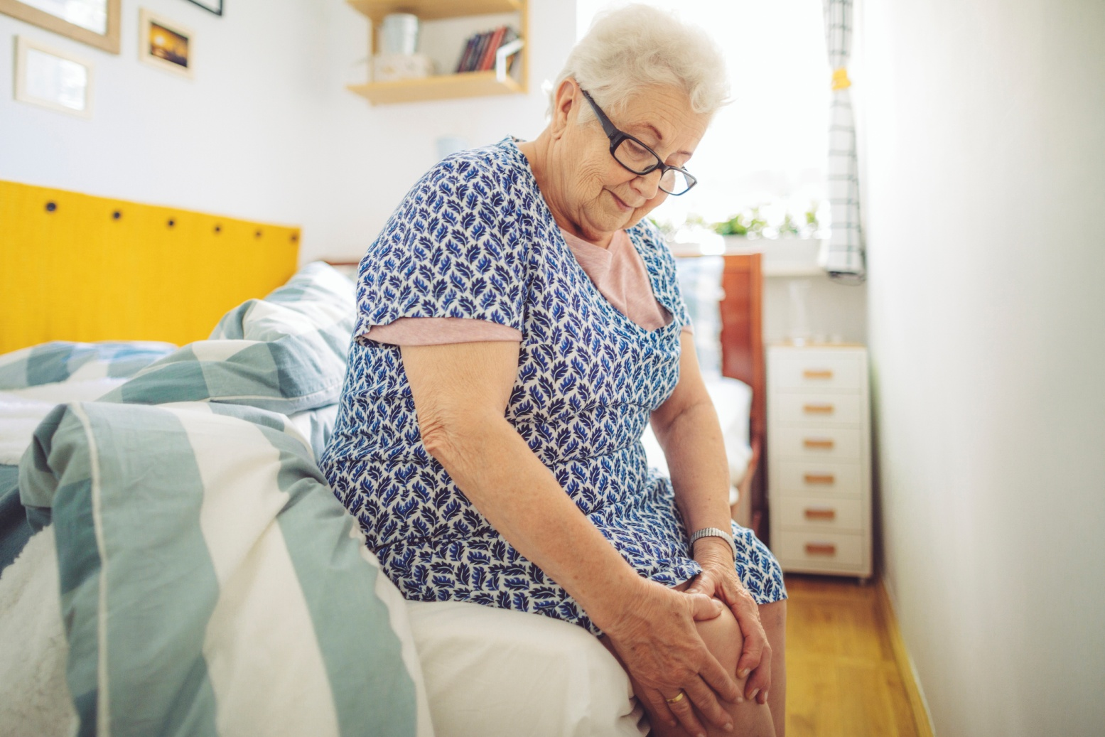
The perspective of health of a (non-health professional) person can vary according to her/his age. For this lady, it might mean being able to get to the shops….

Slide 8

…for this lady it might mean being able to run three marathons in a year

Slide 9
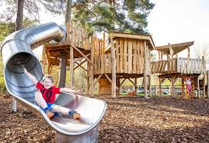
… and for this boy it might be being able to slide
(See Elias and Lowton, 2014; Rowe and Mitchell, 2013; Scriven, Goodall and Morgan, 2023)

Slide 10
The three people are at different stages of their life course: what is a, ‘life course’? Some definitions/descriptions
‘…a sequence of socially defined events and roles that the individual enacts over time’ (Giele and Elder 1998, p. 22),
‘… age-graded patterns that are embedded in social institutions and history’ (Elder, Johnson and Crosnoe, 2003, p. 4);
‘…connections over time as individuals move through culturally and historically defined stages influenced by past experiences, events and circumstances’ (Baxter et al., 2022, p. 2)
‘…focuses on the temporal and contextual elements of an experience’ (Hamilton, Innella and Bounds, 2016, p. 44)
‘Assumes that growth, development and ageing form a continuous process from birth to death and covers all life stages including infants, children, adolescents and youth, adults and older people’ (World Health Organization [WHO], 2025, p. xvi)

Slide 11
The life course approach: background, context, meaning
Life course approach: also referred to as life course perspective/theory/paradigm etc.; developed in the social sciences in the1960s; analysis of human lives within structural/social/cultural contexts
Emphasises importance of time/context/process/meaning on human development: a, ‘contextual, processual and dynamic approach’ (Bengston and Allen, 2003, p. 469).
Development considered as extending through multiple life stages that influence life trajectory; temporal/chronological connections as individuals move through biologically-/culturally-/socially-/historically-defined transitions
Identifies/takes account of key factors/influences in human lives, e.g.: (timing/sequencing of) transitions; continuum of experience (from pre-conception to old age); accumulation of lifelong factors; personal agency within wider context; linked lives…

Slide 12
…aims to understand actions, behaviour and experiences of individuals by combining individual insights with broader/surrounding social forces
Lifestyle approach considers life outcomes to be influenced by factors including:
  Transitions (e.g. biological, behavioural, social): e.g. infancy, puberty, pregnancy, starting school, entering the labour market, becoming a parent, retiring etc.
  Cumulative macro-/meso-level exposures: social (family, friends etc.), economic (wealth of country, job etc.), education (systems), labour (markets), social/cultural values, environmental (rural/urban, air quality etc.)
  Individual (micro-level) factors: cognition, personality and biology
  Life course approach = multidisciplinary in nature, considering (for example): history, sociology, demography, developmental psychology, biology, public health, economics
(See Bengston and Allen,2003; Burton-Jeangros et al., 2015; Elder, Johnson and Crosnoe, 2003; Elder and Giele, 2009; Baxter et al., 2022; World Health Organisation [WHO], 2025l; Aagard-Hansen et al., 2019 )

Slide 13
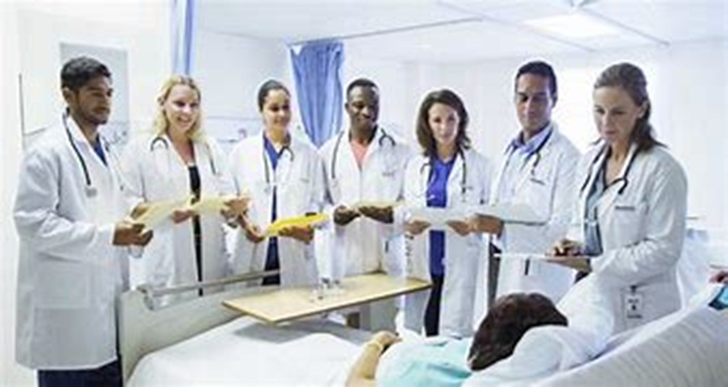


Putting the life course approach into the health/wellbeing context: the social model and ‘wider determinants of health’
Researchers/professionals/experts argue that health and wellbeing (to varying extents) are determined by many different factors; health = more than the absence of disease in a person (this absence = basis of the ‘biomedical model of health’)
Research and related theories/models suggest that health/wellbeing influenced by societal/environmental/economic/structural features: t health includes, ‘wider determinants of health’ (= central to the ‘social model of health’)
(See Blaxter, 1990; Stevenson, 2018; Giddens and Sutton, 2021; Frawley, 2020; Hallam, 2011; Glasby, 2017; McKeown, Record and Turner, 1975; Rodham, 2019; Wilkinson and Pickett, 2006; 2009; Marshall, 2024)
Can you think of some specific examples of wider determinants of health? What might be the effect of these over a life course?

Slide 14
Factors that can impact on health…
Genetics: plays a part in determining lifespan, healthiness, the likelihood of developing certain illnesses.
Individual behaviour/lifestyle/resilience: balanced eating, keeping active, (not) smoking, (not) drinking, dealing with day-to-day stresses of life
Health services: access to/use of services that prevent and treat disease
Ethnicity: different ethnic groups report different levels of health and use different levels of health services
Gender: men and women live with different types of conditions at different ages.

Slide 15
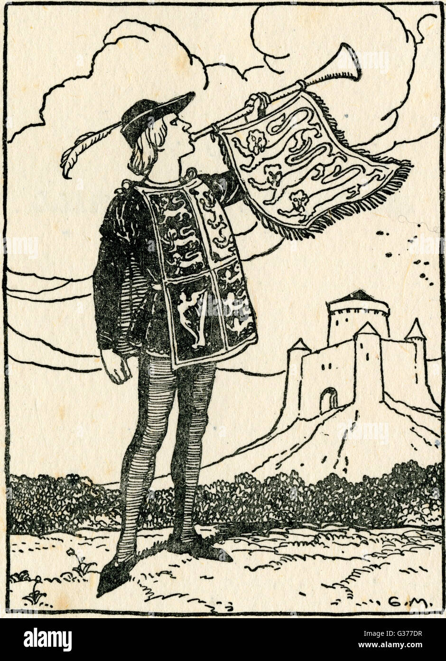
…more factors
Physical environment: safe water/clean air, healthy workplaces, safe houses, communities, transport.
Employment/working conditions: the employed report better health, particularly people with greater control over working conditions
Social support networks: support from families, friends and communities
Culture: customs and traditions, and the beliefs of the family
Such factors have been incorporated into various models/frameworks of health/wellbeing, including…
(See Giddens and Sutton, 2021; Hallam, 2011; Glasby, 2017; Napier, 2017; Rodham,2019)

Slide 16
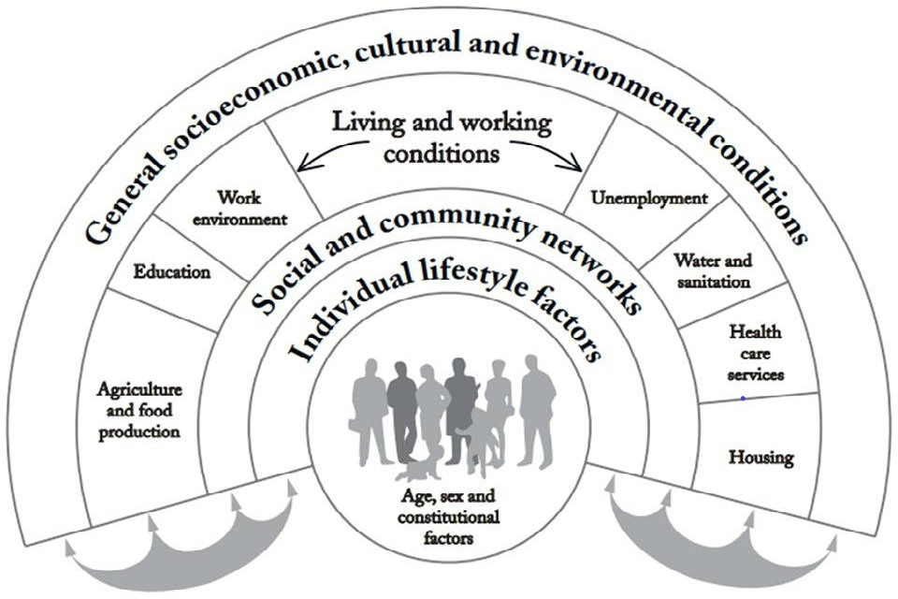
The Main Determinants of Health (Dahlgren and Whitehead, 2006, p. 20)

Slide 17
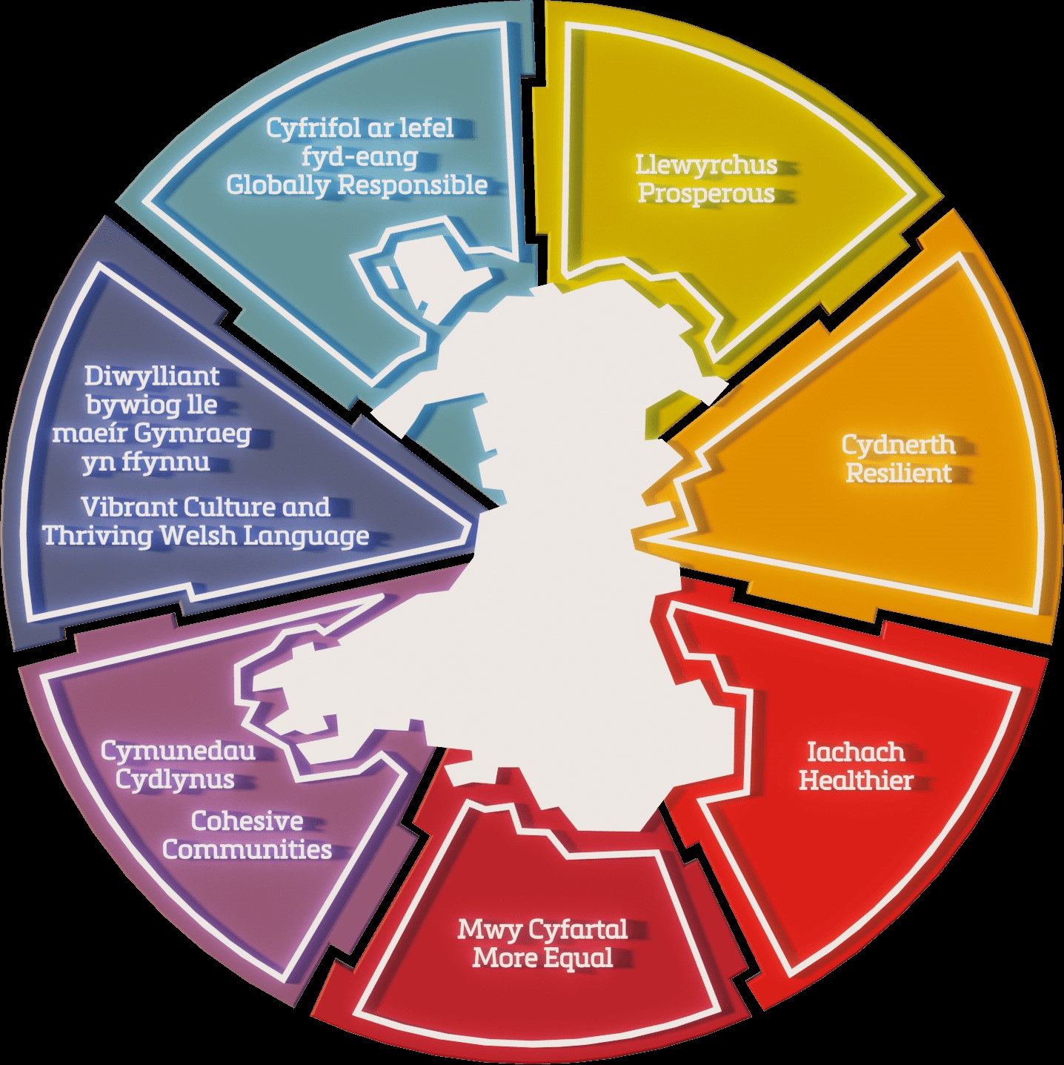
Welsh Government (WG) well-being goals (WG, 2024)
Wellbeing goals include, ‘vibrant culture and thriving Welsh language’:
This could be seen in terms of, ‘cultural capital’, defined by Giddens and Sutton (2021, p. 953) as:
Types of knowledge, skills and education which confer advantages on those who acquire them. Cultural capital can be embodied (in terms of speech or bodily comportment) objectified (in cultural products such as works of art) or institutionalised (in educational qualifications)
(See WG, 2024, p. 2)

Slide 18
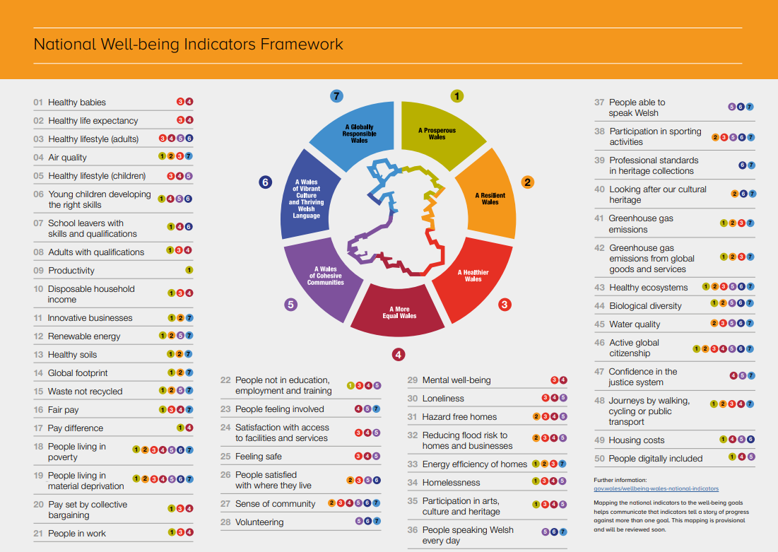
(See WG, 2024, p. 10)

Slide 19
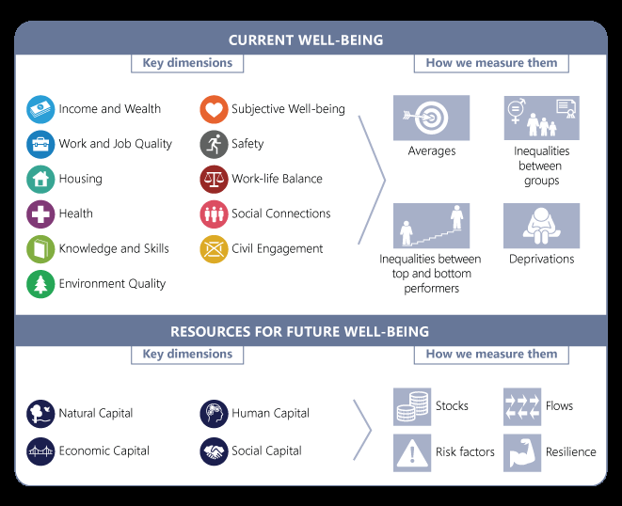
The Organisation for Economic Co-operation and Development (OECD) Well-being Framework (OECD, 2020,p. 21)

Slide 20
Defining the OECD’s (2020), ‘wellbeing resources’
Natural capital:‘…fossil fuel, mineral, and metal reserves (nonrenewable natural capital); agricultural land, forests, and fish stocks (renewable natural capital)’ (International Bank for Reconstruction and Development / The World Bank, 2024, p. 12)
Human capital: ‘labor force’ (International Bank for Reconstruction and Development / The World Bank, 2024, p. 6)
Economic capital: ‘…material goods such as property, wealth and income’ (Giddens and Sutton, 2021, p. 362)
Social capital: ‘…social knowledge and connections that enable people to accomplish their goals and extend their influence’ (Giddens and Sutton, 2021, p. 972).

Slide 21
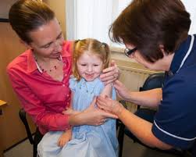

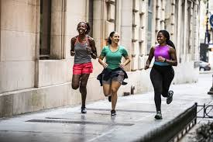
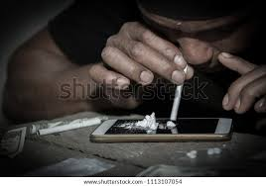
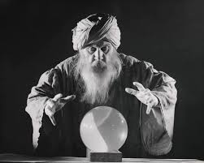
An aside on the use of theory/models/frameworks
It would be helpful if healthcare professionals could reliably predict health behaviour, e.g. who will follow healthcare advice, go for screening, be physically active, eat well/poorly, misuse substances
Although healthcare professionals do not possess healthcare crystal balls to help them in this… …they do have theories (and related models/frameworks) that can inform understanding.
(See, for instance, Chater and Cook, 2014; Benyamini, 2014; Rodham, 2019)

Slide 22
Theory (in health and social care)
The term ‘theory’, according to Gomm (2009, p. 361) is often used, loosely, in reference to:
…any set of explanatory ideas; more narrowly, a coherently related set of ideas offering explanations in terms more abstract and general than descriptions of the particular phenomena [original emphasis] they purport to explain
Theories can provide definitions of concepts and their relationships to each other (and so provide a classifying scheme/typology )
Theories are important in health and social care: can provide a rationale for actions; inform contacts with service users; help gain an understanding of behaviour; support the development of effective practice
(See Wills and Earle, 2007; Gomm, 2009; Roberts, 2009 Coulson and Hallam, 2011)

Slide 23
The purpose/role of theory
Theory may help to answer different sorts of questions, including:
  Descriptive: What is it…?
  Explanatory: Why is it…?
  Predictive: What would happen if…?
  Prescriptive: What should be done…?
Like theories, models/frameworks can relate to descriptive, explanatory, predictive or prescriptive areas (the terms theory/model are often used interchangeably)
(See Wills and Earle, 2007; Gomm, 2009; Roberts, 2009 Coulson and Hallam, 2011)

Slide 24
Defining health; defining wellbeing
There are many definitions of health. The World Health Organization (WHO) definition of health (this is included in the WHO Constitution – see WHO, 2020) has proved enduring:
Health is a state of complete physical, mental and social well-being and not merely the absence of disease or infirmity. (WHO, 2020, p. 2).
Wellbeing is similarly multifaceted/complex and can have similar problems in defining (see Scott, 2012; Vernon, 2014; Allan and Hand, 2014; Fattore and Mason, 2016). It has been viewed as:
…having the ability to engage in meaningful activities, feeling good and in control, and being resilient to changes that occur in life (Rowe and Mitchell, 2013, p. 189).

Slide 25
Returning to the health/wellbeing quiz…
Thinking of the models/frameworks, which of the following dimensions of health/wellbeing were reflected in your answers about your own health/wellbeing? Physical; emotional; mental; spiritual; societal; cultural; environmental
What do you think being healthy/having wellbeing may mean to a person who:
    Has recently started school ?
    Has recently got married?
    Has recently started working?
    Has recently lost their spouse?
    Has recently been called up to the army in Ukraine?
    Lives in relative poverty with unemployed parents who misuse alcohol/illicit drugs and are physically/mentally abusive towards each other?
Which of the above 8 dimensions above might be most/least important to people experiencing such change?

Slide 26

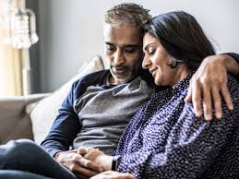
The life course: trajectories and transitions
Human lives can be considered in terms of a, ‘life trajectory’, i.e. the long-term sequence of an individual’s experiences in specific life domains, e.g. work, family, education, health, housing
Life trajectories: punctuated by a sequence of successive changes:
  ‘Events’ – abrupt changes (discrete occurrences), e.g. losing a job
  ‘Transitions’ (of significant interest in social sciences) – longer processes of change (between states): can be at different levels (e.g. biological, behavioural, social); often considered in terms of the acquisition/relinquishment of social roles (e.g. losing a job) but viewed in terms of the related longer-term processes
(See Burton-Jeangros et al., 2015; Walther, Stauber and Settersten,2022; Schatzki, 2022; Nilsen, 2023)

Slide 27
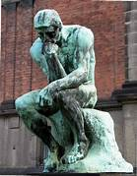
For next week
Consider a transition in your life:
  What was it?
  When did it occur?
  Was the timing important/relevant (in the context of your life trajectory)?
  What other aspects of your life were affected?
  What other people were affected?
  What was the overall impact on your life of the transition?
  …and on your health/wellbeing?
  What do you think about this transition now?
August Rodin (1840 – 1917): Le Penseur (1903), Musée Rodin, Paris

Slide 28
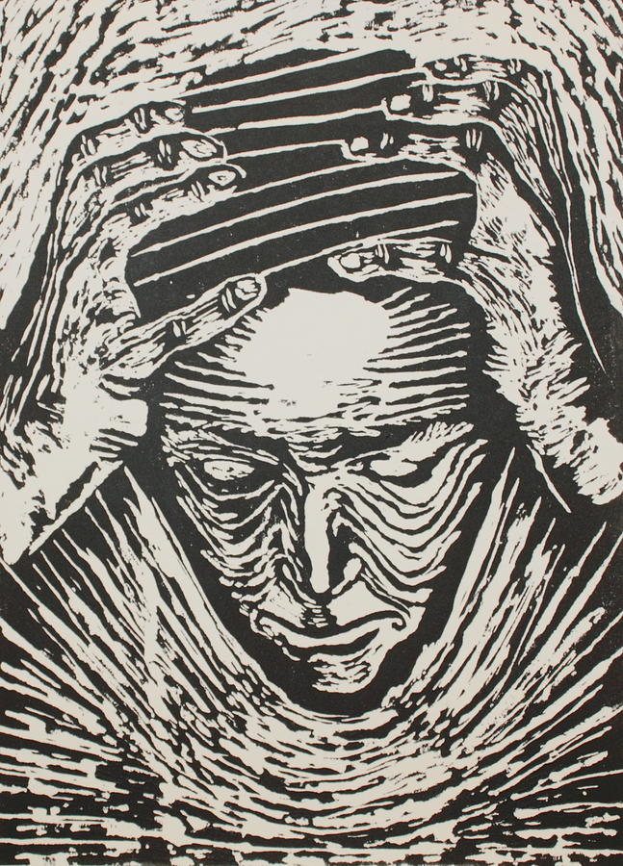
Any questions?

