Slide 1
My Future Career as a Family Support Worker
PROFESIONAL DEVELOPMENT WITHIN HEALTH AND SOCIAL CARE
LECTURER NAME: Beanice Ejiogu
NAME: Dorota Pierzchalska
STUDENT ID: 2519628
LCHS4009

Slide 2

My Career Choice - Family Support Worker
My chosen career is Family Support Worker.
Support vulnerable children and families.
Promote safety and wellbeing.
Provide emotional and practical assistance.
Encourage positive family relationships (Chen et al., 2026).
Improve family outcomes.
(Human Focus, 2026)
Notes:
My dream job in the future is to work as Family Support Worker in the UK Health and Social Care field. I like this career as I would like to assist vulnerable children and families in overcoming their hardships. Family Support workers counsel, give practical help and advice to enhance family wellbeing. They also assist parents to establish positive relations with their children. In my opinion, this profession needs a person to be compassionate, patient and communicative. My future goal is to positively contribute to the life of the people as I advance my studies and enhance my professional knowledge and skills.

Slide 3
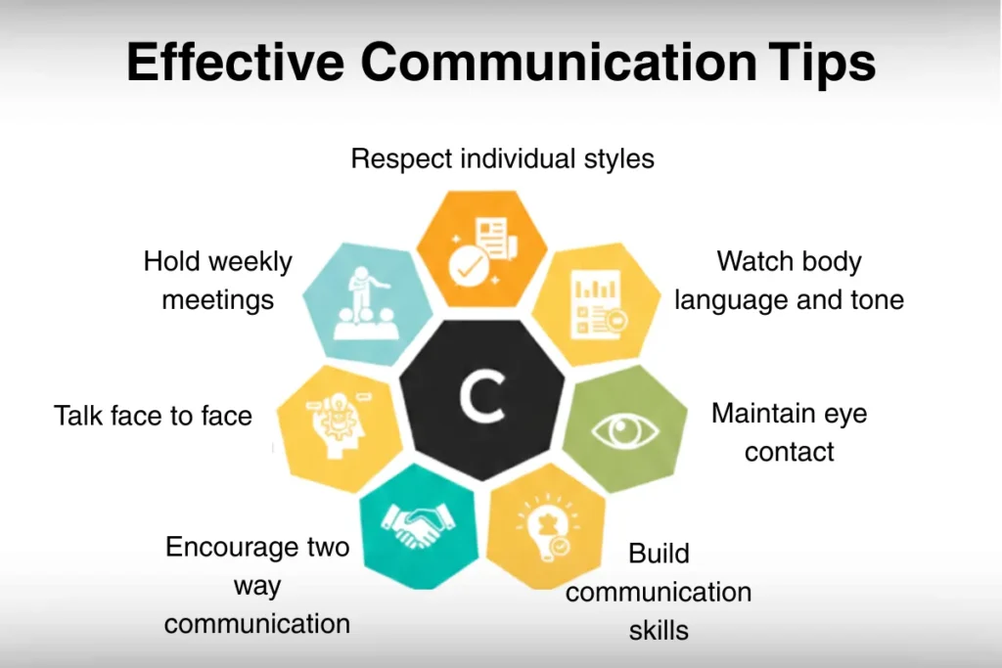
Job Advertisement and Requirements
Role: Family Support Worker.
Employer: To be confirmed.
Strong communication skills required.
Safeguarding knowledge is essential.
Empathy and patience are important (Demerouti, 2025).
Teamwork supports effective care.
Relevant qualifications are desirable.
(Crucial Learning India, 2026)
Notes:
In my selected profession, I am working on the criteria that are usually present in the UK Family Support Worker job adverts. Employers are normally demanding applicants who have good communication, empathy, teamwork and problem solutions skills. The knowledge of protective practices is especially crucial since the job will be to mitigate vulnerable children and families facing challenges. There can be relevant qualifications and prior experiences in social care as well. In my opinion, my interpersonal skills should serve as a good base to this career. Nonetheless, I acknowledge that the further training and work experience will enhance my effectiveness in finding a job in the future.

Slide 4
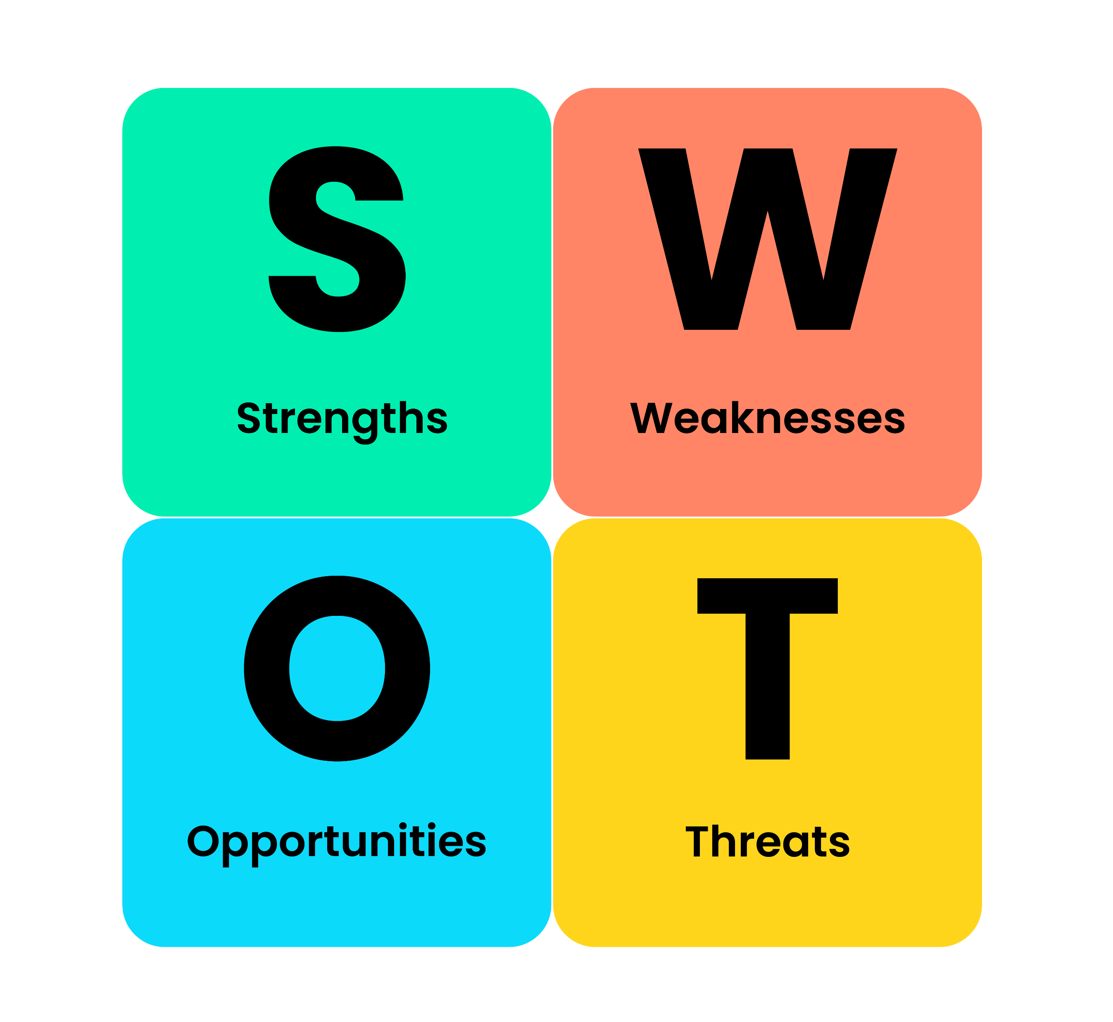
Personal SWOT - Strengths and Weaknesses
Strengths:
  Good communication skills.
  Empathy towards vulnerable families.
  Strong teamwork abilities (Diao and Yao, 2025).
  Patient and supportive attitude.
Weaknesses:
  Limited professional experience.
  Developing safeguarding knowledge.
  Confidence requires improvement (Maree and Magere, 2023).
(The Open University, 2026)
Notes:
The personal SWOT analysis process allows me to see how well I fit to be Family Support Worker. The communication, empathy, patience and teamwork are my primary strengths. These attributes may assist me in developing a trust-based relationship with vulnerable families and how they may feel about them individually. Nevertheless, I do understand that there are also some spheres that need enhancements. My little experience in practice can act as a barrier to my confidence in dealing with difficult circumstances. I also have to establish my knowledge in the area of protection of duties and professional practice. The awareness of these weaknesses will enable me to see the appropriate training opportunities and better equip myself towards future employment.

Slide 5

Personal SWOT - Opportunities and Threats
Opportunities:
  Access safeguarding training.
  Gain volunteering experience.
  Complete relevant qualifications (Morrow et al., 2024).
  Develop professional networks.
Threats:
  Competitive recruitment processes.
  Emotionally demanding situations.
  Heavy workloads.
  Changing safeguarding requirements
(BusinessBalls, 2026)
Notes:
There are a number of opportunities that might help me to develop as a Family Support Worker. Course and qualification and volunteering placements would also be of benefit and they would assist me to enhance knowledge and practical experience. Professional networking would also enable me to come across experienced social care workers and prospective employers. Nonetheless, this profession poses some threats. Recruitment may be competitive and emotionally based scenarios and workloads might add to pressure. Protective demands evolve too, with the direction of professionals. To overcome these issues I will engage in constant learning, time management and the assistance of senior co-workers all through my professional career.

Slide 6
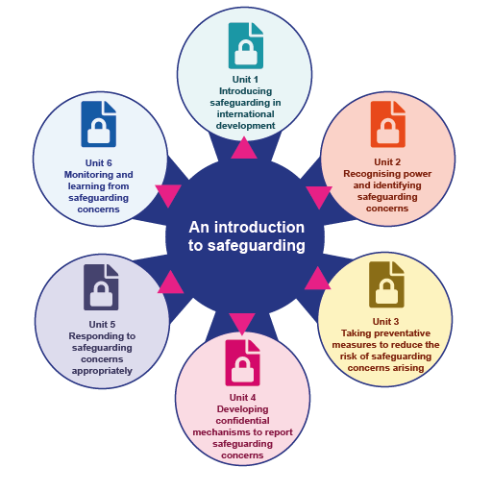
Overcoming Weaknesses and Threats
Use communication to build confidence.
Practise through volunteering opportunities.
Develop safeguarding knowledge through training.
Apply teamwork during difficult situations.
Seek professional guidance (Morrow and Lynch, 2024).
Manage stress through self-care.
(QuestionPro, 2026)
Notes:
I will have my current strengths to address the weaknesses and mitigate possible threats to my career. In case, I can use my communication skills in seeking experience when dealing with situations that are new to me in question. I would apply my empathy and patience in ensuring that my relationships with families who are emotionally challenged were positive. Volunteering would enhance my confidence and help me gain a valuable experience. I am also intending to take part in safeguarding training to enhance my work experience. Managing difficult roles through teamwork would ease my task and frequent self-reflection and correct self-care would reduce stress levels and facilitate my overall professional growth.

Slide 7
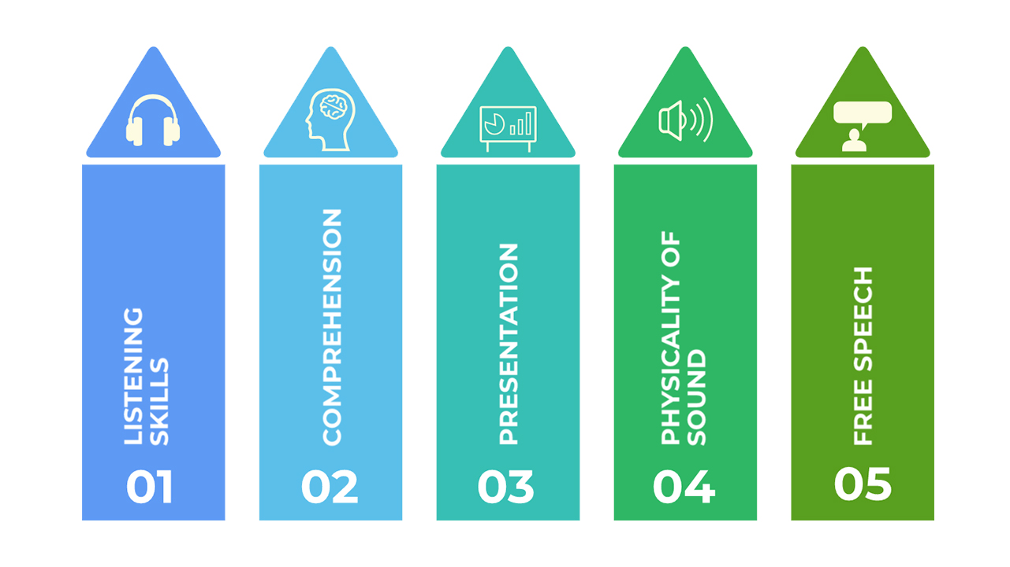
Personal Development and Career Goals
Complete safeguarding certification.
Gain practical family support experience.
Improve communication and assessment skills.
Apply for suitable vacancies (Rachmad, 2022).
Seek regular professional feedback (Yang et al., 2023).
Progress towards becoming a qualified Family Support Worker
(MapleLMS, 2026)
Notes:
My individual development plan emphasises the requirements of acquiring the skills and qualifications that would help me become a successful Family Support Worker. First, I would like to accomplish safeguarding training and discover possible volunteering opportunities. In the next six months, I hope to enhance my communication, assessment, and problem-solving skills with the help of practice. I will also look into the relevant qualification and seek advice of seasoned professionals. After fulfilling pertinent job requirements, I intend to apply within the Family Support Worker vacancies. My final aim is to be a confidently, responsible and professional provider of support to vulnerable families.

Slide 8
References
1. Human Focus (2026) What is a family support worker? Available at: https://humanfocus.co.uk/blog/what-is-a-family-support-worker/ (Accessed: 9 October 2026).
2. Crucial Learning India (2026) Effective communication. Available at: https://cruciallearningindia.in/effective-communication/ (Accessed: 9 October 2026).
3. The Open University (2026) OpenLearn Create learning resource. Available at: https://www.open.edu/openlearncreate/mod/book/tool/print/index.php?id=193957 (Accessed: 9 October 2026).
4. QuestionPro (2026) A SWOT analysis template for the overwhelmed marketer. Available at: https://www.questionpro.com/blog/a-swot-analysis-template-for-the-overwhelmed-marketer/ (Accessed: 9 October 2026).
5. BusinessBalls (2026) SWOT analysis. Available at: https://www.businessballs.com/strategy-innovation/swot-analysis/ (Accessed: 9 October 2026).
6. MapleLMS (2026) Can recruiters use proctoring tools for communication assessment? Available at: https://www.maplelms.com/blog/remote-proctoring/can-recruiters-use-proctoring-tools-for-communication-assessment/ (Accessed: 9 October 2026).

Slide 9
THANK YOU

