Slide 1
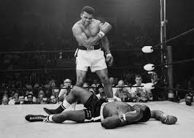
Muhammad ali

Slide 2
Content
Who he was?
What did he achieve
Why was he the one of the best boxers in the world.
Facts about Muhammad Ali
How many fights he had in his career

Slide 3
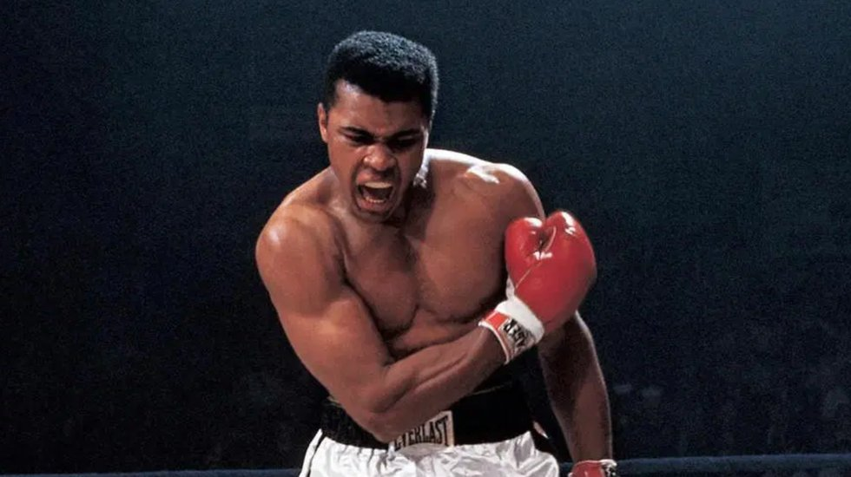
Who he was ?
Muhammad Ali was an American professional boxer. Nicknamed "The Greatest", he is regarded as one of the most significant sports figures of the 20th century. Widely regarded as one of the greatest heavyweight boxers of all time, he held the Ring magazine heavyweight title from 1964 to 1970.

Slide 4
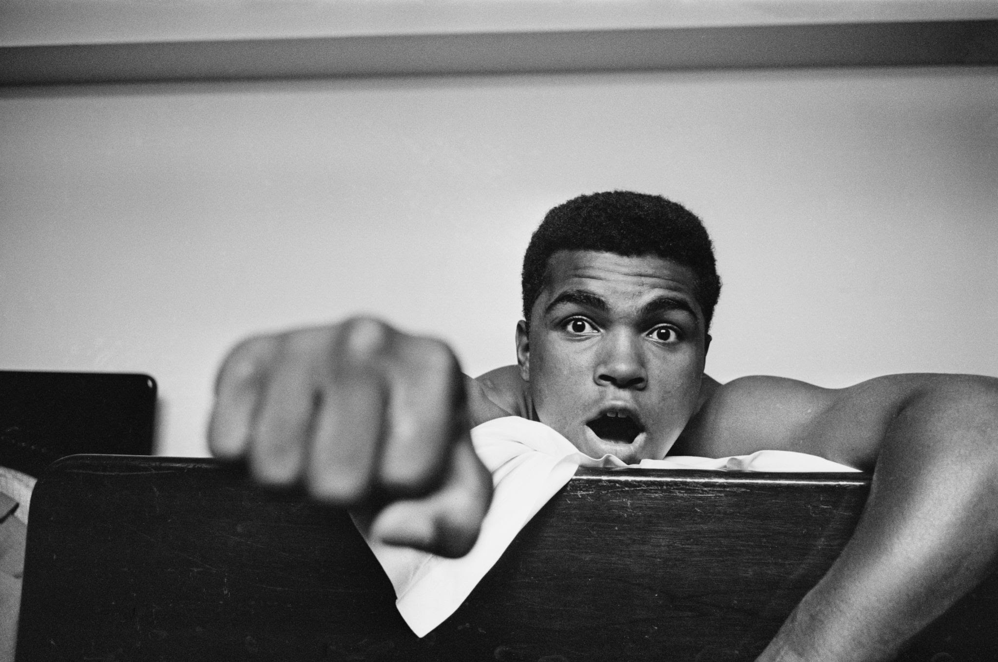
Three important facts about Muhammad Ali
Muhammad Ali was one of the greatest boxers in history, the first fighter to win the world heavyweight championship on three separate occasions. In addition, he was known for his social message of black pride and black resistance to white domination and for refusing induction into the U.S. Army during the Vietnam War.
Muhammad Ali, originally named Cassius Marcellus Clay, Jr., was born in Louisville in 1942. Ali grew up at 3302 Grand Avenue in Louisville's West End and was introduced to boxing at a young age by a city policeman after the boy's bicycle was stolen.

Slide 5
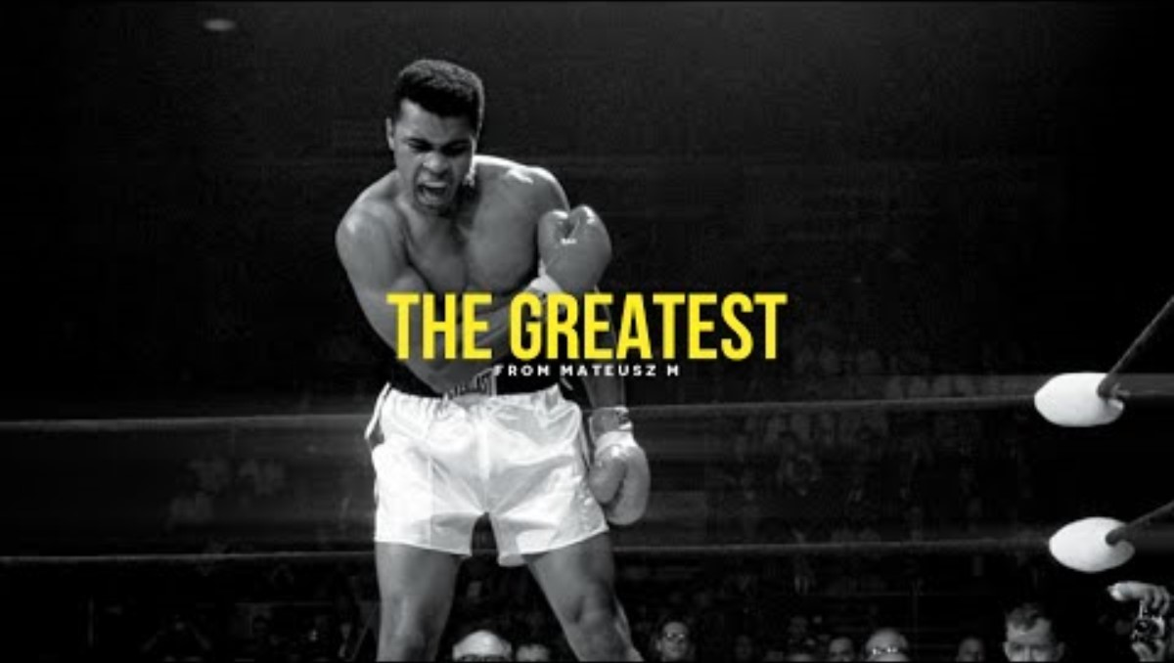
This is the reason why Muhammad Ali was the Greatest

