Slide 1
Research Principles and Philosophy
[LCDB7007]
Week 3 (Part 1 of 2)
Understanding research philosophies and approaches

Slide 2
Understanding research philosophies and approaches

Slide 3
Today’s plan….
Define the key terms ontology, epistemology and explain their relevance to business research;
Explain the relevance for business research of philosophical perspectives such as positivism, pragmatism, and interpretivism;
Distinguish between main research approaches; deductive and inductive;

Slide 4
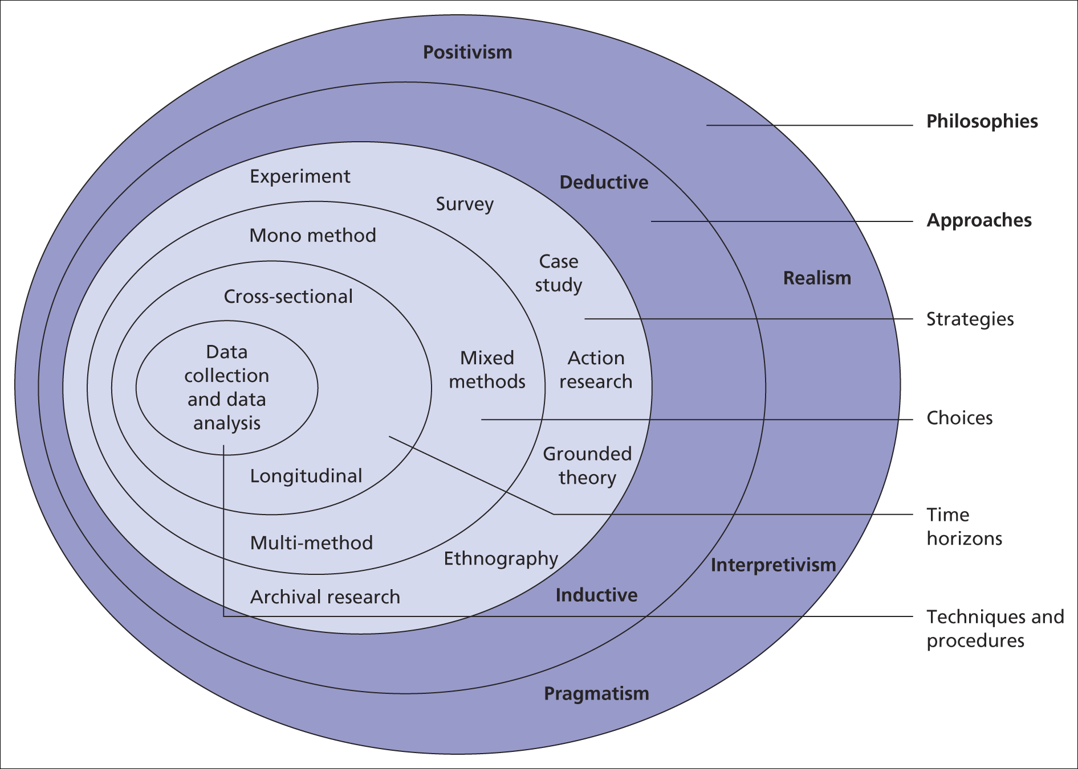
Underlying issues of data collection & analysis
The research ‘onion’
Saunders et al, (2008)
Figure 4.1 The research ‘onion’

Slide 5
Research philosophy
‘Research philosophy is an over-arching term relating to the development of knowledge and the nature of that knowledge’

Slide 6
Understanding your research philosophy
Two major research Philosophy:
  Ontology and
  Epistemology

Slide 7
Understanding Ontology
Ontology
It is concerned with nature of reality. This raise the questions of the assumptions researchers have about the way the world operates and commitment held to particular views. The two aspects of ontology we describe here will both have their devotees among business and management researchers , In addition, both are likely to be accepted as producing valid knowledge by many researchers

Slide 8
Ontology Contd….
Blaikie (1993) describes the root definition of ontology as ‘the science or study of being’ and develops this description for the social sciences to encompass ‘claims about what exists, what it looks like, what units make it up and how these units interact with each other’. In short, ontology describes our view (whether claims or assumptions) on the nature of reality, and specifically, is this an objective reality that really exists, or only a subjective reality, created in our minds.

Slide 9
Ontology Contd….
First aspect of ontology we discuss is objectivism. This portrays the position that social entities exist in reality external to social actors concerned with their existence.
Second aspect, subjectivism holds that social phenomena are created from the perceptions and consequent actions of those social actors concerned with their existence
For example, a workplace report – asking one to question whether it describes what is really going on, or only what the author thinks is going on.

Slide 10
Epistemology
It concerns what constitutes acceptable knowledge in a field of study.
Closely coupled with ontology and its consideration of what constitutes reality, epistemology considers views about the most appropriate ways of enquiring into the
nature of the world (Easterby-Smith, Thorpe and Jackson, 2008) and ‘what is knowledge and what are the sources and limits of knowledge’ (Eriksson and Kovalainen, 2008).

Slide 11
Epistemology Contd….
Blaikie (1993) describes epistemology as ‘the theory or science of the method or grounds of knowledge’ expanding this into a set of claims or assumptions about the ways in which it is possible to gain knowledge of reality, how what exists may be known, what can be known, and what criteria must be satisfied in order to be described as knowledge.
Chia (2002) describes epistemology as ‘how and what it is
possible to know’ and the need to reflect on methods and
standards through which reliable and verifiable knowledge is
produced.

Slide 12
Epistemology
Hatch and Cunliffe (2006) summarise epistemology as ‘knowing how you can know’ and expand this by asking how is knowledge generated, what criteria discriminate good knowledge from bad knowledge, and how should reality be represented or described.
They go on to highlight the inter-dependent relationship between epistemology and ontology, and how one both informs, and depends upon, the other.

Slide 13
Aspects of philosophy
Positivism - the stance of the natural scientist
Interpretivism – researchers as ‘social actors’
Pragmitism

Slide 14
Positivism
Positivism can be defined as “research approaches that employ empirical methods, make extensive use of quantitative analysis, or develop logical calculi to build formal explanatory theory”

Slide 15
Interpretivism
Interpretivism advocates it is necessary for the researcher to understand differences between humans in our role as social actors.
This emphasizes the differences between conducting research among people rather than objects such as trucks and computers.

Slide 16
Interpretivism
Interpretive research is concerned with the meanings that people attach to norms, rules, and values that regulate their interactions.
Care is taken not to impose a previous understanding of norms, rules, and values on others but rather to understand their beliefs and actions from their point of view.
The focus is not only on what they tell us directly about the reasons for their beliefs and actions but also on the social practices that underlie them. Social practice gives meaning to social action

Slide 17
Pragmatism Contd….
Pragmatism holds that the most important determinant of the epistemology, ontology, axiology adopted is the research question.
Pragmatist recognizes that there are many different ways of interpreting the world and undertaking research, that no single point of view can ever give us entire picture and that there may be multiple realities.

Slide 18
Research Approaches
Deduction: if your research starts with theory, often developed based on literature review, and you design a research strategy to test the theory.
Induction: If your research starts by collecting data to explore a phenomenon and you generate or build theory (conceptual framework).
Abduction: You are collecting data to explore a phenomenon, identify themes, and explain patterns to generate a new or modify an exiting theory which you subsequently test through additional data collection .

Slide 19
Deduction
5 sequential stages of testing theory
Deducing a hypothesis
Expressing the hypothesis operationally
Testing the operational hypothesis
Examining the specific outcome of the enquiry
Modifying the theory (if necessary)
Adapted from Robson (2002)

Slide 20
Characteristics of Deduction
Explaining causal relationships between variables
Establishing controls for testing hypotheses
Independence of the researcher
Concepts operationalised for quantative measurement
Generalisation

Slide 21
Induction
Building theory by –
Understanding the way human build their world
Permitting alternative explanations of what’s going on
Being concerned with the context of events
Using more qualitative data
Using a variety of data collection methods

Slide 22
Right research approach
The right choice of approach helps you to
Make a more informed decision about the research design
Think about which strategies will work for your research topic
Adapt your design to cater for any constraints
Adapted from Easterby-Smith et al. (2008)

Slide 23
Combining research approaches
Things worth considering
The nature of the research topic
The time available
The extent of risk
The research audience – managers and markers

