Slide 1
Data Capture & Evaluation
Lawrence Groom & Jennifer Mungham
Dstl

Slide 2
Crown copyright (2024), Dstl. This information is licensed under the Open Government Licence v3.0. To view this licence, visit https://www.nationalarchives.gov.uk/doc/open-government-licence/ . Where we have identified any third party copyright information you will need to obtain permission from the copyright holders concerned. Any enquiries regarding this publication should be sent to: centralenquiries@dstl.gov.uk

Slide 3

Introduction
Who We Are
  Brief history in Company
  Experience
Lecture Plan
  Trials Planning
  Instrumentation Overview
  Range Craft
  Standard Techniques
  Novel Techniques
  Signal Conditioning & Amplifiers
  Triggering
  Timings
  Data Analysis
  Case Studies

Slide 4
Scheme of work
The reality of an OME event – the operation and analysis of a range day involving OME – 2hrs
Blast gauges, high speed cameras, doppler radar – 2 hrs
Novel diagnostics – 2 hrs

Slide 5
Data
Facts or numbers, collected to be examined and considered and used to help decision-making
Types:
  Quantitative: numerical
  Qualitative: non-numerical
Important Considerations:
  Quality
    Accuracy (How close to true value)
    Precision (Refinement in measurement)
    Completeness
    Reliability (Repeatable results)
    Relevance
    Timeliness (up-to date?)
  Validity (trustworthy & fit for purpose)
  Biases

Slide 6
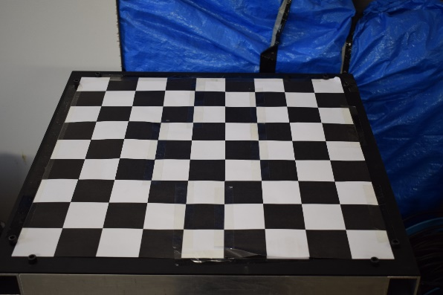
Calibration
“To standardize by determining the deviation from a standard so as to ascertain the proper correction factors” – Meriam Webster
Important for ensuring accuracy and to allow comparison across work
Sensors will have a nominal output but need to calibrate to get specific output for each sensor
Camera field of view will be specific to each set up
System can be calibrated individually or as a whole
Standards

Slide 7
Why do We Capture Data?
“Scientific Method”
  Generate hypothesis
  Tests hypothesis
  Modified hypothesis
  Tests modified hypothesis
  Repeat until hypothesis is consistent with testing data
Example Hypotheses:
  Munition is insensitive to static charges under 25kV
  New formulation has a Chapman Jouguet Pressure of over 30GPa
  New round is easier to load than existing
  Global trends show an increase in the use of “dumb” weapons

Slide 8
Data Capture Methods
Trial
  Dstl definition = “Experimentation; demolition; proving; testing; training; or flying SUAS, with: equipment; people; software; substances or systems, to: acquire data; characterise; develop; dispose; evaluate; learn or understand.”
  Trials can be applied to all stages of an OME article’s lifecycle
Computer Model
  A simple representation of a system or process, especially one that can be used in calculations or prediction of what might happen
Surveys/Polls/Focus Groups
  Collect a series of responses from a group or representative sample of a group of people
Secondary Data Analysis
  Collect data from public or internal sources without doing own experimentation

Slide 9
Trials Planning
Lawrence Groom & Jennifer Mungham
Dstl

Slide 10
What do you need to measure?
Examples include…
  Pressure
    Absolute/Gauge
    Quasi-Static/Dynamic
  Velocity – this may be “of detonation”, “of jet”, “of fragments”
  Time
Do you need to measure velocity of a fragment or the components to calculate velocity?
Do you need to measure pressure or the effect on a particular surface?

Slide 11
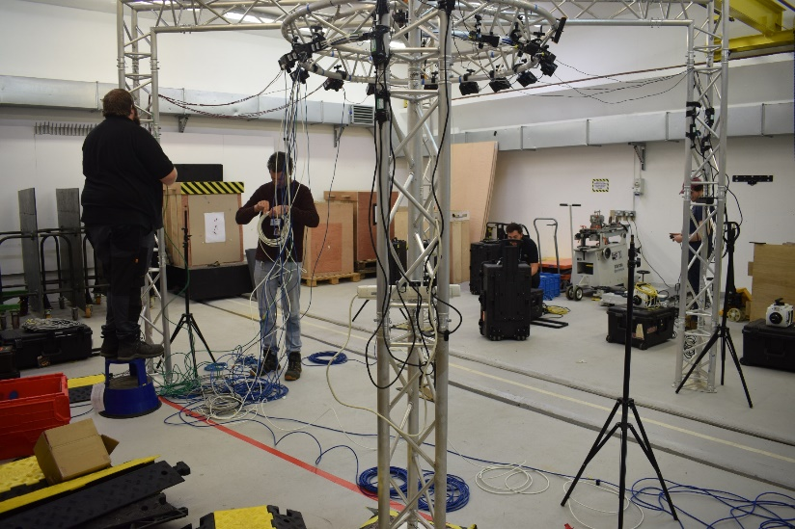
What do you need to measure it?
Recording Equipment (camera, data recorder)
Cables
Supporting Infrastructure (stands, protection)
Cables:
Power
Communications
Control
Tripods/stands
Cable covers

Slide 12
What’s been done before?
Other institutions
  Papers/presentations/visits
Iterative tests
  Part of a longer project
Common test standards
  NATO
  Local agreements
Historical data
Do we need to make changes?
  New requirements
  New legislation
  New technologies
  Supply Chain Issues
  Redundancy
    Limited items – want more techniques as back ups
  Capability in-house/externally
  Didn’t give us info that we needed/missing data

Slide 13
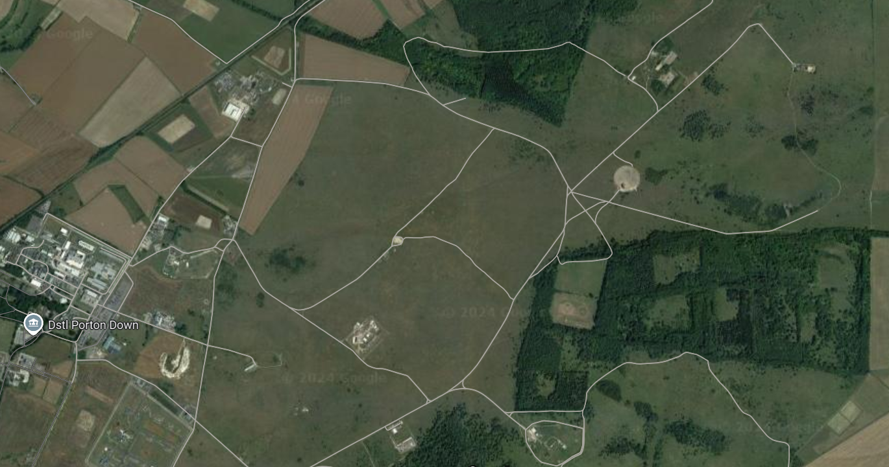
Where can you do the tests
Variety of sites around the world where explosive tests are conducted
Choice may be limited by requirements of the test
  Land/Sea/Air Domain
  Noise limits
  Cover Area
  Facilities
  Indoor/outdoor
  Security
  Licences e.g. FXR,
  Cost
OP13
Hard Target
OP15
BM21

Slide 14

Booking forms galore
Varies between institutions & Test Sites
Might include:
  Personnel
  Range
  Equipment
  Magazine releases
  Transportation
  ADR
  T&S
  Military participation

Slide 15
Compliance
Legal
  Animal Testing
  Radiation Emissions
  GDPR
  SUAS
  Transportation e.g ADR
  Health & Safety
Company rules
  Training/Competence
  Security
SSoW - Safe system of work needs particular attention, you are INST will is adding hazards to a range and increasing the risk of an incident as a result. You need to understand the paperwork and make sure you and everyone else is covered.
PPE - As INST you are probably going to be in the middle of everything. PPE becomes much more than steelies and a coat.

Slide 16
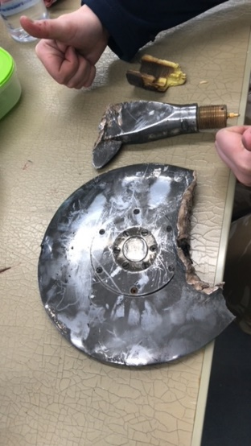

Costs
Range Hire
Personnel
  Time
  T&S
PPE
Waste Disposal
Test Articles
Engineering
Visitor Hosting
Instrumentation
  Calibration
  Equipment Hire
  Consumables
  Research
  New equipment
  Pre-trial tests
  Data Analysis
  Infrastructure Hire (Generators)

Slide 17
Range Craft
Lawrence Groom & Jennifer Mungham
Dstl

Slide 18
Infrastructure
Bare Field, Indoor Range or somewhere in between?
Ground surface
  Concrete pad
  Mud
Power reliability
  Mains – trippable fuses?
  Generators – need RCBD?
  Connections disrupted by shock?
Buildings
  Storage Areas
    Explosive & non-explosive
    Temp controlled?
  Work Areas
    Explosive & non-explosive
    DSE of workstations
  Toilets/kitchenette

Slide 19
Positional Considerations
Sun position
  Providing lighting
  Glare on surfaces
Pressure reflections
  Free-field pressure or triple point
Camera Field of View
  Avoid seeing sensitive items
  Parallel to line of travel for velocity measurements
Cables
  Minimising length of data cables
  Avoiding walking/driving routes
Radiation
  Backstops
  Avoiding walking/driving routes
Fragmentation
  Source directional?

Slide 20
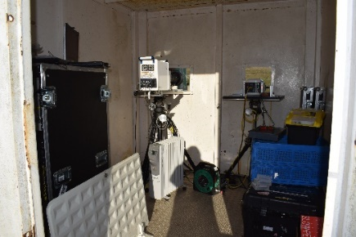
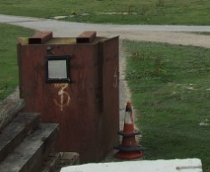
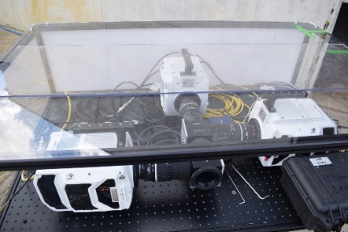
Protection
What grade do you need? Are you stopping SC jets or plastic casings?
Armour – is it good enough for what's coming at it?
Camera housings, cable covers, “splinter-proofs” (big metal box that can usually fit a person and a tripod)
Distance
Chance/probability – not recommended

Slide 21
Illumination
Sun Light
  Variable/unreliable
Argon Flash Bombs
  Contain 10’s grams of explosive – may breach range licence
Magnesium Flash Bulbs
  One use only
  Difficult to source
  Long ramp up time
Halogen/Xenon Bulbs
  Produce lots of heat/UV
  Need protecting from frag/blast
LEDs
  Need protecting from frag/blast
  Flicker-free?
Lasers
  Reduces explosive over-flash
  Significant AOR hazard

Slide 22

Communication
Local Area Networks (LAN)
  Ethernet, Fibre Optic, Wireless Links
  Bandwidth
  Compatibility
  Distance Limitations
  Weather Limitations
  IP Address compatibility
USB
  Bandwidth
  Distance Limitations
Hazards
  Fauna
  Vehicle Access
  Fragmentation

Slide 23
Standard Instrumentation Techniques
Lawrence Groom & Jennifer Mungham
Dstl

Slide 24
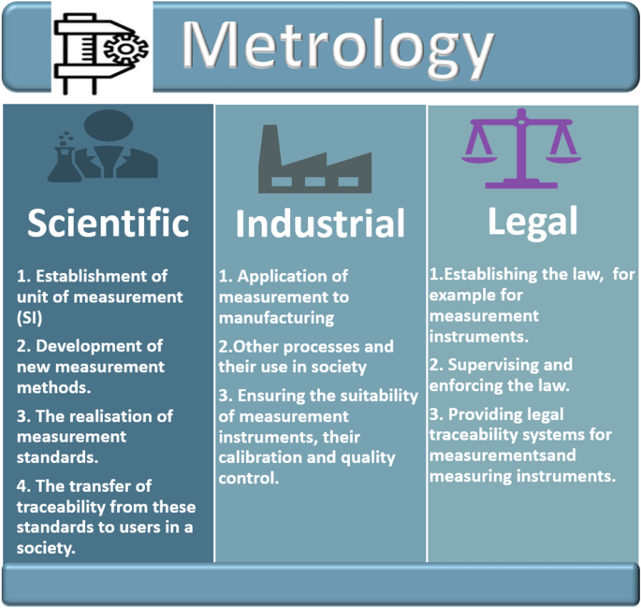
What is Instrumentation
Instrumentation
  measuring instruments regarded collectively
Metrology
  the scientific study of measurement
In Dstl it can range from setting up a piece of kit for a user, to helping to design the trial, running equipment and analysing data

Slide 25
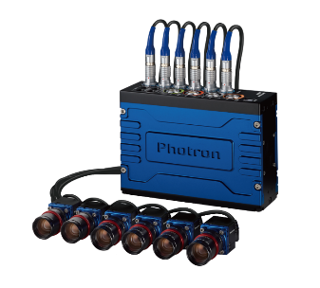
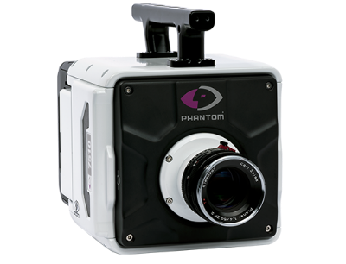
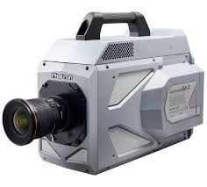
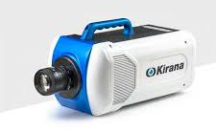
Cameras
Used for:
  Quantitative data
    Calibrated field of view
  Overview of event
    Check for anomalies
    “pretty pictures” for reports/presentations
High-speed is loose term
  Go Pro = 240fps
  Phantom TMX7510 = 75,000fps
  Shimadzu HPV = 10 million fps
  Framing Cameras = 200 million fps
Trade-off between frame rate and spatial resolution
Various manufacturers with many models available
  Phantom, Specialised Imaging, Shimadzu, Photron, IX, Invisible Vision, Cordin, Krontec, etc
Each manufacturer will have bespoke software
Need to consider ancillaries
  Lenses
  Protection
  Mounting
  Communications
  Triggering

Slide 26
Time Of Arrival Devices - TOADs
Ionisation pins
  Moisture sensitive
  Need running at 100V+
  Cheap-ish = £15 each
Piezo pins
  Expensive = £30 each + £30 for cable
  Reliable
Bare copper wire
  Cheap
  Have to scratch off coatings
  Cheap = £0.25 for 1m
Fibre Optic
  Cheap = £0.5 for 1m
  Needs background light blocking
Foils
  Reliable
  Break/make/PVDf
Heterodyne Velocimetry
  Expensive = £90 each
  Very precise

Slide 27
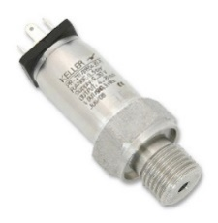
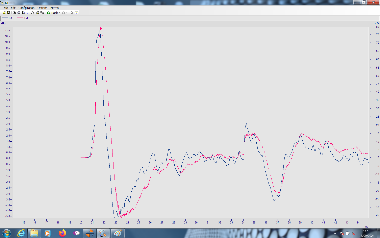
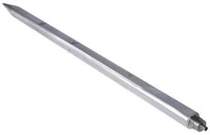
Sensors - Pressure
Pressure = force per unit area
  Absolute Pressure = pressure in reference to a vacuum
  Gauge/Over pressure = pressure in reference to atmospheric level
  Quasi-static pressure QSP = changes in pressure which occur gradually allowing the system to readjust
Measured in Pascals or bar
Reflective or Incident
Sensor Types:
  Piezo Resistive – change in electrical resistivity measured on a Wheatstone bridge
  Piezo Electric – creation of an electric charge
  Integrated Circuit Piezoelectric (ICP)/Integrated Electronics Piezo Electric (IEPE) – Built in amplifiers

Slide 28
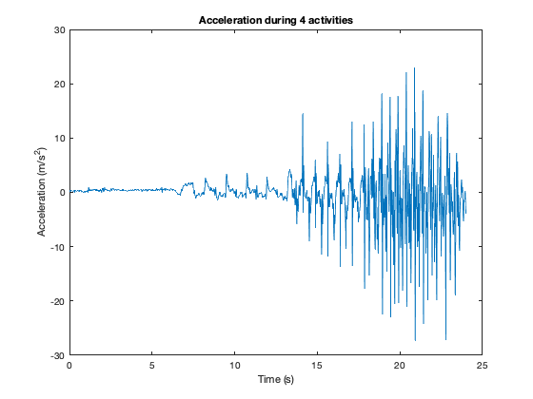
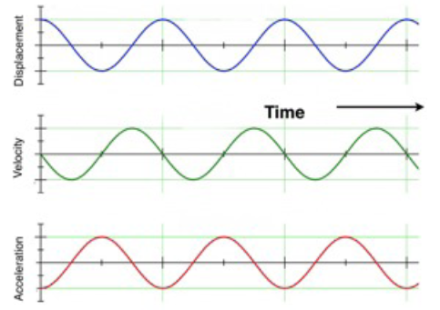
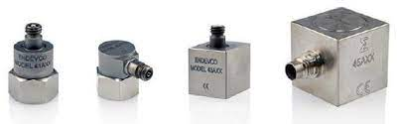
Sensors - Acceleration
Acceleration – Change in rate of velocity for unit of time
Measured in g or ms⁻¹
Single or Triple Axis
Sensor Types
  Piezo Electric
  Piezo Resistive

Slide 29
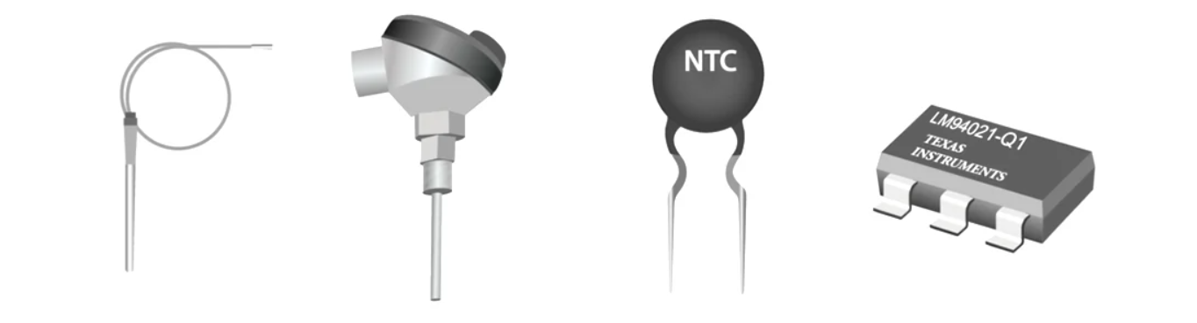
Sensors - Temperature
Temperature = measure of the average kinetic energy of the particles in an object
Measure in Celsius or Kelvin
Sensor Types
  Thermometer
  Thermocouple
  Thermistor
  Resistance Temperature Detectors
  Semiconductor Based Integrated

Slide 30
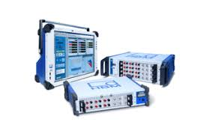
Data Recorders
Data recorders & Oscilloscopes are all essentially analogue to digital converters with memory to store data
High Speed Data Acquisitions Systems
  HBK
  National Instruments
  Pico
  AMO
  Agilent
  Tektronix
For pressure sensors, start at sample rate of 1MS/s
For heterodyne velocimetry, start at sample rate of 10GS/s
Need to also consider:
  Bandwidth
  Bit Depth
  Memory Depth
  Saveable Formats
  Number of channels

Slide 31
Bit Depth
Data Recorder will have a voltage scale i.e. +/- 20V
  = 40V range for recording
Data recorder will have a stated bit depth (usually 8, 12 or 16 bit)
  Analogue input signal is converted into a digital signal
  Digital signals are no longer continuous – they have steps
  Bit depth is the number of steps the voltage range can be divided up into
    E.g. 12 bit depth = 2¹² = 4096
So 40 Volts divided by 4096 steps =9.77mV per step
  This is limit of precision in measurement of data recorder
The more steps and/or the lower the range – the more precise the measurement
  Lower range = lower measurement range so better to have high bit depth

Slide 32
Infra-red Radiation
All objects with temperature above 0 K emit Infrared Radiation (IR)
Detectors turn magnitude of IR into electronic signal
  Visual output = thermogram
Sensor Types
  Thermometer/Radiometer
  Cameras
  Spectrometers
3 things you can’t alter in post-processing with thermal camera:
  Range of camera
  Focus
  Composition
4 things you need to measure before event for IR cameras
  Emissivity of object
  Reflective temperature
  Distance to object
  Atmospheric temperature

Slide 33
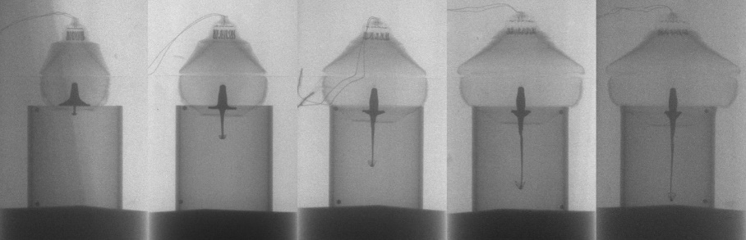
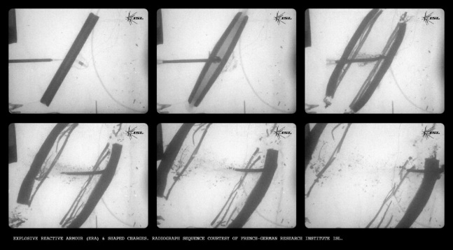
Flash X-Ray Imaging
X-ray pass through low density material such as dust , wood, thin metals
  Higher voltage = higher flux
X-ray imagers not affected by high visual output of explosives
Allows for imagery in early stages of energetic events
Each pulse – needs several ms to recharge so multiple images require multiple emitters

Slide 34
Heterodyne Velocimetry
Direct measurement of velocity
Also known as Photon Doppler Velocimetry (PDV)
Typically refers to the use of 1550nm near IR but can be done with any wavelength of electromagnetic radiation
  Longer wavelengths = longer distances but reduced resolution
Process
  Emission laser reflects off a moving object
  Its movement causes reflected emission to be stretched or compressed (Doppler effect)
  Original and reflected emission mixed (super position) to generate a lower frequency signal known as beat frequency
  Fast Fourier Transform applied to data to create spectrogram and identify all beat frequencies
  Beat frequency directly proportional to velocity of moving object
    v = ½(λ₀*f_{b})

Slide 35
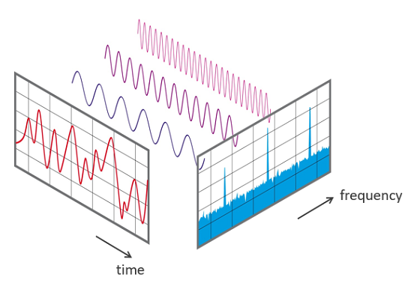
Fast Fourier Transforms
Voltage time signal recorded by oscilloscope
  The sampling rate and number of samples determine the maximum frequency that the oscilloscope can measure (bandwidth)
FFT converts signal from time domain to frequency domain
  Breaks down complex oscillating signal into all individual frequencies within bandwidth
  Generates lots of low magnitude frequencies = noise
  Will highlight high magnitude frequencies = signal

Slide 36
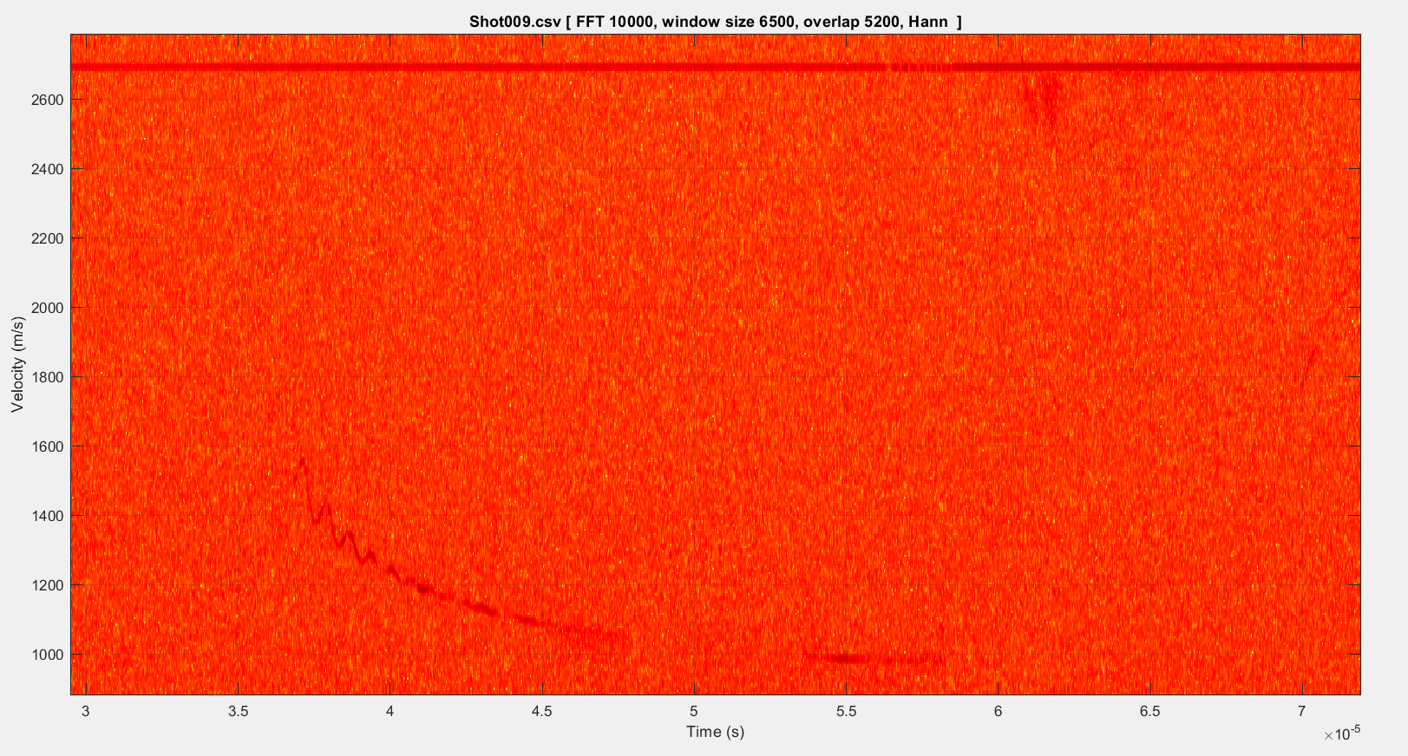
Heterodyne Velocimetry
Spectrogram graph of FFT results
x-y line graph of main line from spectrograph

Slide 37
Novel Diagnostic Techniques
Lawrence Groom & Jennifer Mungham
Dstl

Slide 38
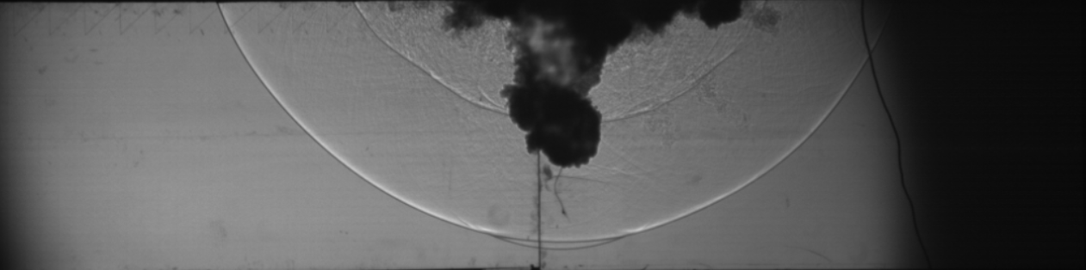

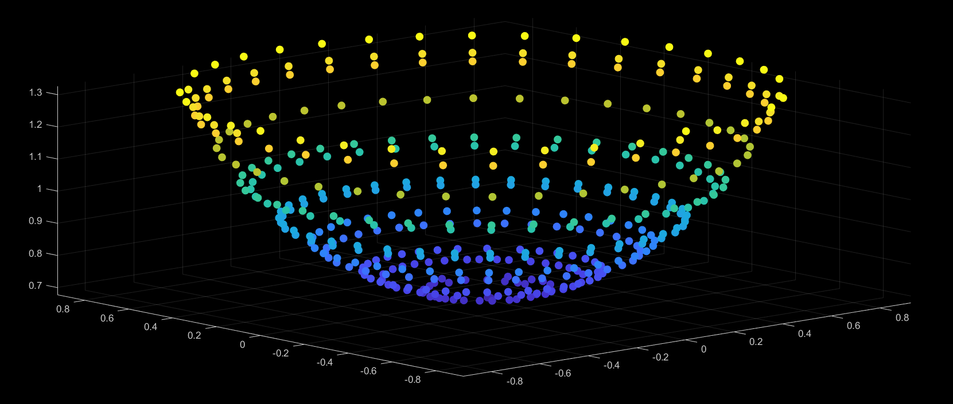
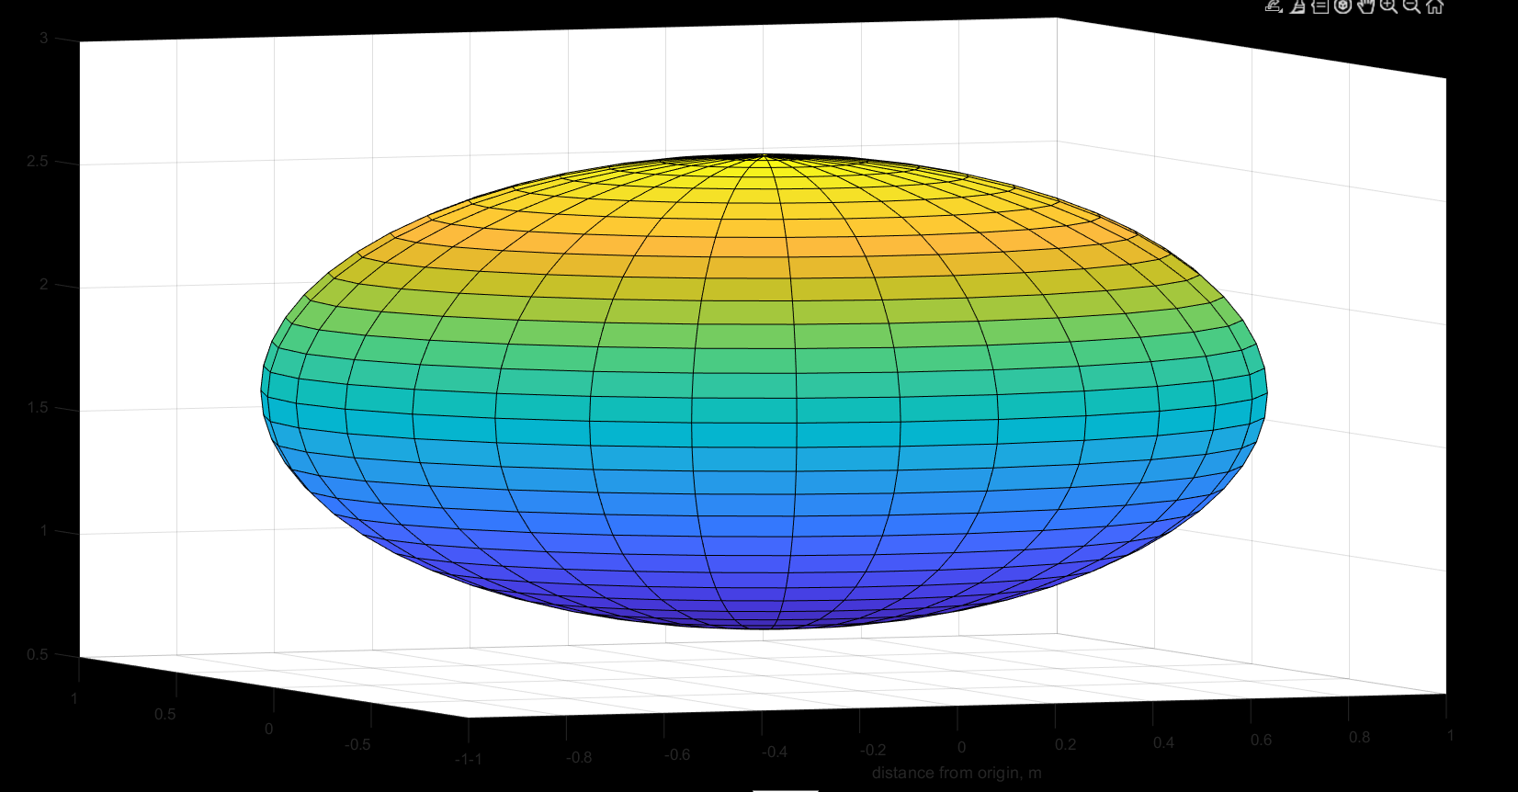
Schliere
Diffraction of light caused by the change of density of medium, for example as a result of pressure, creating an absence on a backboard.
Good for visualising shock waves from complex designs

Slide 39
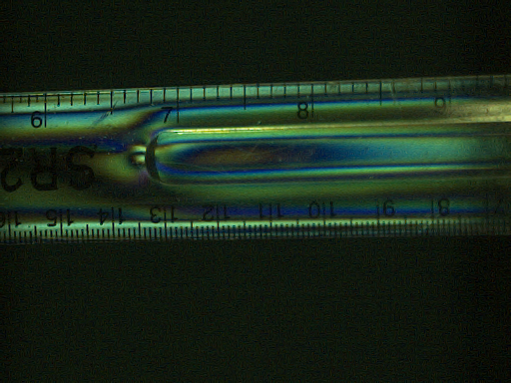
Photo-Elasticity
Change in refractive index of a transparent object
Changes demonstrated as rainbow effect
Can be calibrated to measure stress in the material
Polarised light source viewed through polarised filter on camera

Slide 40
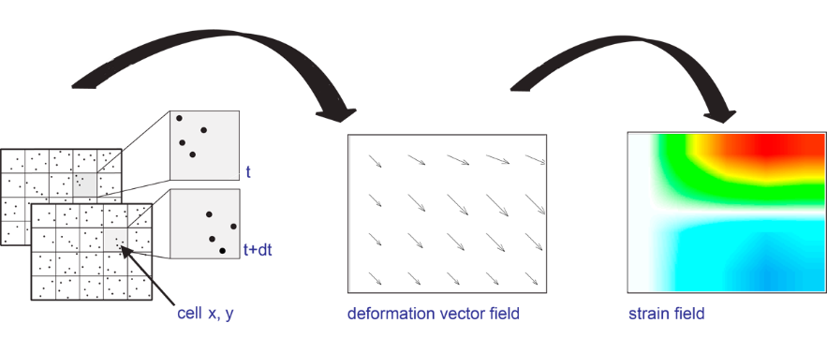
Digital Image Correlation
Surface is covered with “random” speckle pattern
Two cameras view same object at slightly different angles
Software matches speckle pattern between the two cameras and identifies deformations
  Can also calculate strain in material
Play off between resolution and frame rate for the cameras
https://youtube.com/watch?v=4R6gfYbUMDg

Slide 41
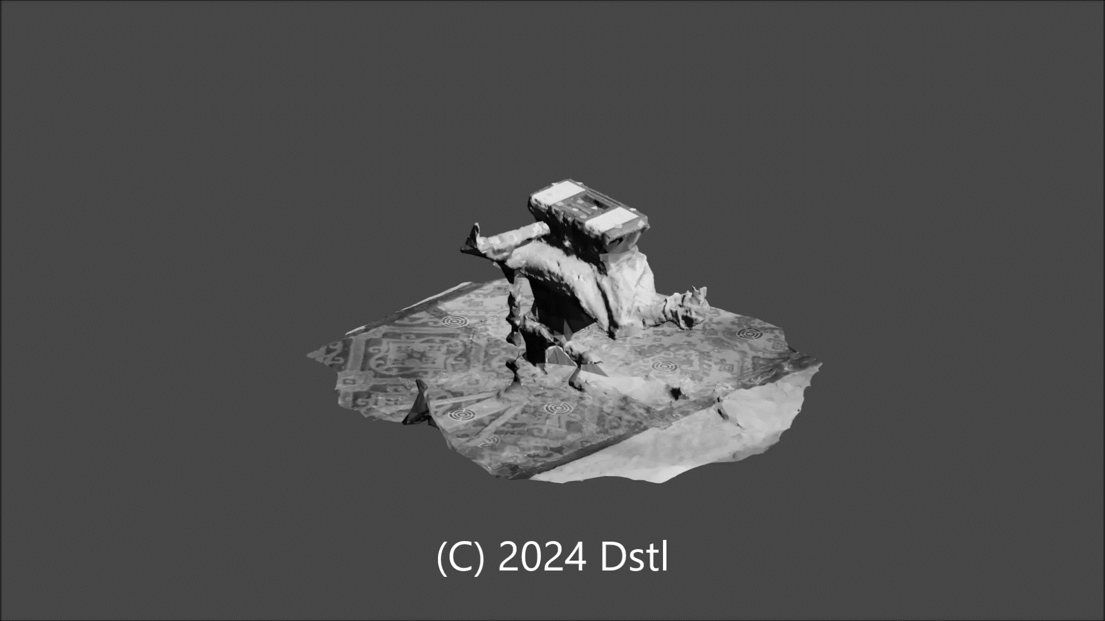
Photogrammetry
Technique of getting quantitative data from a collection of imagery
Colloquially used for generating 3D models from array of imagery
Take images from variety and angles with significant overlap
Modelling programs use overlap to stitch images together

Slide 42
Pyrometry
Method of temperature measurement
Utilises 2 high speed cameras looking down the same optical path
  Non-invasive
  High speed
  High resolution
Each camera is fitted with a narrow (±10nm) IR band-pass filter of a different frequency
Identical lenses used on each camera
Beam splitter keeps optical paths aligned
This method means that data can be captured as fast as the cameras can run with high resolution

Slide 43
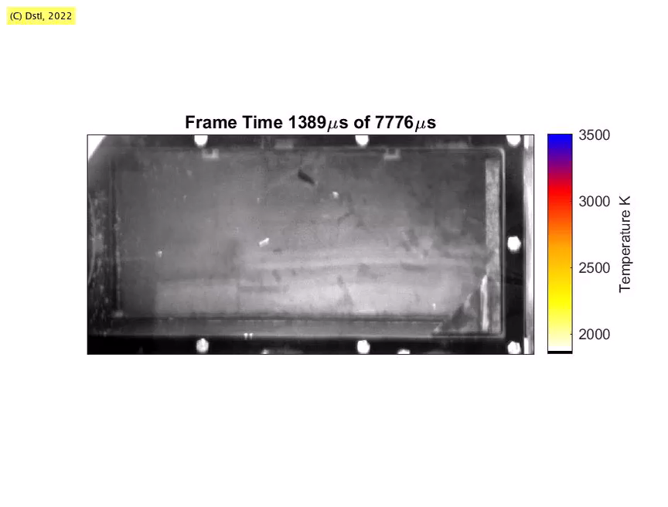

Slide 44
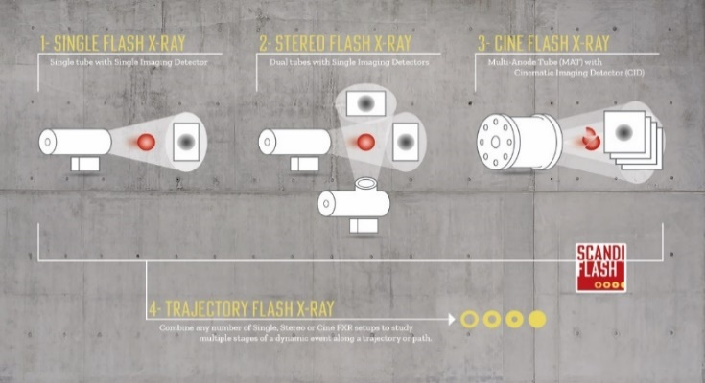
Cine FXR
Process of taking multiple flash x-ray images to create a video effect
  Source generates x-rays of sufficient flux
  X-rays pass through area of interest and interact with scintillator material
  High speed camera images the scintillator
Two areas to sort; source and scintillator
  Current pulse heads have long re-charge time
  Continuous sources generally not strong
  Scintillators have refresh rate
  Scintillators need protection from fragmentation

Slide 45
Signal Conditioning & Amplifiers
Lawrence Groom & Jennifer Mungham
Dstl

Slide 46
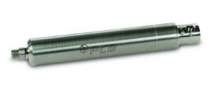
Converters
Piezo electric sensors output in charge
  Small signal
  High impedance (resistance)
Can be built in (IEPE sensors) or separate
Can also apply gain/amplification
Can add noise if susceptible to vibration
Max outputs of 5V (typical)

Slide 47
Gain
Typically working with voltage gain not current or power
Ratio of output to input = Output/Input
  Gain of 1 = no gain applied (unity gain)
  Gain of 10 = output = 10 x input
  Etc.
Applied by amplifiers

Slide 48
Equipment
Conditioners
  Instrument converts one type of electrical or mechanical signal into another
  Can also apply linearization when used as part of calibration process
  Filtering – block out noise frequencies
    Can be active or passive
Amplifiers
  Increase magnitude of a signal

Slide 49
Gauge Settings Spreadsheet
Must be below 5,000mV (max output of charge converters), but as high as possible to reduce signal to noise ratio
100/Gain – setting required for Endevco Istotron amplifier and conditioner
Estimated from Conwep, Kingery & Bulmarsh or previous trials results
Expected Pressure | Gauge | Gauge Sensitivity | Gauge Output | Charge Converter | CC Sensitivity | CC Output | Required Output | Gain | Isotron | Scaling Factor
kPa | SerNo | pC/kPa | pC | SerNo | mV/pC | mV | mV | Required | Setting X 1 | Pa/V
800 | 194000 | 0.80 | 640 | CpP33 | 0.9999 | 640 | 5000 | 7.8133 | 12.8 | 160,000
400 | 194001 | 0.79 | 316 | CP32 | 10.0012 | 3160 | 5000 | 1.5821 | 63.2 | 80,000
200 | 194002 | 0.82 | 164 | CP31 | 10.0041 | 1641 | 5000 | 3.0475 | 32.8 | 40,000
800 | 98416 | 14.20 | 11360 | CP29 | 0.0997 | 1132 | 5000 | 0.4413 | 226.6 | 160,000
400 | 94524 | 13.64 | 5456 | CP28 | 0.9913 | 541 | 5000 | 0.9152 | 109.3 | 80,000
200 | 15 | 13.52 | 2704 | CP27 | 1.0092 | 2729 | 5000 | 1.8323 | 54.6 | 40,000
Scaling factor put into data recorder to turn V into kPa based upon expected pressure and required output
Output of charge converter at expected pressure based on gauge’s and charge converter’s calibration values
Output of gauge at expected pressure based on gauge’s calibration
Ratio of Required output to CC output (1 = no gain applied)

Slide 50
Triggering
Lawrence Groom & Jennifer Mungham
Dstl

Slide 51
Detonators
High Voltage
  Reliable timings (µs)
  Strong signal
  Higher safety base line (harder to accidentally initiate)
Low Voltage
  Variable timings (ms)
  Lower safety base line when compared to HV dets
  Cheaper

Slide 52
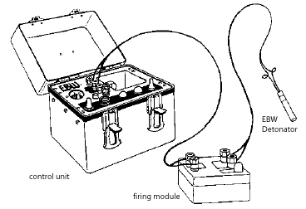
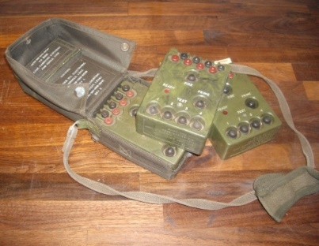
Firing Packs
Reynolds – HV set, bench top firing set with a capacitor block that is located between the firing set (red button) and the detonator
Shrike – Green army, low voltage hand held, two hand operation required
Minex – “Black Shrike” more ergonomic, LV, hand held. Designed for single hand operation.
Wireless – tend to induce large delays for det function but can be used over Km distance.
Shock tube

Slide 53
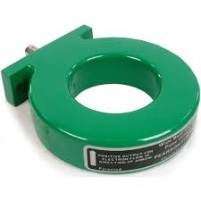
Induction – Pearson Coil
Produces a voltage as a result of magnetic induction from firing cable current
Non intrusive.
Intrinsically safe
Highly recommend the signal from the coil is pushed through a bridge rectifier/diode unit for equipment safety purposes

Slide 54
Event Triggering
Outputs of Explosive
  Light
  Sound
  Blast Wave
  Fragmentation
Electrical contact from case expansion

Slide 55
Software Triggering
Manual trigger
Image Based Auto Trigger (IBAT)
  Light Levels
    % magnitude
    % area
DAQ Trace Levels
If all kit triggers at different times – no common time
Can control multiple cameras at once but if manually triggering – software can only talk to one at a time so trigger times will be different

Slide 56
Timings
Lawrence Groom & Jennifer Mungham
Dstl

Slide 57
T0
Common point in time for experiment
Links all instrumentation
Can be firing pack, detonator, first light output, etc
Delay/ Signal generators
Cable Length effects

Slide 58
Order of Events
Not just explosive chain
Things to consider:
  Synchronising with equipment i.e. Cordin Framing Cameras, Flash X-Ray
  Warm up time for lights
  Reaction time of detonators
  VoD of explosive
  Short recording length ie Pulse power supply
Detonator
Instrumentation
Main Charge

Slide 59
CASE STUDY
Timings activity: Cylinder Expansion Test (CylEx)
  High voltage detonator (7µs)
  PE8 Booster
    VoD 7500ms⁻¹
    Distance 25mm
  Charge
    VoD unknown
    Distance 300mm
Pulse Power supply for Manganin stress gauge at base of charge last 100µs
Oscilloscope for het-v can record for 200µs
  Probes at 200 and 250mm from top of charge
Framing Camera
  16 frames
  5ns interframe time
  7ns minimum delay from trigger

Slide 60
Data Analysis
Lawrence Groom & Jennifer Mungham
Dstl

Slide 61
File Formats
.PNRF – HBK DAQ’s
.DAT
.TP5 – AMO DAQ’s
.WFT
.CSV – Comma Separated Variable
.CINE – Phantom HSV
.MAT – Matlab

Slide 62
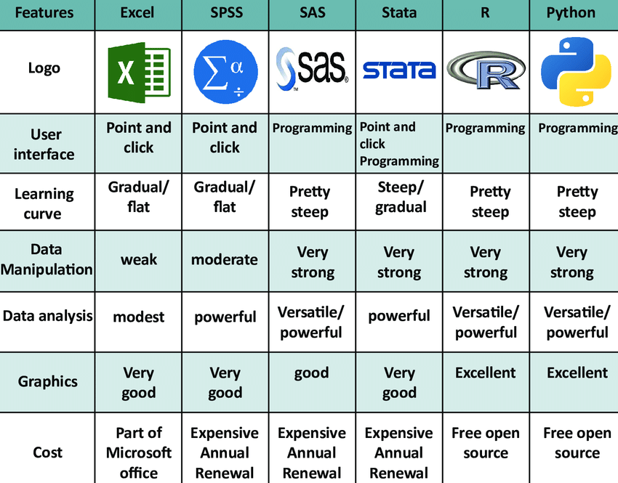
Programs
Excel
  max number of rows when opening normally is 65,536
    At 100MS/s this is 655µs
  Easy to use
MATLAB
Python
Famos
R
  Primarily for statistics

Slide 63
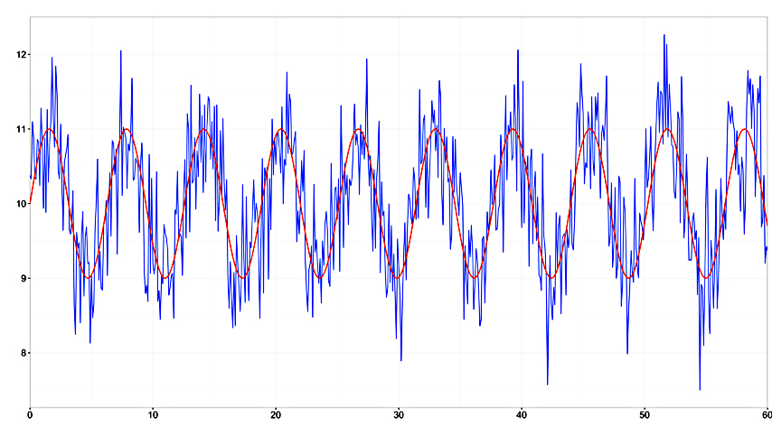
Filtering
Aim: Improve signal to noise ratio
Equipment based or Software based
Different filter types
  High Pass
  Low Pass
  Notch
  Finite Impulse Response (FIR)
    Moving average
Can make unexpected changes to your data

Slide 64
Uncertainties
Written as value or percentage
Typically systematic or random
Combine uncertainties from different sources to give one value for final measurement
  TOADs
    Time resolution of data recorder
    Human error in reading measurement
    Rise time in signal
    Resolution of tape measure
Equipment resolution
  If measuring distance with tape measure – precision if half of smallest legible graduation (0.5mm)
Equipment noise
  Last digit on readout may fluctuate
  Pick up of different frequencies
Human Error
  Random: miswrites a number
  Systematic: misreads number due to parallax

Slide 65
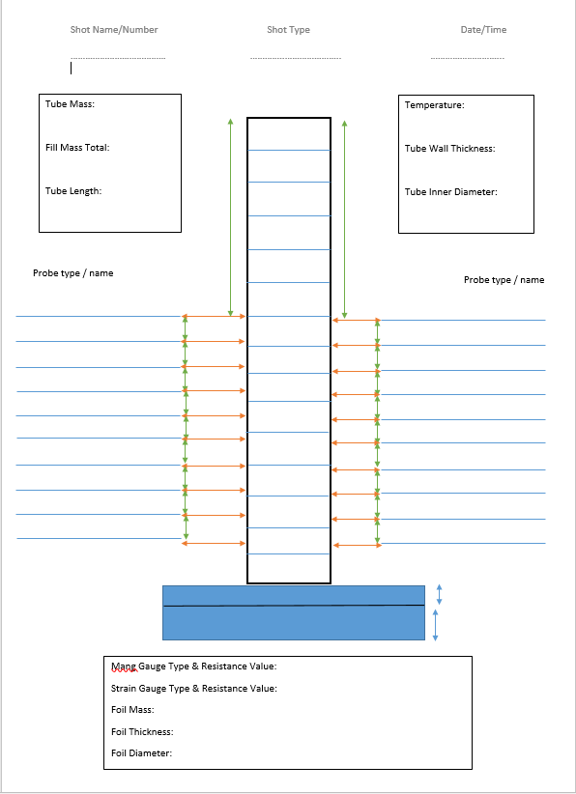
NOTES
Good notes are critical to understand your data
Need to write enough down that you or someone else could replicate the experiment

Slide 66
Case Studies
Lawrence Groom & Jennifer Mungham
Dstl

Slide 67
Cylinder Expansion Test – September 2021
Timeline
  2020 – Background research
  December 2020 – write proposal
  January 2021 – submit proposal
  February 2021 - accepted
  March 2021 – start planning
    Book staff, range & materials
  April – June - Write SSoW (Trials Plan, RAs)
  June – Roundtable & Sign-off
  August 2021 – Trial Delayed to Nov
  October 2021 – Send Stand design for Printing
  October – Run through with kit
  November 2021 – Conduct Trial
  December 2021 – Write Report
  January 2021 – Finalise Report
  January 2021 – Submit proposal for Next FY

Slide 68
Energetic Material Characterisation
Made a new material eg. EpEx 2 how do I know how “good” it is?
  Wedge Test
  DAX
  Cylex
  Critical Diameter Test

Slide 69
Energetic Device Characterisation
Made a new device eg. 155mm shell how do I know how good it is?
  Frag trial

Slide 70
Event Probability Characterisation
If scenario A happens how likely is certain outcomes e.g. sympathetic detonation in a VBIED
  Repeatability
  Statistical confidence

Slide 71
Comparison
Should MOD purchase new product, B, or stick with product original product, A

Slide 73
Contact Details
Lawrence Groom:
  T: 01980 952623
  e: lwgroom@dstl.gov.uk
Jennifer Mungham
  T: 01980 951333
  e: jlmungham@dstl.gov.uk
Dstl Instrumentation Team
  e: ExperimentalTechniques@dstl.gov.uk

