Slide 1
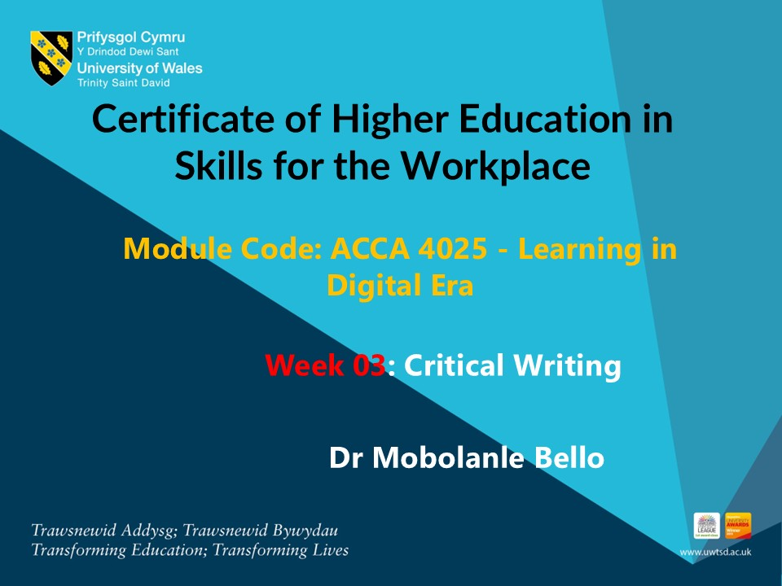

Slide 2
In this session we will…..
Define critical writing
Paraphrasing, summarising and synthesising
Plagiarism
Referencing

Slide 3
WHAT IS PARAPHRASING
Paraphrasing means putting something that you have read or learnt into your own words.
It is an essential skill in academic writing.

Slide 4

What Is Paraphrasing
Video
https://uwtsd.hosted.panopto.com/Panopto/Pages/Viewer.aspx?id=70f06d72-1e2c-4a73-8e18-aee2011341ac

Slide 5
Class Activity 1 – Paraphrasing Quiz
Kindly attempt this quiz in class
https://moodle.uwtsd.ac.uk/mod/quiz/view.php?id=640847

Slide 6
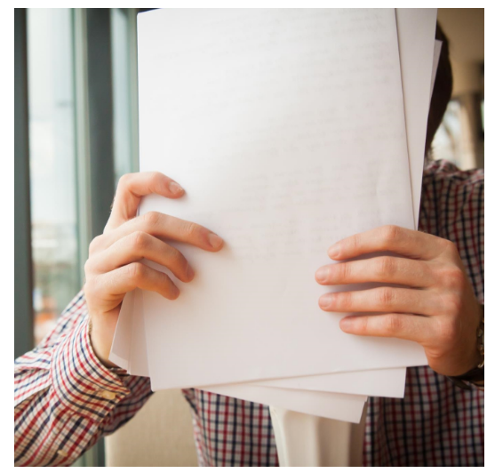
WHAT IS SUMMARISING
Summarising is another way of using another writer’s work in your own words ; to summarise, you need to be able to paraphrase.
Summarising consists of providing a brief overview of someone else’s idea.
In academic writing you often have to summarise part of a book or journal article.
Your summary maybe just one or two sentences, to explain the main idea of the article or compare it with another text, or it might be much longer, up to 50% of the original.

Slide 7

Five Steps To Summarising
You cannot just read a text and produce a summary.
You will likely miss many of the main points and include unnecessary detail.
You may also fail to paraphrase appropriately, leading to a charge of plagiarism.
Instead, follow these steps:

Slide 8
Five Steps To Summarising
Step 1
Skim the text, paying special attention to any headings or subheadings.
Step 2
Read the text again more carefully, underlining/highlighting important information.
Check any unknown words needed to understand the main points.

Slide 9
Five Steps To Summarising
Step 3
Make notes of the main points and supporting points.
Remember to use your own words so that you can paraphrase and avoid plagiarism.
Step 4
Write the summary using your notes.
Make sure you do not add anything which does not appear in the original (e.g., your own comments).

Slide 10
Five Steps To Summarising
Step 5
Check the summary to make sure you have covered all the main points.
Make sure you have included a reference to the source.

Slide 11
Language To Use When Summarising
Although most of the language in the summary will depend on the content.
There are some formulaic phrases which can be used in a summary to make it clearer.
Frame
Reminder Phrases
Transition Signals

Slide 12
Language To Use When Summarising
Frame
The frame begins the summary.
It is the main idea of the source.
This is usually included in the first sentence, with a reference to the author (through a citation or footnote/endnote) and the main idea or argument of the text.
You will also need to use a reporting verb.

Slide 13
Language To Use When Summarising
Frame
Some examples of frames are shown below, for an article titled “The Global Warming Crisis” by F.Brown , published in 2014. These use the Harvard style of referencing.
According to Brown (2014) ……….
Brown’s(2014) article on global warming discusses ………..
Brown *2014), in his article ‘The Global Warming Crisis’, argues that ………

Slide 14
Language To Use When Summarising
Reminder Phrases
It is useful to remind the reader, especially in a longer summary, that you are summarising another text.
Using these phrases also helps to avoid plagiarism, as they include a citation.
Therefore making clear that the ideas are not your own.

Slide 15
Language To Use When Summarising
Reminder Phrases
These examples use the Harvard style of referencing.
The author goes on to say that ……..
The article further states that ……….
The author further states that …….
Brown (2014) also states/maintains/argues/believes that …….
Brown (2014) concludes that……..

Slide 16
Language To Use When Summarising
Transition Signals
Pay attention to the organisation of the original text and use appropriate transition signals when organising the ideas in your summary.

Slide 17
Language To Use When Summarising
Transition Signals
For example, you may need:
Comparison and contrast signals (on the other hand; in contrast, as opposed to)
Cause and effect signals (as a result; therefore, may be due to)
Classification signals (similarly; likewise; in the same way).

Slide 18
15 MINUTES BREAK

Slide 19
INTRODUCING SYNTHESIS
Another method to incorporate other people’s work into your own is synthesis.
Synthesis is something you already do in everyday life.

Slide 20

Introducing Synthesis

Slide 21
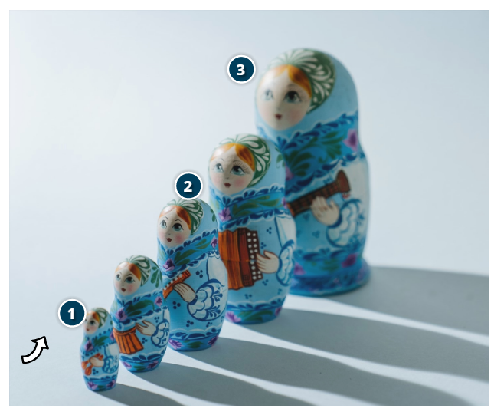
What Is Synthesis
Synthesising ideas follows a structure like that of a Russian Doll.
When you begin the process, you are the smallest doll (doll 1).
But as you read more and gain knowledge, you are continuing to add extra layers to your ideas and opinions (doll 2).

Slide 22
What Is Synthesis
These new ideas and perspective combine with your own thoughts, and you eventually become the biggest doll (doll 3), with all of these ideas underpinning your new viewpoint.
With academic synthesis, you are adding layers to inform and support your thought process.

Slide 23

Synthesis In Writing
In writing, you must demonstrate that you have read and understood the reliable and unbiased findings of other professionals and established academics into the topic.
This may mean pooling together information from different sources that share the same viewpoint and integrating this into your words, making sure not to distort their meaning, content or message.

Slide 24
Synthesis In Writing
This allows you to support your own ideas, and may help you draw attention to something that has not been discussed before or is particularly significant in the context of your work.
You could also synthesise ideas by linking together sources that agree on a point and then comparing and contrasting these with other sources that may disagree.
This can help to prove your point further.

Slide 25
Synthesis In Writing
Select one of these two opinions to form your smallest Russian Doll viewpoint.
Step 1
Opinion A : Recycling at home is really important and helps to reverse climate change
Opinion B : Recycling at home is a waste of time. It does not help to reverse climate change.

Slide 26
Synthesis In Writing
Step 2
Read through the following viewpoints on recycling.
Each viewpoint contains some evidence that may either reinforce or contradict your original viewpoint:
View#1 : Recycling conserves energy and helps reduce the harmful effects of landfill
View #2 : There are better ways to reduce waste
View #3 : Carbon footprint
View #4 : Recycling+

Slide 27
Synthesis In Writing
Step 3
Complete the following sentences
When I began this task, I thought that ……. [Thoughts based on your choice of opinion]
My first source says that …….[Explain the key points of the first view]
My second source says that…..[Explain the key points of the second view]
Taking all of this information into consideration, I now think that…….[Write your new viewpoint which may have been reinforced by new information or changed]

Slide 28
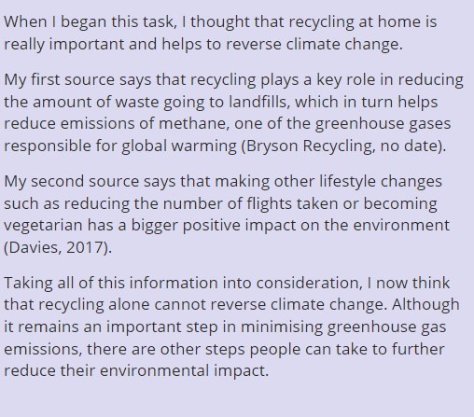
Synthesis In Writing
Example of a good answer

Slide 29
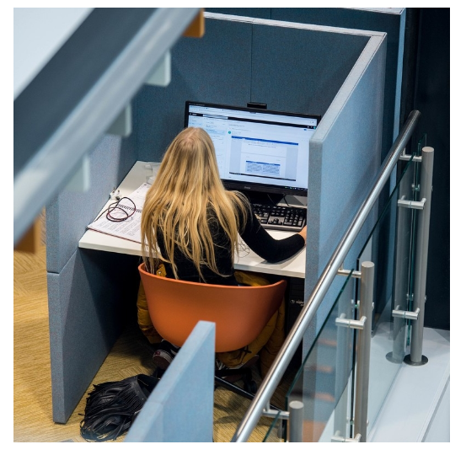
PLAGIARISM
Academic Writing
Throughout your studies, you are expected to demonstrate academic integrity.
Academic integrity means acting with values of honesty, trust, fairness, respect and responsibility in learning, teaching and research.
It is important for students, teachers, researchers and professional staff to act in an honest way, be responsible for their actions, and show fairness in every part of their work.

Slide 30
Plagiarism and its Consequences
An important part of academic integrating is making sure you avoid plagiarism.
UWTSD’s Academic Misconduct Policy (2020-21, p.2) defines plagiarism as “presenting someone else’s work or ideas as the student’s own”
Plagiarism is an example of Academic for which there are penalties.
You can read more about it in the policy – UWTSD Academic Misconduct Policy.

Slide 31

Types Of Plagiarism
Be aware that plagiarism can take different form
Video:
https://uwtsd.hosted.panopto.com/Panopto/Pages/Viewer.aspx?id=834a5f93-a61b-434a-a460-aee20112ee01

Slide 32
Class Activity 2 – Plagiarism Quiz
Kindly attempt this quiz in class
https://moodle.uwtsd.ac.uk/mod/quiz/view.php?id=640848

Slide 33
How to avoid plagiarism when you paraphrase
1) Give credit
Give credit whenever you:
Use another person’s ideas, opinions, or theories
Quote, paraphrase or summarise another person’s spoken or written words
Use pieces of information, such as statistics, graphs, drawings, that are not common knowledge

Slide 34
How to avoid plagiarism when you paraphrase
2) Quote correctly
When using direct quotes, make sure that they are formatted and referenced appropriately.
3) Paraphrase and summarise
Try to paraphrase and summarise ideas and arguments in your own words
Don’t just copy text or rearrange a few words here and there
Always check your paraphrase or summary against the original text

Slide 35
How to avoid plagiarism when you paraphrase
4) Make notes
Keep a record of the sources as you go along.
This will make it easier to collate your references when writing your assignments.
5) Reference correctly
Reference your assignments following the appropriate university guidelines relevant to your subject area

Slide 36
Top tips for avoiding plagiarism
When you paraphrase, ensure that:
You properly acknowledge the author
The text is not close to the original as this could count as plagiarism even if you correctly cite the source.
Always put the ideas you are referring to into your own words.

Slide 37
Class Activity 3 : Plagiarism vs Paraphrasing Quiz
Kindly attempt this quiz in class
https://moodle.uwtsd.ac.uk/mod/quiz/view.php?id=640849

Slide 38
15 MINUTES BREAK

Slide 39
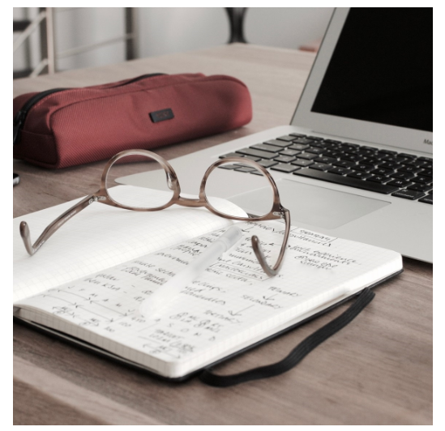
WHAT IS REFERENCING
Referencing is:
Acknowledging when you use someone else’s words, ideas, images or research in your own work.
Providing details that will enable those reading your work to access the resources you used.
These details must be presented in a recognised and consistent way, also known as a referencing style.

Slide 40
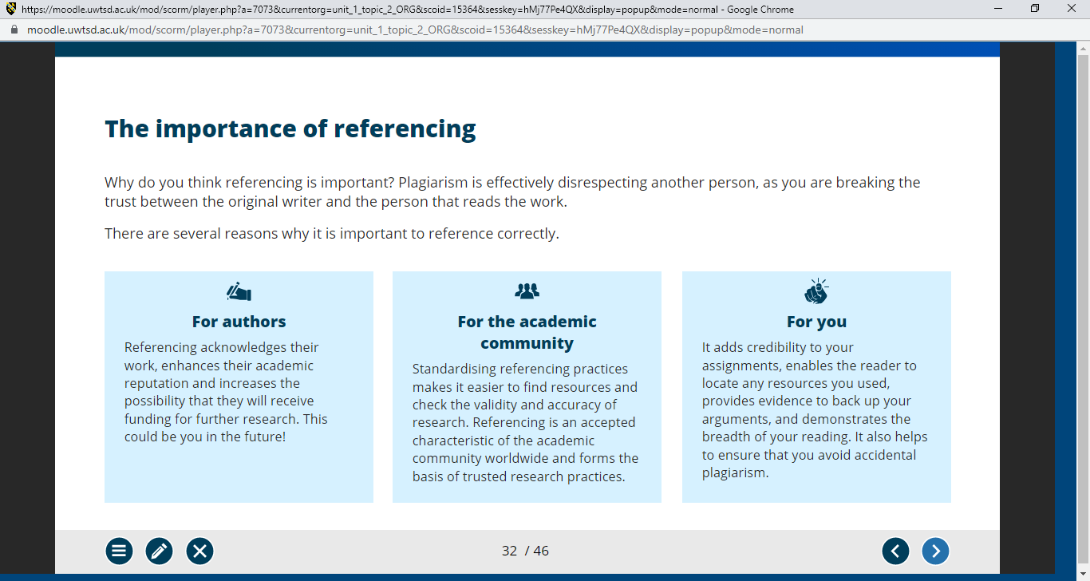
The importance of Referencing
Plagiarism is effectively disrespecting another person, as you are breaking the trust between the original writer and the person that reads the work.
There are several reasons why it is important to reference correctly.

Slide 41
When do I need reference?
Quotes
Paraphrase and summary
Images
Data

Slide 42
When do I need reference?
Quotes
A quotation is where you take the exact wording as written by another author and insert it into your work.
“Keywords are one of the most important elements of your webpage. In fact before you start optimizing your website you need to choose the keywords your page is going to target.”, (Sean 2016).

Slide 43
When do I need a reference?
Paraphrase and summary
Paraphrasing is taking someone else’s idea and putting it into your own words.
Summarising is providing a brief overview of someone else’s idea.

Slide 44
When do I need a reference?
Paraphrase and summary
Paraphrasing
One of the most crucial components of any website is its keyword content. In reality, you must select the keywords your page will target before you begin optimising your website (Sean 2016).
Keywords are one of the most important elements of your webpage. In fact before you start optimizing your website you need to choose the keywords your page is going to target

Slide 45
When do I need a reference?
Paraphrase and summary
Summarising
Keywords are crucial for optimizing your webpage, and it's essential to select the keywords your page will target before starting the optimization process (Sean 2016).
Keywords are one of the most important elements of your webpage. In fact before you start optimizing your website you need to choose the keywords your page is going to target

Slide 46

When do I need reference?
Images
You should provide references for any photographs, images or illustrations that appear in your work.
Photo Credit : Sean 2016

Slide 47
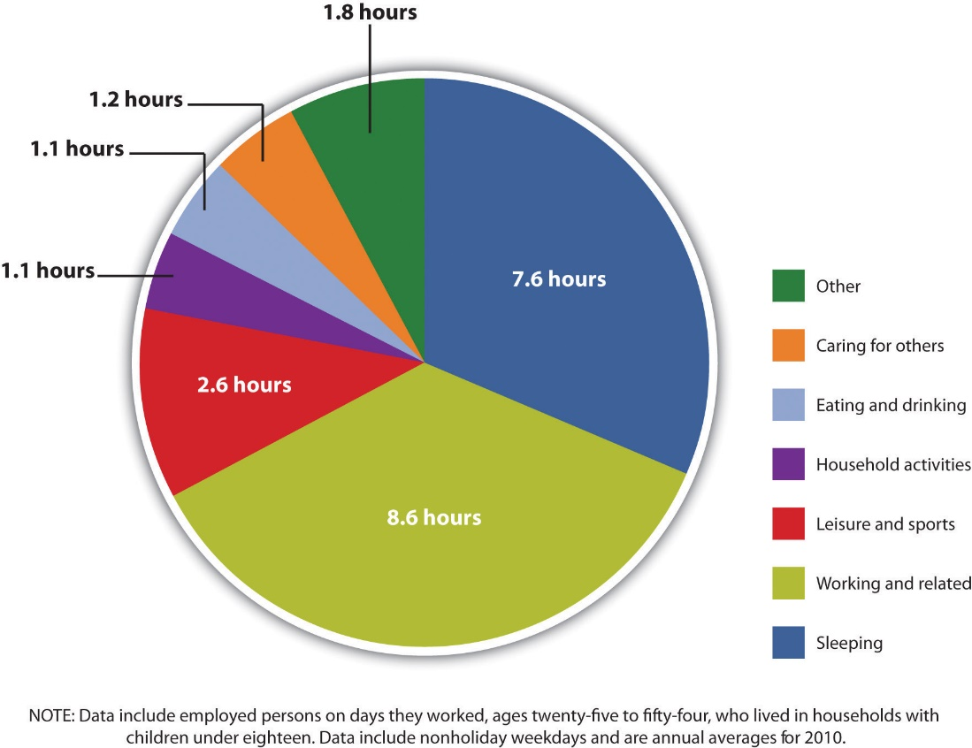
When do I need reference?
Data
You should provide references for any data that you include in your work, including graphs, tables and statistics.
Sean 2016

Slide 48
Referencing Styles
There are many different sets of rules on how to reference, these are known as referencing styles or standards.
Depending on your discipline, you will be using one of the following:
Harvard
APA
IEEE
MHRA

Slide 49
APA: the basics
APA is an acronym for the American Psychological Association.
This referencing style is generally used in the discipline of psychology.
The APA referencing style consists of two elements:
In-text citation
Reference list

Slide 50
APA: the basics
In-text citation
Brief details of the source being used, are inserted within the text of the assignment.
The purpose of a citation is to direct the reader to a full reference at the end of the work.
An in-text citation should include:
the author’s surname, which you can omit you already mentioned in the body of your work;
the year of publication
a page number when citing a quotation.

Slide 51
APA: the basics
Reference List
Full details of the sources used directly within your assignment, compiled as an alphabetical list by author, at the end of your work.
An APA reference should include the following information to enable the reader to locate the original source:.
Authors/editors
Year of publication
Title
Publisher information
If necessary, include the DOI (Digital Object Identifier) or URL when referencing an electronic resource.
Your reference list should be double spaced with a hanging indent 0.5 inches for each entry.

Slide 52
Harvard: the basics
This is the style of referencing most commonly used within UWTSD.
The Harvard referencing style consists of two elements:
In-text citation
Reference list or bibliography

Slide 53
Harvard: the basics
In-text Citation
Brief details of the source being used, are inserted within the text of the assignment.
The purpose of a citation is to direct the reader to a full reference at the end of the work.
An in-text citation generally includes:
the author’s surname, which you can omit you already mentioned in the body of your work;
the year of publication;
a page number when citing a quotation or referring to a very specific section of the text.

Slide 54
Harvard: the basics
Reference list or bibliography
Reference list: Full details of the sources used directly within your assignment, compiled as an alphabetical list at the end of your work.
Bibliography: A list of all texts read for your assignment, whether you have cited them or not, compiled as an alphabetical list at the end of your work. A bibliography is not always required.
A Harvard reference should include the following information, to enable the reader to locate the original source :
Authors/editors
Year of publication
Title
Publisher information
If necessary, include the DOI (Digital Object Identifier) or URL when referencing an electronic source.

Slide 55
IEEE : the basics
This is the style of referencing used by computing courses at UWTSD.
The IEEE referencing style consists of two elements:
In-text citation
Reference list or bibliography

Slide 56
IEEE : the basics
In-text citation
[Number] of the source being used, inserted within the text of the assignment.
The purpose of a citation is to direct the reader to a full reference at the end of the work.

Slide 57
IEEE : the basics
Reference list or bibliography
Reference list: Full details of the sources used directly within the assignment, compiled as a numerical list at the end of the work.
Bibliography: A list of all texts for your assignment, whether you have cited them or not. A bibliography is not always required.
An IEEE reference should include the following information to enable the reader to locate the original source:
Authors/editors
Year of publication
Title
Publisher information
URL and date accesses, or DOI (Digital Object Identifier) when referencing an electronic resource.

Slide 58
MHRA : the basics
This style is often used in humanities. MHRA stands for Modern Humanities Research Association.
The MHRA referencing style consists of two elements:
Footnote/endnote
Reference list or bibliography

Slide 59
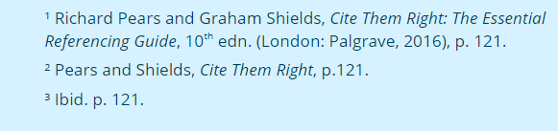
MHRA : the basics
Footnote/endnote
It contains details of the source being used and is linked to numbers in your text.
The purpose is to direct the reader to the reference at the end of the work. Footnotes appear at the bottom of each page, whereas endnotes appear at the end of each chapter.
Note that the first time you cite s source, you should give full details in the footnote/endnote. Any further references to that source can be abbreviated to the author’s surname, the first few words of a title, and a page number.
If you are referencing the same source consecutively, i.e the same as the preceding reference, you can use ‘ibid’ and a page number. This should only be done where there is no possibility of confusion. For example:

Slide 60
MHRA : the basics
Reference list or bibliography
Reference list: Full details of the sources used directly within the assignment, compiled as an alphabetical list at the end of the work.
Bibliography: A list of all texts read for your assignment, whether you have cited them or not, compiled as an alphabetical list at the end of the work. A bibliography is not always required.
An MHRA reference should include the following information to enable the reader to locate the source:
Authors/editors
Year of publication
Title
Publisher information
URL and date accessed or DOI (Digital Object Identifier) when referencing an electronic resource.

Slide 61
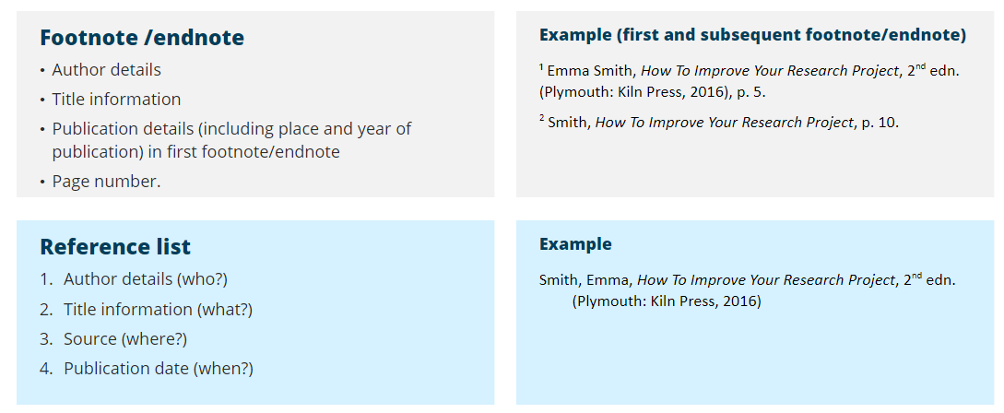
MHRA : the basics
In what order should information appear?

Slide 62
Top tips to improve your referencing
Referencing might seem complicated at first, but remember that it is a skill that you will develop through practice.
Here are a few things to keep in mind:
Be aware. Read and understand the basics before you begin.
Be organised. Keep a record of all sources as you find and use them.
Be consistent in the records you keep and in the way you reference.
Be positive. When used properly, references strengthen and enhance your writing.
Be thorough. Check your references before submitting your assignment.

Slide 63
Class Activity 4 - Referencing
Kindly attempt the quiz in class
https://moodle.uwtsd.ac.uk/mod/quiz/view.php?id=640850

Slide 64
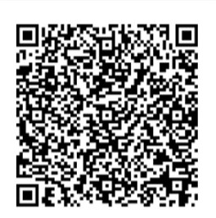
Homework : Academic Integrity & Avoiding Plagiarism
Kindly click on the link below to start the course or use the QR Code
moodle.uwtsd.ac.uk/mod/scorm/player.php?a=7377&currentorg=articulate_rise&scoid=16124&sesskey=8lTY5SBgOC&display=popup&mode=normal​
This should be completed before the next class
Once completed, please send a screenshot of your badge to your lecturer via email.

Slide 65

Homework : Referencing – The Basics
Kindly click on the link below to start the course or use the QR Code
moodle.uwtsd.ac.uk/mod/scorm/player.php?a=7378&currentorg=articulate_rise&scoid=16126&sesskey=8lTY5SBgOC&display=popup&mode=normal​
This should be completed before the next class
Once completed, please send a screenshot of your badge to your lecturer via email.

Slide 66
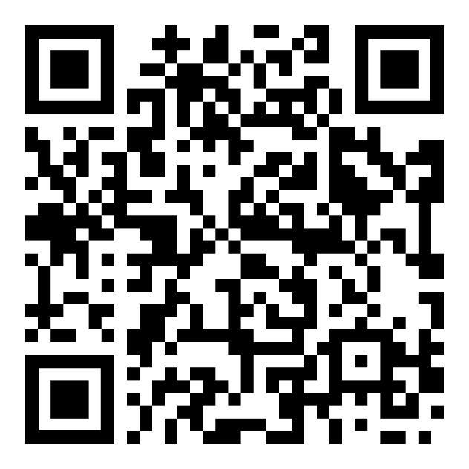
Homework : How to Reference - IEEE
Kindly click on the link below to start the course or use the QR Code
https://moodle.uwtsd.ac.uk/course/view.php?id=11811&section=5
This should be completed before the next class
Once completed, please send a screenshot of your badge to your lecturer via email.

Slide 67
Questions

