Slide 1
DS3 Portfolio
Fatma Mert
Student ID:2537428
Module: Digital Skills
What the portfolio includes
1.Screenshots of my works
2. Skills I have developed in this module
3. My progress and reflection

Slide 2
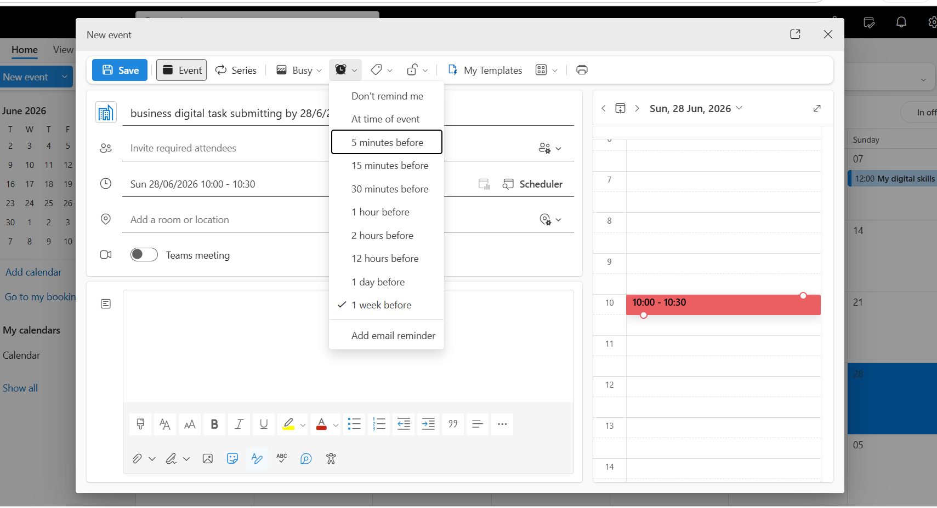
Calendar
1.What the work is
Setting and managing a digital calendar
2.What skills it shows
Using digital tools
Organising and planning
Time management
3.What you learned
How to organise my schedule
How to set reminders and share calendar
How to manage my time more effectively

Slide 3
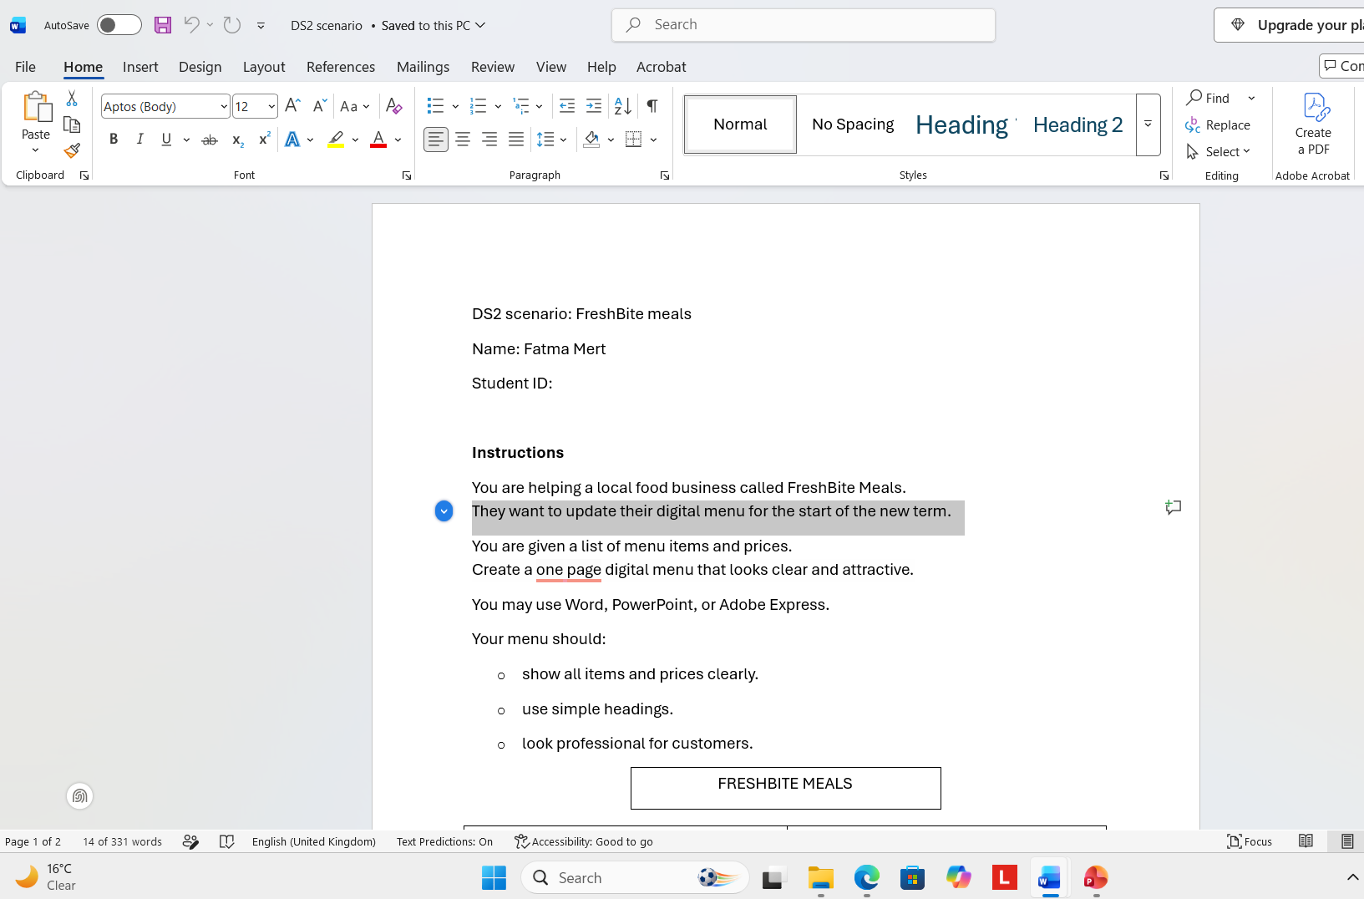
Word/My assignment
1.What the work is
Assignment, recreating business menu using Microsoft word
Using formatting and editing tools
2.What skills it shows
document formatting
Editing and grammar checking
Professional document design
3.What you learned
How to use fonts, layouts and formatting tools
How to check spelling and grammar
How to create clear and professional documents

Slide 4
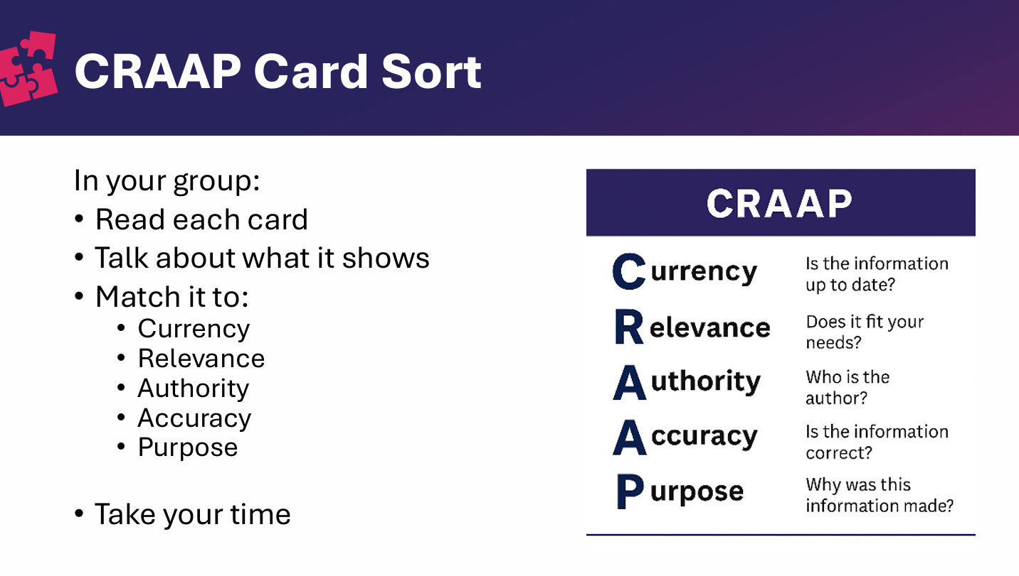
CRAAP
1.What the work is
Learning how to evaluate information using craap test.
2.What skills it shows
Critical thinking
Research
Evaluation online sources
Digital literacy.
3.What you learned
How to check if information is current and relevant
How to identify reliable authors and accurate information
How to recognise the purpose of a website
How to choose trustworthy sources for assignments.

Slide 5
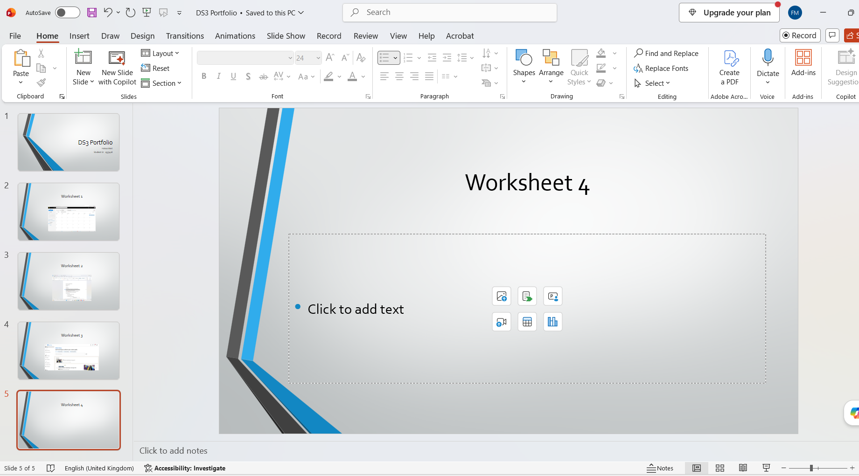
Powerpoint
1.What the work is
Creating my digital portfolio presentation
Presenting evidence of my learning
2.What skills it shows
Presentation design
Communication
Organisation and creativity
3.What you learned
How to create clear and professional slides
How to organise information effectively
How to present my work confidently

