Slide 1

Which digital tools are commonly used for collaboration

Slide 2

Introduction
What digital tools to use?
How to use them?
Where you get them from?
What is engine search?
Reference

Slide 3
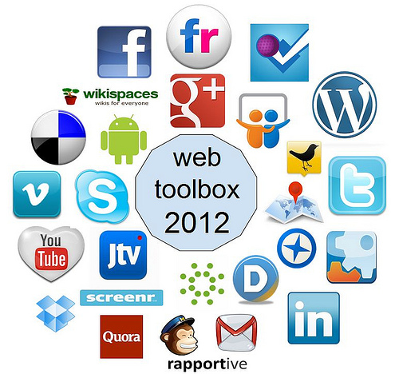

What digital tools to use?
The most useful digital tools are Microsoft Teams, Outlook, Skype, WhatsApp, Google Meet and more others.
Those tools are helping everyone to keep safe and record the conversation
Most of it is helping to collaborate with others from a long distance
( Verbina, 2021 )
This Photo by Unknown Author is licensed under CC BY-SA-NC

Slide 4

How to use them?
It is very easy to access all of them.
Not hard to learn how to use them.
All of them are coming wit a tutorial to teach every new person on every type of the tools.
All it takes is just to download them and create an account so it can be saved every data.
( Verbina, 2021 )

Slide 5

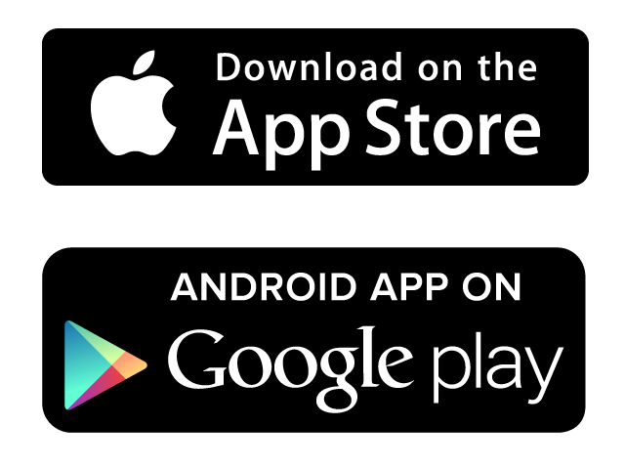

Where you get them from?
There are some many platforms which can help you just to download it
Some of the you can download from Apple Store, Google Store or from the origin ‘Engine’ search of Google
It is very simple to get them on a device, it just takes a few minutes to be downloaded on a device and to create an account.
( Verbina, 2021 )

Slide 6


What is engine search?
Engine search is a platform where anyone can search everything they will need
Can take everyone everywhere they need to go
Can help with to do researchers about a school/business
Can help to buy things you need and can not find in store

Slide 7
Reference
Verbina. E ( July16, 2021) Best Collaboration Tools for 2022 – Survey Results.
Available at: https://blog.jetbrains.com/space/2021/07/16/best-collaboration-tools/
Accessed on: February 27 2022

