Slide 1
Essential Skills
Link In and Learn

Slide 2
Session Objectives
In this session we will:
Discover professional connections between your class network
Conduct a personal SWOT analysis
Discover LinkedIn Learning and identify relevant resources for continual professional development (CPD)
This session will help you make connections between your skills and professional aspirations. Looking onward to your professional development.

Slide 3
Session Schedule
Exploring Graduate Profiles– 25 Mins
Evaluating your own skills and aspirations – 20 mins
Completing SWOT analysis– 30 mins
Setting plans for future development – 35mins
Reflection 10 mins

Slide 4
Profiles of Graduates from UWTSD
IICL, Birmingham

Slide 5


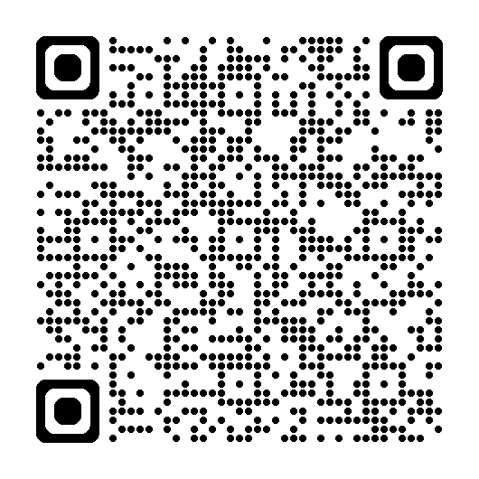
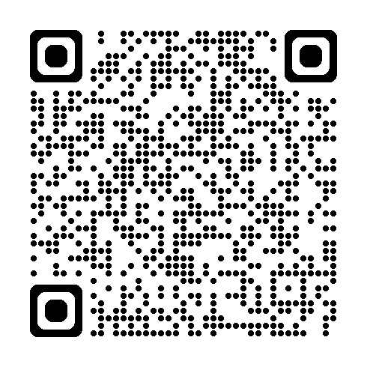

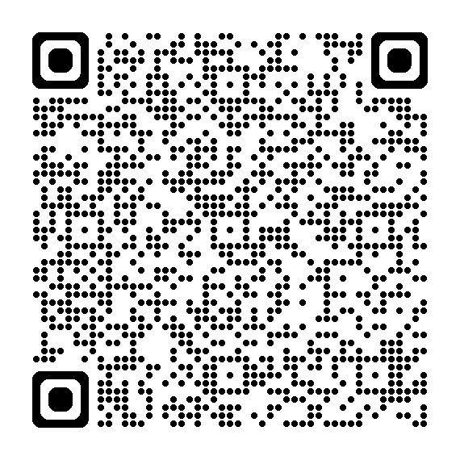
Graduate Profiles
Noreen Akhtar
Michael Thomas
Madiha Hassan and Syed Islam
Learning about the journeys that others have taken to achieve success can help you to develop your own aspirations.
Let’s explore these profiles on Moodle
Notes:
Noreen Akhtar - https://www.uwtsd.ac.uk/news/mum-overcomes-adversity-achieve-first-class-honours-health-and-social-care-degree
Michael Thomas - https://www.uwtsd.ac.uk/news/passion-education-and-leadership-fuels-new-journey-uwtsd
Birmingham News Article - https://moodle.uwtsd.ac.uk/pluginfile.php/1156558/mod_resource/content/1/UWTSD%20Graduate%20Profiles%20in%20Birmingham%20Mail.pdf

Slide 6
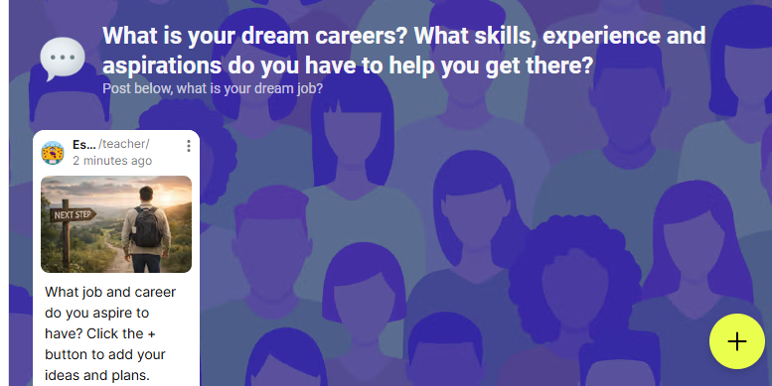
What are your skills and aspirations?
Use the Padlet available on Moodle in Week 2.
Post your ideas for your dream job. What skills and experience do you already have?
Click to view
https://moodle.uwtsd.ac.uk/mod/lti/view.php?id=726757
Notes:
Padlet - https://moodle.uwtsd.ac.uk/mod/lti/view.php?id=726757

Slide 7
Share
What skills and experience do people have in common?
Do any of us have similar dream careers?
Can you recommend any ideas to other students?

Slide 8
SWOT Analysis

Slide 9
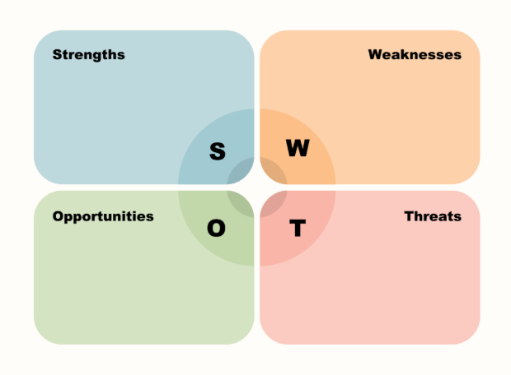
What Is a SWOT Analysis?
A SWOT analysis is a simple tool used to help you understand your current situation and plan for improvement.
SWOT stands for:
S – Strengths: What you are good at
W – Weaknesses: Areas you want to improve
O – Opportunities: Chances to develop or progress
T – Threats: Challenges that could affect your success

Slide 10

Why Do We Use a SWOT Analysis?
The purpose of a SWOT analysis is to help you:
Recognise the skills and qualities you already have
Identify areas where you can improve
Think about opportunities available to you at university
Become more aware of challenges and how to manage them
For Level 4 students, a SWOT analysis is not about being perfect or having everything figured out. It is about self-awareness and taking small steps toward academic and professional development.

Slide 11
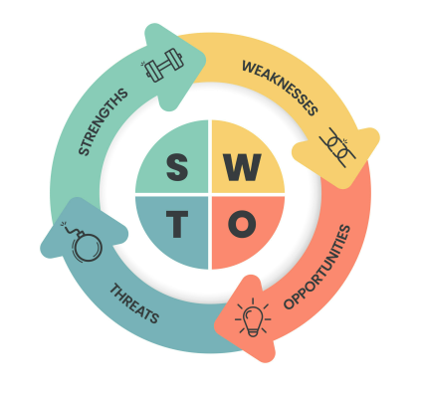
How Does This Help You?
Completing a SWOT analysis can help you:
Feel more confident about your abilities
Set realistic goals for your studies
Make better use of university support and opportunities
Start planning for your future career in a simple, manageable way
Your SWOT analysis is a starting point, not a final judgement. It can change and develop as you gain more experience and confidence.

Slide 12


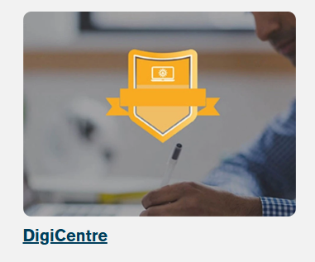
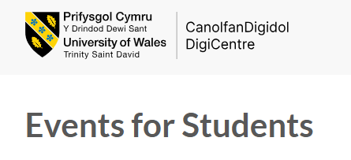

What opportunities are available at UWTSD?
Notes:
Careers - https://www.uwtsd.ac.uk/study/experience-and-facilities/student-support-and-wellbeing/careers-service
Digi Centre - https://digitalskills.uwtsd.ac.uk/
Register for LinkedIn Learning - https://digitalskills.uwtsd.ac.uk/students/
Student Union Skills Week - https://www.uwtsdunion.co.uk/opportunities/skills-week?parent_link=events-menu-wrapper
Training Events for Students - https://digitalskills.uwtsd.ac.uk/events-for-students/

Slide 13
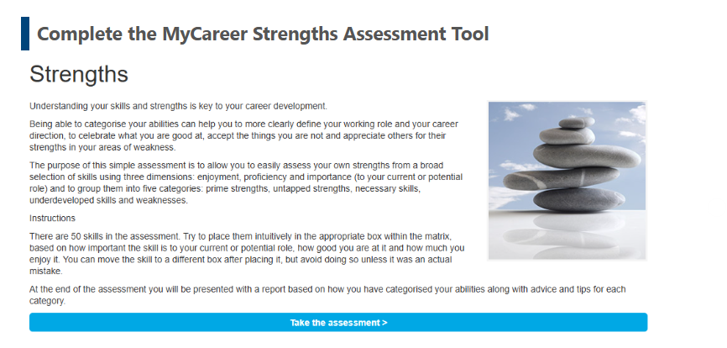
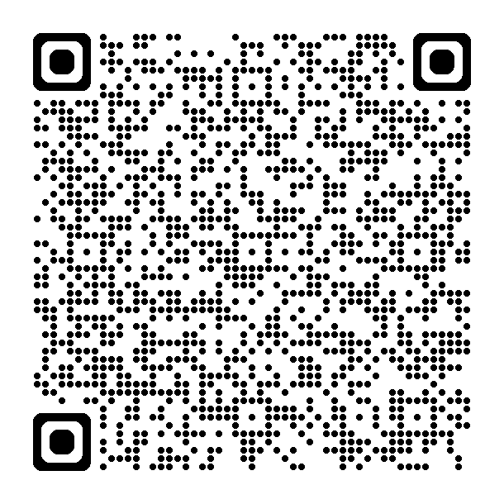
Assess your strengths and priorities in the workplace using the UWTSD My Careers tool.
https://uwtsd.careercentre.me/resources/careerassessments/?quizId=30&Referral=Action&Programme=Self-Awareness&ProgrammeID=WmQrSndNVEZ3VWRlbmphb1BSRVJUQT090&TaskId=63110
Notes:
https://uwtsd.careercentre.me/resources/careerassessments/?quizId=30&Referral=Action&Programme=Self-Awareness&ProgrammeID=WmQrSndNVEZ3VWRlbmphb1BSRVJUQT090&TaskId=63110
The activity requires drag and drop of different skills to evaluate themselves.

Slide 14
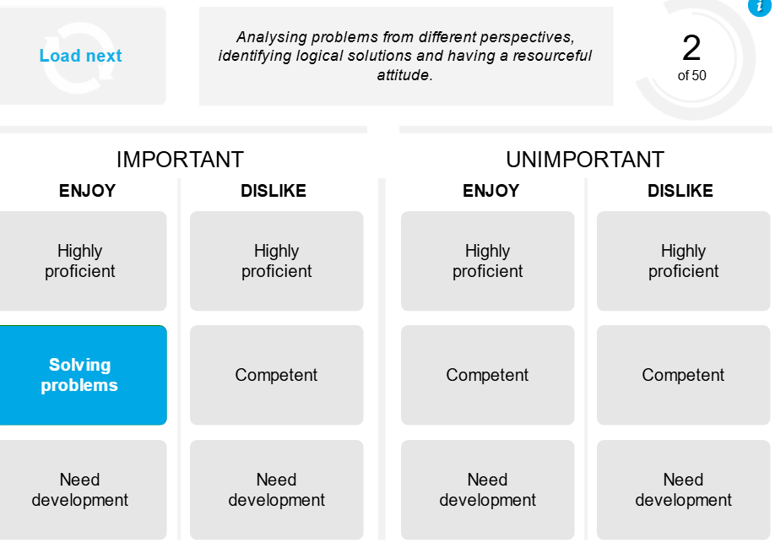
Share and discuss
What were your results?
Reflect on what you learned for this self assessment.
Which skills did you find easiest to position?
Which skills were challenging to position?

Slide 15
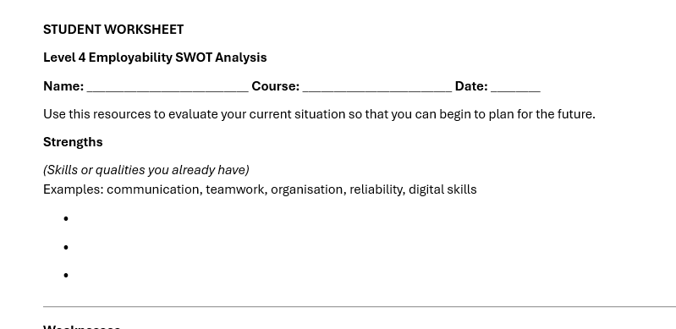
Use your strengths assessment to help you complete your personal SWOT analysis.
Available on Moodle in Week 2.
Notes:
Resources available on Moodle

Slide 16

How did you answer the final question?
Share and discuss – do we have shared strengths and weaknesses or different ones?

Slide 17
Using LinkedIn Learning

Slide 18


LinkedIn Learning
LinkedIn offers a learning platform. UWTSD subscribes to this platform, as a student at UWTSD you can use the DigiCentre to access the LinkedIn learning.
Use you full university email address to signup to the LinkedIn learning platform via the DigiCentre.
Notes:
https://digitalskills.uwtsd.ac.uk/
Demonstrate to students how to access the UWTSD Digit Centre –ensure everyone in signed up to LinkedIn Learning and this will create a LinkedIn profile for any students without one or link any active accounts with their university account and any LinkedIn learning will appear as a badge on their profiles.

Slide 19
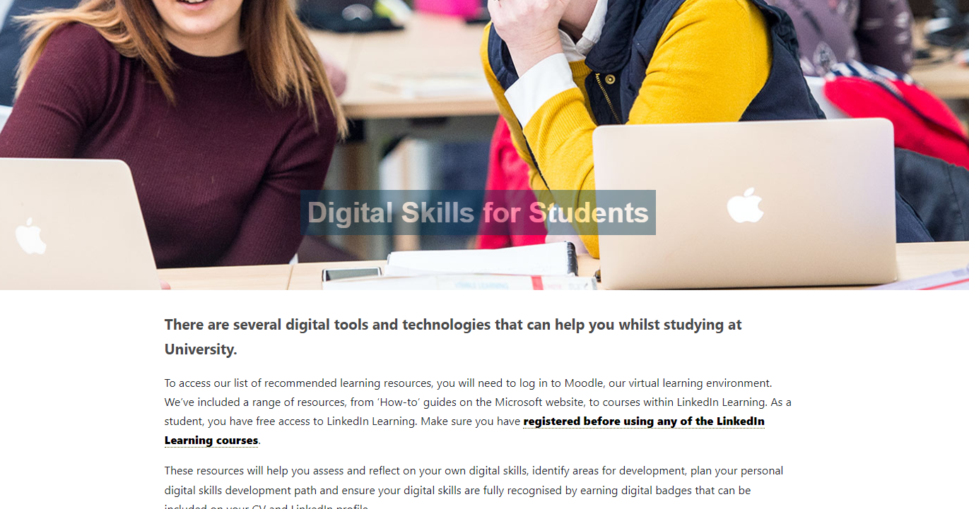

The DigiCentre
Notes:
https://digitalskills.uwtsd.ac.uk/students/
https://www.linkedin.com/learning/

Slide 20




On the main university page go to quick links which is located at the top of the page
When you are in, find the icon for the DigiCentre which look like this
The scroll down a little and find the icon for Student that look like this
How to get to the DigiCentre and student section?

Slide 21
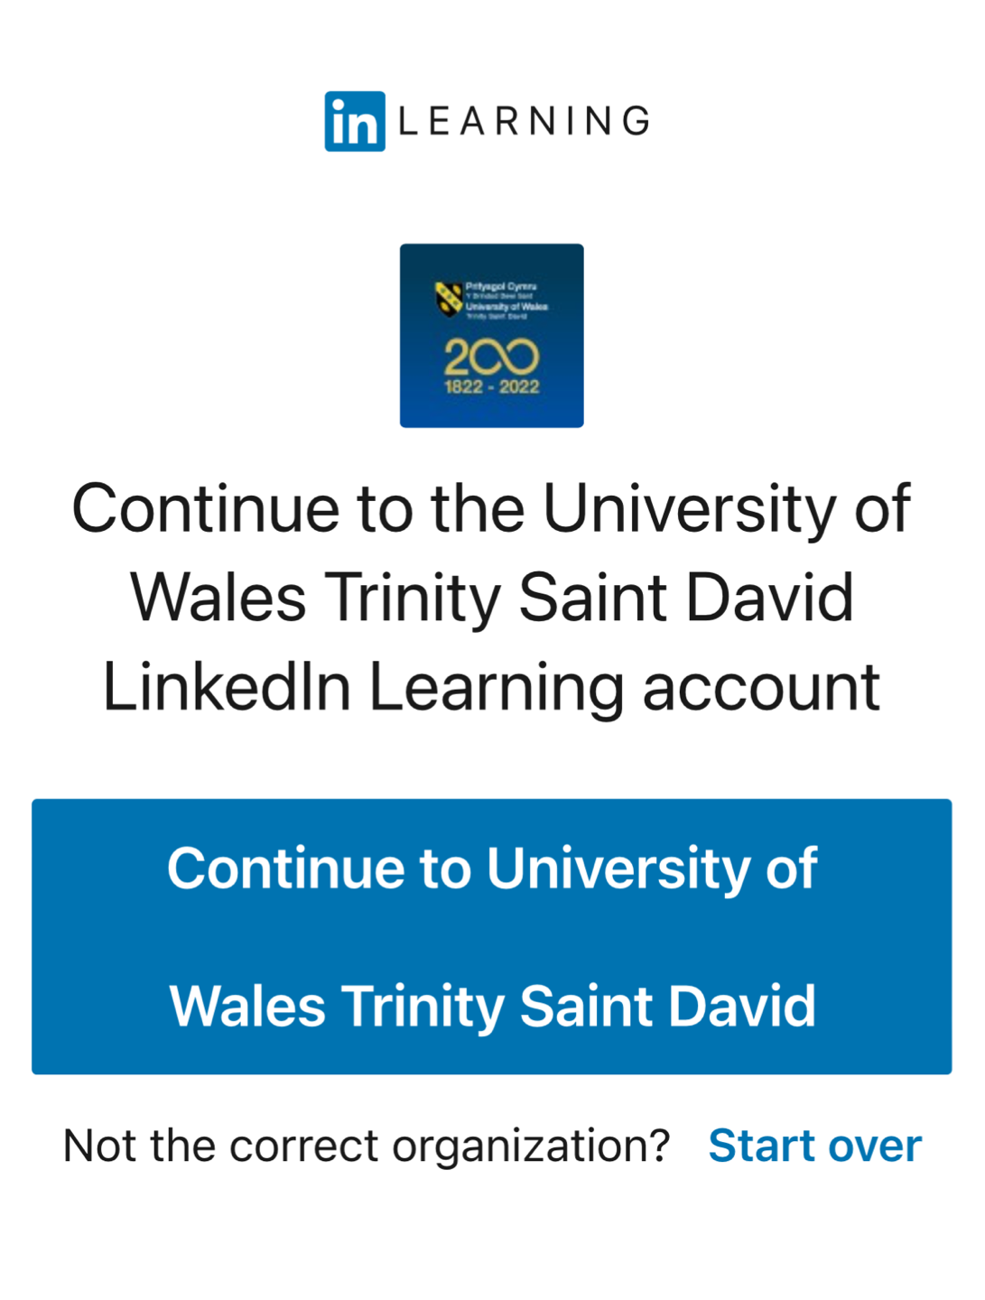
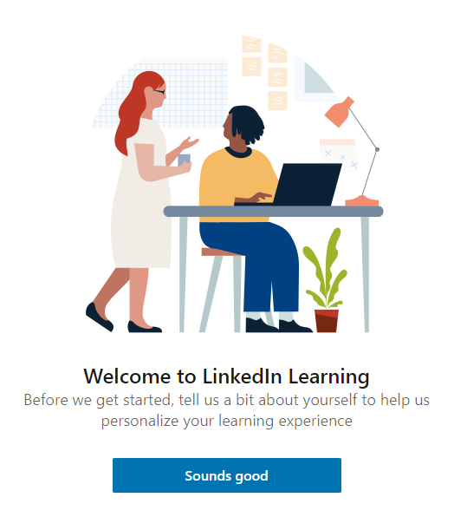

When in the student section in the first paragraph find the hyperlink text that says – (registered before using any of the LinkedIn Learning courses)
You will be prompted to click a blue box for this university as you can see.
Where to go in the student section
If you don’t see this go to the next step
Next just click “Sounds good”

Slide 22
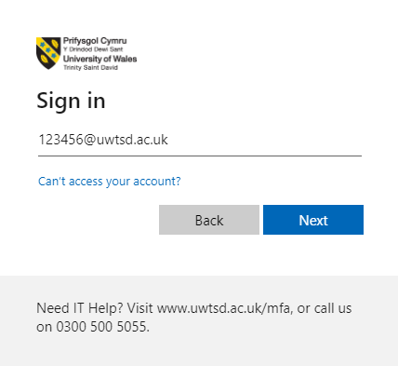
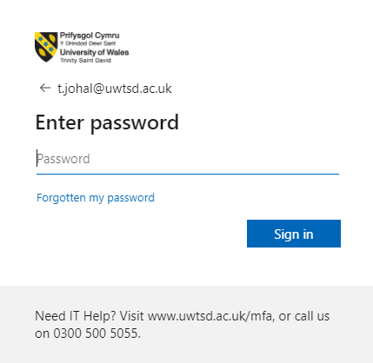

Next you will see this page open. You will be required to put in your login details. It is important that you use this style of login - 123456@uwtsd.ac.uk
Usernames & passwords
Then put in your password

Slide 23
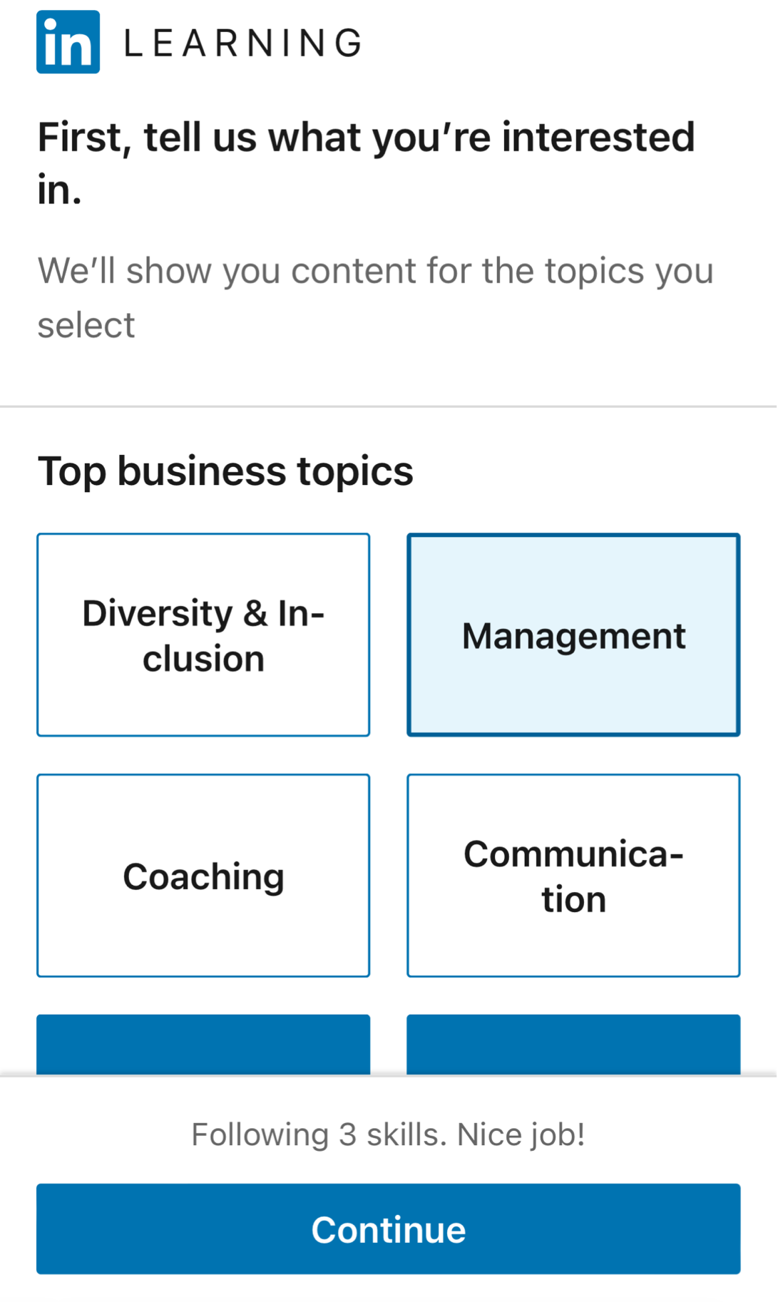

You will be asked to authenticate by either using the app or by text/call
Then you can choose areas of interest to you.
2FA & learning interests

Slide 24
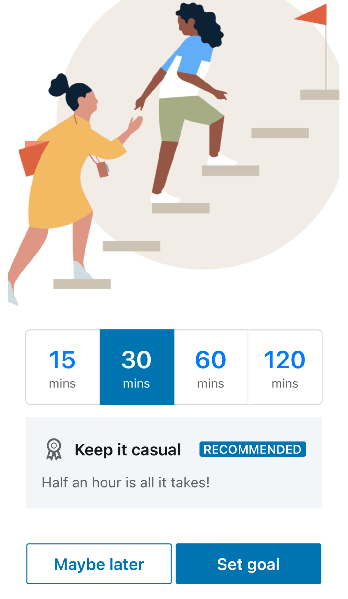
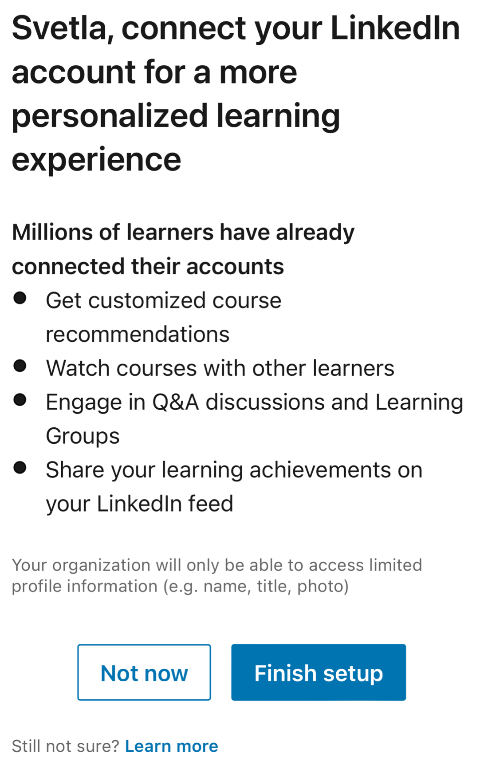

You can just click “Maybe Later” on the weekly goal section
Goals & connecting accounts
Then you can link your professional LinkedIn account. If you do not have a LinkedIn account then just click “Not now”

Slide 25
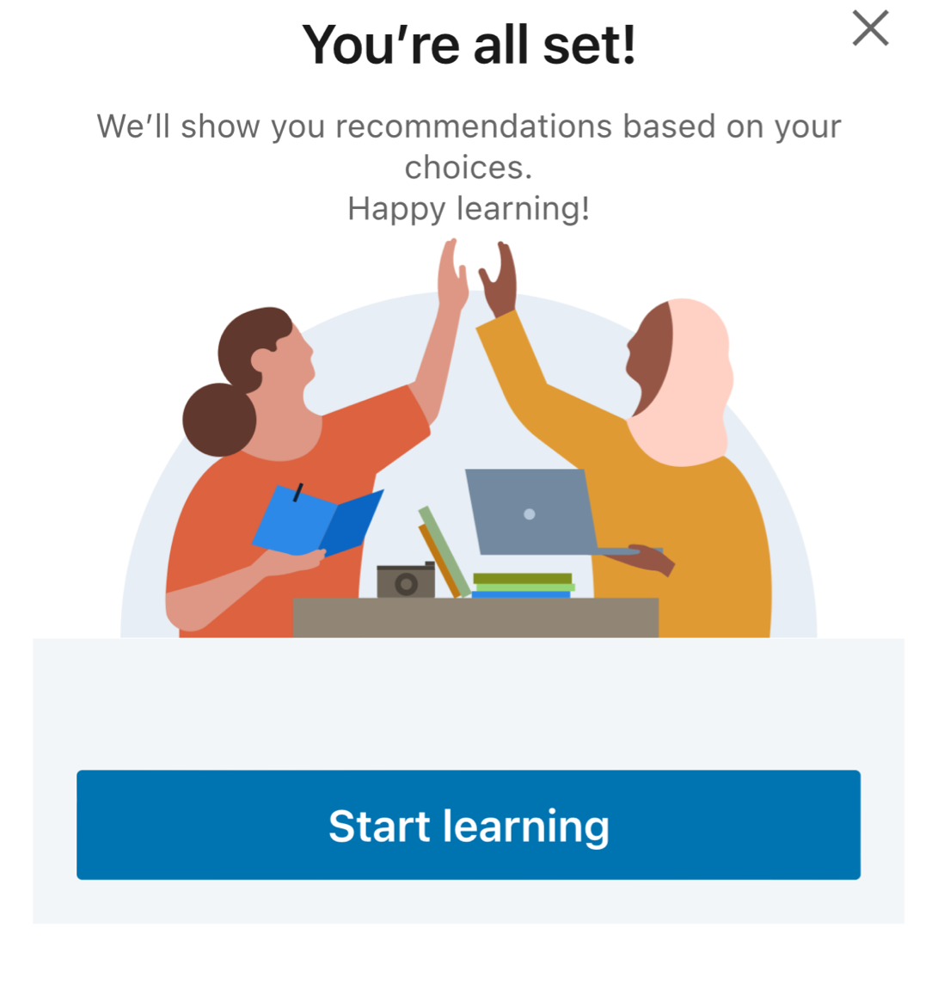

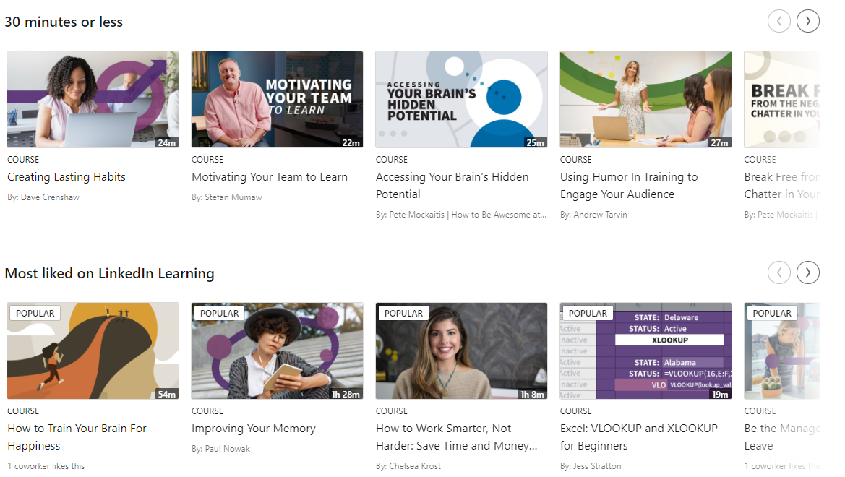
Congrats you are all done and just need to click “Start Learning”
Final steps
Now you can go ahead and search for courses that can help improve your digital skills.

Slide 26
Aim to register for LinkedIn learning and identify three courses that support you to develop your weaknesses.

Slide 27
Summary
During in this session we have:
Shared our career aspirations, experience and skills
Made connections with fellow students
Conducted a personal SWOT analysis
Discovered LinkedIn Learning and identify relevant resources for continual professional development (CPD)

Slide 28
Your Personal Progress Padlet
There is no assessment attached to your Essential Skills sessions. However, you should maintain your personal progress Padlet.
After each week, add to your personal progress Padlet.
What should you include in a personal progress Padlet ?
Include:
What you have done in your session.
What key points have you learned.
How you intend to apply learnings to your module assessments and onward professional development.

Slide 29


Traffic Light it
 | Where is your learning at ?
Red | I have misunderstood some of the topics. (write down 2 questions that you need help with)
Amber | I have understood most of the topics so far (write down 1 question and 1 key theme you have understood)
Green | I have understood the topics so far (write down 2 key themes from the lesson to show your understanding)

