Slide 1

Forensic Case Formulation
Tools for forensic assessment

Slide 2
What is Forensic Case Formulation (FCF)?
Formulation is the process of gathering and integrating diverse information to develop a concise account of the nature and aetiology of the problems affecting a person's mental health to guide idiographic treatment design and other decision-making.
Formulation is a core competency in mental health practice, including forensic mental health; however, there is no single agreement concerning the details of how it should be carried out or evaluated. This is because it is a relatively new concept within Forensic practice (Hart et al., 2011).

Slide 3
What is Forensic Case Formulation (FCF)?
However, within the past decade, case formulation has become an explicit part of work in many forensic services, where it is used to gain an understanding of each offender’s criminal behaviour, clinical problems and criminogenic needs (Joseph & Benefield, 2012).
This understanding is typically used to devise a tailored management and treatment plan for each offender, with the aim of reducing their risk of re-offending and improving their psychological wellbeing (Minoudis et al., 2013).

Slide 4
What is Forensic Case Formulation (FCF)?
Formulation-focused consultation meetings are typically led by a psychologist or caseworker and attended by an individual member of forensic staff or a team of forensic staff.
Self-report questionnaires, qualitative interviews and structured assessment tools are used to gain a detailed account of the offending behaviour.
Several studies indicate that formulation-focused consultation meetings increases staff understanding of offenders. Improvements are also reported in staff knowledge, staff confidence in managing offenders, staff motivation to work with offenders and satisfaction with pathway plans (Knauer et al., 2017).
Improvements are noted in staff capability of working with personality disordered offenders for example (Ramsden et al., 2014), providing psychological understanding, team consistency and increased awareness (McMullan et al., 2014).

Slide 5
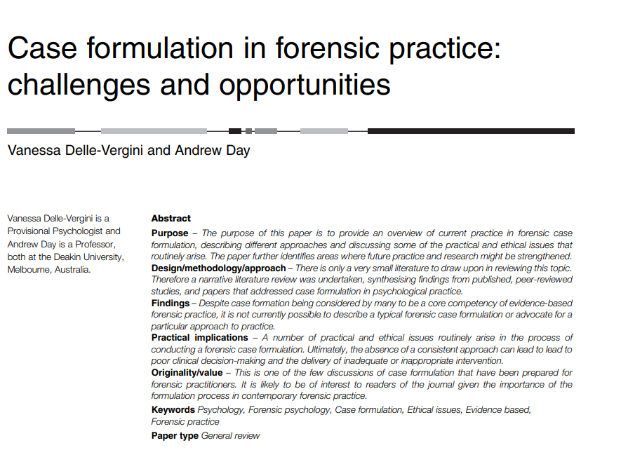
What is Forensic Case Formulation (FCF)?
One primary aim of any case formulation is to inform intervention (Bieling and Kuyken, 2003), by helping the practitioner to develop a better therapeutic relationship (Sim et al., 2005) and by providing a reference point from which to evaluate treatment progress (Davies et al., 2010).
It enables practitioners to develop a coherent set of explanatory inferences (based on theory) that describe and explain why the person has a particular problem at a particular time in a way that can usefully identify possible interventions (Kuyken, 2006).

Slide 6
Risk and Forensic Case Formulation
FCF aims to provide a better understanding of the risk of future offending and the role that treatment can play in managing this risk.
The formulation provides a structure to answer questions such as “why the person offends” and “what are the most relevant factors that maintain the offending?” (see also Logan et al., 2011; Reid and Thorne, 2007).
For Logan (2014), the forensic case formulation serves to organise information, create an understanding of the service contact that is agreed upon between the clinician and the client, and to act as “the springboard for intervention” (p. 174).
Implementing interventions allows the formulation to be tested and, ultimately, confirmed or rejected.
Lastly, and importantly the formulation is seen as an effective means of communicating risk-relevant information to an intended audience.
Without a formulation, offenders who have complex presentations (or are not well understood) will not be risk managed with focus, clarity, or confidence, and inappropriate interventions will be more likely to be offered (Logan et al., 2011).

Slide 7
Risk and Forensic Case Formulation
Whilst there are no hard and fast rules relating to how to conduct a CFC, there are several frameworks that exist. One such framework is the 5P`s illustrated below (Logan, 2014).
Presenting problems – the offending behaviour
Predisposing factors - vulnerabilities of the offender
Precipitating factors – the trigger
Perpetuating factors – maintaining factors
Protective factors – buffers or supportive factors
In addition, there is the 3D`s framework (Johnstone, 2013) which consists of –
Drivers – motivational factors (what the offender hopes to achieve from the offending behaviour)
Destabilisers – similar to trigger factors
Disinhibitors – similar to predisposing factors
These models help the FCF build up an understanding of the cognitive, emotional and behavioural elements of the offender and their offending behaviour. These are referred to as criminogenic NEEDS.
Both RISKS and NEEDS are important to the FCF and link to a model of offender rehabilitation known as RNR, or Risk, Needs and Responsivity (Andrews & Bonta, 2006)

Slide 8
Conducting a Forensic Case Formulation:
Your task:
Conduct a RISK ASSESSMENT – using the SAVRY (next slide) read the case study of `Rick` and evaluate the level of RISK that you feel applies to him.
Using the 5P`s framework, conduct a FORENSIC CASE FORMULATION of `Tom` to evaluate his criminogenic NEEDS.
In next week`s session we will discuss Tom`s potential for rehabilitation following the RNR model of rehabilitation (Andrews & Bonta, 2006) and the GLM (Good Lives Model; Ward & Brown, 2004).

Slide 9
The SAVRY – Structured Assessment of Violence Risk in Youth
(Borum, et al., 2006).
The Structured Assessment of Violence Risk in Youth (SAVRY) is a structured assessment tool that helps measure a young person’s risk for future violence, aggression or any other forms of behaviour considered to be serious.
All items addressed in SAVRY are drawn from scientific research on the risk and protective factors involved in the development of violence and aggression in youth.
SAVRY emphasizes dynamic factors and is designed to be useful in intervention planning and monitoring of ongoing progress. This includes the formulation of clinical treatment or intervention plans, conditions of community supervision and release/discharge planning.

Slide 10
The SAVRY – Structured Assessment of Violence Risk in Youth
This tool is intended for adolescents aged 12 to 18 who: have been detained; or have been referred for a comprehensive, in-depth assessment of violence risk.
SAVRY is composed of 30 items, of which 24 are associated with risk factors and 6 with protective factors. The 24 risk items are divided into three categories, namely historical, social/contextual and individual/clinical risk factors, as follows:

Slide 11
Historical Risk: Social and Contextual Risk Individual /Clinical Risk
History of Violence
History of Nonviolent Offending
Early Initiation of Violence
Past Supervision/Intervention Failures
History of Self-Harm or Suicide Attempts
Exposure to Violence in the Home
Childhood History of Maltreatment
Parental/guardian Criminality
Early Caregiver Disruption
Poor School Achievement
Peer Delinquency
Peer Rejection
Stress and Poor Coping
Poor Parental Management
Lack of Personal/Social Support
Community Disorganization
Negative Attitudes
Risk Taking/Impulsivity
Substance-Use Difficulties
Anger Management Problems
Low Empathy/Remorse
Attention Deficit/Hyperactivity Difficulties
Poor Compliance
Low Interest/Commitment to School

Slide 12
Protective factors:
In addition to these risk factors, SAVRY also assesses the presence of six protective factors, as follows:
Prosocial Involvement
Strong Social Support
Strong Attachments and Bonds
Positive Attitude Toward Intervention and Authority
Strong Commitment to School
Resilient Personality Traits
These are either present or absent

Slide 13
How to score and interpret the SAVRY for `Rick`:
SAVRY is composed of 30 items, of which 24 are associated with risk factors and 6 with protective factors. The 24 risk items are divided into three categories, namely historical, social/contextual and individual/clinical risk factors, as follows:
Historical Risk Factors (10 items)
Social and Contextual Risk Factors (6 items)
Individual/clinical Risk Factors (8 items)
Scoring of risk
  For each risk factor, scoring is as follows
  Protective factors (6 items)
  For protective factors, they are either present or absent
There is no `absolute` total risk score, rather, it helps identify areas of high risk that may require prioritising in the FCF
Score | Risk
0 | Low
1 | Moderate
2 | High
Protective factors
Present = | Absent =

Slide 14
Using the 5P`s Model (Logan, 2014) for the case study of `Tom`.
Presenting problem – what is the main issue with Tom`s offending behaviour?
Predisposing problem – what factors underly Tom`s behaviour that may make him more vulnerable to offending behaviour:
Precipitating factors – what triggers may have led to the offending behaviour?
Perpetuating factors - what maintaining factors are present, that prevent Tom from desisting from crime?
Protective factors – what sources of support may be available to Tom, that can help him to desist from crime?

Slide 15
Following on from your assessment of Risk…
Planning a successful rehabilitation intervention depends upon your effective evaluation of your `target offending population` - one person or a group of individuals.
In your case, either young offenders or female offenders.
Two typical models of offender rehabilitation are the GLM (Ward et al., 2004) and the RNR (Andrews & Bonta, 2006 ) model.

Slide 16

Over to you for discussion!

Slide 17
References
Andrews, D. A., & Bonta, J. (2006). The psychology of criminal conduct, 4th ed, Anderson.
Bieling, P. J., & Kuyken, W. (2003). Is cognitive case formulation science or science fiction? Clinical Psychology: Science and Practice, 10, 52– 69. doi: 10.1093/clipsy.10.1.52
Davies, J., Jones, L. and Howells, K. (2010), “Evaluating individual change”, in Daffern, M., Jones, L. and Shine, J. (Eds), Offence Paralleling Behaviour: A Case Formulation Approach to Offender Assessment and Intervention, Wiley, 287-302.
Delle-Vergini, V., & Day, A. (2016). Case formulation in forensic practice: challenges and opportunities. Journal of Forensic Practice, 18(3), 240-250.
Hart, S., Sturmey, P., Logan, C. and McMurran, M. (2011), “Forensic case formulation”, International Journal of Forensic Mental Health, 10(2), 118-26.
Johnstone, L. (2013). Working with complex cases: Mental disorder and violence. In C. Logan & L. Johnstone (Eds.), Managing clinical risk: A guide to effective practice, Routledge, 56-58.
Joseph, N., & Benefield, N. (2012). A joint offender personality disorder pathway strategy: An outline summary. Criminal Behaviour and Mental Health, 22(3), 210–217. doi:10.1002/cbm.1835.

Slide 18
References
Knauer, V., Walker, J., & Roberts, A. (2017). Offender personality disorder pathway: The impact of case consultation and formulation with probation staff. The Journal of Forensic Psychiatry & Psychology, 28(6), 825–840. doi: 10.1080/14789949.2017.1331370.
Kuyken, W. (2006), “Evidenced-based case formulation: is the emperor clothed?”, in Tarrier, N. (Ed.), Case Formulation in Cognitive Behaviour Therapy, Routledge, 12-35.
Logan, C. (2014), “The HCR-20 Version 3: a case study in risk formulation”, International Journal of Forensic Mental Health, 13(2), 172-80, doi: 10.1080/14999013.2014.906516.
Logan, C., Nathan, R., & Brown, A. (2011). Formulation in clinical risk assessment and management. In R.W. Whittington & C. Logan (Eds.), Self-harm and Violence: Towards best practice in managing risk , Wiley-Blackwell, 187-204. doi: 10.1002/ 9781119991175.ch10.
McMurran, M., Logan, C. and Hart, S. (2012), Case Formulation Quality Checklist, unpublished checklist, University of Nottingham.
Minoudis, P., Craissati, J., Shaw, J., McMurran, M. M., Freestone, M., Chuan, S. J., & Leonard, A. (2013). An evaluation of case formulation training and consultation with probation officers. Criminal Behaviour and Mental Health, 23, 252–262. doi: 10.1002/cbm.1890.

Slide 19
References
Ramsden, J., Lowton, M., & Joyes, E. (2014). The impact of case formulation focussed consultation on criminal justice staff and their attitudes to work with personality disorder. Mental Health Review Journal, 19(2), 124–130. doi:10. 1108/MHRJ-12-2013-0039.
Reid, W.H. and Thorne, S.A. (2007), “Personality disorders and violence potential”, Journal of Psychiatric Practice, 13(4), 261-8, doi: 10.1097/01.pra.0000281488.19570.f8.
Sim, K., Gwee, K.P. and Bateman, A. (2005), “Case formulation in psychotherapy: revitalizing its usefulness as a clinical tool”, Academic Psychiatry, 29(3), 289-92.
Ward, T., & Brown, M. (2004). The good lives model and conceptual issues in offender rehabilitation. Psychology, crime & law, 10(3), 243-257.

