Slide 1
Module Name: Electronics I
Module Code: ACDB5002
Lecture – 9(Part-1)
Prepared By,
- Jenifer Prince Devaraj M.E., M.Ed.

Slide 2
Bus interfacing
Bus Interfacing
A bus is a communication pathway which can connect two or more devices (CPU, memory and I/O).
The bus is a set of circuits that runs throughout the board and connects memory, I/O devices and CPU together.
A bus con­sists of multiple pathways or lines. Each line is capable to transmit digital signal representing a binary digit, either 1 or 0.

Slide 3
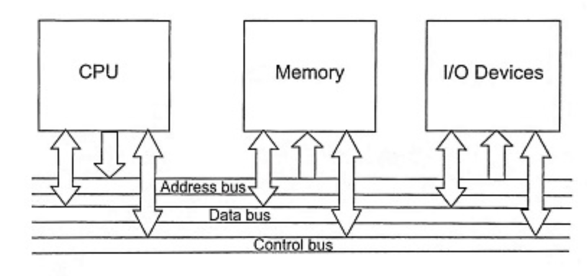
Bus interfacing
System Bus
A sequence of bits can be transmitted across a single line.
Simultaneously, several lines can be used to transmit bits in parallel.
A bus that connects major components such as the CPU, memory, and I/O is called system bus.

Slide 4
Bus interfacing
Need of Bus Interfacing
A microcomputer consists of a set of components such as CPU, memory, I/O device and these components communicate with each other to perform a specified task.
The collection of paths which connect the vari­ous devices or modules is called the interconnection structure.

Slide 5
Bus interfacing
Need of Bus Interfacing
Peripherals connected to the computer need special communication links for interfacing them with the CPU.
The data transfer rate of peripherals is usually slower than the transfer rate of CPU, and consequently synchronization mechanism may be needed.
Data codes of peripherals differ from CPU and memory.
To supervise and synchronize all input and output transfer, a special hardware component is required which is called as Interface Unit.

Slide 6
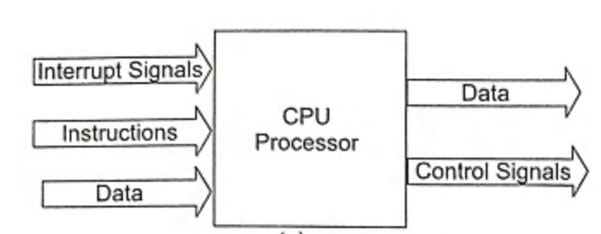
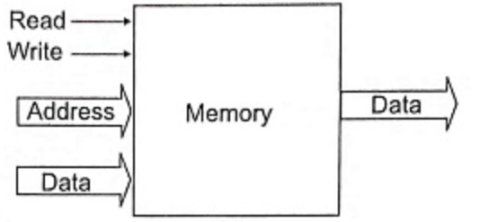
Bus interfacing
I/O Signals of a Processor, Memory

Slide 7
Bus interfacing
Classification Of Bus
Data bus
Address bus and
Control bus

Slide 8
Bus interfacing
Data Bus
The data bus provides a path for moving data between the system modules and devices. These lines are also called data lines.
The data bus typically consists of 8,16 or 32 sepa­rate lines.
Each line is capable of carrying only 1 bit at a time and the number of lines determines how many bits can be transferred at a time to increase overall system performance.

Slide 9
Bus interfacing
Address Bus
The address bus is used to locate the source or destination of the data on the data bus.
The width of the address bus determines the maximum possible memory capacity of the system. The address bus is also known as address lines.

Slide 10
Bus interfacing
Control Bus
The control bus is used to control the access to and the use of the data and address lines.
The most commonly used control lines are memory read, memory write, I/O read, I/O write, clock, reset, bus request, bus grant, interrupt request, interrupt acknowledge (ACK) and trans­fer ACK.

Slide 11
Bus interfacing
Types of I/O Interface
Serial Interfacing
Parallel Interfacing

Slide 12
Bus interfacing
Serial Interfacing
Exchange data with peripherals in serial mode.
Data’s are transmitted one at a time. Slow, inexpensive to implement.
If the bus has ‘n’ data lines, the serial I/O interface accepts ‘n’ bits of data simultaneously from the bus.
These ‘n’ bits are sent to the I/O device , one bit at a time, requiring n time slots for transmission.
Eg: Keyboard Interfacing

Slide 13
Bus interfacing
Parallel Interfacing
Parallel interfacing is required when I/O devices can handle datas at high speed which is not supported by the serial interface.
In Parallel interface, n- bits of data are handled simultaneously by the bus and the I/O device.
It can faster interchange the data.
But Expensive due to need of multiple wires.
I/O device those requiring high data transfer rate use this arrangement.

Slide 14
Bus interfacing
Serial Communication
Serial communication is the process of sending data one bit at a time, sequentially, over a communication channel or computer bus.
This is in contrast to parallel communication, where several bits are sent as a whole, on a link with several parallel channels.
Serial Communication can be classified into
  Asynchronous Serial Communication
  Synchronous Serial Communication

Slide 15
Bus interfacing
Asynchronous Serial Communication
A bit of data are sent at constant rate
If there is no data, a line stays high at logic 1 called mark bit.
The beginning of the groups of data are identified by a start bit which is always low and end of transmission is identified with a ‘0’ bit called stop Bit.
An Even Parity bit is send at the start of transmission there is a transfer of signal.

Slide 16
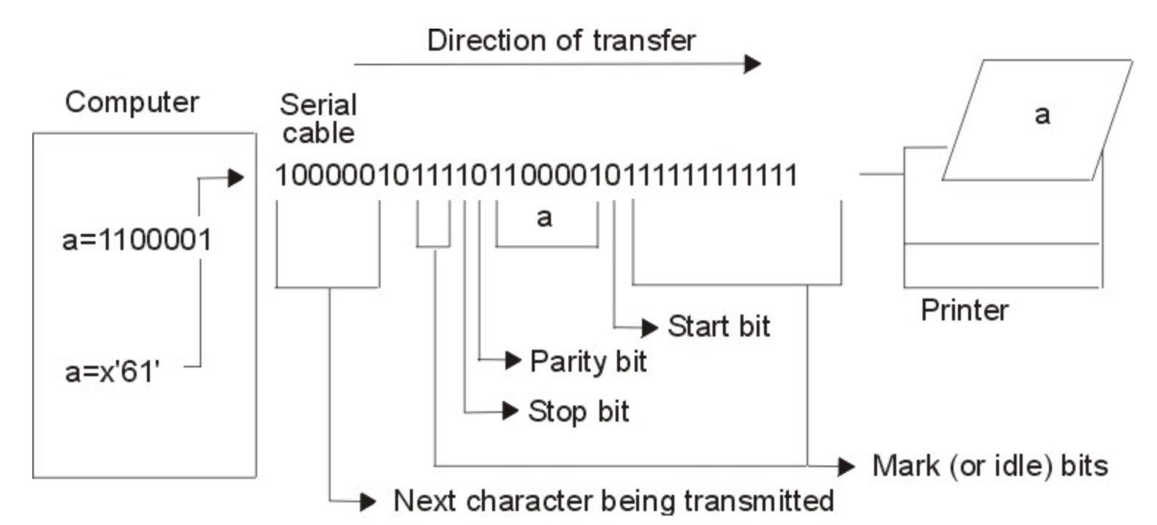
Bus interfacing
Asynchronous Serial Communication

Slide 17
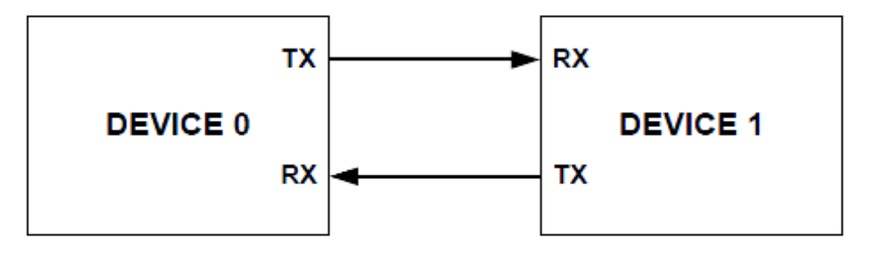
Bus interfacing
UART
The universal synchronous Receiver Transmitter consist of two wires which allows full duplex operation.
It is also a point to point communication between two devices, other wire is driven by other device.
Both the devices has a transmitter and receiver ports.

Slide 18
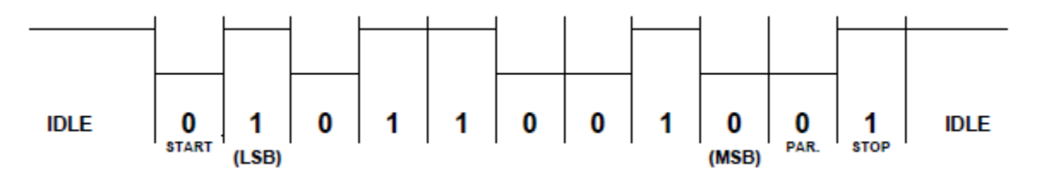
Bus interfacing
UART Transmitter
Transfer of a data is done by 5 to 9-bits.
The transfer bits contains 1 Start bit(1 logic low)Various information data bits(bits from 5, 6, 7, 8, 9)
Optional parity bit and 1 stop bits(logic high)

Slide 19
Bus interfacing
UART Receiver
At the receiver end, the UART device continually inspects the device for the incoming signal.
After detecting a falling edge, it starts to sample the input bits.
The actual value of the transferred bits are normally determined by samples from 8- 10 bits.

Slide 20
Bus interfacing
Synchronous Serial Communication
The data bits are transmitted and received at both the ends by using a synchronized clock signal.
The start and the stop bits in frame of asynchronous format represents wasted over heads that reduces the overall character rate.

Slide 21
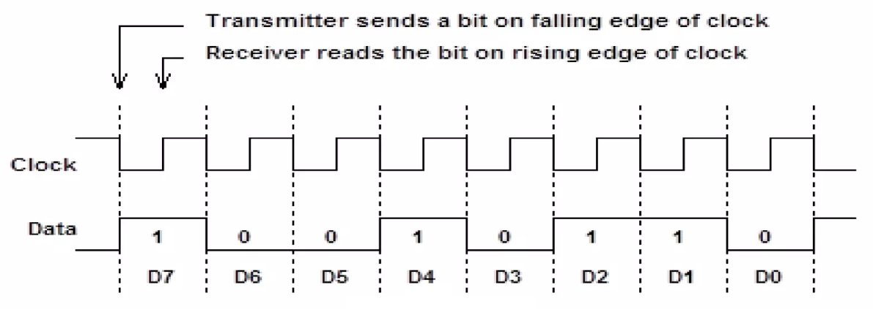
Bus interfacing
Synchronous Serial Communication
The data bits are transmitted and received at both the ends by using a synchronized clock signal.
The start and the stop bits in frame of asynchronous format are not found in Synchronous Serial Communication.

Slide 22
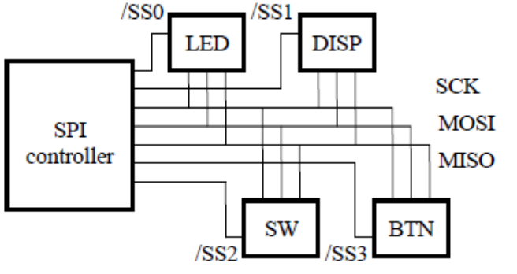
Bus interfacing
Serial Peripheral Interface (SPI)
SPI is a full duplex interface. It works under the master- slave mechanism.
The slave units are limited by the number of select signals.
SPI is a synchronous communication protocol.
SCK - Transfer clock,
MOSI - Master output, slave input
MISO - Master input, Slave output
SSn - Slave select n

Slide 23
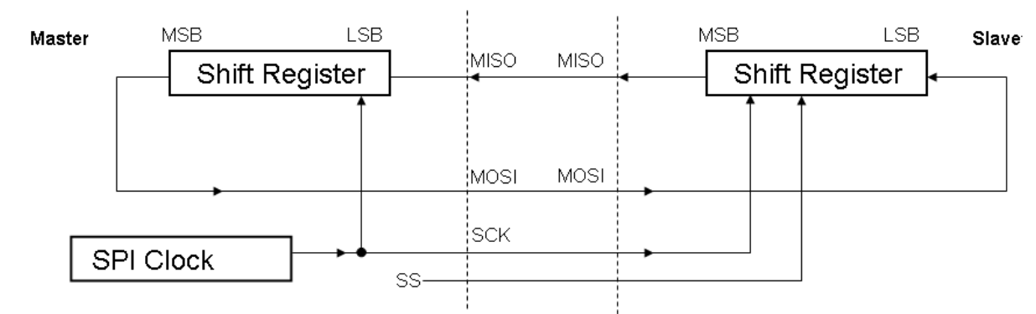
Bus interfacing
SPI - Operation
Both Master and slave contains shift registers which operate in parallel with the SCK clock.
The Master Shift in the MISO signal while Slave Shifts in the MOSI signal.

Slide 24
Bus interfacing
SPI - Operation
To begin communication, the master configures the clock using a frequency supported by the slave device that is few MHz.
The master selects the slave device with logic 0 on the select line.
During each clock cycle, a full duplex transmission occurs.
Master sends a bit on the MOSI line and slave reads it a. Similarly, slave send a bit on the MISO line and master reads it.
When the task is completed, the master sends stops toggling the clock signal and typically deselect the slave.

Slide 25
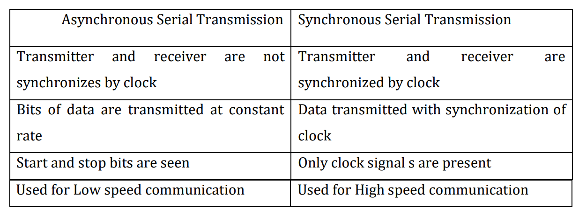
Bus interfacing
Asynchronous Vs Synchronous Serial Communication

Slide 26
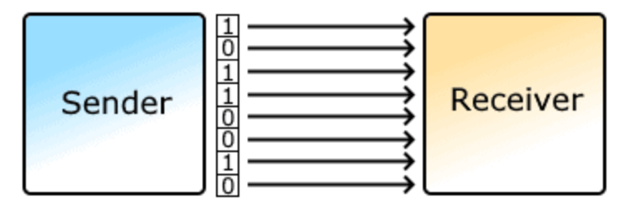
Bus interfacing
Parallel Communication
In parallel communication the various data bits are simultaneously transmitted using multiple communication links between sender and receiver.
Here, despite using a single channel between sender and receiver, various links are used and each bit of data is transmitted separately over all the communication link.

Slide 27
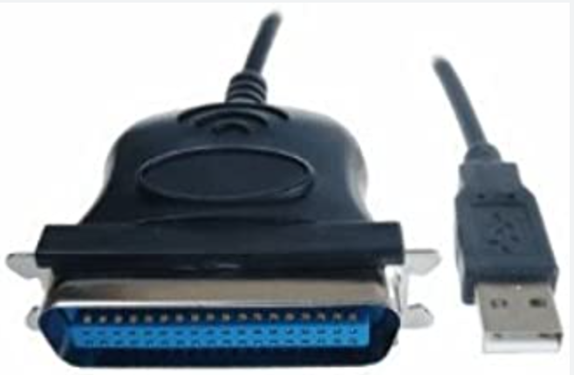
Bus interfacing
Example : Printer
DB-25, Centronics connector used to create communication in a special cable to connect the printer to the computer.
When a PC sends data to a printer or other device using a parallel port, it sends 8 bits of data (1 byte) at a time.
These 8 bits are transmitted parallel to each other, as opposed to the same eight bits being transmitted serially through a serial port.

Slide 28
Bus interfacing
Example : Printer
Pin 1 carries the strobe signal. It maintains a level of between 2.8 and 5 volts, but drops below 0.5 volts whenever the computer sends a byte of data. This drop in voltage tells the printer that data is being sent.
Pins 2 through 9 are used to carry data. To indicate that a bit has a value of 1, a charge of 5 volts is sent through the correct pin. No charge on a pin indicates a value of 0.

Slide 29
Bus interfacing
Example : Printer
Pin 10 sends the acknowledge signal from the printer to the computer. Like Pin 1, it maintains a charge and drops the voltage below 0.5 volts to let the computer know that the data was received.
If the printer is busy, it will charge Pin 11. Then, it will drop the voltage below 0.5 volts to let the computer know it is ready to receive more data.
The printer lets the computer know if it is out of paper by sending a charge on Pin 12.

Slide 30
Bus interfacing
Example : Printer
As long as the computer is receiving a charge on Pin 13, it knows that the device is online.
The computer sends an auto feed signal to the printer through Pin 14 using a 5-volt charge.
If the printer has any problems, it drops the voltage to less than 0.5 volts on Pin 15 to let the computer know that there is an error.

Slide 31
Bus interfacing
Example : Printer
Whenever a new print job is ready, the computer drops the charge on Pin 16 to initialize the printer.
Pin 17 is used by the computer to remotely take the printer offline. This is accomplished by sending a charge to the printer and maintaining it as long as you want the printer offline.
Pins 18-25 are grounds and are used as a reference signal for the low (below 0.5 volts) charge.

Slide 32
Thank You

