Slide 1
LCBB6003
Leadership and management, theory and practice
WEEK 5
Session 1:
Managing in organizations

Slide 2
Content of the Session
Defining Management
Management characteristics
The management process: Managerial functions
Mistakes managers make in carrying out the managerial functions
Combining Effectiveness and Efficiency
Management Skill the Key to Management Success
Management Skill: A Classical View

Slide 3
Defining Management
Management is the process of working with people and distributing an organization’s resources to achieve goals efficiently and effectively.

Slide 4
Management characteristics
A process/series of related activities
Concentrating on reaching organizational goals
Working with and through people and other organizational resources

Slide 5
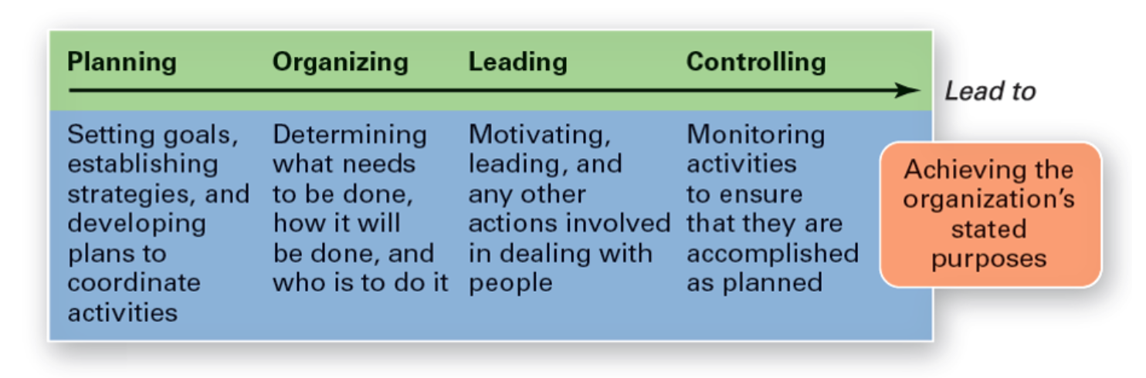
(Robbins et al., 2021)

Slide 6
The Management Process: Managerial Functions (1 of 2)
Planning
  Setting organizational goals
  Identifying actions to achieve the goals
Organizing
  Determining tasks and groupings of work
  Assigning tasks to individuals in the organization

Slide 7
The Management Process: Managerial Functions (2 of 2)
Leading
  Working with people within organizations
  Guiding the activities of organization members in appropriate directions
Controlling
  Monitoring and measuring organizational performance
  Determining if organization should be modified to meet pre-established standards

Slide 8
Mistakes Managers Make in Carrying out the Managerial Functions
Classic mistakes commonly made by managers in carrying out various management functions
Planning Not establishing objectives for all important organizational areas Making plans that are too risky Not exploring enough viable alternatives for reaching objectives
Organizing Not establishing departments appropriately Not emphasizing coordination of organization members Establishing inappropriate spans of management
Influencing Not taking the time to communicate properly with organization members Establishing improper communication networks Being a manager but not a leader
Controlling Not monitoring progress in carrying out plans Not establishing appropriate performance standards Not measuring performance to see where improvements might be made

Slide 9
Management Process and Organizational Resources (1 of 4)
The four functions of management are interrelated
Performance of one function depends on performance of the others
Managers use these activities solely for reaching organizational goals.

Slide 10
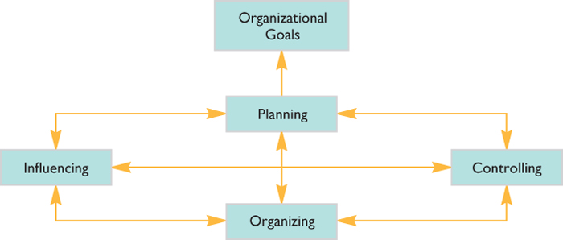
Management Process and Organizational Resources (2 of 4)
Relationships among the four functions of management used to attain organizational goals

Slide 11
Management Process and Organizational Resources (3 of 4)
Four Types of Organizational Resources: Human, Monetary, Raw Materials, Capital.
Managerial Effectiveness
  The degree to which an organization accomplishes its goals
Managerial Efficiency
  The degree to which an organization uses its resources wisely

Slide 12
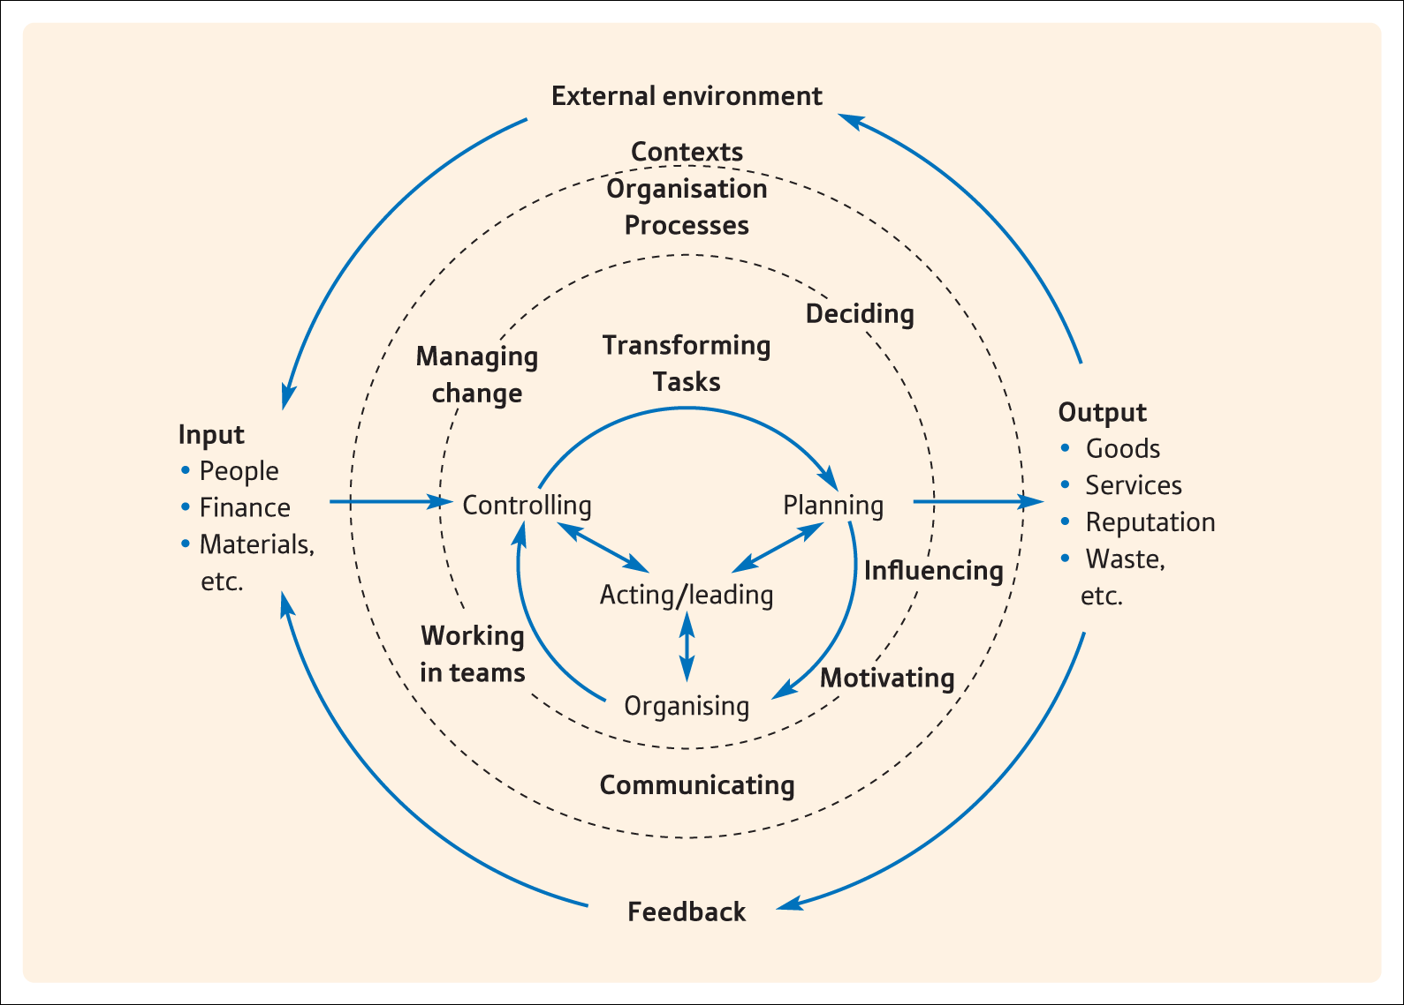
Managing tasks, processes and context
(Robbins et al., 2021)

Slide 13
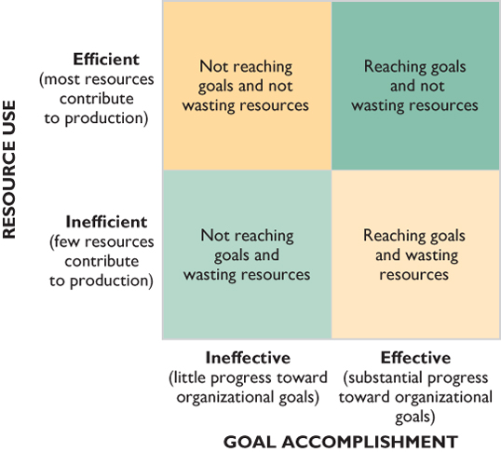
Combining Effectiveness and Efficiency
Various combinations of managerial effectiveness and managerial efficiency
(Robbins et al., 2021)

Slide 14
Management Skill the Key to Management Success
Defining Management Skill
  Ability to carry out process of reaching organizational goals by working with and through people and other organizational resources
  Companies focus on developing managerial skills to enhance the manager’s and organization’s abilities to achieve goals

Slide 15
Management Skill: A Classical View (1 of 2)
Technical
  Ability to apply specialized knowledge and expertise to work-related procedures
Human
  Building cooperation within the team being led
Conceptual
  Ability to see the organization as a whole

Slide 16
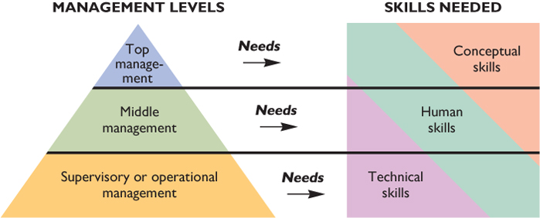
Management Skill: A Classical View (2 of 2)
As a manager moves from the supervisory to the top-management level, conceptual skills become more important than technical skills, but human skills remain equally important
(Robbins et al., 2021)

Slide 17
Management Skill: A Contemporary View (1 of 3)
Task-Related
  Efforts aimed at carrying out critical management-related duties
People-Related
  Efforts aimed at managing people in the organization
Change-Related
  Efforts aimed at modifying organizational components

Slide 18
Management Skill: A Contemporary View (2 of 3)
Management Employability Skills
  A persons’ ability to gain and maintain a career as a manager
  Six skills related to employability,
  Not a comprehensive list as many skills are needed to be a successful manager

Slide 19
Management Skill: A Contemporary View (3 of 3)
Skills managers need to perform their tasks
Communication Effectively sharing meaning with others.
Critical Thinking Assessing situations to identify and solve problems.
Creativity Generating new ideas that contribute to organizational success.
Collaboration Understanding and working within the dynamics of a group.
Personal Ethics Dealing with people, problems, and situations with honesty and integrity
Adaptability Working independently or as part of a team
Socially Responsible Contributing to the welfare of the community.

Slide 20
Activity
Form groups of 4-5 members and complete the following activity.
Your group will take on the role of managers at Samsung Electronics, a global leader in consumer electronics. Samsung is planning to launch a new line of smart home devices (such as AI-powered security cameras, smart refrigerators, and automated lighting systems) targeting tech-savvy consumers.
The company aims to capitalize on the growing demand for interconnected home technology solutions.
Using the four managerial functions, describe the key actions and strategies Samsung should implement to successfully launch the new product line within the next six months.
Be prepared to present your work.

Slide 21
References
Crawford, J. (2023) Leadership: Advancing Great Leaders and Leadership. IntechOpen. Available at: https://doi.org/10.5772/intechopen.104266.
Yukl, G.A. and Gardner, W.L. (2020) Leadership in organizations. Ninth edition. Harlow: Pearson Education Limited.

