Slide 1



Angela thomas ford company presentation

Slide 2
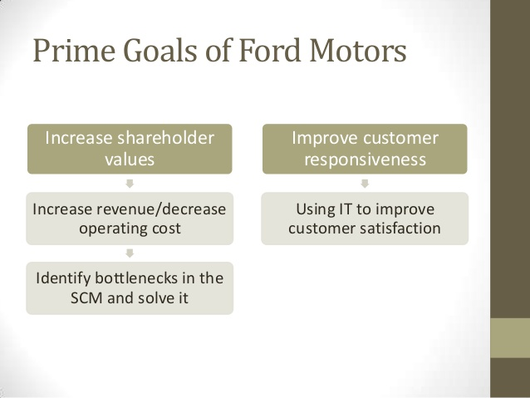
Ford company goals
Improve fuel economy across global products.

Slide 3

Ford fuel alternatives
Electrical Choices Ford’s electric strategy involves three types of electric vehicles ,hybrid, plug-in hybrid and all electric,to provide customers with fuel economy options and help reduce CO2 emissions.

Slide 4
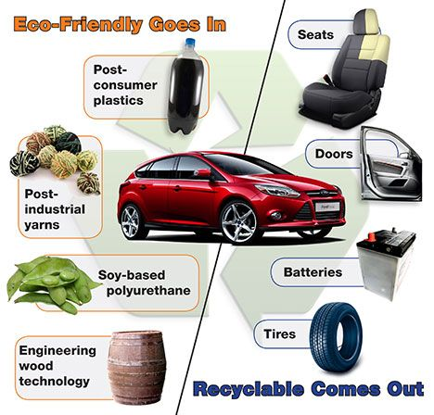
Development of materials
Recycled Materials Using recycled content in materials diverts consumer and industrial waste from landfill, reduces the depletion of natural resources, and can lower both energy consumption and costs. However.
Renewable Materials Ford continue use more plant based materials to lower carbon footprint.

Slide 5

Design and manufacture
Improving Vehicle Safety Quality is critical to the safety of customers and, therefore, Safety continues to be one of the highest priorities in the design of there vehicles. They are committed to designing and manufacturing vehicles that achieve high levels of safety over a wide range of conditions.
Encouraging Safer Driving Driver safety is not just about making safer vehicles. They also encourage safer behavior behind the wheel.

Slide 6
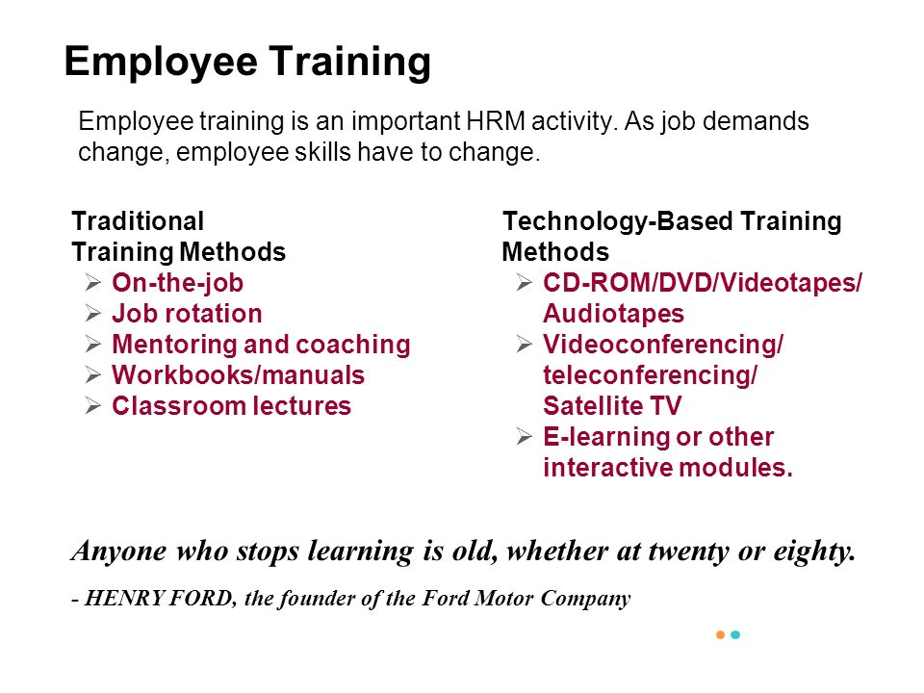
Ford motor company empolyees
Ford motor company require all its employees to be expertly trained in what they do.

Slide 7
The encouragement of staff
They encourage their staff to be the best that’s why its been a functional organization and a successful business since june 16 1903.

Slide 8
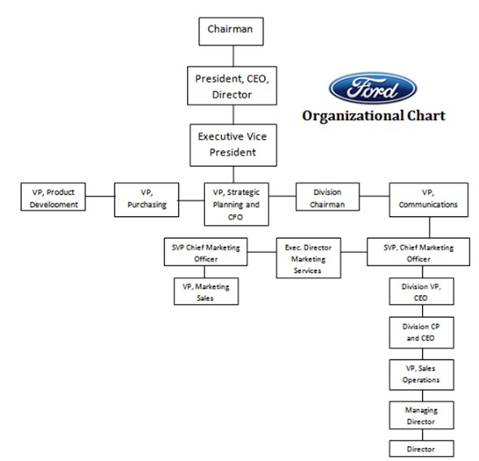
Each employee has to report to a functional manager.

Slide 9

A social career alongside your business career can make you a top class manager

Slide 10
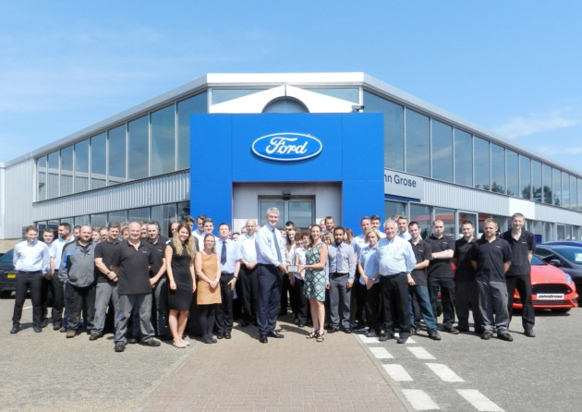
Team members should come up with their own ideas before meeting as a group.

Slide 11

Joanne sheehan a corporate affairs manager was part of the team who is credited by successful launch of the ford car.

Slide 12

Working at ford motor company is having great staff and great team work.

Slide 13

Make friends and work together as a team.

Slide 14

Finding the perfect car for you and your needs.

Slide 15
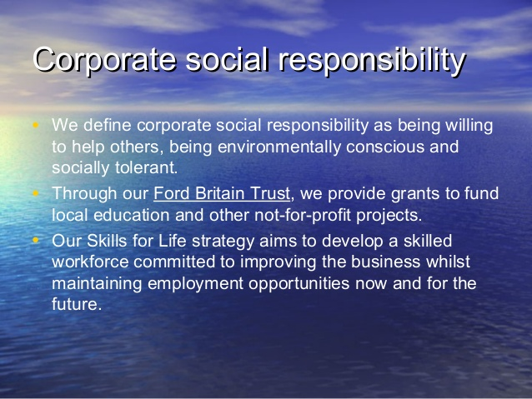
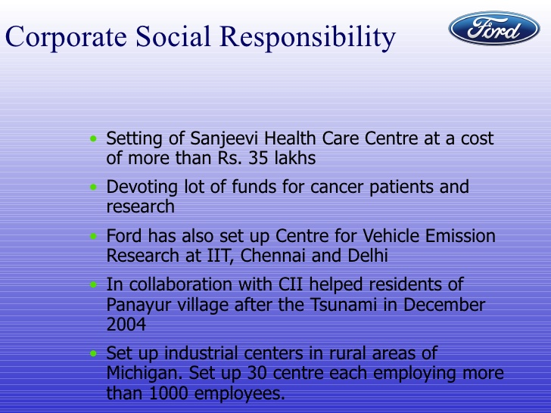
Corporate Social Responsibility We define corporate social responsibility as being willing to help others, being environmentally conscious and socially tolerant. With those guiding principles in mind, we’ve designed a special programme to promote tolerance and equal opportunities, and actively support social and environmental protection programmes.

