Slide 1


Sports Management Portfolio
Tracksuit to Boardroom

Slide 2
Why University ?
  Research Skills & Critical Reflection
  Employment / Salary / Progression
  Knowledge / Certification
  Life Experience & Placement Opportunities
  Confidence / Social Skills
  Friendships/ Networks
  Industry & Academic Understanding

Slide 3
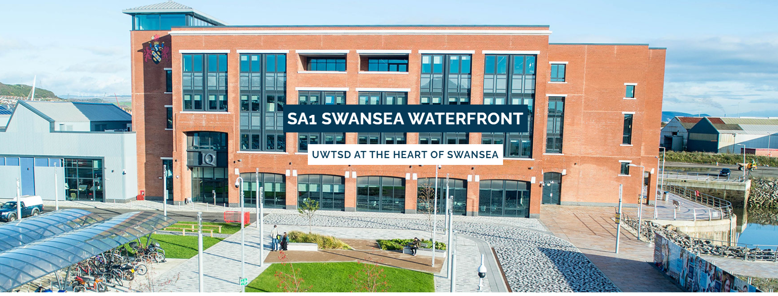
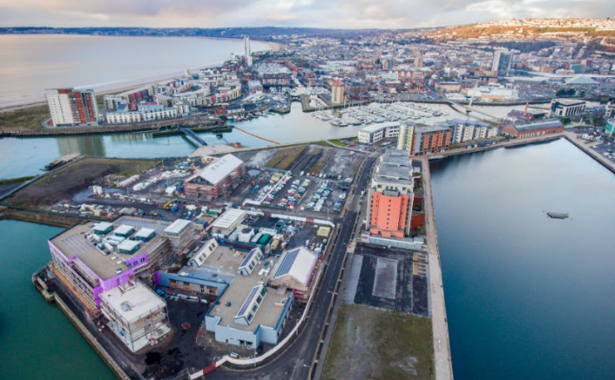
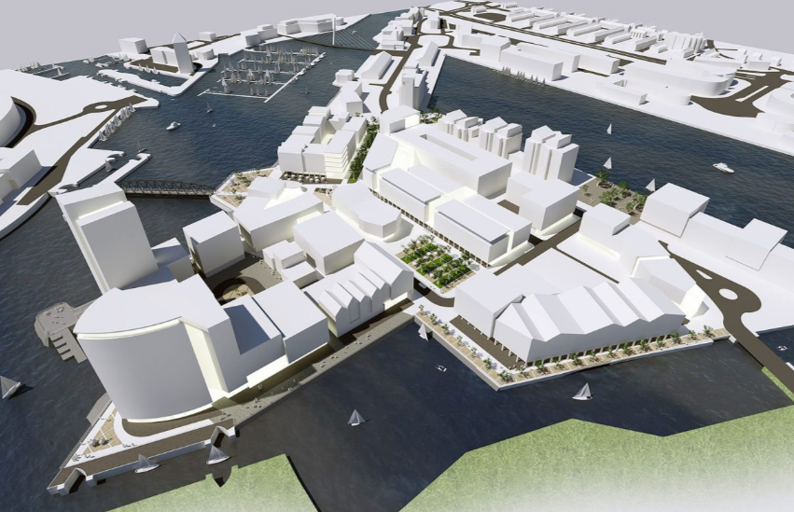

A Transformational University
SA1, Cultural Quarter, City Waterfront Campus, Entertainment
THE FUTURE …

Slide 4
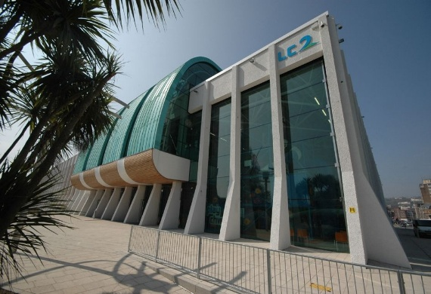
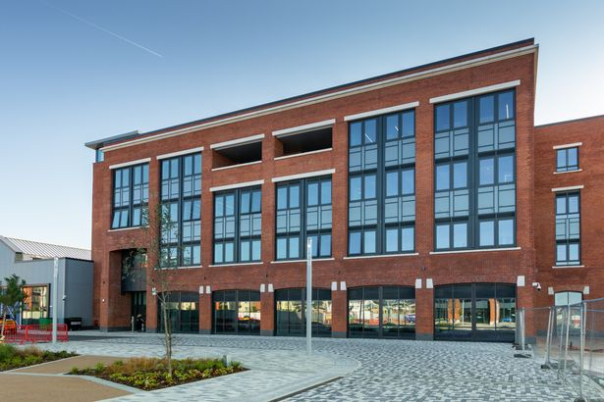
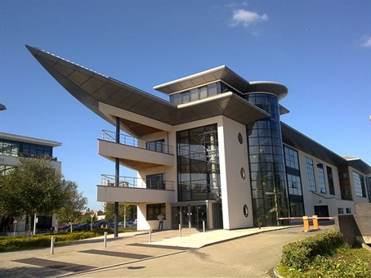
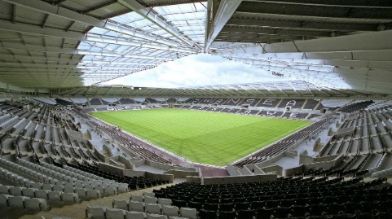
UWTSD Sports Facilities Swansea
LC Sports Centre Swansea
SA1 Waterfront Campus
WELCOME
Liberty Stadium
SA1 Technium 1 & 2

Slide 5
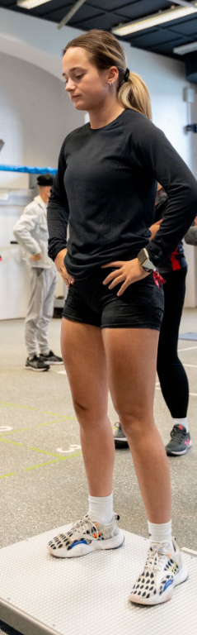
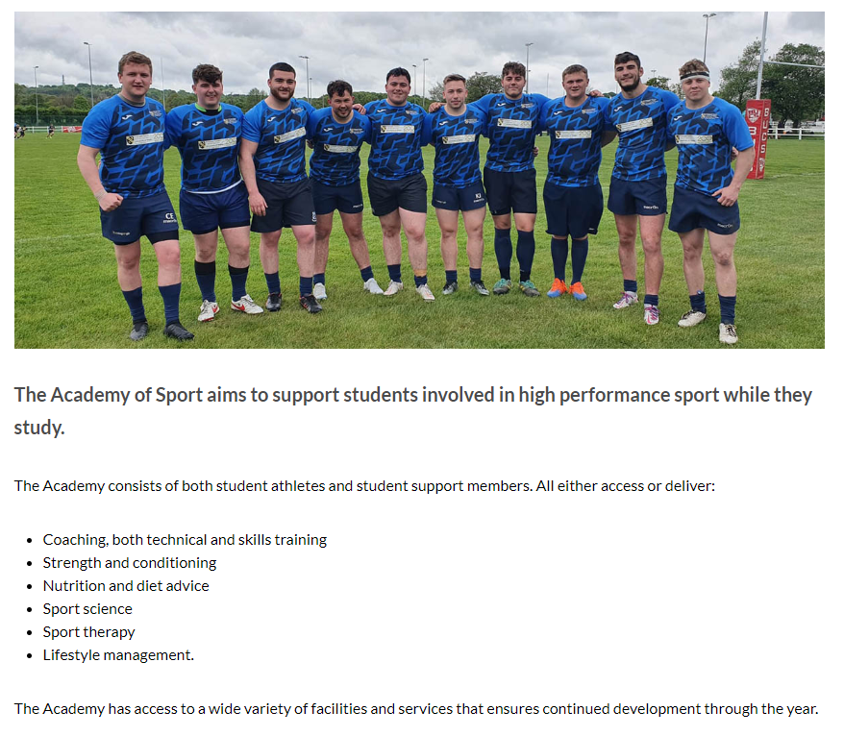
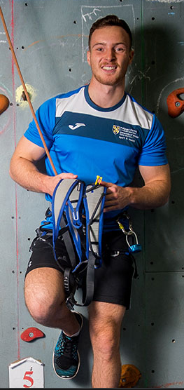
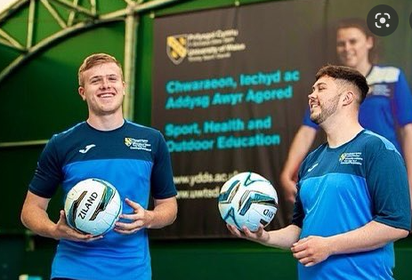
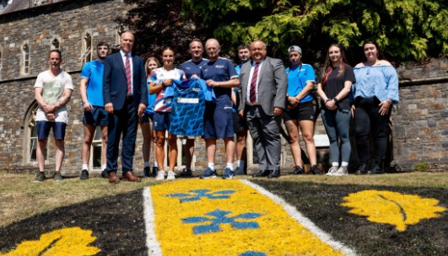
Academy of Sport

Slide 6
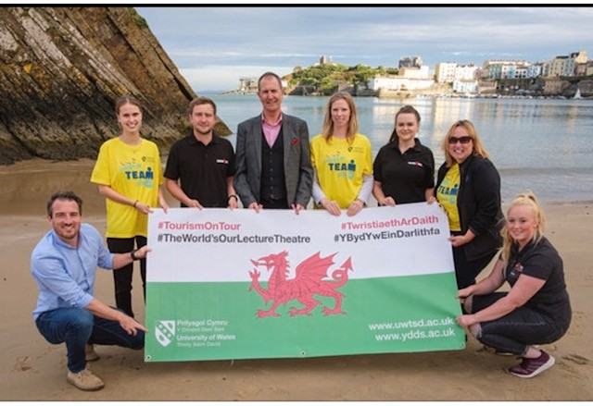
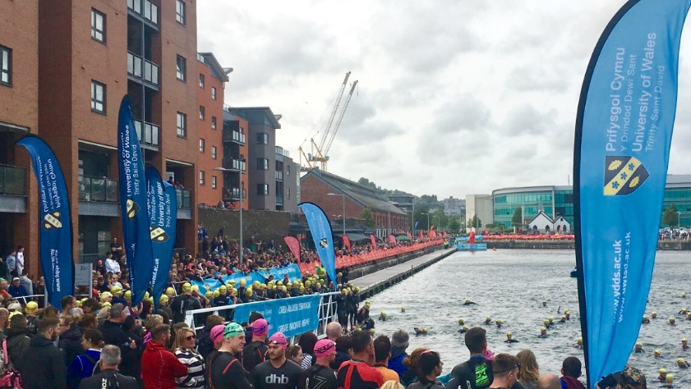
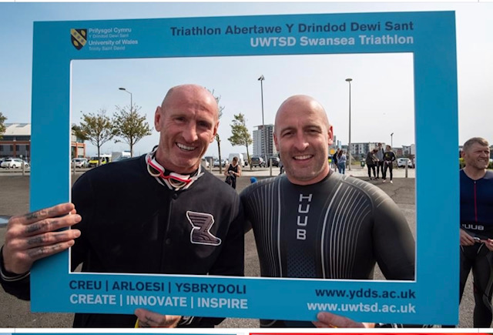

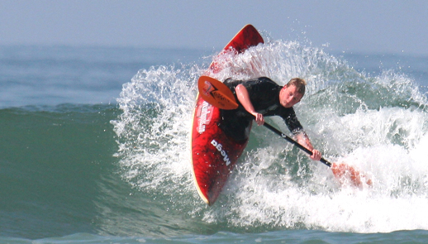
EVENTS TAKE CENTRE STAGE

Slide 7
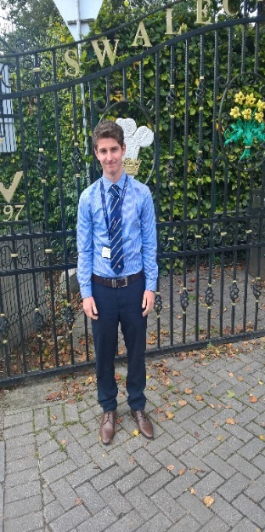
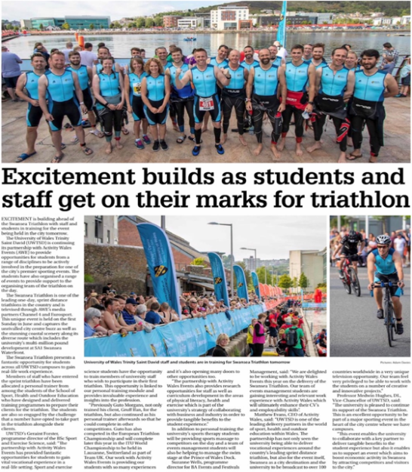
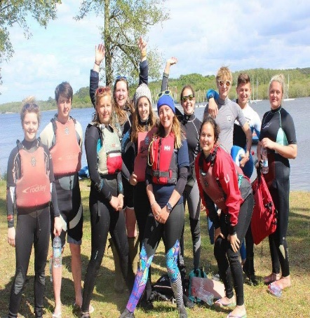
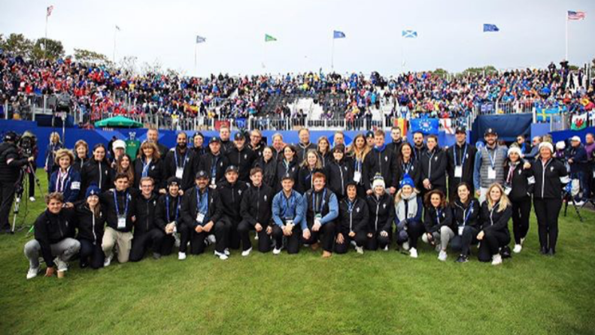
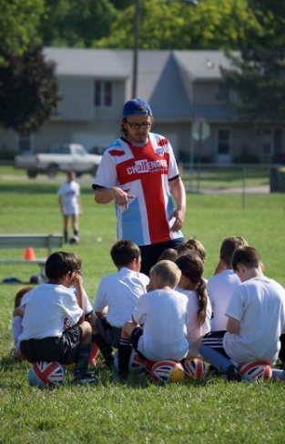
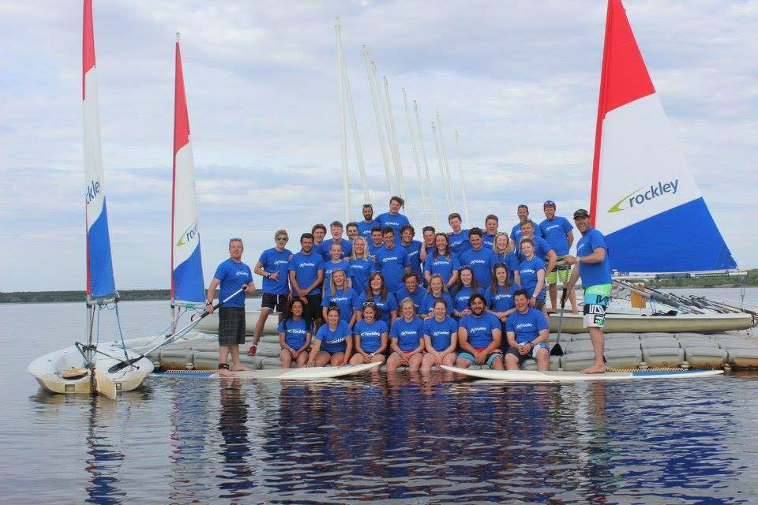
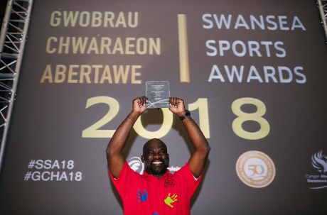
Placement Opportunities

Slide 8
Sample Modules
The Business of Sport
Coaching
Fitness & Health
Professional and Elite
Sports Development
Entrepreneurship
International Market
Sales & Merchandise
Marketing
Professional Development
Operations
Stadia Management
Culture
Major Events
Strategy
Policy
Contemporary Themes

Slide 9



Employability
What are industries expectations of graduates?
What skills and abilities do you need to gain employment and to start your journey towards a successful career?
What are you prepared to give in return?

Slide 10
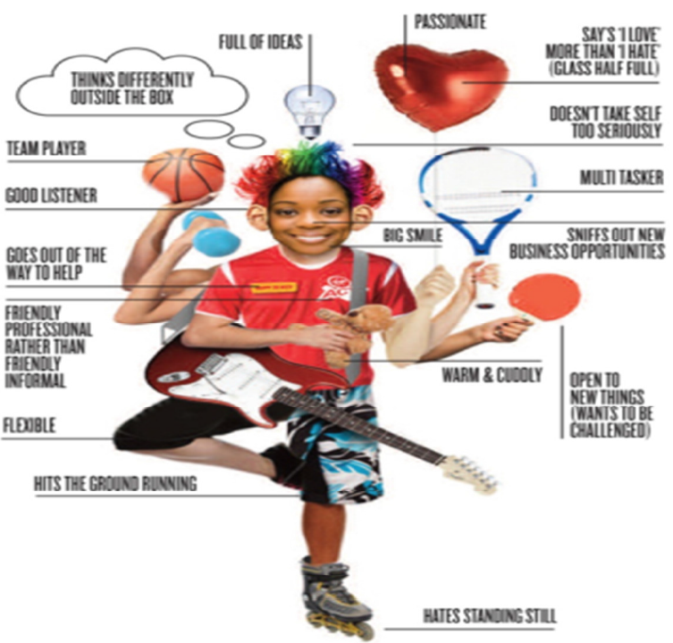
Industry Expectation

Slide 11
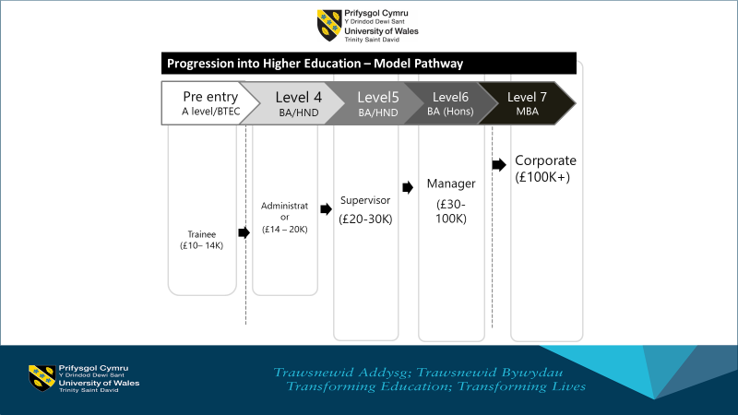
Where will your education take you ?
Income? Wellbeing? Enjoyment? Experiences?

Slide 12
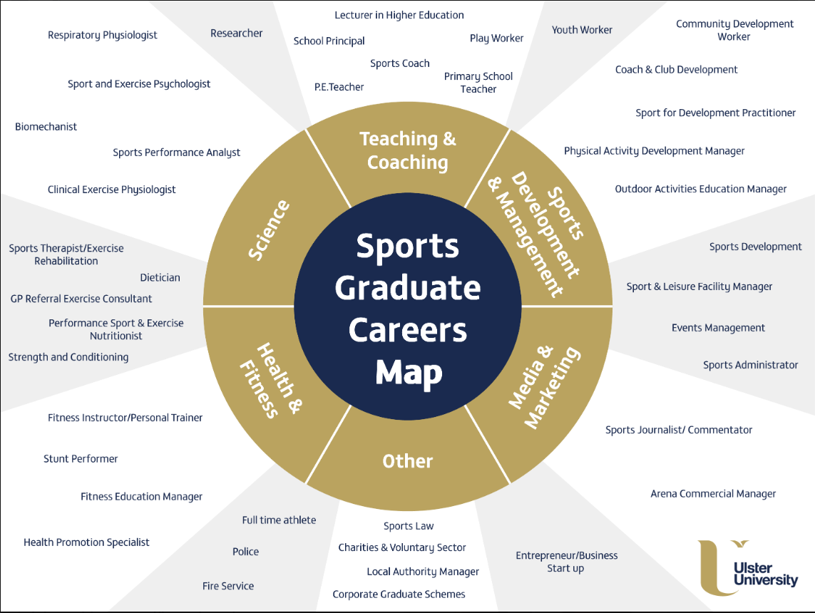

Sports Management Portfolio
Tracksuit to Boardroom

Slide 13
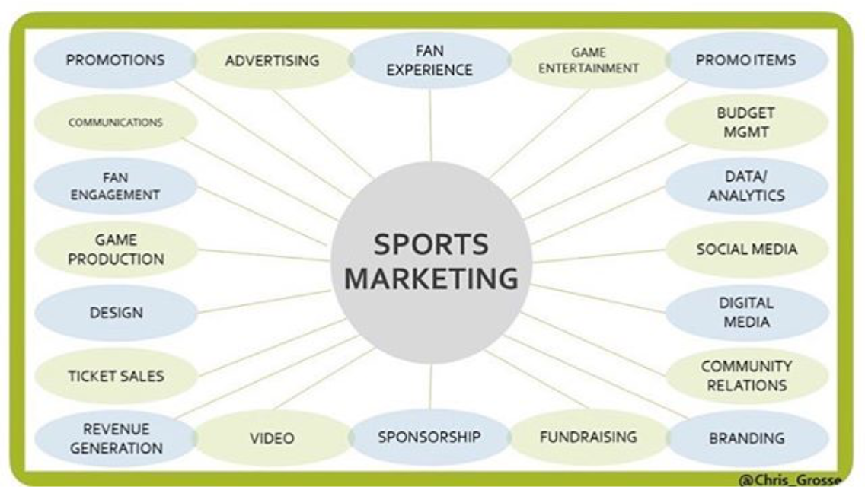


Slide 14
Major trends in the World of Sport / Health / Physical Activity
Obesity (Age, Gender) Lifestyles (Social aspects, Behaviour) Growth in football (Where) Overseas ownership of sports franchises (Examples) Health and Well-being (MOT) | Traditional Team Sport (Consequences) Facility Developments (Purpose) Player Power (Examples) Revenue Generation (Tickets, Sponsorship, Media) Management Structure (Trusts)
and employers

Slide 15


What is your Future?
Retirement?
Pension?
Mortgage?
Car Loan?
Physical Health?
Family?
Mental Health and Well-being?
Travel?
Experiences?
Employment?

Slide 16
A Sports Management Degree – Key POINTS
Practical | Community | Professional & Elite | Infrastructure | Strategy & Policy
Sports Coaching | Sports Development | Long Term Athlete Development | Stadiums / Gyms / Health Clubs | Future Generations Act.
Fitness Instruction | Community Engagement | Player Development Pathways | 21st Century Schools | Facilities for Future Generations.
Sports Mentoring | Active for life (Participation) | Coach Education | Multipurpose playing facilities | Wellbeing and Physical Activity
Sports Leadership | Club Sustainability | Managing Major Sports Events | Aquatic Centre's | Prevention is better than cure (Health)

