Slide 1

Module Name: Problem-solving and Decision-making
Work-related Stress in the UK
Anca Iuliana Gogoase
Student Number 2026352
Lecturer’s Name: Sujeewa Herath

Slide 2
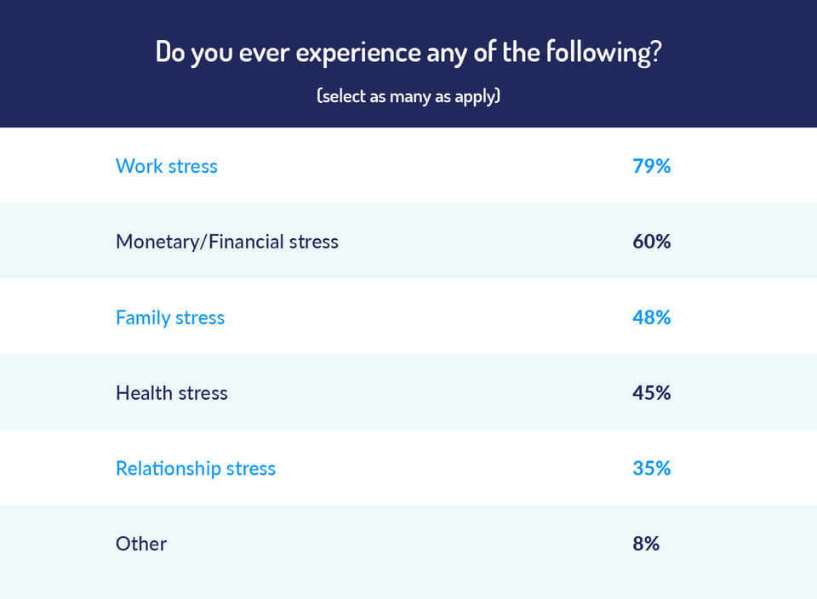
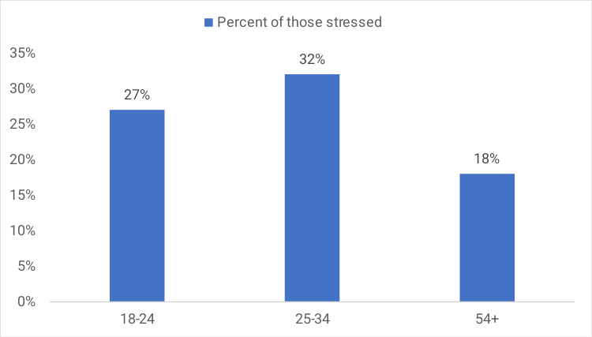
Introduction
Work-related stress is adverse reaction emanating from excessive pressures or other forms of demand placed on people at the workplace
Normally develops due to lack adequate resources or support (physical, emotional, or financial.
Work-related Stress in the UK

Slide 3
Impacts of Work-related Stress
Stress places high demands on employees' physical and mentally and affect their behaviour, performance and relationships with colleagues.
Work-related stress leads to anxiety, loss of sleep, lack of concentration.
Organisations experience lessened productivity due to disengaged employees and absenteeism.
$14.7bn expenditure on healthcare due to stress-related illnesses
5.54M inpatient hospital admissions
68.9M people seek GP appointments.
943,374 hospital admissions for chest pain driven by stress-related illnesses

Slide 4
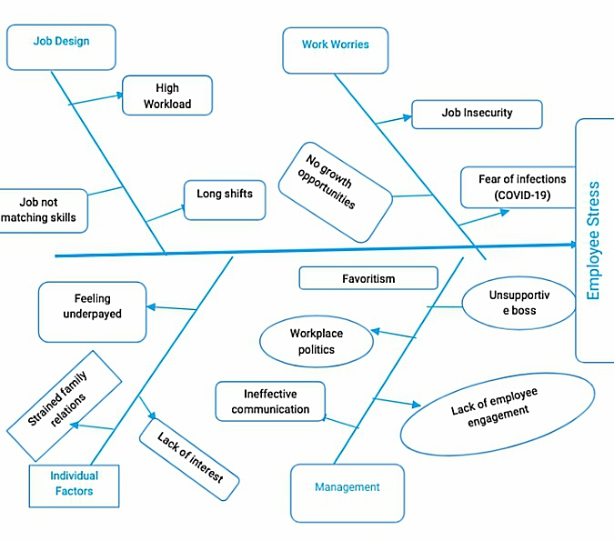
Cause and Effect Analysis (Fishbone Diagram)

Slide 5
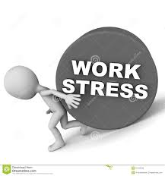
PESTLE Analysis of Work-related Stress
Political factors
In human resource perspective, Brexit has resulted to labour shortages across different sectors.
Besides, workers being anxious about their job security, human resource managers could be stressed due to lack of enough people to recruit
Economic factors
A rise in inflation causes a sharp increase in the cost of leaving.
Workers who are worried about their financial situation are likely to be stressed at work.
They may find it hard to concentrate leading to poor performance, which makes stress even more worse

Slide 6
PESTLE Analysis Cont'
Technological factors
Technology, however, contributes to high workloads as employees feel under enormous pressure be productive, efficient, as they work often in isolation
Workers using technology also experience boredom due to lack of adequate social interactions.
Sometimes new software and equipment feels daunting and more complex. These factors fuels stress and causes frustration
Legal factors
There is several UK employers not paying workers according to the minimum wage requirements.
Feeling underpaid or not being paid makes employees stressful.
Full-time employees in the UK work an average of 42 hours per week, nearly 2 more hours than typical EU employees.
This long hours culture contributes to overwork, stress, and exhaustion.
Social factors
Family-related conflicts can adversely affect the job performance of workers and thereby their job satisfaction.
UK millennials and Generation Z, feel strained as they struggle with the lack of social interactions, often working from home. Others struggle with childcare demands coming with young families
Enviromental factors: Factors like diseases and too much pressure to act an environmentally sustainable way are issues that can affect the employees' mental state.

Slide 7
Causes and Solutions to Work-related Stress
Causes High Workload Unsupportive boss Low salaries Job not matching skills | Solutions Enhance work/life balance through Flexible work arrangements, encourage breaks, setting realistic deadlines Managers to motivate, encourage and listen to the needs of subordinates Ensure employers comply with minimum wage requirements Aligning roles with employees' skills and experience
Negative Workplace Politics Lack of Employee engagement Job insecurity Ineffective Communication | Foster a culture of teamwork and accountability. Ensure goals are well-defined, with Employees understanding their roles Involving employees in making key decisions affecting them. Offering career growth opportunities including trainings/ offer pay rise Encourage interdepartmental communication

Slide 8
The PMI Analysis
Causes of Workrelated stress | Solution | Plus | Minus | Interesting
High Workload | Enhance work/life balance through Flexible work arrangements, encourage breaks, | Employees can have time for family and feel less pressurized to work It can boost morale | Scheduling issue may arise including coordination Productivity may diminish to some extent due to decreased working time. | Would flexible work arrangements require additional staff? Would their be other onsite activities to help to improve workers welfare
Lack of employee engagement | Involving employees in making key decisions affecting them. | Boosts morale and commitment Employees can feel valued | Increased risk of diminished line of distinction between the management level and employee level | Would the Executive agree to sit on the same table with subordinates What deciins would not involve employees
Workplace politics | Foster a culture of teamwork and accountability | Employees will be focused toward achieving the goals. They will not have time to gossip or engage in unnecessary activities. | Individual differences could make it hard to achieve teamwork There could be unhealthy Competition among staffay | How will staff with individual differences get reconciled Would there be need for training in work ethics Who would be responsible for ensuring focus and accountability
Low salaries | Review compensation and benefits | Employees can become more motivated as they will be able to meet their financial obligations | Have a negative impacts on the firms profitability | Where would be the source of additional capital? Will shareholders agree with salary increment?
Job Insecurity | Offer career growth opportunities | Employees will be confident in the work and develop a feeling of career fulfilment | A lot res and time needed Could be unsustainably in diminished economic conditions | Hiw will Individual training needs be identified Who will be responsible for the training

Slide 9

Conclusion
Work-related stress is a serious issue in the UK.
It is linked to negative workplace politics, high workloads, unsupportive managers, lack of engagement, and low wages.
Work-related stress impacts people's physical and emotional health, contributes to absenteeism and thus poor performance.
Organizations need to ensure a conducive work environment for all the employees.

