Slide 1
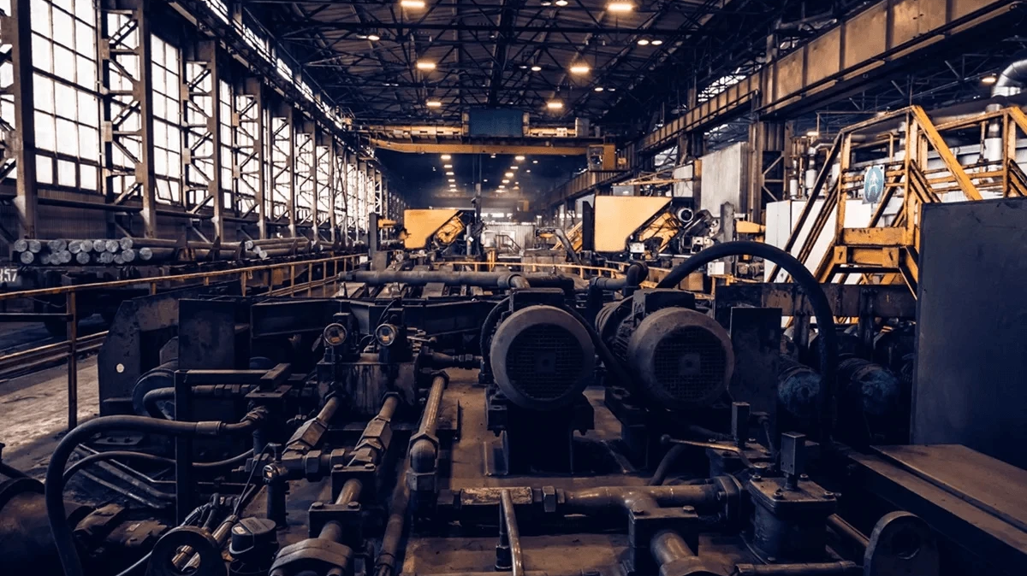
Hafsa Khan (2511466)
Haseeb Kiyani (2511018)
Communication Barriers
at Flight Foods Ltd
An Analysis of Environmental Noise and Language Barriers
Using the Shannon-Weaver Model.
n

Slide 2
1
Who is Flight Foods Ltd?
Understanding the company profile, stakeholders, and quality control challenges in ready meal manufacturing.
What We'll
Cover Today
The Shannon-Weaver Model
2
Introducing our analytical framework—the 1949 communication theory that helps identify where messages break down.
3
Problem 1: Environmental Noise
Analyzing how physical noise from old machinery creates communication bottlenecks at the channel stage.
A clear step-by-step plan of our analysis, starting with understanding of the company, then spotting communication problems, and finally suggesting solutions based on the evidence.
4
Problem 2: Language Barriers
Examining how multicultural workforce dynamics create encoding and decoding challenges in message transmission.
5
Solutions & Recommendations
Evidence-based strategies to address both environmental and linguistic communication barriers.
Analysis Framework
Using the Shannon-Weaver Model (1949) to diagnose communication breakdowns in a multicultural manufacturing environment.
6
Conclusion
Key takeaways and the critical importance of effective communication for food safety and business success.

Slide 3
CASE STUDY CONTEXT
Meet Flight Foods Ltd
The Company
Medium-sized ready meal manufacturer specializing in pre-packaged meals for airlines
Currently experiencing serious quality control problems affecting production
Ready Meal Production Environment
Quality Control Issues
The People
Gary
Floor Manager—the boss trying to fix quality issues
Undercooked Food
Poor Packaging
Cross-Contamination
40
Factory Workers
Meals not reaching proper temperature
Inconsistent sealing and presentation
From 5 different cultural backgrounds
Meat in vegetarian meals—critical issue!
Equipment
Old, noisy machinery on factory floor

Slide 4
ANALYTICAL FRAMEWORK
Our Analysis Tool—The Shannon-Weaver Model
What is it?
The 5 Components
Created in 1949 by Claude Shannon (mathematician) and Warren Weaver (scientist)
Sender
1
The person with a message to send
A simple way to understand how communication works—and where it breaks down
Example: Gary giving instructions
Encoder
2
How message becomes transmittable
The Key Concept: NOISE
Example: Gary speaking
"Noise" Definition
Channel
Anything that interferes with the message getting through clearly
3
How the message travels
Example: Air/sound in factory
Decoder
Literal Noise
Figurative Noise
4
How listener understands message
Machinery, environmental sounds
Language confusion, jargon
Example: Workers hearing & processing
Receiver
5
The person getting the message
Example: The workers

Slide 5
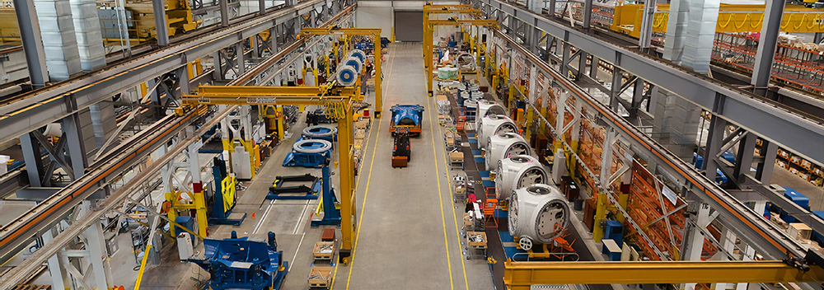
COMMUNICATION BARRIER
#1
Barrier #1—Environmental Noise
What is it?
Physical distractions in the workplace that prevent messages from being heard clearly.
Industrial Machinery Creating Constant Noise
In Flight Foods' Factory
Old Machines
Where It Hits in the Model
Constantly clanking and banging
"Madhouse" Environment
Gary's own description of the factory
THE CHANNEL STAGE
Cannot Hear Instructions
Workers literally cannot hear clearly
The message cannot travel clearly through all that noise. The channel is blocked by physical interference.
Running Around
Gary shouting and repeating himself
Think of it like a phone call with bad reception—static makes the listener hear something different.

Slide 6
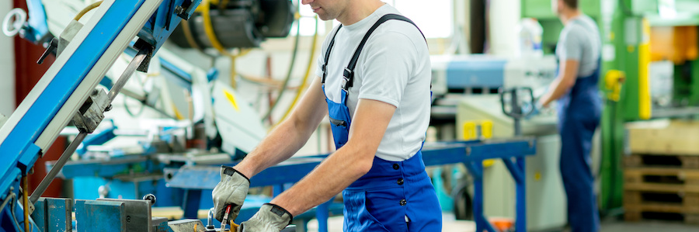
EVIDENCE & IMPACT
Environmental Noise—The Evidence
Real Examples from the Case
"Madhouse" Description
Gary calls the factory a "madhouse" with constant machine noise
Workers Need Protection from Excessive Noise
Can't Hear Instructions
Workers can't hear instructions clearly the first time
Research Support
Time Wasted
Gary wastes time running around trying to explain tasks multiple times
Stans et al. (2017)
Acoustic environment directly impacts communication effectiveness
Bottleneck Created
The noise creates a bottleneck at the "channel" stage
UiTM Study
Workers in noisy environments must raise voices and get distracted
The Bottom Line
When it's too loud, people can't hear. When people can't hear, they make mistakes. That's why food quality is suffering.
Excessive noise forces people to raise their voices
Background noise causes distraction and missed information

Slide 7

COMMUNICATION BARRIER
#2
Barrier #2—Language Barriers
What is it?
When people can't understand each other properly due to:
Different native languages
Limited fluency in shared language
Multicultural Workforce in Manufacturing
Use of jargon or unclear terms
Where It Hits in the Model
In Flight Foods' Factory
40
40 Workers
ENCODING / DECODING
From 5 different cultural groups
Limited English
The message isn't being packaged or unpacked properly. Meaning gets lost in translation.
Workers speak native languages with "a few English words thrown in"
Gary Struggles
Gary struggles to explain tasks clearly
Encoding Problem
Decoding Problem
Gary's words don't translate clearly
Workers interpret differently
Wrong Actions
Younger workers "seem to do something else" despite instructions

Slide 8

EVIDENCE & IMPACT
Language Barriers—The Evidence
Real Examples from the Case
Native Language Dominance
Workers speak their native languages, not fluent English
Communication Breakdown in Multicultural Teams
Gary's Communication Failure
Gary can't communicate instructions effectively
Research Support
Misunderstanding Pattern
Workers appear to understand but then do something completely different
Guffey & Loewy (2012)
Language diversity is a primary obstacle in multicultural workplaces
Desperate Measures
Gary's solution: plastering walls with signs (which isn't working)
Robbins & Judge (2017)
"Semantic barriers"—when words don't carry the same meaning
The Reality
Gary thinks putting up signs will solve it, but that's a band-aid. The real issue is encoding and decoding aren't matching up.
Language barriers create "semantic barriers" where meaning gets lost
Limited fluency leads to misunderstood instructions

Slide 9
STRATEGIC SOLUTIONS
Solutions—Fixing the Noise Problem
Equipment Solutions
Communication Solutions
Environmental Solutions
Visual Aids
Regular Maintenance
Use demonstrations instead of shouting
Quiet Zones
Reduce machine noise through proper upkeep
Designated areas for important communications
Hand Signals
Noise Barriers
Create signals for common tasks
Strategic Timing
Install sound-absorbing materials
Schedule briefings during quieter periods
Pictures & Diagrams
Visual instructions bypass noise
Target: Reduce physical noise at the source
Target: Optimize communication environment
Target: Alternative communication channels
Research Insight: Reducing environmental noise is crucial for effective communication. If you can't hear, you can't communicate—so fix the physical environment first.

Slide 10
STRATEGIC SOLUTIONS
Solutions—Fixing the Language Barriers
Training Solutions
Communication Solutions
Organizational Solutions
English Training
Basic English language training for workers
Visual Diagrams
Bilingual Supervisors
Show, don't just tell—demonstrate tasks
Hire bilingual team leaders
Gary's Training
Buddy System
Teach Gary key phrases in workers' native languages
Multilingual Signage
Pair workers for peer learning
Signs with pictures, not just text
Target: Build shared language competency
Target: Reduce reliance on verbal communication
Target: Build linguistic bridges in teams
Research Insight: Training and alternative communication channels (visuals, demonstrations) are effective ways to overcome language barriers. Don't just rely on verbal communication when words are the problem.

Slide 11
Conclusion
What We Found
Bottom Line
Flight Foods has two major communication barriers: environmental noise and language differences
Effective communication isn't just "nice to have"—it's essential for food safety and business success .
These barriers are causing real quality problems: undercooked food, wrong ingredients
The Shannon-Weaver model helps us pinpoint exactly where communication breaks down
Fix the communication,
fix the quality problems.
The Good News
Both problems have practical, proven solutions
Noise reduction, visual communication, and language training can fix this
Remember: This isn't just academic theory—this is about preventing food safety disasters and saving the company money.

Slide 12
ACADEMIC SOURCES
References
1
Shannon, C.E. and Weaver, W. (1949)
4
Robbins, S.P. and Judge, T.A. (2017)
The Mathematical Theory of Communication.
Organizational Behaviour. 17th edn.
Urbana, IL: University of Illinois Press.
Harlow: Pearson Education.
Foundational communication theory model
Semantic barriers in organizational communication
2
Stans, S.E.A. et al. (2017)
'The role of the physical environment in conversations between people who are communication vulnerable and health-care professionals'
5
Jelanit, F. and Nordin, N.S. (n.d.)
'Barriers to Effective Communication at the Workplace'
Disability and Rehabilitation, 39(26), pp. 2594-2605.
UiTM Shah Alam.
Environmental impact on communication effectiveness
Workplace communication barriers research
3
Guffey, M.E. and Loewy, D. (2012)
Essentials of Business Communication. 9th edn.
Academic Foundation
Mason, OH: South-Western Cengage Learning.
This analysis is grounded in established communication theory and peer-reviewed research, ensuring evidence-based recommendations for Flight Foods Ltd.
Language barriers in multicultural workplaces

Slide 13
Thank You for Listening.
Any Questions?

