Slide 1
Long-term memory and Eyewitness Testimony

Slide 2
Aims of the Lecture
Recap defining long term memory
Discussion on Declarative vs Non Declarative Memories
Discussion on Implicit Memories and Priming.
Encoding and Self-Referent Effect.
To Discuss Flashbulb Memories
To Discuss Eye Witness Testimony

Slide 3
Long-term memory (LTM) the final stage of the multi-store memory model proposed by the Atkinson-Shiffrin, providing the lasting retention of information and skills.
Bahrick et al. (1975) -very long term memory (VLTM). Nearly 400 participants aged 17 – 74. Tests: A free recall test, where participants tried to remember names of people in a graduate class. A photo recognition test, consisting of 50 pictures. A name recognition test for ex-school friends.
Results - participants who were tested within 15 years of graduation were about 90% accurate in identifying names and faces. After 48 years they were accurate 80% for verbal and 70% visual. Free recall was worse. After 15 years it was 60% and after 48 years it was 30% accurate.

Slide 4
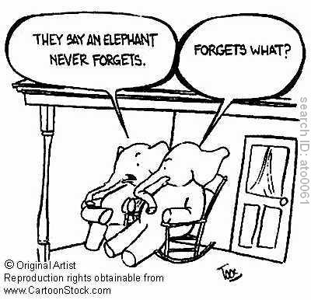
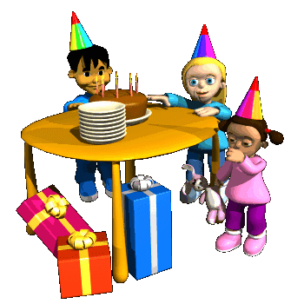
Long Term Memory
One of the earliest and most influential distinctions of long-term memory was proposed by Tulving (1972).
Explicit (declarative) memories
  Memories of facts
  Episodic – personal experiences tied to places & time (memories for events that happened to you)
  Semantic – general knowledge/your organised knowledge about the world, words and other factual information capital of France…
Implicit (non-declarative) memories
  Procedural (Implicit - a ‘know how’ memory )
  Memories of behaviours, skills, etc.
  Demonstrated through behaviour

Slide 5
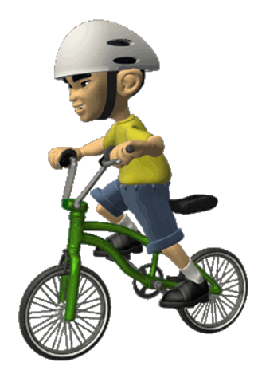
Long Term Memory
Whereas, declarative knowledge involves “knowing that”, for example London is the capital of England, zebras are animals, your mum’s birthday etc. Recalling information from declarative memory involves some degree of conscious effort – information is consciously brought to mind and “declared”.
Cohen and Squire (1980) drew a distinction between declarative knowledge and procedural knowledge. Procedural knowledge involves “knowing how” to do things. It included skills, such as “knowing how” to playing the piano, ride a bike; tie your shoes and other motor skills. It does not involve conscious thought (i.e. it’s unconscious - automatic). For example, we brush our teeth with little or no awareness of the skills involved.

Slide 6
LTM
However, their procedural memory appears to be largely unaffected. They can recall skills they have already learned (e.g. riding a bike) and acquire new skills (e.g. learning to drive).
Evidence for the distinction between declarative and procedural memory has come from research on patients with amnesia.
Typically, amnesic patients have great difficulty in retaining episodic and semantic information following the onset of amnesia.
Their memory for events and knowledge acquired before the onset of the condition tends to remain intact, but they can’t store new episodic or semantic memories. In other words, it appears that their ability to retain declarative information is impaired.

Slide 7
Implicit Memories
Priming Effects
Activating particular associations in memory just before carrying out an action or task.
Eg, a person who sees the word "yellow" will be slightly faster to recognize the word "banana."
This happens because yellow and banana are closely associated in memory.
The terms positive and negative priming refer to when priming affects the speed of processing. A positive prime speeds up processing, while a negative prime lowers the speed to slower than un-primed levels.
The word NURSE is recognized more quickly following the word DOCTOR than following the word BREAD

Slide 8
Long-term memory - Encoding
Information can be kept alive in short-term working memory by rote repetition or maintenance rehearsal.
But to transfer something into long-term memory, you would find it much more effective to use elaborative rehearsal – a strategy that involves thinking about the material in a more meaningful way and associating it with other knowledge that is already in long-term memory.
Notes:
Perhaps the most effective form of elaborative rehearsal is the linking of new information to the self. In one study, subjects sat in front of a microcomputer and looked at forty trait words (for example, shy, friendly, ambitious). In some cases, they were told to judge whether the words were self-descriptive; in others,they judged the word’s length, sound, or meaning. When asked to list as many of the words as they could, subjects remembered more after thinking about the words in reference to themselves than for other purposes. Apparently, the self can be used as a memory aid: By viewing new information as relevant to ourselves, we consider that information more fully and organize it around common themes. The result is an improvement in recall. Hence, why I tell you guys to try and personalize this material as much as possible, even if it is just coming up with examples of when these things have happened to you…it increases your likelihood of remembering it for the exam.
Although the transfer of information to long-term memory often requires a great deal of thought and effort, certain types of information are encoded automatically and without conscious control. When you meet someone for the first time, you may have trouble remembering their name but you can easily recall their face. Similarly, people encode information about time, spatial locations, and event frequencies without conscious effort.

Slide 9
Elaborative rehearsal
A technique for transferring information into long-term memory by thinking about it in a deeper way
The more deeply you process something, the more likely you are to recall it at a later time.
Linking of new information to the self.
participants looked at forty trait words (for example, shy, friendly, ambitious).
some were told to judge whether the words were self-descriptive;
others asked to judged the word’s length, sound, or meaning.
recall as many of the words as they could
participants remembered more after thinking about the words in reference to themselves than for other purposes.

Slide 10
Long-term memory - Encoding
Self-referent effect
By viewing new info as relevant to the self, we consider that info more fully and are better able to recall it.
Levels of processing
Semantic is more effective than visual or acoustic processing
Craik & Tulving (1975)
Notes:
To demonstrate this process, Craik & Tulving (1975) showed a subject a list of words, one at a time, and for each asked them for 1) a simple visual judgment that required no thought about the words themselves (Is the word printed in capital letters?); 2) an acoustic judgment that required subjects to at least pronounce the letters as words (Does the word rhyme with smell?); or 3) a more complex semantic judgment that compelled subjects to think about the meaning of the words (Does the word fit the sentence ‘I saw a blank in the pond’?). Subjects did not realize that their memory would be tested later. Yet words that were processed at a ‘deep’ level, in terms of meaning, were more easily recognized than those processed at a ‘shallow’ level.
Does making complex semantic judgments, compared to simple visual judgments, activate different regions of the brain? Is it possible to see physical traces of deep processing? Using functional MRI technology, researchers devised a study similar to the Craik & Tulving study where subjects were shown stimulus words on a computer and were instructed to determine whether the words were concrete or abstract (a semantic judgment) or simply whether they were printed in uppercase or lowercase letters (a visual judgment). As in past research, subjects later recalled more words for which they made semantic rather than visual judgments. In addition, however, the brain-imaging measures showed that processing the words in semantic terms triggered more activity in a part of the frontal cortex of the language-dominant left hemisphere.

Slide 11
Retrieval
Implicit Measures
Word Completion: the learner is presented with fragments of words, then asked to complete the fragmented word (f – sh)
Priming Task: earlier background activities (e.g., reading a story)
may help to complete fragments of word in a particular manner.
In both of the above mentioned tasks the learner is not explictly asked to remember.
Explicit Measures
Recall: learn a list of words. Then recollect the material learned. The number of items correctly recalled becomes the measure of explicit memory.
Recognition: the learner is presented with the previously learnt items or words mixed with new items and his or her job is to identify the previously learned items. Usually recognition is found to be a more sensitive measure than recall.

Slide 12
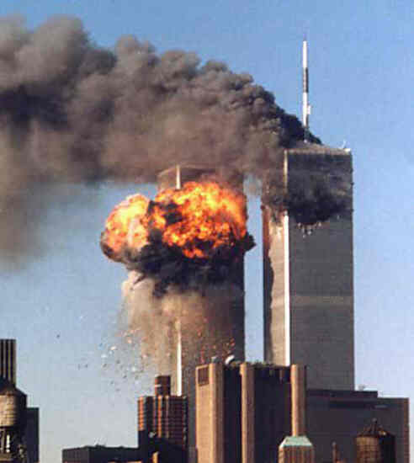
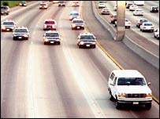
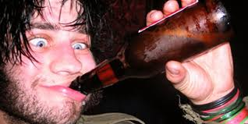
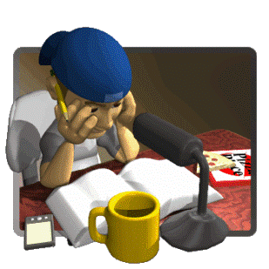
The Context Matters!!!
Flashbulb Memories (Brown & Kulik, 1977)
  Medgar Evers vs. Kennedy
  Neisser (1982) -FBM is a result of rehearsal and reworking
Mood Congruent Memory
State Dependent Memory
Notes:
Research consists of Interviews and surveys about dramatic events:
Brown & Kulik (1977) first to describe this type of memory, they interviewed US participants tended to have vivid memories of political assassinations
In their study, all participants had good recall of Kennedy assassination, BUT they found that black participants had a better recall of Medgar Evers (a civil rights worker) death
This shows importance of relevance of the information – culture seems to influence things
Physiological arousal may also be important (the Amydgala seems to play a key role here)
Neisser (1982) proposed that the enduring nature of FBM is a result of rehearsal and reworking after the event
We use the conventions of storytelling recounting important events – FBMs are just as susceptible to distortion as other memories.
It’s difficult to check the accuracy of flashbulb memories – nothing different about them
E.g Neisser himself was sure he was listening to the baseball when pearl harbour was bombed in WWII – but it couldn’t have been possible because it wasn’t in the baseball season
Furthermore, The McCloskey et al. (1988) study also proposes that flashbulb memories are not special memories

Slide 13
Eyewitness Testimony
Eyewitness testimony is a legal term. It refers to an account given by people of an event they have witnessed.
Juries tend to pay close attention to eyewitness testimony and generally find it a reliable source of information.
Anxiety / Stress
Reconstructive Memory
Weapon Focus
Leading Questions (Loftus and Palmer, 1974)
However, research into this area has found that eyewitness testimony can be affected by many psychological factors:

Slide 14
Crime Scene Challenge
You will have 2 minutes to study the photograph of a crime scene on the next slide.
Try to pay attention to details as you will be asked 10 questions about the crime scene!
You are not allowed to write anything down until after the time is up.
Ready?
Notes:
14

Slide 15
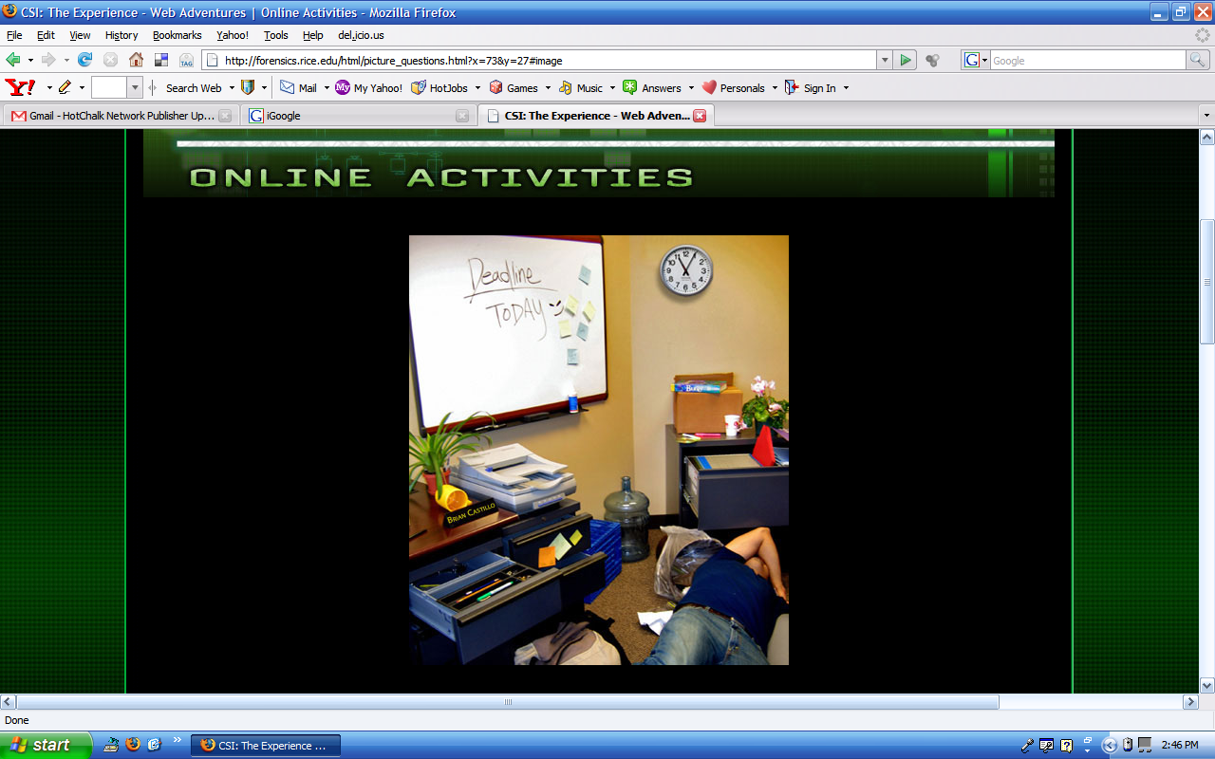
Notes:
15

Slide 16
Answer each question below.
1. What color coffee mug was in the picture? Blue Red Yellow
2. When was the deadline? Yesterday Today Tomorrow
3. What time was on the clock on the wall? 10:40 11:05 1:55
4. How many sticky notes were on the whiteboard? Four Six Eight
5. Which of the following was NOT in the picture? Stapler Trash Can Printer
6. What was the name on the plaque on the desk? Bill Brian Carl
7. What color was the victim's shirt? Black Blue Red
8. How many plants were in the picture? None One Two
9. What was the color of the marker in the desk drawer? Red Blue Green
10. Where was the book in the picture? On a box In the trash can Under the body
Source: http://forensics.rice.edu/html/picture_begin.html
Notes:
16

Slide 17
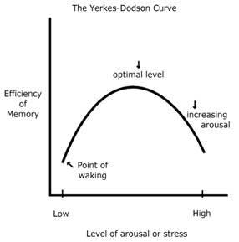
Anxiety / Stress
This means that for tasks of moderate complexity (such as EWT), performances increases with stress up to an optimal point where it starts to decline.
Almost always associated with real life crimes of violence. Deffenbacher (1983) reviewed 21 studies and found that the stress-performance relationship followed an inverted-U function proposed by the Yerkes Dodson Curve (1908).

Slide 18
Anxiety / Stress
However, a study by Yuille and Cutshall (1986) contradicts the importance of stress in influencing eyewitness memory.
Clifford and Scott (1978) - people who saw a film of a violent attack remembered fewer of the 40 items of information about the event than a control group who saw a less stressful version. As witnessing a real crime is probably more stressful than taking part in an experiment, memory accuracy may well be even more affected in real life.
They showed that witnesses of a real life incident (a gun shooting outside a gun shop in Canada) had remarkable accurate memories of a stressful event involving weapons.

Slide 19
Anxiety / Stress
The police interviewed witnesses, and thirteen of them were re-interviewed five months later.
Recall was found to be accurate, even after a long time, and two misleading questions inserted by the research team had no effect on recall accuracy.
One weakness of this study was that the witnesses who experienced the highest levels of stress where actually closer to the event, and this may have helped with the accuracy of their memory recall.
The Yuille and Cutshall study illustrates two important points:
1. There are cases of real-life recall where memory for an anxious / stressful event is accurate, even some months later.
2. Misleading questions need not have the same effect as has been found in laboratory studies (e.g. Loftus & Palmer).

Slide 20
Reconstructive Memory
Bartlett ’s theory of reconstructive memory is crucial to an understanding of the reliability of eyewitness testimony as he suggested that recall is subject to personal interpretation dependent on our learnt or cultural norms and values, and the way we make sense of our world.
People store information in the way that makes the most sense to them. We make sense of information by trying to fit it into schemas, which are a way of organizing information
Schemas are mental 'units' of knowledge that correspond to frequently encountered people, objects or situations. They allow us to make sense of what we encounter in order that we can predict what is going to happen and what we should do in any given situation. These schemas may, in part, be determined by social values and therefore prejudice.

Slide 21
Reconstructive Memory
Schemas are therefore capable of distorting unfamiliar or unconsciously ‘unacceptable’ information in order to ‘fit in’ with our existing knowledge or schemas. This can, therefore, result in unreliable eyewitness testimony.
Bartlett tested this theory using a variety of stories to illustrate that memory is an active process and subject to individual interpretation or construction.
'War of the Ghosts', Bartlett (1932) showed that memory is not just a factual recording of what has occurred, but that we make “effort after meaning”- we try to fit what we remember with what we really know and understand about the world. As a result, we quite often change our memories so they become more sensible to us.
His participants heard a story and had to tell the story to another person and so on, like a game of “Chinese Whispers”.

Slide 22
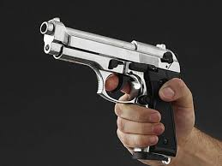
Weapon Focus
Loftus et al. (1987) showed participants a series of slides of a customer in a restaurant. In one version the customer was holding a gun, in the other the same customer held a chequebook. Participants who saw the gun version tended to focus on the gun. As a result they were less likely to identify the customer in an identity parade those who had seen the chequebook version
This refers to an eyewitness’s concentration on a weapon to the exclusion of other details of a crime. In a crime where a weapon is involved, it is not unusual for a witness to be able to describe the weapon in much more detail than the person holding it.
However, a study by Yuille and Cutshall (1986) contradicts the importance of weapon focus in influencing eyewitness memory.

Slide 23
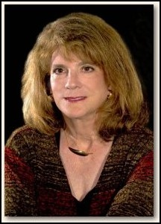
Constructive Memory
Elizabeth Loftus
Memories are not always what they seem.
A constructed memory is a created memory.
Misinformation effect
According to The Innocence Project (2008) "Eyewitness misidentification is the single greatest cause of wrongful convictions nationwide, playing a role in more than 75% of convictions overturned through DNA testing."
Still, the criminal justice system profoundly relies on eyewitness identification and testimony for investigating and prosecuting crimes (Wells & Olson, 2003).

Slide 24
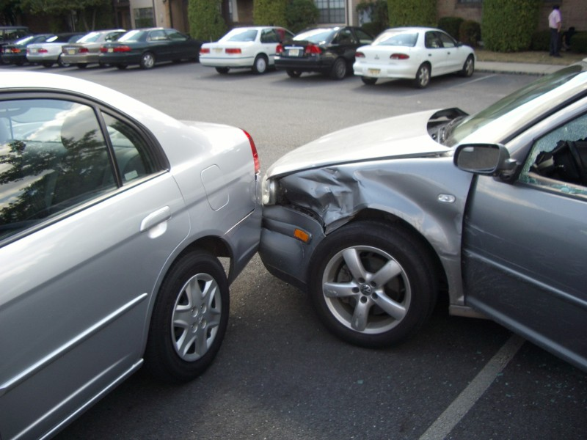
Loftus & Palmer (1974) -
A laboratory experiment. Three groups of students, after watching a film of a car crash were asked questions (an independent measures design)
Aim: - To see the effect of leading questions on Eye Witness Testimony
The first group were asked – “How fast were the cars going when they hit each other?”
For the other group the words: - smashed into each other were substituted.
A control group were not asked about speed.
A week later they were re-interviewed and asked: - “Did you see any broken glass?”

Slide 25
Results
These words have very different connotations regarding speed and force of impact.
The word smashed tends to imply broken glass and it is feasible to expect broken glass at a car accident.
They unconsciously incorporated these connotations into their memory of the event and it had affected their judgement of speed and memory of the scene.
The smashed group’s average estimated speed was 41mph
The hit group’s average estimated speed was 34mph
Although there was no broken glass at the scene 32% of the participants who heard the word smashed said there was, compared to only 14% of the hit group and only 12% of the control group.

Slide 26
Can Eyewitness Testimony Be Improved?
  A cognitive interview is a technique whereby a trained interviewer tries to improve eyewitnesses’ memories by focusing their attention on the details and context of the event.
different perspective
mentally reinstate the environmental and personal context of the crime
different narrative order.
report every detail
  http://www.simplypsychology.org/cognitive-interview.html

Slide 27
Additional Work
Watch this video
http://gocognitive.net/interviews/introduction-phonological-loop
Watch the EWT video on moodle and answer the questions

Slide 28
References
Best, J. (1999) Cognitive Psychology. ITP: Wadsworth Publishing Company.
Eysenck, M.W and Keane, M.T. (2005)
Cognitive Psychology. New York: Psychology Press.
Gross, R.D. (2005). Psychology: The Science of Mind and Behaviour. London: Hodder and Stoughton.
Hayes, N. (1998) Foundations of Psychology: An introductory text. Surrey: Thomas Nelson and sons Ltd.
Matlin, M.W. (2009) Cognitive Psychology. 7th Edition: John Wiley & Sons.

Slide 29
Further Reading
Current issues in applied memory research
http://tsd-c.worldcat.org/title/current-issues-in-applied-memory-research/oclc/503451429&referer=brief_results
Impact of expert psychological testimony on the unreliability of eyewitness identification.
http://tsd-c.worldcat.org/title/impact-of-expert-psychological-testimony-on-the-unreliability-of-eyewitness-identification/oclc/113581176&referer=brief_results
Ten years in the life of an expert witness.
http://web.ebscohost.com/ehost/detail?sid=4ff09168-bb79-4c75-b3c0-1b8d0b25d4f2%40sessionmgr104&vid=1&hid=123&bdata=JnNpdGU9ZWhvc3QtbGl2ZQ%3d%3d#db=pdh&AN=1987-00988-001

Slide 30
Further Reading
Memory by Alan D Baddeley; Michael W Eysenck; Michael C Anderson
http://tsd-c.worldcat.org/title/memory/oclc/237880710&referer=brief_results
Memory and cognition journal
http://tsd-c.worldcat.org/title/memory-cognition/oclc/45405146&referer=brief_results
http://aja.ncsc.dni.us/publications/courtrv/cr48-1-2/CR48-1-2Wise.pdf

