Slide 1
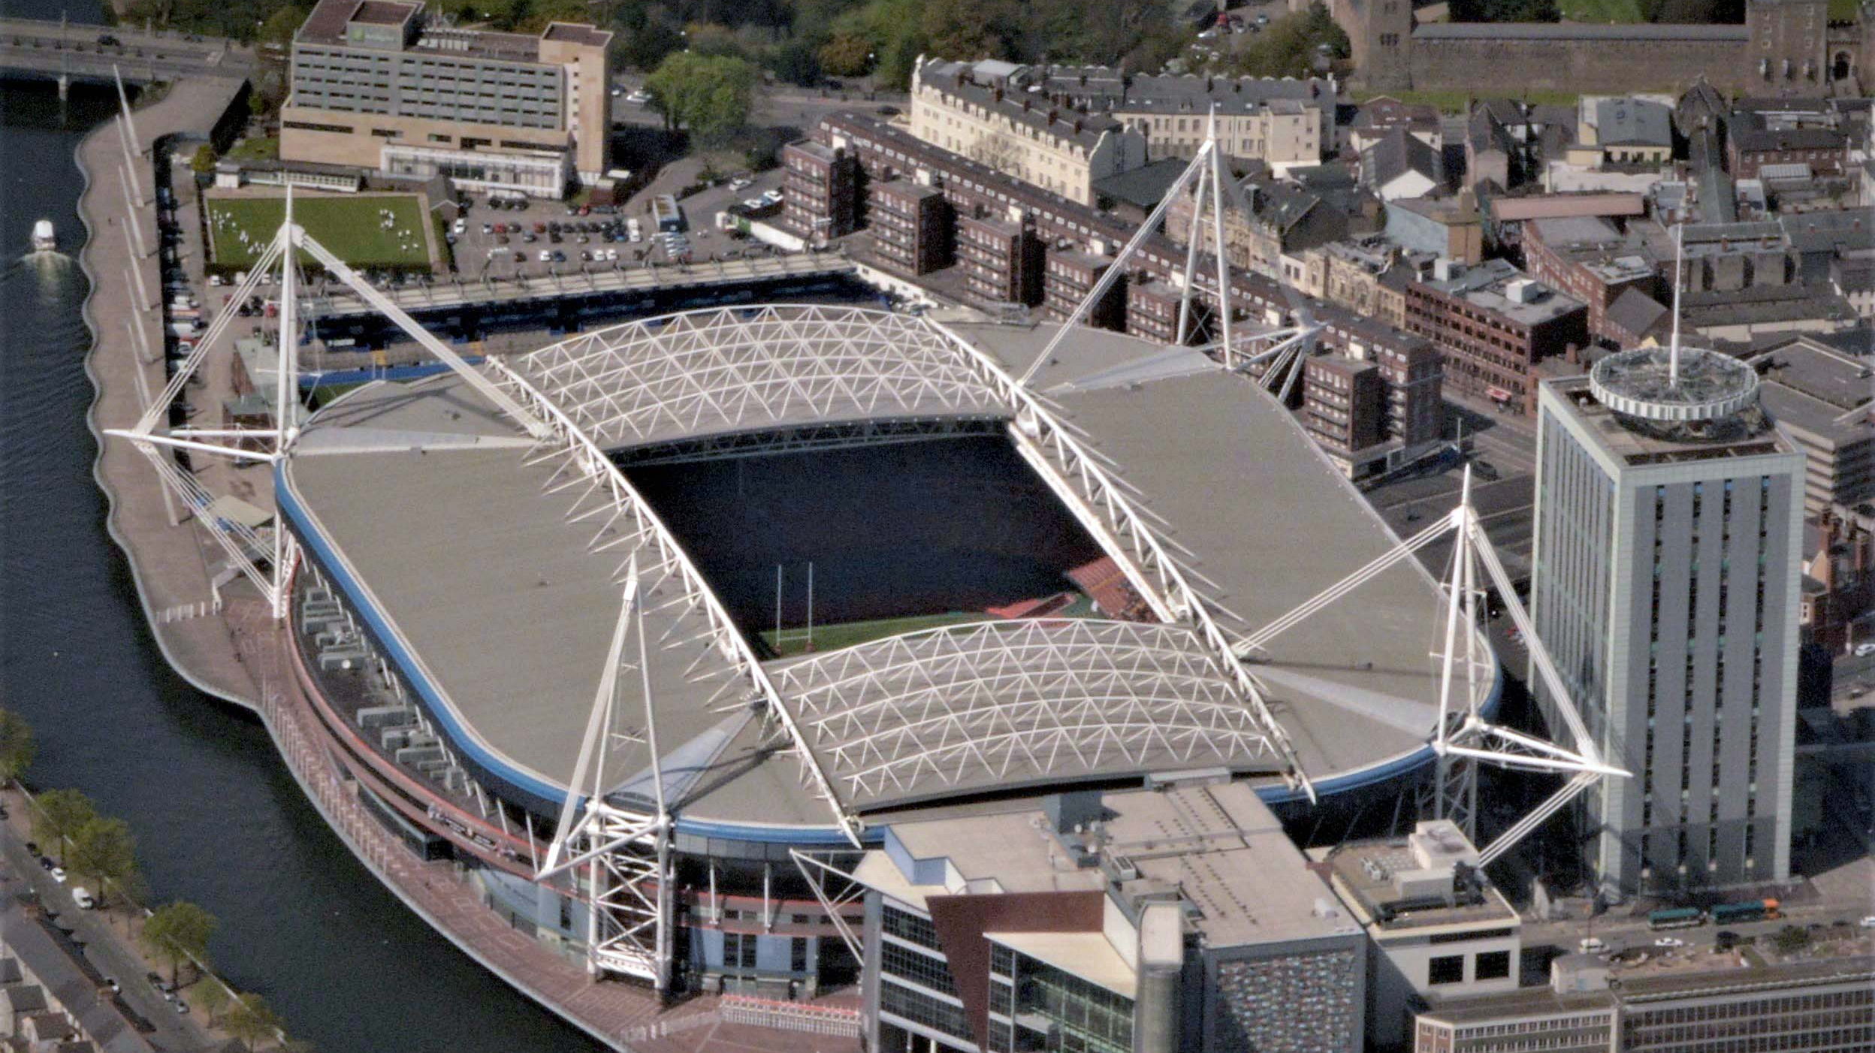
Pre Event Crisis Review Principality Stadium: Emergency Planning
Presented By Elijah Thomas
Student number:2313487
Module: Crisis Management

Slide 2

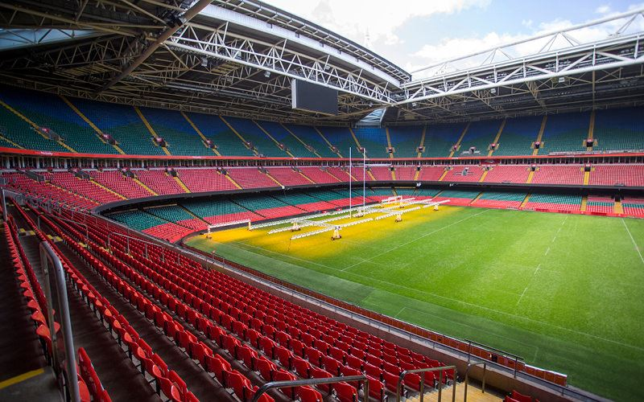

About Principality Stadium
Cardiff’s Principality Stadium, built in 1999 to host the Rugby World Cup, has a capacity of 73,931 and a footprint of more than 400,000 square feet. It is a fully enclosed venue, featuring a retractable roof that allows events to take place in different weather conditions (Information, 2025).
Cardiff Principality will be home to the large 2028-euro championships event. The risk of a terrorism crisis is always on the agenda, As a sport’s venue principality must always take precaution’s and be ready to act (Stadium, n d.)
Understanding the significance of crisis management and strategically planning for emergencies prevents various crisis before they happen foreseeing emergencies and saves lives (Liu-Lastres & Cahyanto, 2023).

Slide 3

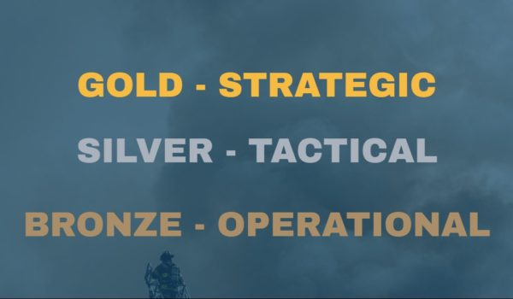
Roles and Responsibility Of Operation Bronze Command
As an operational specialist my role is to brief the team on emergency planning procedure’s and ensure all staff on an operational level are aware of their roles and responsibilities
The team’s role under bronze command is to plan for emergency’s and to implement tactical plan’s, Being the first response to an emergency executing immediate and practical tasks to save lives and mitigate impact of incidents (Byrnes, 2024)
Bronze delivers the immediate health and safety response and works with Silver commanders to deploy the appropriate emergency services.

Slide 4
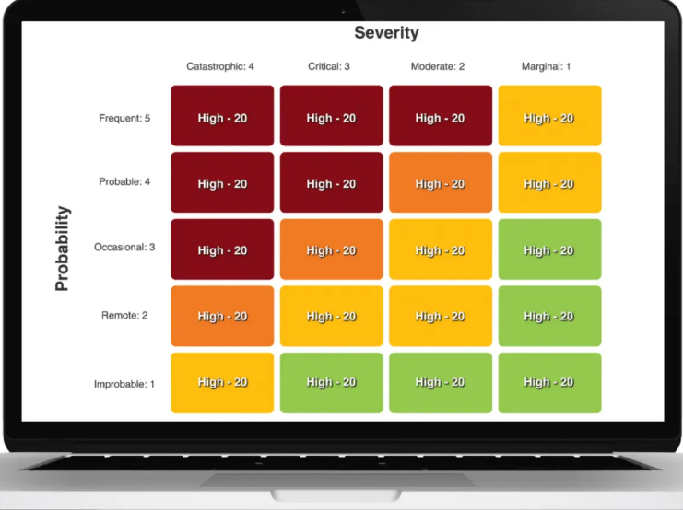
Threat Identification and Risk Planning
As guidance staff should follow the risk assessment matrix to avoid risk and promote the safety of themselves and personnel in the event of a crisis (Vector Solutions, 2018)
Bronze Command is responsible for identifying emerging threats and assessing risks, operating under the tactical direction of Silver Command to ensure effective implementation of response plans.
All staff on duty must consider and be ready to act among the following life-threatening crisis (Smillie, 2019)
Crowd Surge’s – Implement tactics such as establishing barriers, stewards managing exit/entry points
Fire – Identifying the fire’s scale, immediate risk’s and identifying people in reported fire
Terrorism – Ensure safety through an immediate on ground response, ensuring safety of personnel and emergency evacuations

Slide 5
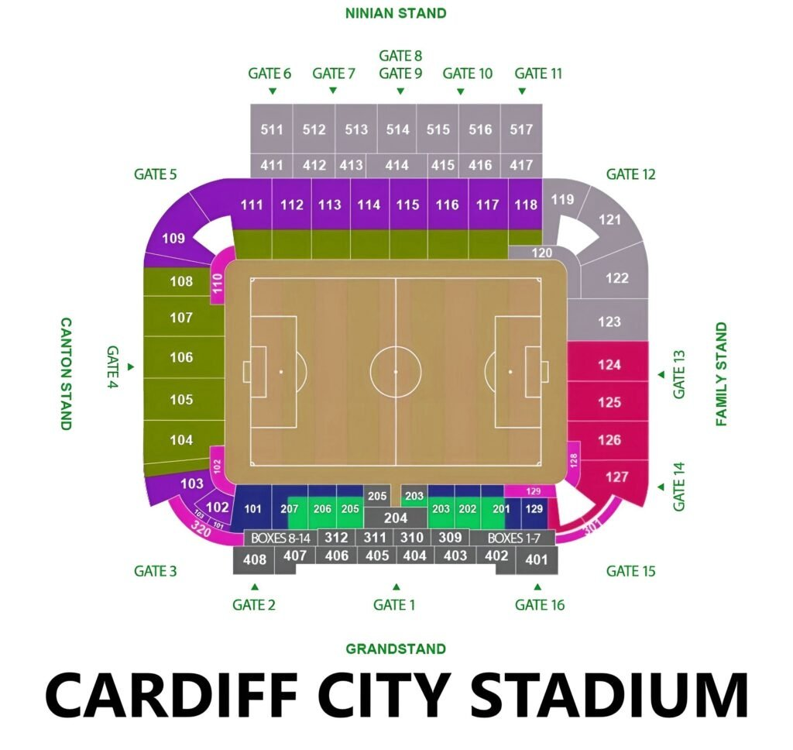
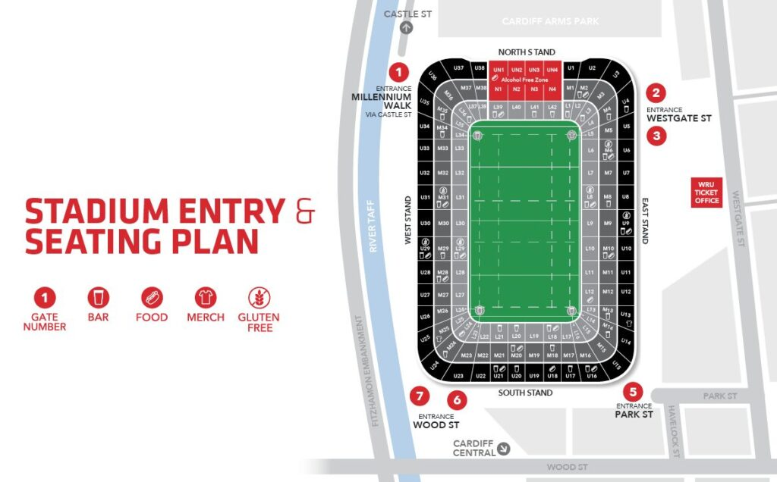
Operational Planning and Site Onboarding
Bronze command operational staff familiarising and planning is crucial in minimising causalities, allowing a smooth emergency response from silver and efficient crowd movement during evacuations (Nichola, 2025)
Identifying Safe Zones – Rendezvous points, Fire exits, First aid posts and Sheltered area’s
Communication Plans locations – Communication Channels, Monitoring System’s, Code Message’s and command Post’s
Familiarity with ingress and egress routes – Reduce panic, faster evacuation and ability to aid emergency services

Slide 6
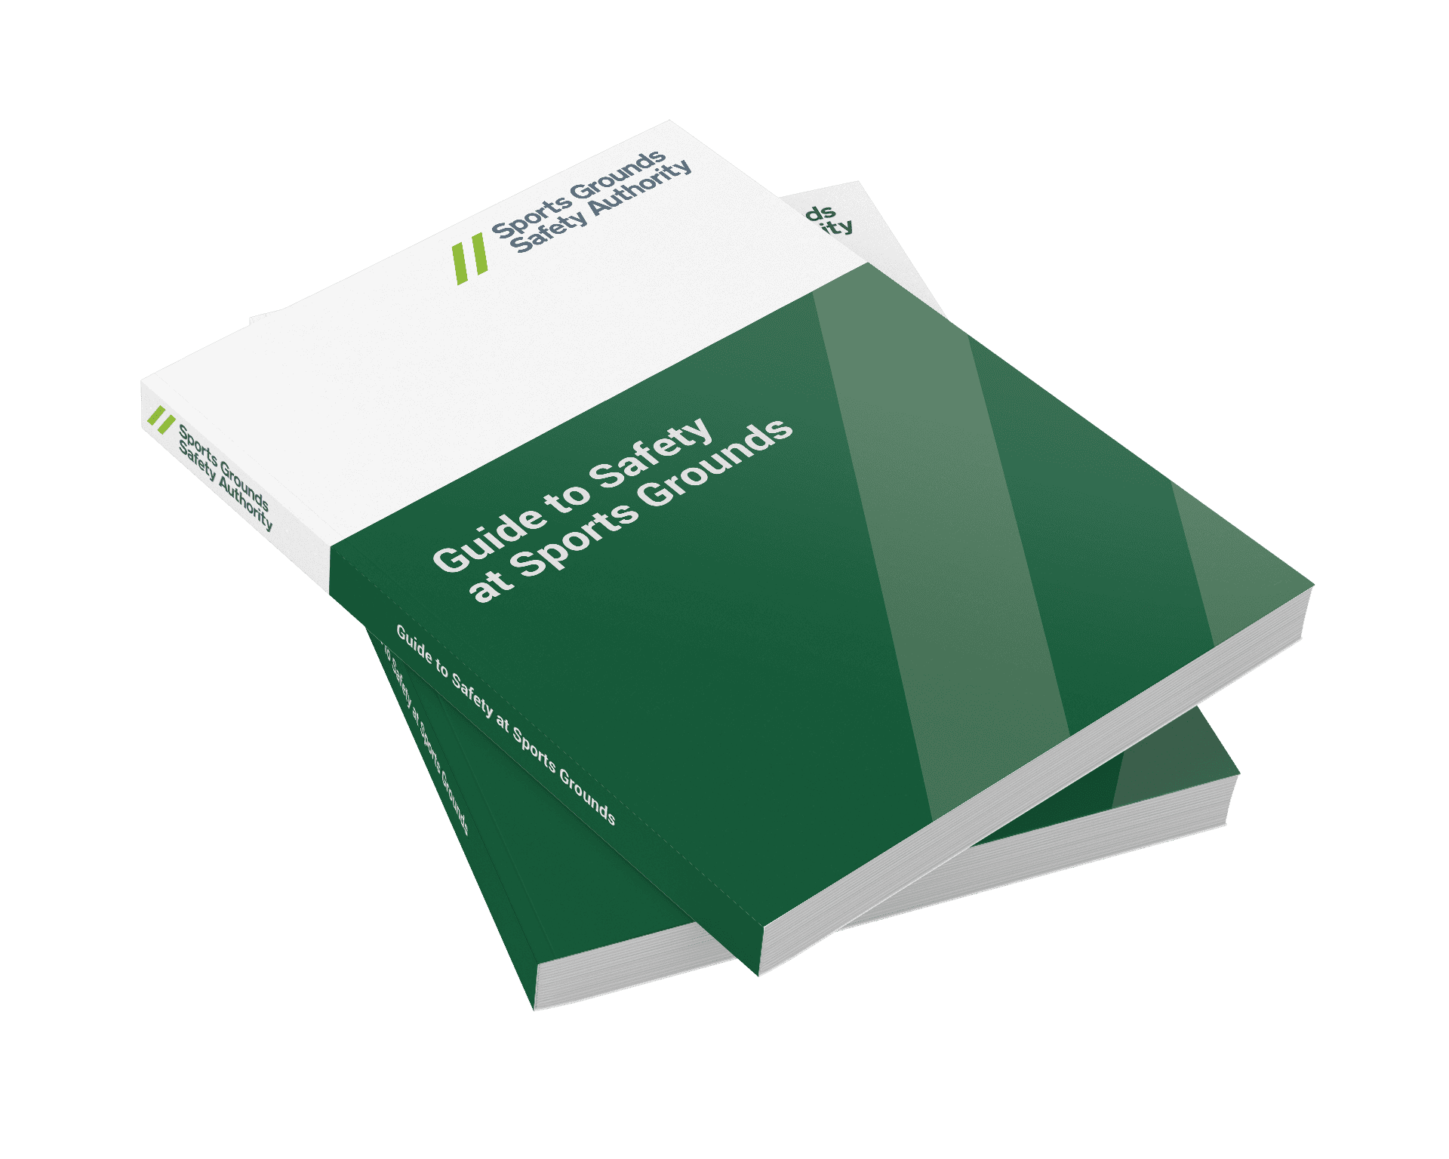
Green Guide and Crowd Control
.
The green guide known as the “guide to safety and sports grounds” is crucial in the principality stadium during the 2028 euros. The book provides best practice guidance, advice on ensuring safety inside venue’s and directly informs emergency planning and crisis response (Sports Grounds Safety Authority, n. d.)
The Green Guide state’s that crowd management must be proactive, planned and predetermined in risk assessments. Crowd’s must be able to move freely, and routes be able to handle large flows
The stewarding team at operational level must monitor crowd control, prevent overcrowding, guard exits to keep them clear and help spectators safely
Evacuation must be possible under all conditions in the case of a crisis such as terrorism, fire or crowd disaster. Offering safe evacuation routes, unblocked exits and emergency planning drills running smoothly

Slide 7
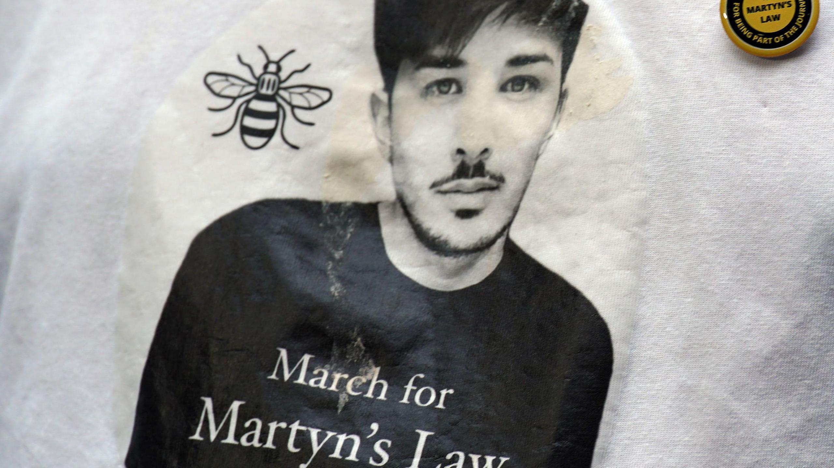
Legislation, Guidance and Martyn’s Law
Martyn’s Law 2025, Is a new UK law that requires events venues to improved security and be more prepared for potential terrorism attacks. Turning security from voluntary to a legal requirement (ProtectUk, 2024)
This has come to bring venue’s being split into risk tier’s depending on their size. Cardiff Principality as an 800+ person venue falls under the enhanced tier and remains high risk for a possible terrorism threat (Health, 2025)
Under Martyn’s Law, Premises must ensure staff are trained to respond to potential terrorism threats. Every large events premises must have a named responsible person tasked with ensuring compliance to this law. Whereas other staff must have appropriate training and instruction to be aware of emergency procedures (Marblism, 2025)

Slide 8
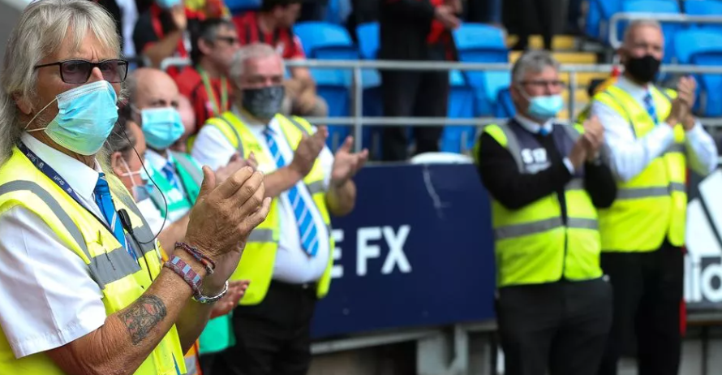
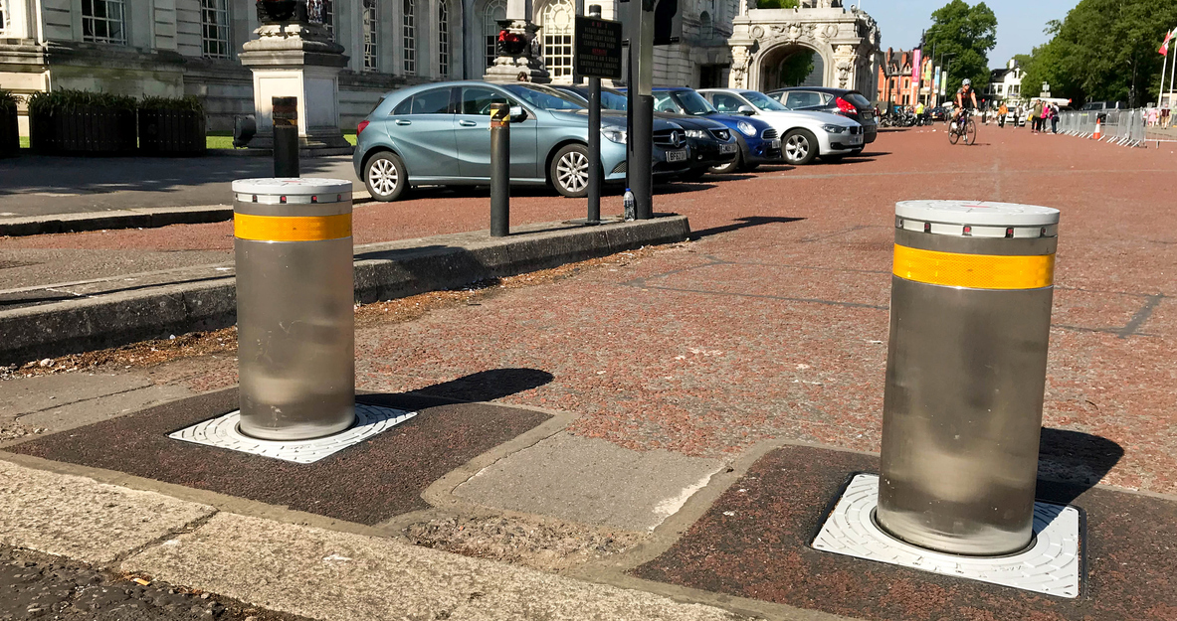
Security Planning and Counter Terrorism Measure’s
Security Planning help’s counter terrorism by identifying risk's early, implementing fast control measure’s and ensures compliance with regulatory legal acts sycg as Martyn's law and the green guide.
At an operational level, security planning should include monitoring for potential suspicious behavior, overseeing surveillance activities, and ensuring that screening and search procedures are consistently maintained to a high standard
Within Principality Stadium, attention must also be given to vehicle movements and the procedures associated with hostile vehicle mitigation. All stewards must hold a Level 2 qualification in stewardship, safety, and security, along with equivalent relevant experience in other roles, to ensure they are fully capable of mitigating associated risks (Hormann, 2025)
As part of national guideline’s security should follow the national strategy “pursue, protect, prepare and prevent” as part of their legal requirement as an enhanced tier threat level venue (Pursue Prevent Protect Prepare the United Kingdom’s Strategy for Countering International Terrorism Annual Report, 2010)

Slide 9
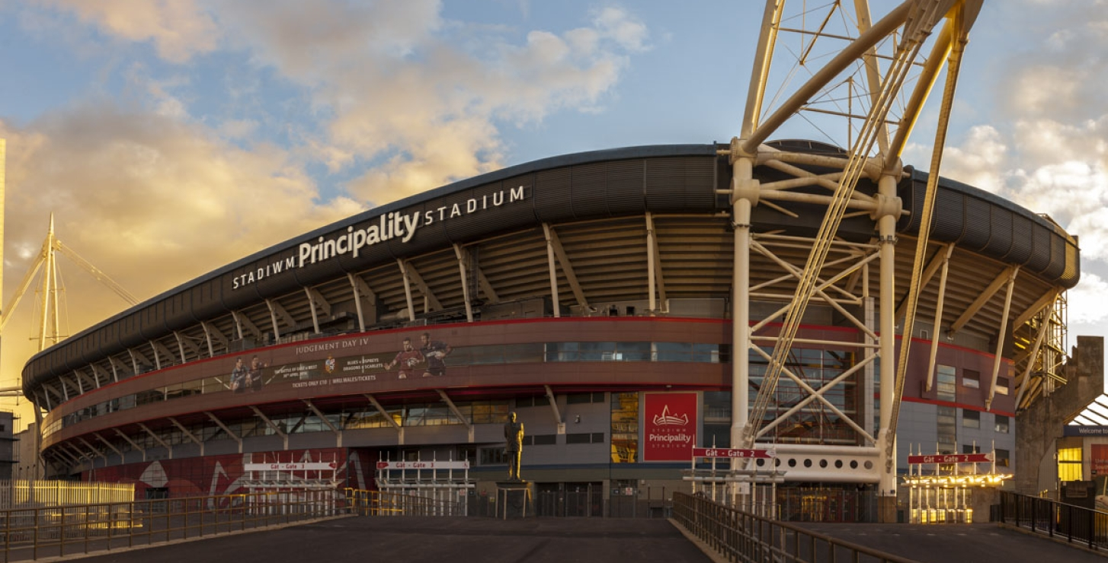

Training, Exercising and Continuous Awareness
In conclusion, continuous staff training, regular crisis-management exercises, and ongoing awareness play a crucial role in countering terrorism and other crises to ensure the smooth running of the euro’s 2028.
Staff Training – Live crisis scenario training, Clear roles and responsibilities and peer discussion’s
Staff Familiarisation – Clear knowledge of plans, escape routes and emergency equipment such as first air and fire equipment
Event Brief’s and Debriefs –Ensure roles and responsibilities clear, Address risks and lessons learnt if a crisis does occur for future safety
Updating documentation – To reflect where new training is needed, new legislation change’s staff responsibilities and new potential risk’s

Slide 10

Thank you for listening! Any Questions?

Slide 11
Reference’s
Reference list
Byrnes, J. (2024, December 30). In the field of crisis management and emergency response, the Gold/Silver/Bronze (GSB) command system is essential for ensuring coordinated and efficient actions. Originating in the UK, this hierarchical structure has been crucial for public sector organisations, and there is growing awareness of it. Linkedin.com. https://www.linkedin.com/pulse/goldsilverbronze-hierarchy-command-origins-crisis-james-7otre
Health, S. for. (2025, March 25). Martyn’s Law explained: Standard Tier | Skills for Health. Skills for Health. https://www.skillsforhealth.org.uk/article/martyns-law-explained-standard-tier/
Hormann. (2025). Mobile vehicle barriers for increased security. Hormann.co.uk; Garage Doors, Operators and Front Doors from Hörmann UK. https://www.hormann.co.uk/industry-commerce-and-public-authorities/perimeter-security-systems/mobile-vehicle-barriers/?gad_source=1&gad_campaignid=23201364704&gbraid=0AAAAADlEikv8pbpXrRD4rcLBivYL-F6LX&gclid=Cj0KCQiA0KrJBhCOARIsAGIy9wBVzdT7hQKHOdykekWQyDTVCGFDoXOln96imGvTHyatwxD-co7NgWEaAnT9EALw_wcB
Information , C. (2025). Cardiff Information. England Rugby Travel. https://www.englandrugbytravel.com/general-information-wales-v-england-six-nations-2025/cardiff-information/
Liu-Lastres, B., & Cahyanto, I. P. (2023). Are we always ready? Examining event professionals approaches to risk and crisis management and resilience. Tourism Management Perspectives, 46, 101073. https://doi.org/10.1016/j.tmp.2023.101073
Marblism, P. (2025, October 16). Martyn’s Law: What UK Security Professionals and Venues Need to Know — SIA News Updates 2025 - Zems Academy. Zems Academy. https://zems.org.uk/2025/10/16/martyns-law-what-uk-security-professionals-and-venues-need-to-know-sia-news-updates-2025/
nichola. (2025, March 3). How to Prepare for Emergency Situations at Events. Envisage Security Staff. https://www.envisagesecuritystaff.co.uk/how-to-prepare-for-emergency-situations-at-events/
ProtectUK. (2024). Martyn’s Law | ProtectUK. Www.protectuk.police.uk. https://www.protectuk.police.uk/martyns-law
Pursue Prevent Protect Prepare The United Kingdom’s Strategy for Countering International Terrorism Annual Report. (2010). https://assets.publishing.service.gov.uk/media/5a7cacbf40f0b65b3de0a75a/7833.pdf
Smillie, E. (2019). Ten Principles of Crisis Communications | Knowledge Hub. Osrl. https://www.osrl.com/knowledge-hub/resource-library/crisis-management/enhancing-crisis-communication-strategies-for-effective-oil-spill-response/
Sports Grounds Safety Authority. (n.d.). Guide to Safety at Sports Grounds (Green Guide). SGSA. https://sgsa.org.uk/document/greenguide/
Stadium , P. (n.d.). Home. Principality Stadium. https://www.principalitystadium.wales/
Vector Solutions. (2018, April 23). Risk Matrix Calculations – Severity, Probability, & Risk Assessment. Vector Solutions. https://www.vectorsolutions.com/resources/blogs/risk-matrix-calculations-severity-probability-risk-assessment/

