Slide 1
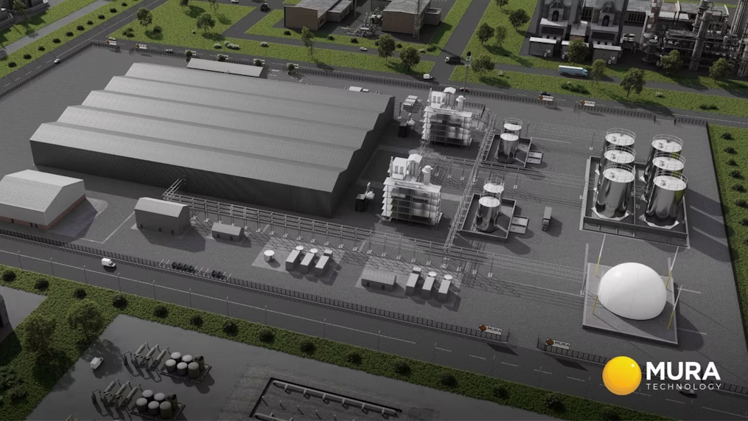
Navigating Cultural Differences:
Mura Technology's Expansion into Germany
Module: International Business Communication
Module code: LCBB6001
Lecturer name: DR.CHARLES NWAOGWUGWU
Assignment title: Assessment 2
Student ID: 2119900
Student name: Daniela Jicmon

Slide 2

Introduction
Mura Technology uses cutting-edge technology to dispose of trash in a green way.
Making useful things out of "unrecyclable" plastics is new for Mura Technology.
In this presentation I will discuss Mura Technology growing in Germany, this will include analysing how the UK and Germany have different ways of life and communication styles.
Notes:
Introduction
Mura Technology is a leader in handling trash in a green way because it has a cutting-edge way to recycle. Making useful things out of "unrecyclable" plastics is a new method for Mura and it is used to protect landfills from plastics that cannot be recycled. The UK and Germany have different ways of life which affects the way people work. In this presentation, I will analyse these differences and explain how Mura can adapt to open an office and grow in Germany.

Slide 3

Mura Technology aims to navigate the future of sustainable environmental innovation by using cutting-edge technology to turn "unrecyclable" plastics into useful items that are better for the world.
Their hydrothermal recycling process has completely changed the world of recycling and is better for the earth than traditional ways of dealing with trash.
Mura Technology aims to grow globally to reduce carbon emissions, and growing in Germany could help achieve this.
Overview of
Mura Technology
Notes:
Overview of Mura Technology
Mura Technology has completely changed how recycling works, which is good for the earth and one of the best ways to deal with trash. This company uses cutting-edge technology to turn "unrecyclable" plastics into useful items that are better for the world (Lamontagne, 2016). To grow within Germany and make this office the EU main office, individuals working at Mura will need to adapt to the working style in Germany. Such growth will help to fight plastic trash on a bigger level and fuel further growth for Mura in the long term. The cutting-edge technology uses steam which acts like a scissor, cutting longer-chain hydrocarbon binds in plastics to produce valuable chemicals and oils.

Slide 4
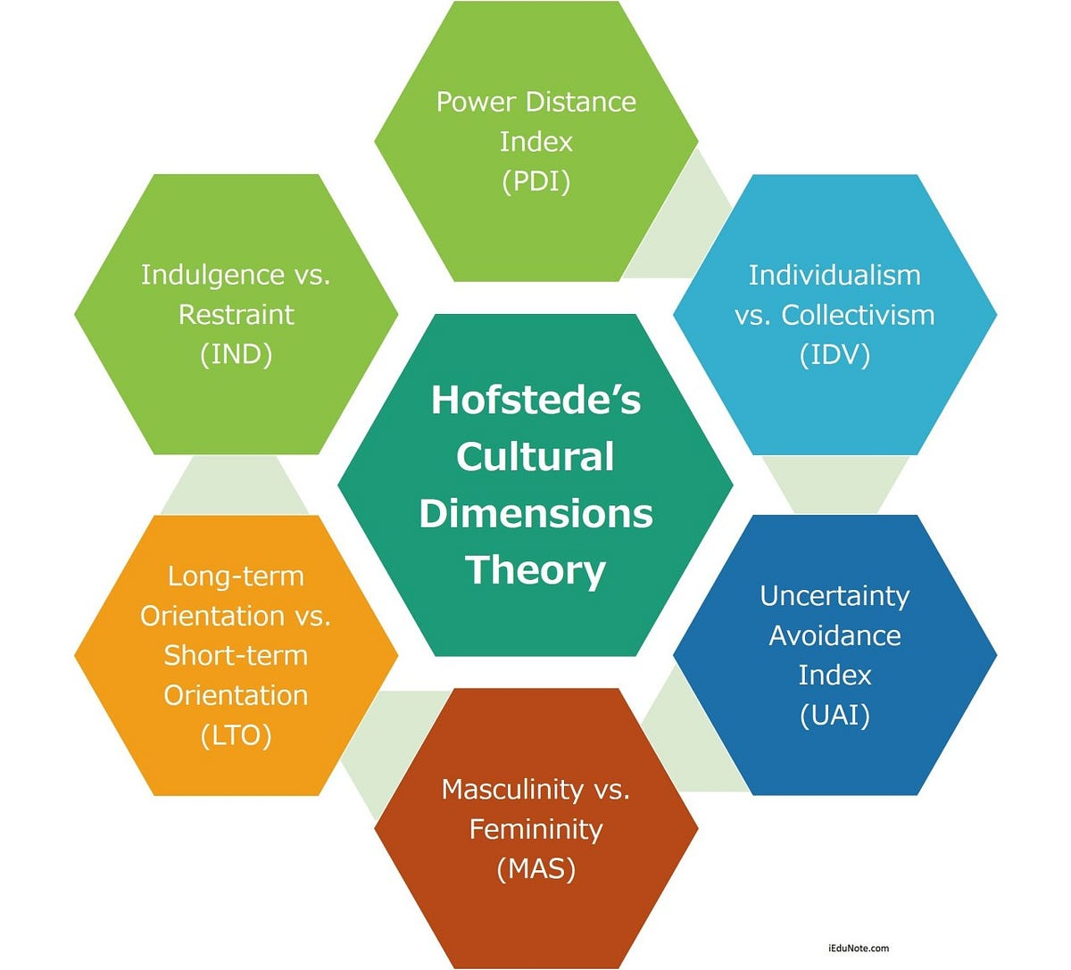
Cultural Dimensions Framework
This model by Hofstede examines cultural values within the workplace.
There are many ways in which cultures are different: the difference in power; the desire for freedom vs. unity; and the desire to avoid confusion vs. the desire to think quickly.
Being able to think in this way helps to deal with the fact that the UK and German societies are different.
Notes:
Cultural Dimensions Framework
This model by Hofstede helps to organise the theories behind different working styles in different countries (Fujimura and Nommensen, 2019). There are many ways in which cultures are different, such as the difference in power, the desire for freedom vs. unity, and the desire to avoid confusion vs. the desire to think quickly. Being able to think in this way helps to deal with the fact that UK and German societies are different.
Individualism vs. Collectivism
British and German cultures are individualistic ones by comparing them it becomes apparent that Germans react more based on personal/social preferences and the British appreciate innovation and creativeness. In this way, it may be easier for Mura to integrate its business in Germany, instead of more collective countries such as Sweden and Norway.
Uncertainty-Avoidance
The UK is among those countries with a low uncertainty avoidance index as planning is not that detailed as it is in Germany. Germans seem to prefer deductive planning or presenting of methods and ideas which means details are important to create certainty in German businesses. This may create some difficulty for Mura and as such managers and employees will have to adapt their communication styles to ensure they can integrate within Germany. For example, when presenting the hydrothermal recycling process to investors or future employees, managers would need to ensure they provide detailed methods and explanations behind this model of recycling, to attract German talent.
Long term orientation vs short term orientation
To ensure long-term growth, Mura as a British company needs to establish a strong and growing customer demand for their recycling methods. As such, they need to fit in a long-term orientation plan because Germans care about their communities and the environment. An example of how Mura can drive a long-term strategy is to decrease use of virgin fossil-based feedstocks and develop a customer demand for circular polymers, which are technologies Mura has developed.

Slide 5
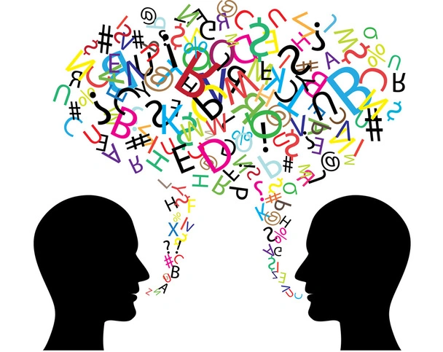
Language and Communication
When developing a UK business in another country, it is important to use clear and concise language.
Further, to encourage the development of successful business relationships, individuals need to be able to talk and work together.
Teams from Mura Technology in the UK and Germany can use professional translation services and teach their own staff the language so that they can talk easily and properly.
Notes:
Language and Communication
When people want to talk to someone in German or English, they need to be careful as they switch between the two. If people want to get along, they need to be able to talk and work together (Lewandowska-Tomaszczyk, 2021). Teams from Mura Technology in the UK and Germany can use professional translation services and teach their own staff the language so that they can talk easily and properly.
Germans are known for their punctuality and directiveness and their decision-making power is concentrated at the top with clear lines of authority and responsibility communication.
German work culture and employees are expected to follow the established chain of command and teamwork collaboration is crucial to the German working culture. Managers are respected for their experience and expertise and their decisions are followed without questions and this hierarchical structure provides clarity and direction in communication within organizations. To ensure that Mura can successfully grow in Germany, this is something that will need to be adopted throughout the company’s structure. This will also help employees communicate well amongst themselves as they have established roles and responsibilities, which in turn can lead to better productivity and better growth in the long-term.

Slide 6

Ethnic Makeup and Diversity
One similarity between the UK and Germany is that both societies are made up of individuals from many different races and cultures.
Ways to encourage diversity and openness at work:
people can get together in social groups,
take classes on diversity,
and set rules that everyone must follow.
It is important for employees to be open to new ideas and differences.
Notes:
Ethnic Makeup and Diversity
Countries have a lot of people of different races living together. These things are the same in the UK and Germany. It is better for an organisation's attitude when people are open to new ideas and differences (Myers et al., 2019). To encourage diversity and openness at work, Mura should encourage people to get together in social groups, take classes on diversity, and set rules that everyone must follow. This will again ensure proper integration amongst employees which makes them work harder and helps the company as a whole do better.

Slide 7

Social Structures and Values
To help staff at Mura Technology work together, it is important to know and follow the rules, customs, and social norms of the area.
Both Germans and Britons are individualists, however the British score is one of the highest in the world.
Germany value union and order.
Notes:
Social Structures and Values
To help everyone at Mura Technology work together and get to know each other, it is important to know and follow the rules, customs, and social norms of the area.
Both Germans and Britons are individualists, however, the British score is one of the highest in the world. One thing that is very important in Germany, though, is union and order. This is important to know if people want to do business with other people successfully (Bourdieu, 2018).
In the UK as an employer you may need to work with trade unions that represent groups of your employees. Trade unions will negotiate with you the working conditions of workers, pay and holidays. You need to recognise the trade union before they can negotiate with you. On the other hand in Germany the trade union has a dual structure like trade union and works council. Trade unions set the framework for working conditions, such as collective wage agreements for the whole sector or single companies, defining wage levels and working time. On the other hand, works council are elected by employees and represent their interest on company level. Trade unions in Germany are more collective with employees having higher bargaining powers in the labour markets. To ensure that Mura can attract the best talent for the company, it needs to match these labour protections in its German office.

Slide 8

Religious Values and Beliefs
Faith influences how people live, and what they do.
It is essential to know and respect a country’s religious holidays to develop their business in that country.
Mura Technologies should ensure they:
            Respect and acknowledge religious events
            Include training and learning courses on religious values
            Implement rules to respect others’ religious beliefs so that they can work with people of all faiths.
Notes:
Religious Values and Beliefs
As people have different faith thoughts and views, this changes how they live and what they do. It is important to know about religious holidays and events if one wants to understand other countries (El-Khani and Calam, 2017). Mura should allow employees time off for religious events, host training and learning courses, and have rules that respect people's religious beliefs so that they can work with people of all faiths. These things help keep everyone safe and ensure a good work/life balance which can again help the productivity of the workforce.

Slide 9

Business and
Work-related Attitudes
The way people in Germany and the UK do business and work is very different.
The UK values freedom and the ability to change, while Germany values speed and well-organised work.
Being a team player, encouraging open communication, and respecting those in charge are all important in Germany for business.
Notes:
Business and Work-related Attitudes
The way people in Germany and the UK do business and work is very different. The UK values freedom and the ability to change, while Germany values speed and well-organised work. Being a team player, encouraging open communication, and respecting those in charge are all important in Germany for business (Ejeh Abba, 2019). Ensuring these practices are encouraged will help the people who work at Mura Technology's German management office get along better and work together better.

Slide 10

Recommendations and Solutions
Provide training to ensure workers can deal with the most important cultural problems, like language obstacles and different social systems and values.
Projects and mentoring programmes to bring together people from different cultures will help them learn about each other and develop business relationships.
Some of these are holding regular meetings throughout the process of setting up the new management office in Germany to ensure clear communication.
Utilise tools and different technology to ensure efficient set-up.
Notes:
Recommendations and Solutions
Firstly, Mura should help its workers find and deal with the most important cultural problems, like language obstacles and different social systems, by giving them a lot of cultural training and sponsoring language classes. Further, projects and mentoring programs that bring together people from different places will help them learn more about each other (Stahl Hofer et al., 2018), ensuring a safe working environment for all employees. Secondly, by holding regular meetings, making sure there are clear ways to talk to each other, and using technology to get around real issues, Mura can ensure that management is best prepared for growing in Germany.

Slide 11
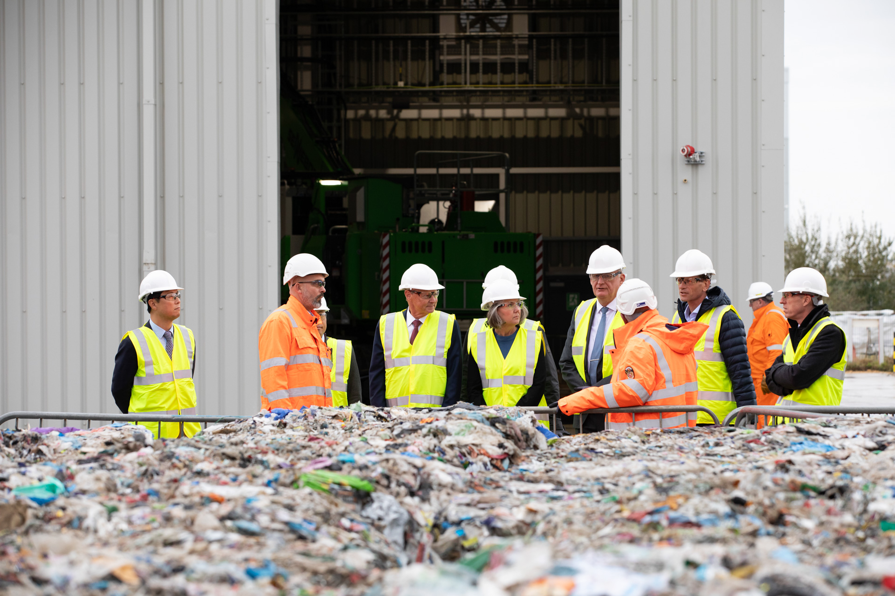
Conclusion
For Mura Technology to grow, people need to know how life is different in Germany and the UK, and be accepting of and honor these differences.
It will be simple to connect with others and work together.
If Mura Technology wants to do well in Germany, they need to utilise tools, training, and support groups to encourage the acceptance of different values and cultures within Germany.
Notes:
Conclusion
For Mura Technology to grow, people need to know how life is different in Germany and the UK. All need to understand and be able to work with people from other countries if they want to do well in foreign businesses. It will be simple to connect with others and work together. If Mura Technology wants to do well in Germany, they need to be aware of how people are different and pay attention to what they have to say. This will create a good working environment, contributing to productivity, profits and growth.

Slide 12
References
Bourdieu, P. (2018) The social structures of the economy. Oxford, England: Polity Press.
Ejeh Abba, F. (2019) “The effect of employee work-related attitudes on employee job performance,” Management and Business Research Quarterly, (9), pp. 19–27. doi: 10.32038/mbrq.2019.09.03.
El-Khani, A. and Calam, R. (2017) The role of values and religious beliefs in positive parenting. Edited by M. R. Sanders and T. G. Mazzucchelli. Oxford University Press.
Fujimura, C. K. and Nommensen, S. (2019) Cultural dimensions of well-being: Therapy animals as healers. Lanham, MD: Lexington Books.
Lamontagne, N. D. (2016) “Recycling the Unrecyclable: Industry innovations aim to keep traditionally difficult-to-recycle plastics out of the landfill,” Plastics engineering, 72, pp. S14–S16. doi: 10.1002/j.1941-9635.2016.tb01526.x.
Lewandowska-Tomaszczyk, B. (ed.) (2021) Cultural conceptualizations in language and communication. 1st ed. Cham, Switzerland: Springer Nature.
Myers, T., Richardson, F. and Chung, J. E. (2019) “Racial and ethnic makeup in hospital’s social media and online platforms: Visual representation of diversity in images and videos of Washington, D.c. hospitals,” Journal of health communication, 24(5), pp. 482–491. doi: 10.1080/10810730.2019.1617807.
Stahlhofer, N. J., Schmidkonz, C. and Kraft, P. (2018) Conscious business in Germany: Assessing the current situation and creating an outlook for a new paradigm. Cham, Switzerland: Springer International Publishing.

