Slide 1
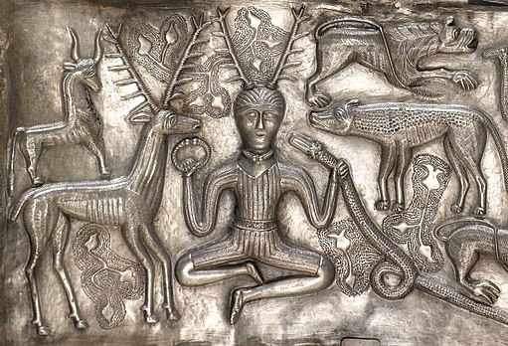
The gods and goddesses of the Celts
Prof. Jane Cartwright

Slide 2
Polytheistic – a pantheon of deities comparable to others in Indo-European religion, each linked to aspects of life and the natural world. By a process of syncretism, after the Roman conquest of Celtic areas, these became associated with their Roman equivalents, and their worship continued until Christianization.
local and tribal rather than national – sometimes names appear only once; other names occur in inscriptions across the Celtic world. In Gaul, over four hundred different Celtic god-names are recorded, of which at least 300 occur just once. They were linked to various aspects of everyday life and the natural world.
Sources: ancient places of worship, statues, pottery, engravings, stone tablets, cult objects and place names or personal names.
Répertoire des dieux gaulois – list of Celtic names of gods attested in inscriptions.

Slide 3
Julius Caesar's Commentarii de Bello Gallico (The Gallic War, 52–51 BC)
Names six of them, together with their functions:
Mercury was the most honoured of all the gods and many images of him were to be found. Mercury was regarded as the inventor of all the arts, the patron of travellers and of merchants, and the most powerful god in matters of commerce and gain.
Apollo, who drove away diseases
Mars, who controlled war
Jupiter, who ruled the heavens,
Minerva, who promoted handicrafts.
He adds that the Gauls regarded Dis Pater as their ancestor.^{[1]}
In characteristic Roman fashion, Caesar does not refer to these figures by their native names but by the names of the Roman gods with which he equated them, a procedure that complicates the task of identifying his Gaulish deities with their counterparts in the insular Celtic literatures. He also presents a neat schematic equation of god and function that is quite foreign to the vernacular literary testimony. Yet, given its limitations, his brief catalog is a valuable witness.

Slide 4
R. Haeussler and A. King (eds), Celtic Regions in the Roman Period (Aberystwyth: Celtic Studies Publications, 2017), p. 5
‘Who is Mercury in Roman Gaul, Britain or Spain: was he ever the Roman god, adopted by the natives or imported by soldiers and colonists, or was this not predominantly a Latin name for an indigenous god whose ‘real’ name escapes us?[...]Caesar’s interpretations reveal the problem of translatability; can there ever be two identical deities in two different cultures or religions? No. Consequently, different people would have made different identifications between Celtic, Greek and Roman deities depending on their personal knowledge of the local cult or deity, on their personal interpretation, and depending on time, since a cult’s meaning is bound to change over time.’

Slide 5
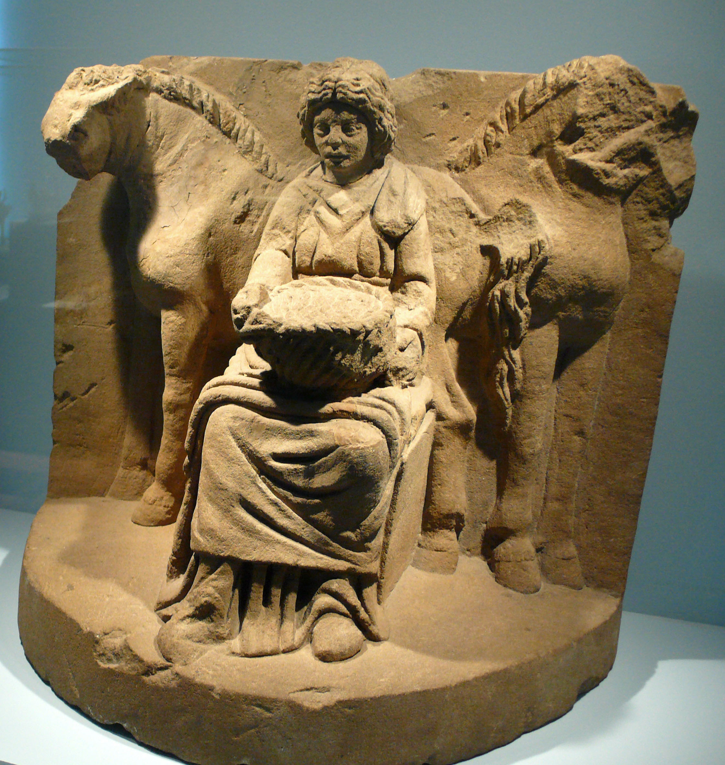
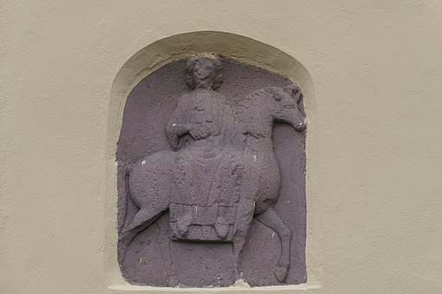
Epona – the horse goddess (no direct Roman equivalent) often equated with Rhiannon in the Mabinogi https://commons.wikimedia.org/wiki/File:K_Epona_Relief_Nord.jpg 200AD Germany

Slide 6
Epona
The cult of the Gaulish horse goddess Epona was widespread. Adopted by the Roman cavalry, it spread throughout much of Europe, even to Rome itself. She seems to be the embodiment of "horse power" or horsemanship, which was likely perceived as a power vital for the success and protection of the tribe.
Rhiannon in the Mabinogion appears on a magical horse; is punished and made to act like a horse (since she’s accused of killing her own child); a foal usually disappears on the night Pryderi is snatched.
But does this make her Epona?

Slide 7
Cernunnos – a horned god (antlers)
A recurrent figure in Gaulish iconography is a deity sitting cross-legged with antlers, sometimes surrounded by animals, often wearing or holding a torc. The name usually applied to him, Cernunnos, is attested only a few times: on the Pillar of the Boatmen, a relief in Paris (currently reading ERNUNNOS, but an early sketch shows it as having read CERNUNNOS in the 18th century); on an inscription from Montagnac (αλλετ[ει]νος καρνονου αλ[ι]σο[ντ]εας, "Alletinos [dedicated this] to Carnonos of Alisontea"); and on a pair of identical inscriptions from Seinsel-Rëlent ("Deo Ceruninco").
Representations of this sort of deity, however, are widespread; the earliest known was found at Val Camonica in northern Italy, while the most famous is plate A of the Gundestrup Cauldron, a 1st-century BC vessel found in Denmark. On the Gundestrup Cauldron and sometimes elsewhere, Cernunnos, or a similar figure, is accompanied by a ram-headed serpent. At Reims, the figure is depicted with a cornucopia overflowing with grains or coins
https://commons.wikimedia.org/wiki/File:Gundestrupkedlen-_00054_(cropped).jpg

Slide 8
Lugh
According to Caesar the god most honoured by the Gauls was ‘Mercury’, and this is confirmed by numerous images and inscriptions. Mercury's name is often coupled with Celtic epithets, particularly in eastern and central Gaul; the commonest such names include Visucius, Cissonius, and Gebrinius. Another name, Lugus, is inferred from the recurrent place-name Lugdunon ('the fort of Lugus') from which the modern Lyon, Laon, and Loudun in France, Leiden in the Netherlands, and Lugo in Galicia derive their names; a similar element can be found in Carlisle (formerly Castra Luguvallium), Legnica in Poland and the county Louth in Ireland, derived from the Irish "Lú", itself coming from "Lugh".
The Irish and Welsh cognates of Lugus are Lugh and Lleu, respectively, and certain traditions concerning these figures mesh neatly with those of the Gaulish god. Caesar's description of the latter as "the inventor of all the arts" might almost have been a paraphrase of Lugh's conventional epithet samildánach ("possessed of many talents"), while Lleu is addressed as "master of the twenty crafts" in the Mabinogi.
A member of the Tuatha Dé Danann, Lugh is portrayed as a warrior, a king, a master craftsman and a savior He is associated with skill and mastery in multiple disciplines, including the arts. He is also associated with oaths, truth and the law, and therefore with rightful kingship.
Lugh is linked with the harvest festival of Lughnasadh, which bears his name.

Slide 9
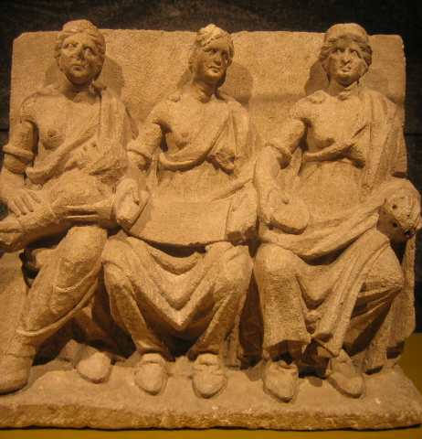
Mother goddeses
Mother goddeses are a recurrent feature in Celtic religions. The epigraphic record reveals many dedications to the Matres or Matronae, which are particularly prolific around Cologne in the Rhineland. Iconographically, Celtic mothers may appear singly or, quite often, triply; they usually hold fruit or cornucopiae or paterae; they may also be full-breasted (or many-breasted) figures nursing infants.

Slide 10
Mother goddesses were at times symbols of sovereignty, creativity, birth, fertility, sexual union and nurturing. At other times they could be seen as punishers and destroyers: their offspring may be helpful or dangerous to the community, and the circumstances of their birth may lead to curses, geasa or hardship, such as in the case of Macha's curse of the Ulstermen or Rhiannon's possible devouring of her child and subsequent punishment.

Slide 11
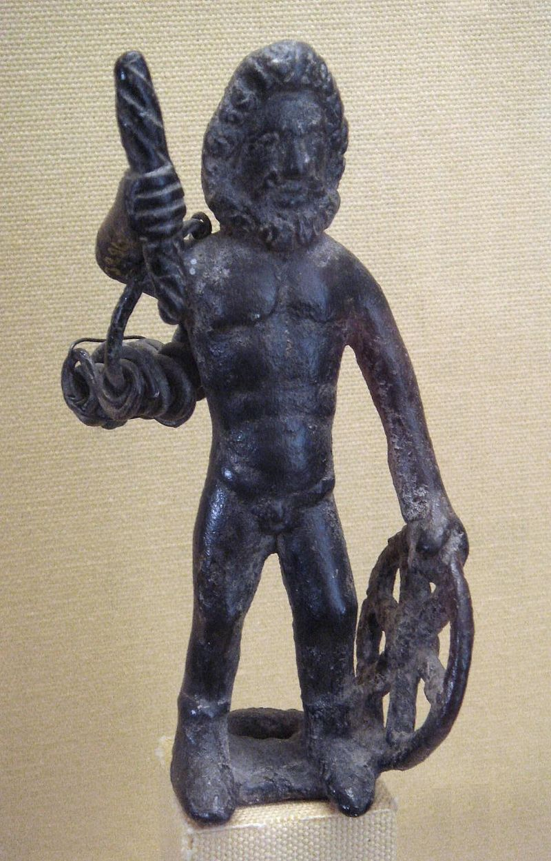
Taranis
The Gaulish Jupiter is often depicted with a thunderbolt in one hand and a distinctive solar wheel in the other. Scholars frequently identify this wheel/sky god with Taranis, who is mentioned by Lucan. The name Taranis may be cognate with those of Taran, a minor figure in Welsh mythology, and Turenn, the father of the 'three gods of Dana' in Irish mythology.
Source: Wikimedia Commons and Wikipedia

Slide 12
Some different views…
Miranda Green:
The essence of Celtic religion was the recognition of the supernatural in all aspects of nature – in trees, water, mountains and the sun.
Water like the sun a regenerative force that could heal; frequent association of water with heads (votives and skulls found in springs and wells).
John Collis:
I am sceptical that there is anything we can label as ‘Celtic Religion’.
word of caution: many publications on the gods of the Celts lump together all images of horned gods/characters from different places and periods. Is every female figurine seated on a horse Epona?

