Slide 1

AHAC 7005 Heritage project management in the modern world: assessing values, impacts, setting and rural and urban landscapes
Martin Locock

Slide 2
Valuing heritage
Key to informed Cultural Resource Management decision making
What is the heritage? > why is it important? > how important is it? > how is it affected?
General principle: developments which have positive impacts on other factors (society, economy) may be approved if they have no, or minor, negative impacts on assets

Slide 3
Assigning values
Rarity
Integrity
Documentation
Group value
Cultural significance
Research Agenda
Monument Class Descriptions

Slide 4
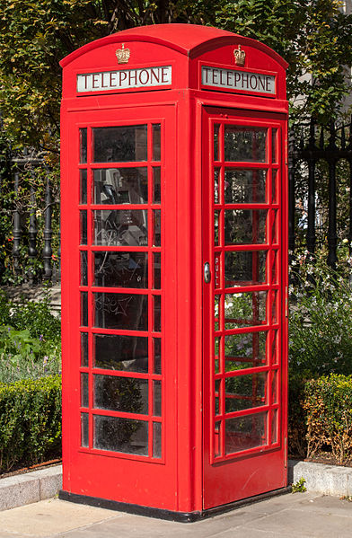
In practice
About 25,000 telephone boxes are Grade II Listed Buildings

Slide 5
In practice
Rarity – low
Integrity – variable
Documentation – limited for each
Group value – other buildings?
Cultural significance – low (?)

Slide 6
Typical value classification
National (designated assets: SAMs, LB Grades I and II*, ?II)
Regional Non-designated but important
Local Known by the community
Low Not important/ not known
None Destroyed/ erroneous

Slide 7
Assessing impact
Positive / negative
Visual / physical
Direct / indirect
Setting
Major / minor / none / positive

Slide 8
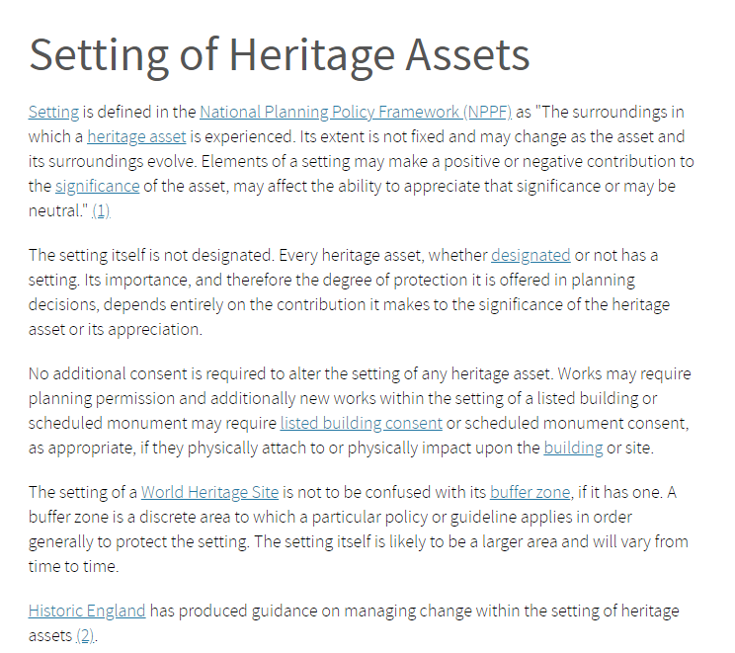
Setting of monuments
https://historicengland.org.uk/advice/hpg/has/setting/ April 2020

Slide 9
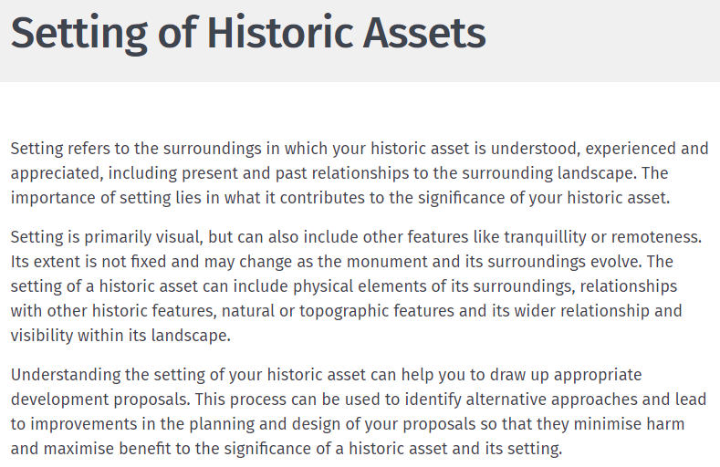
https://cadw.gov.wales/advice-support/placemaking/heritage-impact-assessment/setting-historic-assets April 2020

Slide 10
Assessment of setting process
Step 1: which assets and their setting are affected
Step 2: how settings and views contribute to the significance of the asset or allow it to be appreciated
Step 3: effect of the proposal (+/-) on significance or appreciation of significance
Step 4: explore ways to maximise+ or minimise–
Step 5: decision and monitor

Slide 11
Typical issues
Temporary/permanent
Contemporary / historic
Visibility

Slide 12
Managing urban heritage
Urban landscape issues
Built environment
Urban landscape designations (Conservation Areas)
Urban archaeology
Brownfield land and contamination
Tree Preservation Orders

Slide 13
Managing rural heritage
Agri-environmental schemes: Tir Gofal and Glastir
Planted Ancient Woodland Sites (PAWS) and Restored Native Woodland on Ancient Sites (RNWAS)
Historic Hedgerows
National Nature Reserve (NNR)
Local Nature Reserve (LNR)
Site of Special Scientific Interest (SSSI)
Rights of Way

