Slide 1




INTEGRATION OF HEALTH, WELLBEING, AND SUSTAINABLE DEVELOPMENT IN HEALTH AND SOCIAL CARE
  Name: Sonia Tariq
  Student ID: 2208954
  Lecturer’s name: Parese Ahmed
  Module code and title: BMHP6030

Slide 2
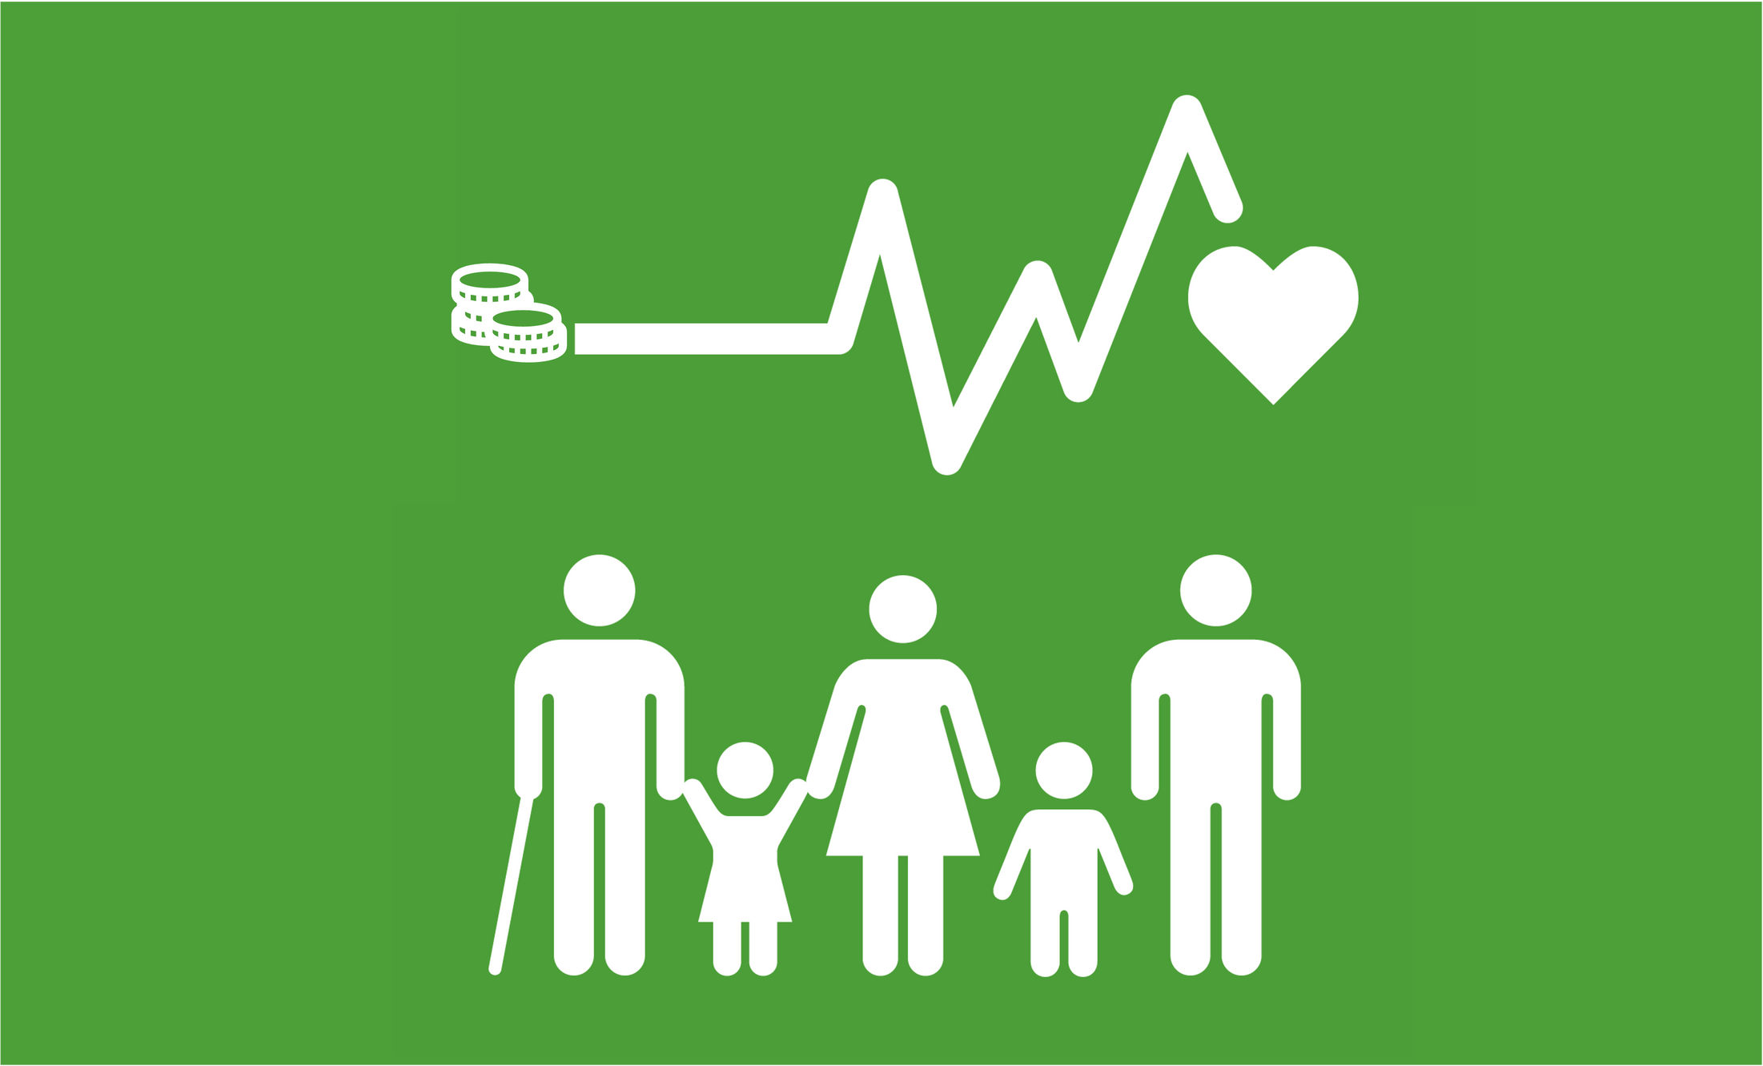
INTRODUCTION
  Purpose:
  The aim of this presentation is to critically examine how the concepts of health, wellbeing, and sustainable development are interconnected and integrated within the health and social care sector. It seeks to highlight how these elements collectively influence the design, implementation, and delivery of healthcare services that promote long-term health outcomes and societal resilience.
  Focus:
  The discussion will focus on key theoretical perspectives, policy frameworks, and practical applications that shape modern healthcare systems. It will also explore how global strategies such as the World Health Organization’s Sustainable Development Goals (SDGs) have reshaped healthcare priorities to include holistic wellbeing, sustainability, and equity in access to services.

Slide 3
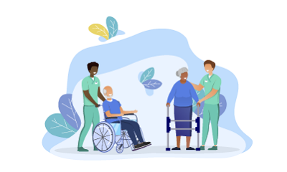
DEFINING HEALTH
Understanding Health:
  WHO definition: “A state of complete physical, mental, and social well-being, not merely the absence of disease.” (Gautam et al., 2024).
Components:
  Physical health: Proper body functioning, nutrition, fitness.
  Mental health: Emotional balance, cognitive well-being.
  Social health: Relationships, social participation, community belonging.

Slide 4

DEFINING WELLBEING
The Concept of Wellbeing:
  Holistic state encompassing physical, emotional, psychological, and social factors (Physiopedia, 2025).
  Influenced by:
    Lifestyle and personal choices.
    Social support systems.
    Economic and environmental factors.
  Connection between health and wellbeing: both reinforce quality of life and life satisfaction.

Slide 5
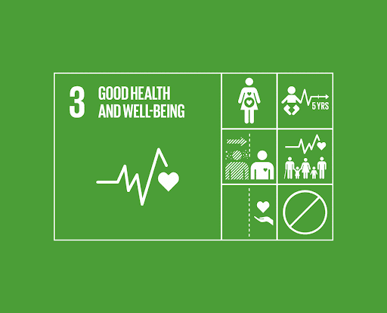
SUSTAINABLE DEVELOPMENT
Sustainable Development and Health
  Definition: Meeting present needs without compromising future generations’ ability to meet theirs (HEC PARIS, 2020).
  Relevance in health: Ensures long-term resource availability, healthy environments, and equitable access.
  Linked to UN Sustainable Development Goals (SDGs) — particularly SDG 3: Good Health and Wellbeing.
  Example: Promoting green hospitals, waste reduction, and climate-resilient healthcare systems.

Slide 6
INTEGRATION OF HEALTH AND WELLBEING
  Holistic Approach: Focuses on treating the whole person, addressing physical, mental, emotional, and social needs rather than just the symptoms of illness (Ambushe et al., 2023).
  Collaborative Practice: Involves multi-disciplinary teams, including medical professionals, mental health specialists, and social care workers, to deliver coordinated and person-centred care.
  Preventive Focus: Shifts emphasis from reactive treatment to prevention, early intervention, and patient empowerment through lifestyle education and self-management.
  Example: NHS MECC Initiative: Encourages healthcare staff to use every interaction with patients as an opportunity to promote positive health behaviours and wellbeing (NHS England, 2020).
Integrating Health and Wellbeing Approaches

Slide 7
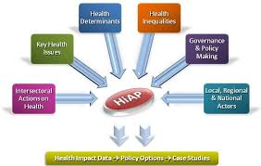
SUSTAINABLE DEVELOPMENT IN HEALTH POLICIES
  Health in All Policies (HiAP): A WHO framework promoting collaboration across sectors to ensure all policies consider their health impact.
  Triple Bottom Line Approach: Integrates environmental, social, and economic sustainability into healthcare planning and decision-making.
  Environmental Sustainability: Focuses on reducing healthcare’s carbon footprint through waste reduction, resource efficiency, and eco-friendly operations.
  Example: NHS Net Zero Strategy: Aims to achieve carbon neutrality by promoting renewable energy, sustainable transport, and green supply chains (NHS England, 2022).

Slide 8
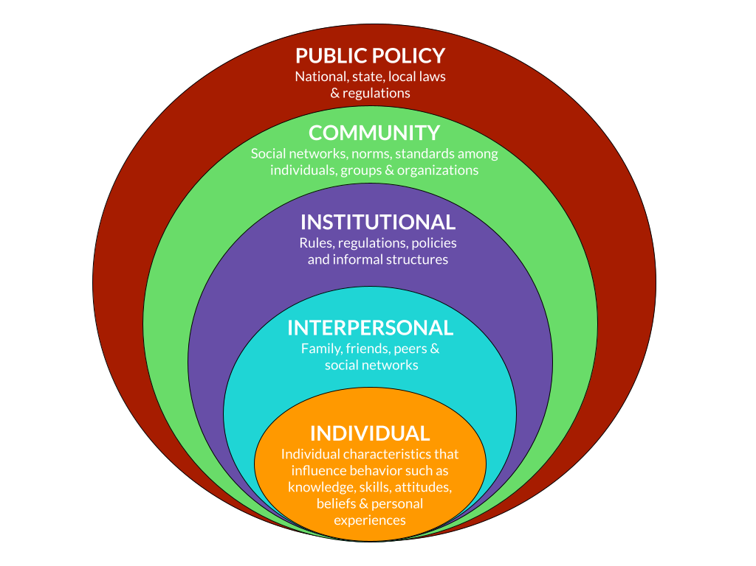
THEORETICAL PERSPECTIVES
  Biopsychosocial Model: Emphasizes that health is shaped by the interaction of biological, psychological, and social factors, promoting a more comprehensive and person-centred approach to care.
  Social Determinants of Health Framework: Highlights how socioeconomic conditions such as income, education, employment, and living environment directly influence individual and community health outcomes.
  Ecological Model of Health: Recognizes multiple layers of influence on wellbeing, including individual behaviour, interpersonal relationships, community structures, and broader policy contexts (Rural Health Information Hub, 2025).
Together, these models support a holistic understanding of health and guide integrated care practices within the health and social care system.

Slide 9
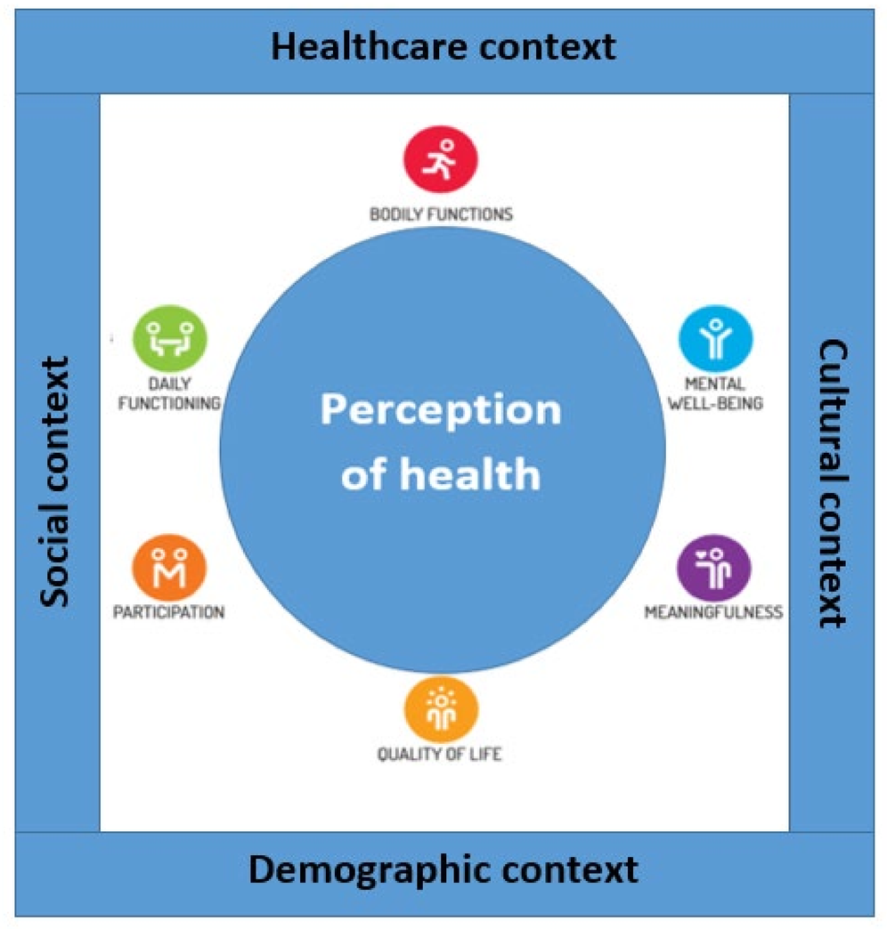
POLICY AND GOVERNANCE
  Supportive Policies: Governments and health authorities promote holistic health through preventive health strategies, national mental health and wellbeing frameworks, and the development of integrated care systems that connect primary, secondary, and social care services (Funk et al., 2021).
  Preventive Focus: Policies increasingly emphasize early intervention, health promotion, and community-based care to reduce long-term healthcare costs and improve population wellbeing.
  Major Problems: Funding constraints, disjointed policy practices, and unequal resource allocation are hindering improvements.
  Goal: Strengthen governance, coordination and accountability to deliver equitable and sustainable initiatives on health and wellbeing.

Slide 10
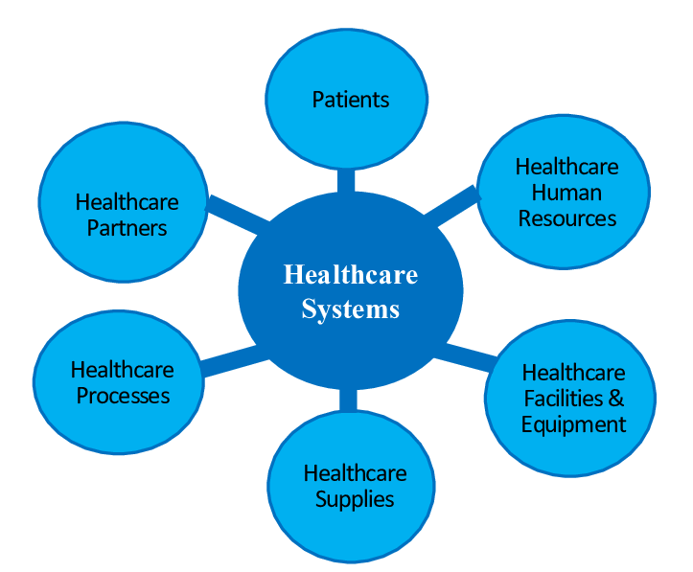
SERVICE DELIVERY
New Care Models: Health systems are embracing new models like telehealth, mobile health applications, and digital monitoring systems to enhance the accessibility and continuity of care (Ahmed et al., 2025).
Community-Based Programmes: Local wellness programs enhance preventive health, lifestyle education and social support, enhancing connections between the healthcare provider and community.
Case Study: The NHS Integrated Care Systems (ICS) and the integrative medicine model at Mayo Clinic describe that integration within the discipline is encouraged to provide holistic and coordinated care (Van der Feltz-Cornelis et al., 2023).
Patient-Centred Focus: Employs preventive, individualized, and active care as the first choice that allows individuals to play an active role in controlling their health.

Slide 11
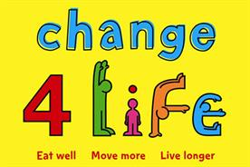
PUBLIC HEALTH INITIATIVES
  National Campaigns: Programmes such as “Change4Life” and “Every Mind Matters” promote healthier lifestyles, balanced nutrition, physical activity, and mental health awareness across all age groups (NHS, 2022).
  Health Education: Public health initiatives aim to inform and empower individuals to make positive lifestyle choices that prevent chronic diseases and improve overall wellbeing.
  Collaborative Approach: Effective implementation involves partnerships between healthcare providers, schools, workplaces, and community organizations.
  Key Outcomes: Increased public awareness, healthier behavioural patterns, early detection of health risks, and a measurable reduction in preventable diseases across communities.

Slide 12

EQUITY AND ACCESS
  Health Inequalities: Persistent disparities exist in access, quality, and outcomes of healthcare services based on factors such as geography, income, ethnicity, gender, and disability (Chen, 2025).
  Universal Healthcare Systems: Aim to provide equitable access to essential health services regardless of socio-economic status or location.
  Targeted Interventions: Focused programmes address the specific needs of vulnerable and marginalized groups, including rural communities, minorities, and low-income populations.
  Cultural Competence and Accessibility: Promotes inclusive service delivery by training healthcare professionals to respect cultural diversity and ensure services are physically and linguistically accessible to all.

Slide 13

CHALLENGES AND FUTURE DIRECTIONS
Challenges:
  Inequality, policy fragmentation, resource scarcity.
  Workforce burnout and ageing populations.
Future directions:
  Integrate sustainability into all levels of healthcare.
  Strengthen prevention and digital health innovations.
  Foster global partnerships for health equity.

Slide 14
CONCLUSION
  Health, wellbeing, and sustainability are interdependent.
  Integration ensures improved quality of life, system resilience, and equity.
  Collaborative policies, sustainable governance, and inclusive practices are key for future-ready healthcare.
CHIDI EZE

Slide 15
Reference list
  Ahmed, M.M., Okesanya, O.J., Olaleke, N.O., Adigun, O.A., Adebayo, U.O., Oso, T.A., Eshun, G. and Lucero-Prisno, D.E. (2025). Integrating Digital Health Innovations to Achieve Universal Health Coverage: Promoting Health Outcomes and Quality Through Global Public Health Equity. Healthcare, 13(9), p.1060. doi:https://doi.org/10.3390/healthcare13091060.
  Ambushe, S.A., Awoke, N., Demissie, B.W. and Tekalign, T. (2023). Holistic nursing care practice and associated factors among nurses in public hospitals of wolaita zone, south ethiopia. BMC Nursing, [online] 22(1). Available at: https://bmcnurs.biomedcentral.com/articles/10.1186/s12912-023-01517-0.
  Chen, A.M. (2025). Barriers to health equity in the United States of America: Can they be overcome? International Journal for Equity in Health, 24(1). doi:https://doi.org/10.1186/s12939-025-02401-w.
  Funk, M., Saraceno, B., Drew, N. and Faydi, E. (2021). Integrating mental health into primary healthcare. Mental health in family medicine, [online] 5(1), p.5. Available at: https://pmc.ncbi.nlm.nih.gov/articles/PMC2777555/.
  Gautam, S., Jain, A., Chaudhary, J., Gautam, M., Gaur, M. and Grover, S. (2024). Concept of Mental Health and Mental well-being, it’s Determinants and Coping Strategies. Indian Journal of Psychiatry, [online] 66(Suppl 2), pp.S231–S244. doi:https://doi.org/10.4103/indianjpsychiatry.indianjpsychiatry_707_23.
  HEC PARIS (2020). What is Sustainability? [online] HEC Paris. Available at: https://www.hec.edu/en/institutes-and-centers-expertise/sustainability-organizations/think/executive-factsheets/what-sustainability [Accessed 16 Mar. 2025].
  NHS (2022). Healthier Families. [online] nhs.uk. Available at: https://www.nhs.uk/healthier-families/.
  NHS England (2020). Making Every Contact Count (MECC). [online] NHS England. Available at: https://www.hee.nhs.uk/our-work/population-health/our-resources-hub/making-every-contact-count-mecc.
  NHS England (2022). Delivering a net zero NHS. [online] www.england.nhs.uk. Available at: https://www.england.nhs.uk/greenernhs/a-net-zero-nhs/.
  Physiopedia (2025). The Concept of Wellness. [online] Physiopedia. Available at: https://www.physio-pedia.com/The_Concept_of_Wellness.
  Rural Health Information Hub (2025). Ecological models. [online] Ruralhealthinfo.org. Available at: https://www.ruralhealthinfo.org/toolkits/health-promotion/2/theories-and-models/ecological.
  Van der Feltz-Cornelis, C., Attree, E., Heightman, M., Gabbay, M. and Allsopp, G. (2023). Integrated Care pathways: a New Approach for Integrated Care Systems. The British Journal of General Practice, 73(734), p.422. doi:https://doi.org/10.3399/bjgp23X734925.
CHIDI EZE

