Slide 1

Name: Maymunah Akhtar
Student Number:2433756
Module:Professional Development in Health and Social care
Module Code: LCHS4009
Assignment title: Self-Awareness Presentation

Slide 2
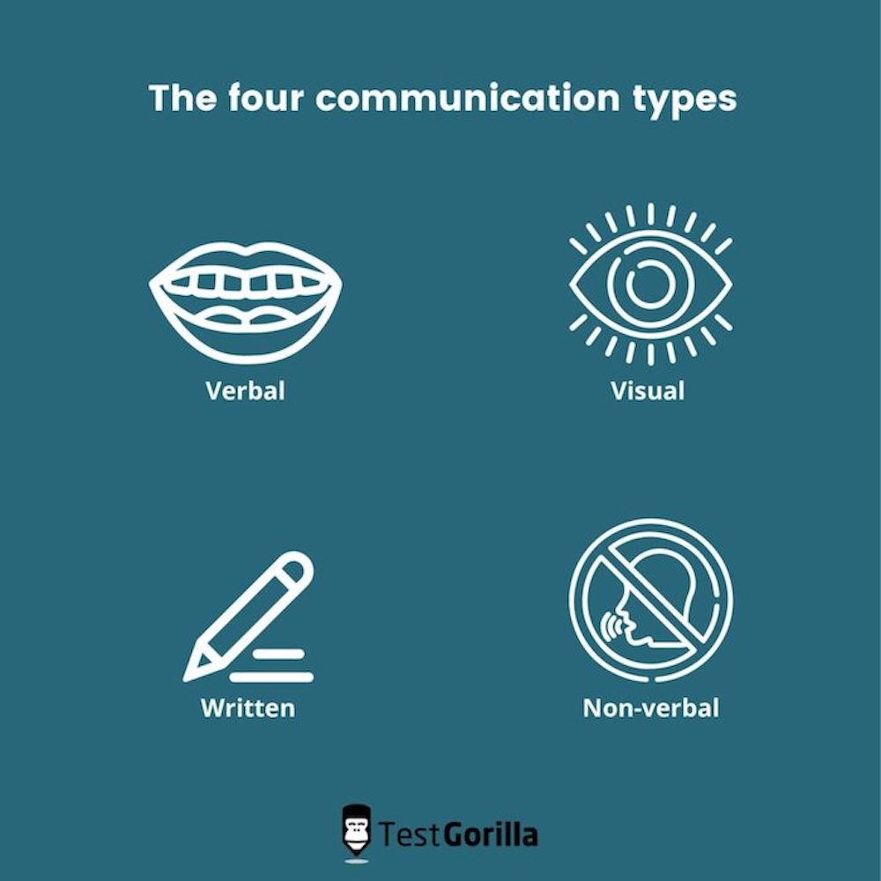
Communication
Sharing any information to someone through verbal, non-verbal and in writing is all part of communication.
In health and social care, it includes active listening, effective questioning, appropriate body language and clear documentation (Koprowska, 2020).
Effective communication ensures information is clear, understood and appropriate for the situation.
(Bing,N.D.)

Slide 3
Why communication matter in health and social
Effective communication is essential health and social care because it:
Builds trust and connection with patients
Encourages making secure and knowledgeable decisions
Reduces the risk of errors
Strengthens teamwork and collaboration
Ensures consistency of care
Research shows that strong patient‑provider communication can improve patients’ understanding of their care, reduce stress, and even enhance their sense of purpose and well-being (Wu et al., 2024).

Slide 4
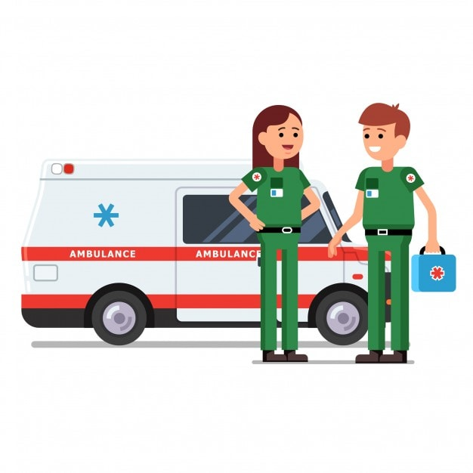
Why communication is essential for paramedics
Paramedics work in unpredictable, high-pressure situations where clear communication is very important. They must communicate effectively with:
Patients and families
Ambulance colleagues
Police, fire and other emergency services
Hospital staff during handovers
Effective communication supports rapid assessment, safe decision-making, and coordinated care. Research shows that structured communication training improves clinical performance and patient outcomes (Aspegren, 1999).
(Bing,N.D.)
This Photo by Unknown Author is licensed under CC BY

Slide 5
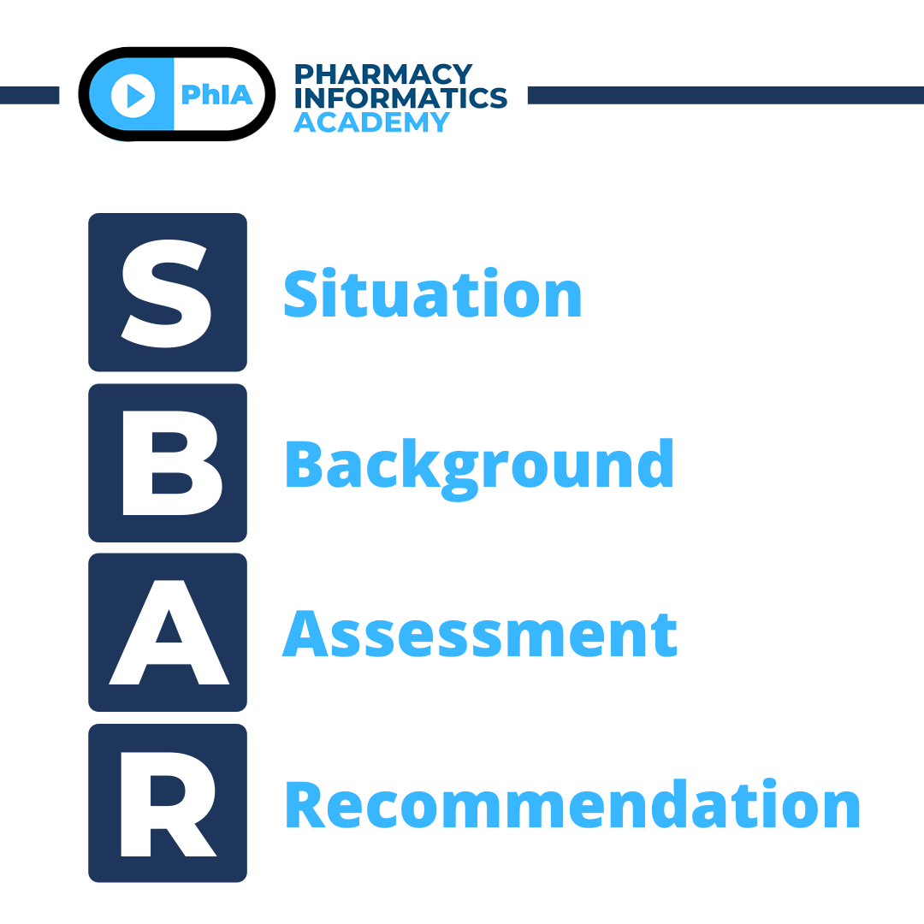
Using SBAR MODEL
A structured communication technique called SBAR is used to show information in a clear and precise manner.
S-Situation: what is happening right now?
B-Background: relevant medical history or events leading up to the situation
A-Assessment: what you think the problem is
R-Recommendation: what you believe needs to happen next
Structured communication tools, such as SBAR, are supported by research as effective methods for teaching and improving communication in clinical settings (Aspegren, 1999).
(Bing,N.D.)

Slide 6

PRACTICAL EXAMPLE:SBAR IN A REAL-LIFE EMERGENCY
Scenario: Road-traffic collision A paramedic would use SBAR when handing over to hospital staff.
S-Situation: “This is a 33 years old male involved in a high-speed collision. He is conscious but in sever pain.”
B-Background: “No known medical history. Air bag activated. No loss of consciousness.”
A-Assessment: “suspected fractured femur, stable air way, rapid breathing, increased pulse.”
R-Recommendation: “request immediate trauma assessment and pain management”
This structured approach ensures accurate, efficient communication and improves the patient's safety.

Slide 7
conclusion
Communication is a core skill in paramedic practice
It underpins safe, effective, and patient-centred care
Clear and compassionate communication is essential in high-pressure situations
Structured tools such as SBAR reduce errors and improve information exchange
Effective communication improves professional practice and patient outcomes.

Slide 8
References
Aspegren, K. (1999). BEME Guide No. 2: Teaching and learning communication skills in medicine-a review with quality grading of articles. Medical Teacher, 21(6), 563–570. https://doi.org/10.1080/01421599978979
Koprowska, J. (2020) Communication and interpersonal skills in social work. 5th edn. London: Learning Matters.
Wu, Q., Ngien, A., Jiang, S. and Dong, Y. (2024). ‘Why communication matters? The roles of patient‑provider communication and social media use in cancer survivors’ meaning in life, Computers in Human Behaviour, 156, Article 108218. https://doi.org/10.1016/j.chb.2024.108218

