Slide 1

All Things Being Equal!
ECES4013
Key Concepts and Terms
Session 2.

Slide 2

Session Objectives
By the end of this session you will be able to
Recall key definitions.
Discuss how society can include and exclude individuals and groups.

Slide 3

Reflection
What barriers have you come across in your journey through the education system?

Slide 4

Key vocabulary- suggestions?

Slide 5
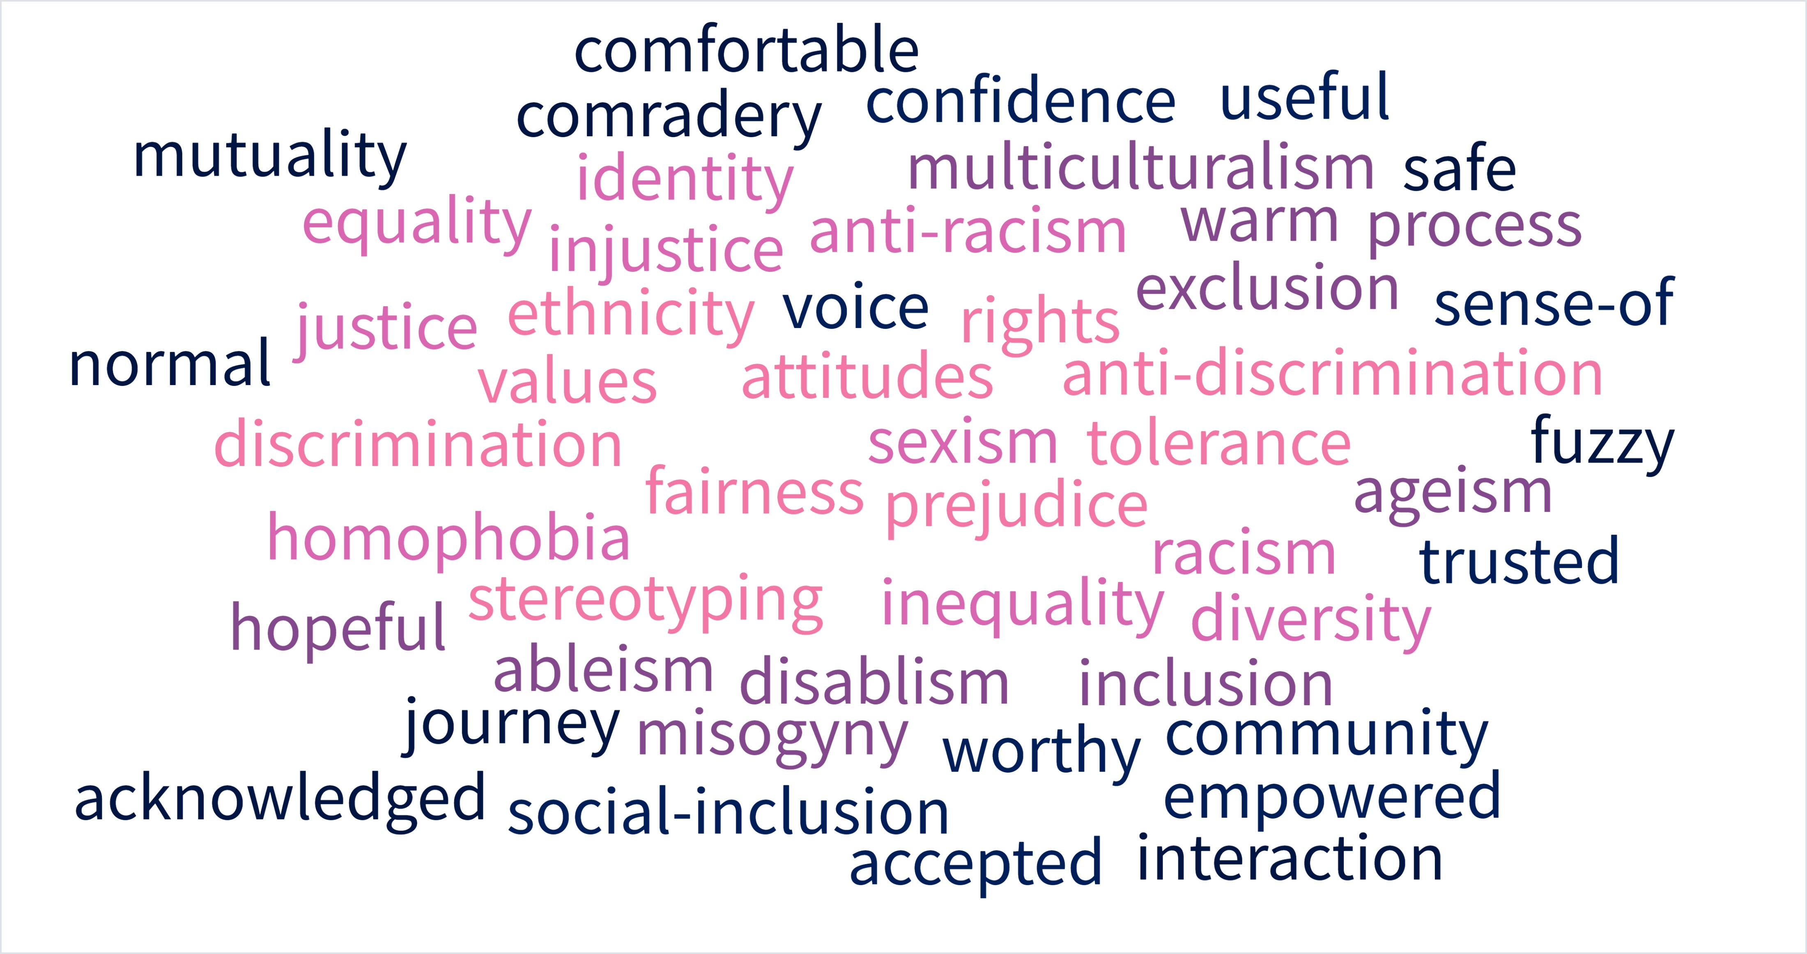

Slide 6
Key Definitions

Slide 7
Society
How would you define society?
Write a definition, then refine it with a partner until you are both satisfied.

Slide 8
Some definitions of society:
A group of people who occupy a particular territory and speak a common language and share a common culture.
A group of human beings, broadly described as being separate from other groups by mutual interest, beliefs and common cultural bonds.
A long-standing group of people sharing cultural aspects such as language, dress, norms of behaviour and artistic forms.
A society is a grouping of individuals which is characterised by common interests and may have distinctive culture and institutions. Members of a society may be from different ethnic groups…

Slide 9
Do these definitions satisfy us? How do they resonate with your own?

Slide 10

What about this......?
Margaret Thatcher famously declared in the 70s that there is no such thing as ‘society’. There are only individuals and families.
She is not alone. Some theorists believe that the most remarkable and insidious feature of the present-day edition of social ills is that they arise mostly from the absence of society, rather than from its pressures.
(From: Bauman, Z. (2008) The Absence of Society)

Slide 11

Big concept
Definition of society
Local? National? Global? Specific? General?
Different communities of people make up different societies.
It’s possible to belong to one or lots of different communities at the same time. We have multiple identities. We can belong to different societies.
SOCIETY is a big concept.
We will consider this further at another time.

Slide 12
Perthyn
Belonging
Beth yw ystyr ‘perthyn’ i gymdeithas?
Beth mae perthyn:
  Yn teimlo fel?
  Yn edrych fel?
Beth all ddigwydd pan nad yw person yn teimlo ei f/bod nhw’n ‘perthyn’?
What does it mean to ‘belong’ to society?
What does it:
  Feel like to belong?
  Look like in practice?
What can happen if someone feels like they don’t ‘belong’ in society?

Slide 13
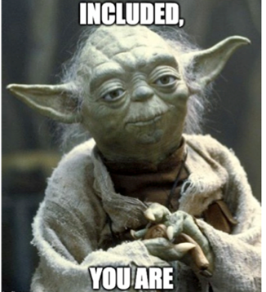
Social Exclusion and Inclusion
Exclusion from the prevailing social system and its rights and privileges, typically as a result of poverty or the fact of belonging to a minority social group.
The process of improving the terms on which individuals and groups take part in society

Slide 14
Eithrio Cymdeithasol/Social Exclusion
‘A process that deprives individuals and families, groups and neighbourhoods of the resources required for participation in the social, economic and political activity of society as a whole.’
(Pierson, 2005:7)
‘Social exclusion is a complex and multi-dimensional process. It involves the lack or denial of resources, rights, goods and services, and the inability to participate in the normal relationships and activities, available to the majority of people in a society, whether in economic, social, cultural or political arenas. It affects both the quality of life of individuals and the equity and cohesion of society as a whole.’
(Levitas et al, 2007:9)

Slide 15

Tasg
Task
Reflect on the definitions of social exclusion discussed.
Write a list of examples of what social exclusion might look like in practice. Consider:
  Who might be affected?
  Why are they affected?
  How are they affected?

Slide 16

Who is affected by exclusion?
Cis-Gender, Gender Fluid, Non-Binary.
Minority ethnic and faith groups, Gypsy Travellers, asylum seekers and refugees
Pupils who need to learn English or Welsh as an additional language (EAL)
Pupils with ALN
Gifted and talented pupils
Children ‘looked after’ by the local authority
Other children, such as sick children, young carers, children from families under stress, pregnant schoolgirls and teenage mothers
Any pupils who are at risk of disaffection and exclusion
Who else?

Slide 17
I N C L U S ION
The module considers inclusion from a macro-perspective; the big picture.
We need to re-adjust our concept and definition of inclusion.
Umbrella term under which inclusive education is a strand.
Topics are concerned with the social aspect; the nature of an inclusive society; social inclusion.

Slide 18

One definition
‘Inclusion is a process of identifying, understanding and breaking down barriers to participation and belonging.’
(National early Childhood Forum, June 2003)

Slide 19
Inclusion is:
The manipulation of the system to fit the child
Changing the policies, practices and cultures of a setting to be inclusive
The feeling derived from being included
Inherent in the term ‘inclusive’ is the possibility of being excluded.

Slide 20
Inclusive society
What does this term mean to you? Write down some thoughts. Share with a partner.
Think of some ideas and words which would be true of an inclusive society.

Slide 21
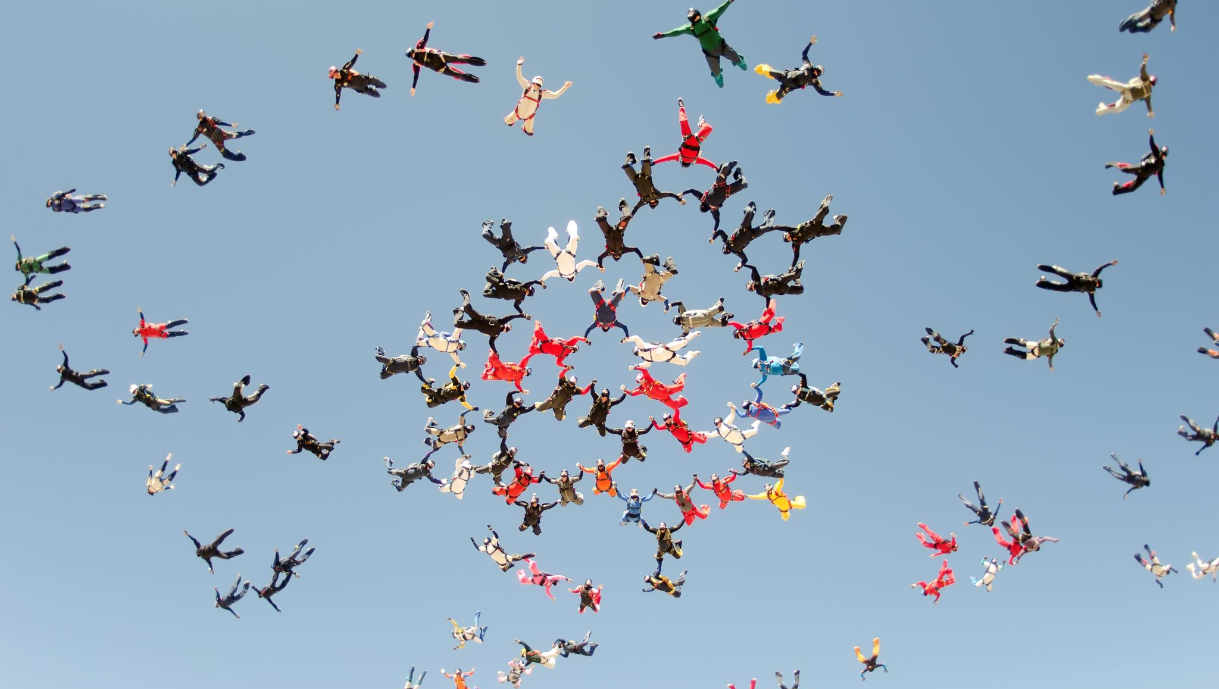
Social Inclusion
‘social inclusion is defined as the process of improving the terms of participation in society for people who are disadvantaged on the basis of age, sex, disability, race, ethnicity, origin, religion, or economic or other status, through enhanced opportunities, access to resources, voice and respect for rights’ (United Nations, 2016: 20)
Read the full report here
Notes:
Check this and update

Slide 22
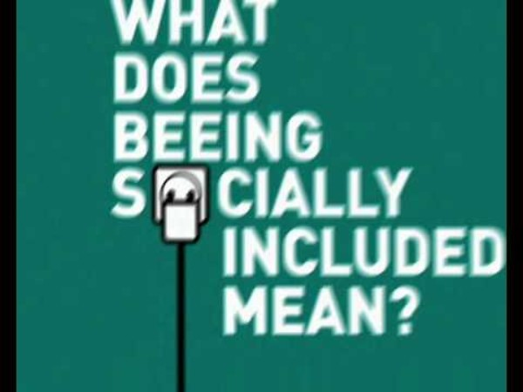
Social inclusion: some information - from Serbia!
Notes:
http://www.youtube.com/watch?v=d3KOFZeuQmw

Slide 23
A society for all
An inclusive society is ‘a society for all’ (The World Summit for Social Development, 1995).
Inclusive societies are stable, safe, just and tolerant.
They respect diversity, equality of opportunity and participation of all people, including disadvantaged and vulnerable groups and persons.
Notes:
Check this and update if needed.

Slide 24
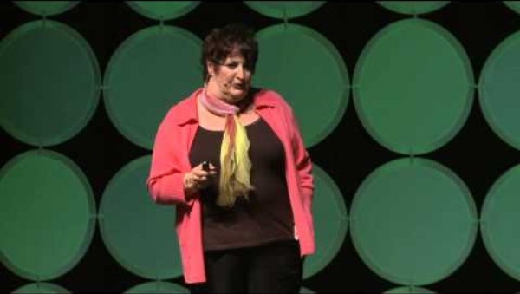
Task
Watch the video (13 mins)
Discuss the key points raised in your groups
Consider do these points still apply today?
Select one person to report back to the main group on your findings (10 mins)

Slide 25
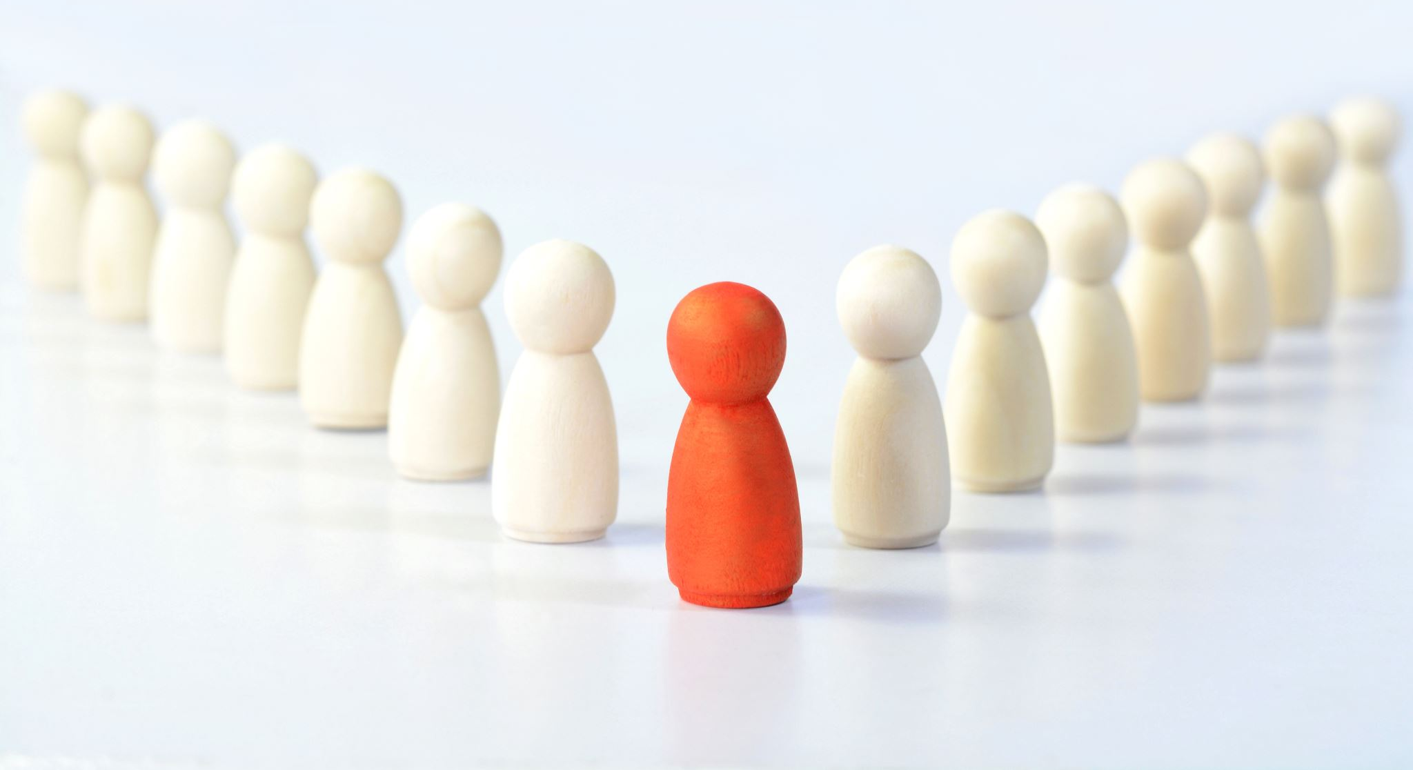
Task
Now we have discussed social exclusion and inclusion in more depth revisit the task from earlier
How can people be excluded in society?
How can people be included in society?
Write your final comments on a post it note (one post it note for each point)
Stick the post it note on the board

Slide 26
Session Objectives
At the end of this session, are you able to
Recall key definitions.
Discuss how society can include and exclude individuals and groups.

Slide 27

Questions

Slide 28
Reference list
Levitas, R., Pantazis, C., Fahmy, E., Gordon, D., Lloyd, E. and Patsios, D. (2007) The Multi-dimensional Analysis of Social Exclusion, London, Department for Communities and Local Government (DCLG)
Pierson, J. (2010) Tackling Social Exclusion. 2nd Edition, London: Routledge.
United Nations (2016) Leaving no one behind: the imperative of inclusive development. Available at https://www.un.org/esa/socdev/rwss/2016/full-report.pdf [Accessed 23.3.21)

