Slide 1
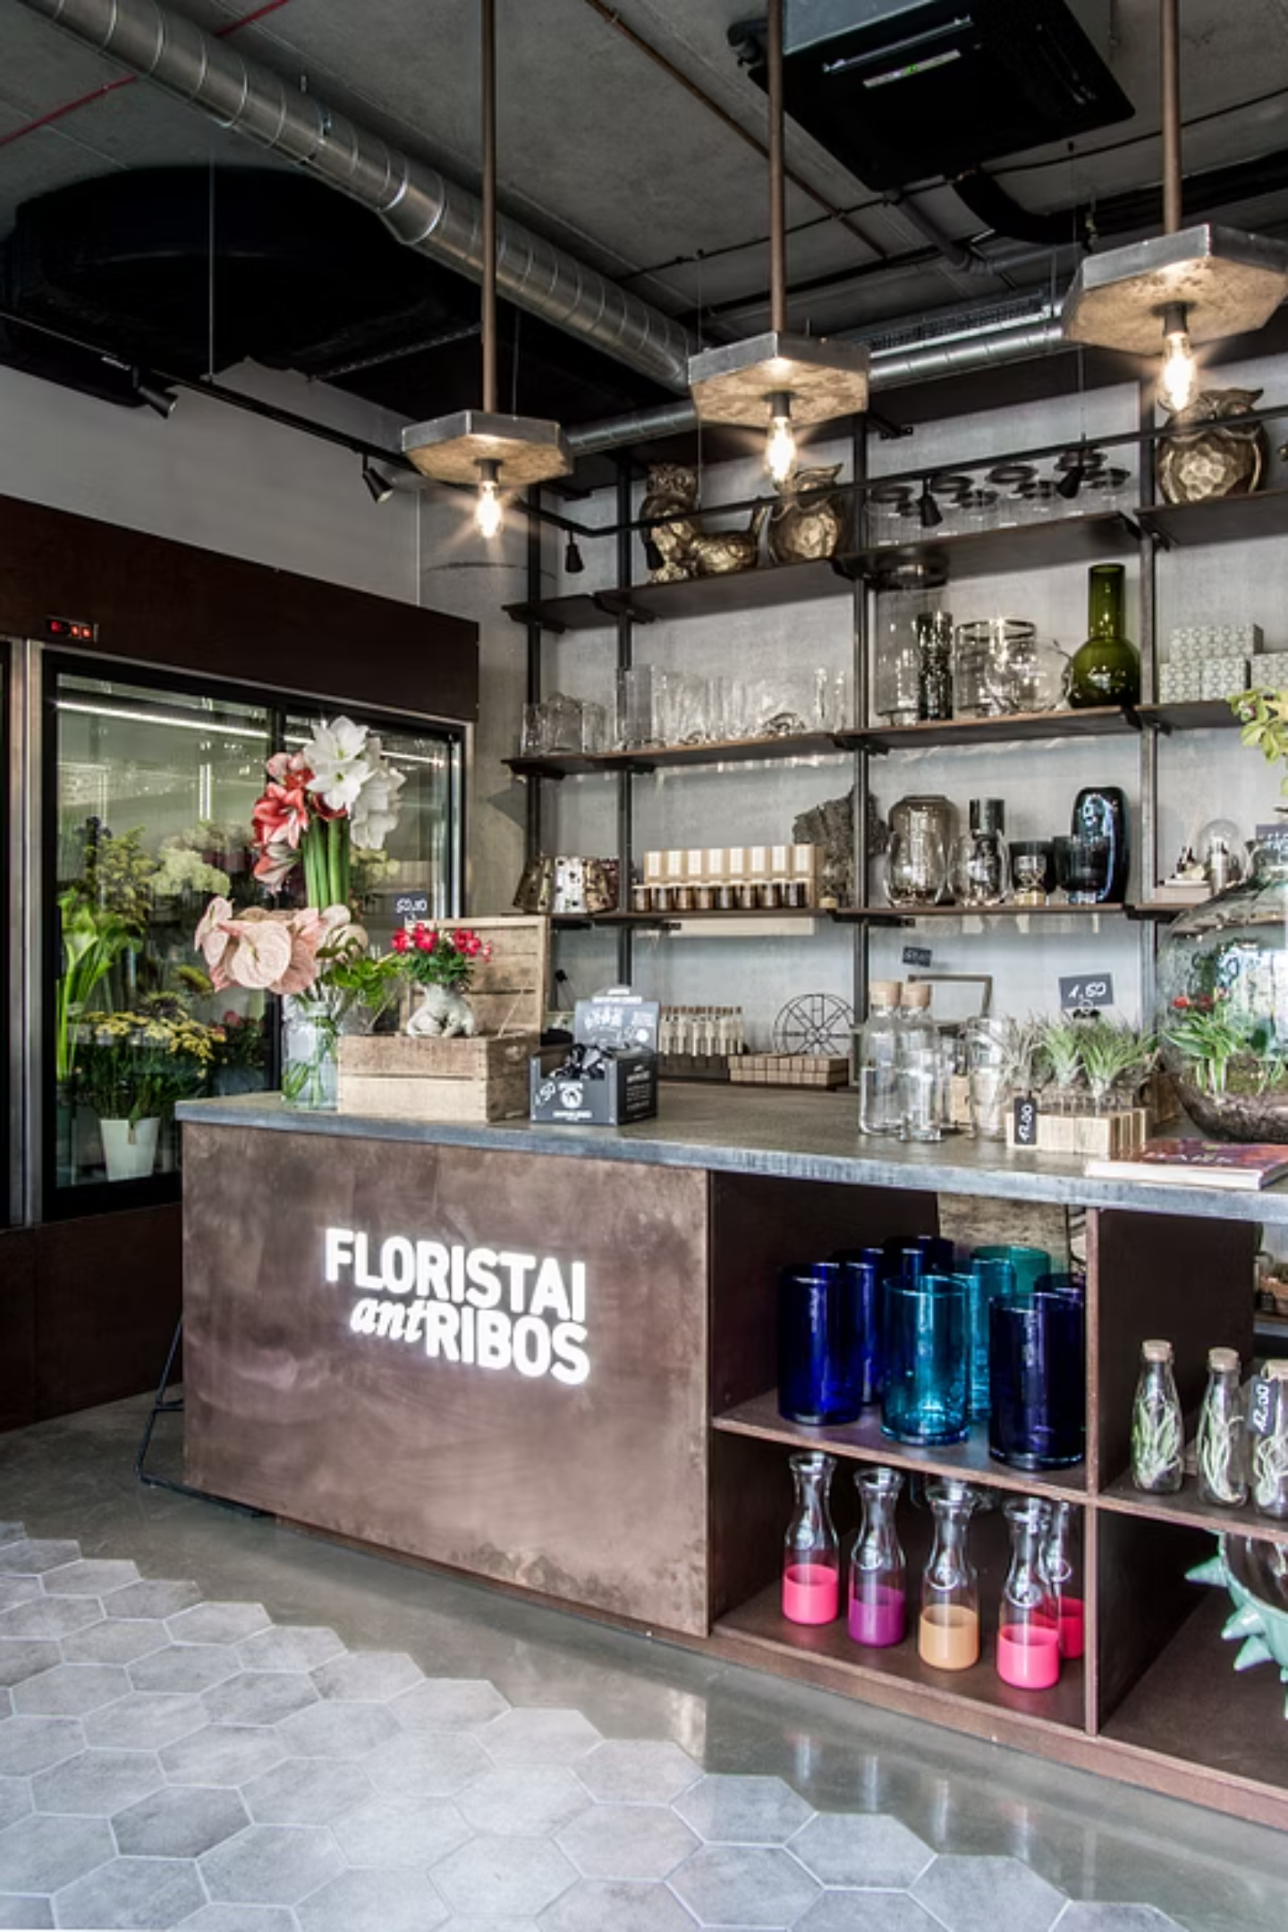

LCLM4004:
Problem Solving and
Decision Making
Case: Green Haven Florists – Declining In-Store Sales
Ewelina Bernas
2509446
Lecturer: Mr. Chijioke Uba
Page 1

Slide 2
Introduction, Purpose, and Structure
This presentation analyses the underlying causes of a significant 12-month decline in in-store sales at Green Haven Florists. Our objective is to provide actionable insights for reversing this trend.
1
2
3
4
Issue Scope
5W2H Analysis
PESTEL Analysis
Fishbone Analysis
Defining the boundaries of the problem.
A precise framework for problem definition.
Examining macro-environmental factors.
Identifying root causes systematically.
5
6
Key Findings
Recommended Actions
Summarising core conclusions.
Strategic steps and implementation plan.
A structured approach reduces bias and improves the quality of managerial decisions in complex situations (Bazerman and Moore, 2013).
The case is framed by broader retail challenges: high-street footfall pressure, escalating operating costs, and evolving customer expectations for convenience and digital engagement.
Page 2
Notes:
In this session, we will discuss how the sales of the Green Haven Florists store were declining using systematic problem-solving. It is not merely the description of what is occurring, but rather the goal too is the diagnosis of causes underlying and relating it to logical connections to sensible, practical and evidence-based solutions. It begins its description with a brief overview of the case, followed by three complementary analysis schemes: PESTEL analysis, fishbone (cause-and-effect) diagram, and 5W2H model. Its tools are guided by the observations of its predecessors, guiding the view of the issue in numerous varied ways and on a more profound and profound level. It is a strategy that illustrates the art of systematic decision-making, and on which the managers restrict the application of assumptions and support the level of their judgments with a more formal systematic analysis. The presentation concludes with a conclusion outlining the key conclusions and makes transparent and realistic suggestions that can be implemented by Green Haven Florists in a bid to stabilise performance and sustain the growth in sales.

Slide 3
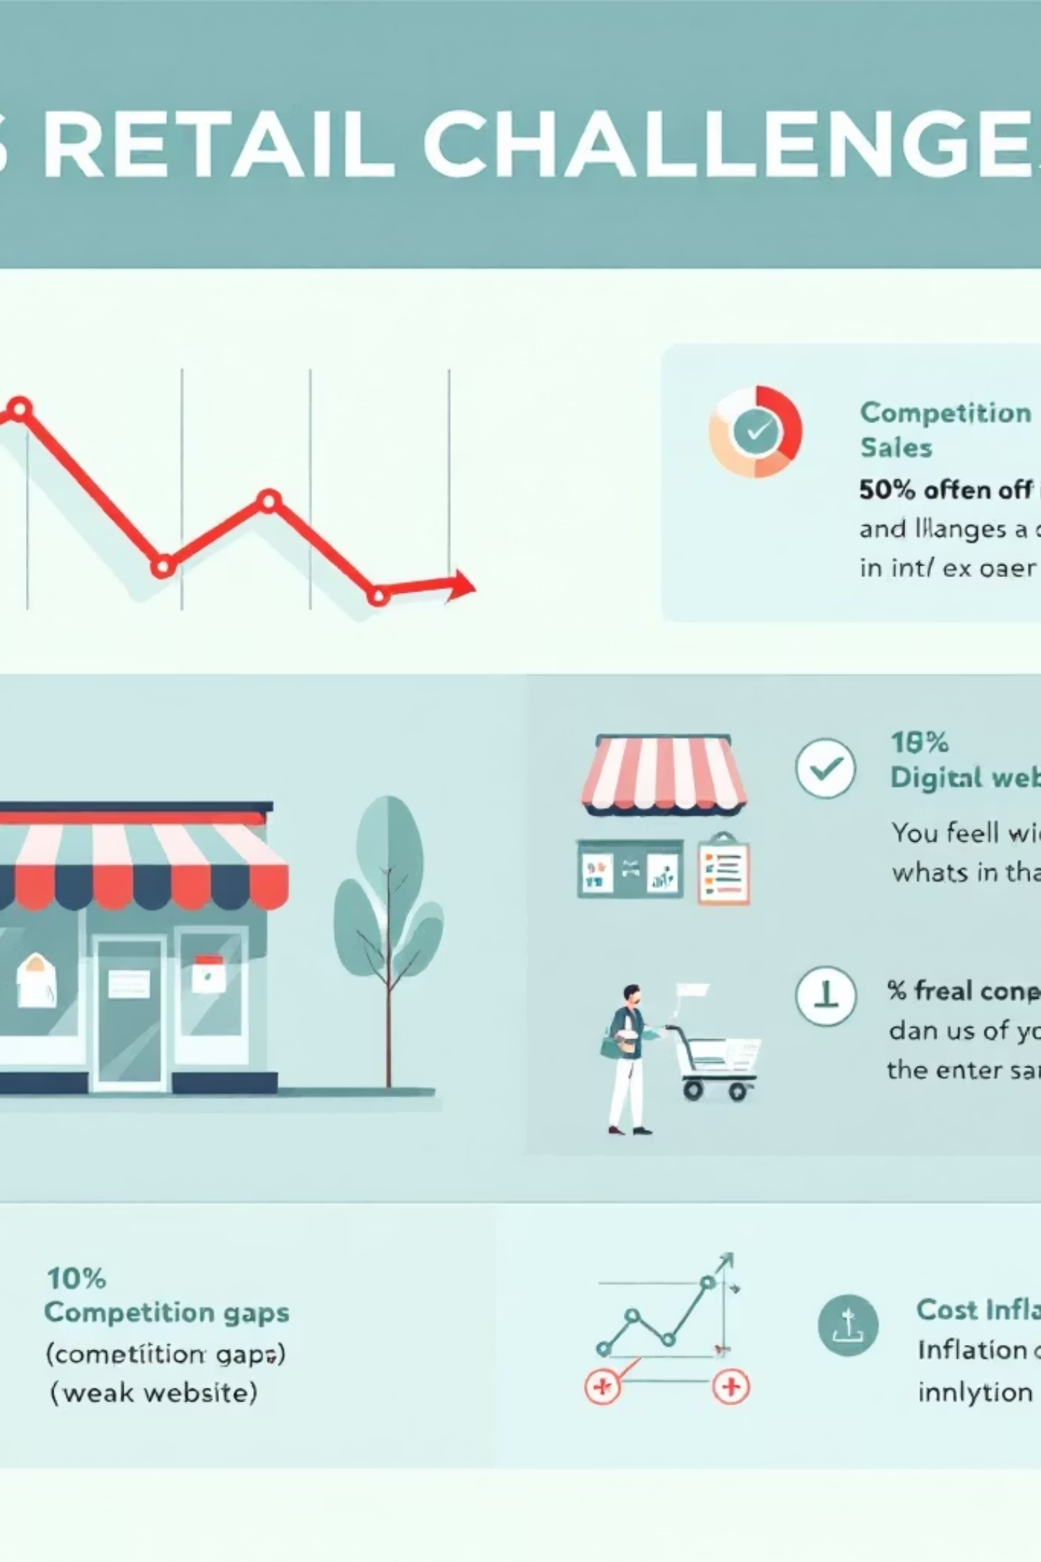
Nature and Scope of Issues Affecting In-Store Sales
The Challenge: A Multifaceted Decline
Core Problem
In-store sales have fallen by approximately 30% over 12 months, concurrently with an increase in operating costs. This dual pressure significantly impacts profitability.
Key Areas of Impact
Customer acquisition (dwindling footfall)
Conversion rates (in-store experience)
Profitability (rising cost inflation)
The online share of UK retail sales has achieved structural significance, intensifying the shift away from physical purchasing across many categories (Office for National Statistics, 2026a). Furthermore, retail sales conditions remain highly sensitive to wider demand shifts, directly influencing discretionary high-street spending patterns (Office for National Statistics, 2026b).
Page 3
Notes:
Green Haven Florists is experiencing a twofold problem: a reduction in in-store sales over the last year and an increase in operating costs. This is an indication of broader customer behaviour changes and retailing conditions, such as the ongoing increase in online shopping and declining reliance on high-street shopping-tendencies both noted in Office for National Statistics retail statistics. Simultaneously, local market competition has become more intense, as social-media-based florists and bigger chains have even greater marketing capabilities supported by more robust marketing budgets. The major contributory factors, hence, are reduced footfall, poor digital presence, a shift in customer expectation to convenience and delivery, and cost pressures occurring as a result of inflation. It is important to understand this broader context because the external market forces contributing to the fall will not be resolved through purely in-store fixes.

Slide 4
5W2H Analysis for Problem Definition
The 5W2H framework is instrumental in precisely defining a problem, clarifying constraints, and guiding targeted actions rather than generic fixes (Johnson et al., 2019).
Element
Green Haven Florists (Applied)
What
In-store sales decline and margin pressure across core product lines.
Why
Reduced high-street footfall, increased competition, inadequate digital support, and rising operational costs.
Who
Directly impacts walk-in customers, the local community, staff morale, supplier relationships, and delivery partners.
Where
The primary high-street store location and its immediate local catchment area.
When
A consistent decline over the past 12 months, exacerbated during traditional peak seasonal events.
How
Characterised by fewer customer visits, lower in-store conversion rates, and reduced repeat purchases.
How much
Approximately 30% sales decline coupled with rising input costs for premium flowers and sustainable packaging solutions.
Page 4
Notes:
The 5W2H model assists in getting a clear understanding of the issue by defining the problem by responding to seven simple yet effective questions: what, why, who, where, when, how, and how much. This framework does not require leaping directly to solutions, but makes sure that the issue is clearly established. The what in this case is the decrease in in-store sales and profitability. The reasons of why entails the reduction of customer visits, an increase in competition and an increase in costs. The person who deals with internal stakeholders, including the staff and owners, as well as external stakeholders, including the customers and suppliers. The where is concerned with the local high-street setting, which is witnessing a shifting shopping behaviour. The word " when is used to determine a downward trend of twelve months as opposed to a brief seasonal variation. How clarifies how it will work: the number of people visiting the store will decrease, and the rate of conversion to purchases will be lower. Lastly, the seriousness of the issue is indicated by the use of how much, which demonstrates the severity of the problem. In general, this step provides structure and eliminates oversimplified conclusions.

Slide 5
PESTEL Analysis: Macro-Environmental Forces
PESTEL identifies the macro-environmental forces shaping demand, competition, and cost conditions for Green Haven Florists (Yuksel, 2012).
Political (P)
Economic (E)
Technological (T)
Environmental (E)
Local regeneration initiatives or changes in parking regulations may impact store accessibility. Potential government support schemes for small businesses could offer avenues for assistance.
Cost pressures on consumers reduce discretionary spending. Significant input cost inflation for imported flowers directly affects margins.
Opportunities exist in online ordering platforms, Customer Relationship Management (CRM) systems, and efficient delivery solutions. Social media is a primary channel for discovery.
Rising sustainability expectations are increasing packaging costs. There is growing pressure for waste reduction and ethically sourced materials.
Social (S)
Legal (L)
Consumers increasingly value convenience, driving demand for delivery and subscription services. Trust and social proof are predominantly sought online.
Compliance with consumer rights and regulations for delivery/returns is crucial. Data protection laws (e.g., GDPR) apply to online orders and subscription management.
Page 5
Notes:
A PESTEL analysis assists in analysing the macro-environmental forces that influence the performance of the florist. Politically, decisions during the planning of urban areas and routes to access can affect the store's footfall, including the availability of parking. As an economy, inflation and limited disposable income make customers more sensitive to price, as well as raising the supplier and operating expenses. Social tendencies are also important since customers demand convenience, speed of delivery and being able to browse and place orders online. Technologically, customer interaction and customer visibility have become a necessity based on online ordering platforms and social media marketing, especially for small retailers. Environmentally, the increasing concerns over sustainable packaging pose both differentiation prospects and further financial strains, necessitating a suitable balance between ethical application and price. Delivery expansion or subscription model is legally required to meet consumer protection and data management-related requirements. In fact, the strengths of PESTEL lie in its emphasis on external forces, which the firm cannot directly influence, allowing the management to change the strategy before it starts to respond with operational band-Aids.

Slide 6
PESTEL Implications for Green Haven
Economic Volatility & Discretionary Spending
Shifting Competitive Landscape
Competitive advantage is increasingly tied to offering seamless convenience, such as reliable delivery and flexible subscription models. Digital discovery through local search and social media is paramount for reaching new customers.
Economic pressures can severely depress discretionary purchases and amplify price sensitivity among consumers. Concurrently, these pressures contribute to rising business operating costs (Bank of England, 2026).
Sustainability as a Value Proposition
Legal & Compliance Readiness
Sustainability should be repositioned as a core value – emphasising quality, ethical sourcing, and longevity – rather than solely an increased cost burden.
Introducing subscription and delivery services necessitates robust legal and compliance readiness, ensuring clear terms of service, transparent refund policies, and diligent data handling practices.
Page 6
Notes:
There are various strategic implications when one interprets the PESTEL findings. Reported cases of economic uncertainty and inflation at the Bank of England indicate that customers might have to limit their impulse buying to flowers unless the value proposition is very clear. Hence, the business should be more differentiated and not just compete based on price. Another important implication is technology, as the digital discovery is now the primary method of how customers find the services in the local area. The business may not be visible even in the neighbourhood without a good online presence. Social shifts also show the increasing need for convenience, i.e. the delivery and subscription models may stabilise the income. The expectations of the environment can be converted to a marketing benefit through focusing more on sustainability and not viewing it as a cost burden. On the whole, this suggests that the implication is that the florist needs to rebrand itself as an omnichannel local service and not to be wholly dependent on the old-fashioned footfall.

Slide 7





Fishbone (Cause–Effect) Analysis: Identifying Root Causes
Fishbone analysis structures root causes by category, ensuring actions target underlying drivers, not just symptoms. Systematic testing of causes leads to more consistent solutions.
Market
Operations
Competition
Marketing
Cause Categories → Likely Drivers:
Market & Footfall: Declining high-street visits; fewer impulse buys.
Competition: Agile Instagram florists; aggressive national chains.
Digital & Marketing: Outdated website, weak SEO, no social proof or subscriptions.
Customer Experience: Limited delivery; unclear value proposition.
Pricing & Costs: Volatile imported flower prices; higher sustainable packaging costs.
Operations: No delivery capability; inconsistent promotions.
Page 7
Notes:
The fishbone or cause-and-effect diagram assists in categorising the potential root causes. Instead of pointing to a single cause, it demonstrates the combination of several problems resulting in decreasing sales. When measured under market influences, low high-street traffic diminishes impulse buying. Another significant branch is competition, where both independent Instagram-based florists and national chains compete by drawing customers through digital marketing or discounts. Some of the weaknesses demonstrated by the marketing branch include the old-fashioned website and poor online advertising. In practical terms, an inadequate delivery infrastructure minimises convenience in comparison with competitors. There is also pressure on pricing and costs because imported flowers and sustainable materials make it expensive. Customer experience is another subdivision, and there may be fewer repeat visits because of limited product innovation or promotions. The studies on the root-cause analysis underline that the identification of the interrelated causes enhances the efficacy of the corrective action since the solutions are applied to the systems and not the individual symptoms. This transforms the fishbone diagram into a robust shift to the practical recommendations.

Slide 8
Key Findings: Conclusions and Insights
Multicausal Decline
Footfall Constraint
Customer Demand for Convenience
The decline in in-store sales is a result of structural footfall reduction, digital platform weaknesses, cost inflation, and intensified competitive pressure.
Relying solely on walk-ins for recovery is limited by the critical constraint of declining high-street footfall (British Retail Consortium, 2026).
Customer feedback clearly indicates a significant demand for delivery and subscription services, highlighting a clear "convenience gap" in current offerings.
Omnichannel Imperative
Leveraging Repeat Purchase
An omnichannel strategy is essential: strengthening digital discovery and adding flexible fulfilment options while simultaneously enhancing the in-store experience for conversion.
The most impactful solutions will focus on increasing repeat purchases and reducing demand volatility through initiatives like subscriptions, seasonal bundles, and automated reminders.
Page 8
Notes:
Several important conclusions can be drawn using a combination of the three tools. To begin with, the drop is not a one-time phenomenon but a structural one; that is, mere temporary promotions will not help the situation. Second, decreased footfall is a limitation that the business does not have complete control over, as demonstrated by the overall monitoring statistics provided by the British Retail Consortium and therefore the business strategy has to minimise reliance on the walk-in traffic. Third, convenience and digital access are obvious preferences of the customers, which means there is a service gap with the competitors. Fourth, the increasing expenses imply efficiency and smarter product bundling to defend the margins. Lastly, the analysis indicates that the combination of enhancing digital and service innovation will have the greatest influence, instead of focusing on any operational change. The findings are the direct role in the recommendations made in the following slide.

Slide 9

Recommended Actions and 30/60/90 Plan
Continuous improvement principles underpin reliable service design (covering delivery, ordering, and complaints handling) and help protect quality while scaling changes (Oakland, 2014).
Recommended Actions
30/60/90 Day Plan & KPIs
Online Ordering + Click & Collect
0–30 Days: Foundation
Launch a basic online ordering system combined with a click-and-collect service for immediate impact.
Refresh website (optimise for mobile + ordering), define delivery radius, and initiate staff training.
1
Local Delivery Service
KPIs: Online enquiries, conversion rate.
Introduce a local delivery service with a clear service promise, including time slots and minimum order values.
31–60 Days: Expansion
Subscription Bouquets Pilot
2
Launch subscription service and establish external delivery partnerships.
Pilot subscription bouquets (weekly/bi-weekly) incorporating loyalty incentives for recurring customers.
KPIs: Subscription sign-ups, repeat purchase rate.
Digital Discovery Upgrade
61–90 Days: Optimisation
Enhance Google Business Profile, actively manage reviews, increase Instagram content cadence, and create seasonal landing pages.
3
Refine pricing bundles and develop a comprehensive campaign calendar.
KPIs: Average order value, gross margin percentage, footfall-to-sale conversion.
Page 9
Notes:
It is advisable to have a staged implementation process, where quick wins are adopted, followed by planned developments. During the first 30 days, Green Haven Florists ought to modernise its site, build stronger local awareness, and present a basic click-and-collect service. The 31-60 days need to prioritise making local delivery and testing the subscription delivery to facilitate repeat buying. Early customer feedback can be used to refine promotions and bundle pricing between days 60 and 90. The introduction of changes must not interfere with day-to-day service, and that is why it is in line with a principle of continuous improvement. KPIs that could be used to monitor performance must include online enquiries, repeat purchase rate, average order value and enquiry to sale conversion. Afterwards, it will be a profitable omnichannel model.

Slide 10
References
Asian Productivity Organisation (1976). Ishikawa, K. Guide to Quality Control. Tokyo: Asian Productivity Organisation.
Bank of England (2026) Monetary Policy Report – February 2026. [online] Available at: https://www.bankofengland.co.uk/monetary-policy-report/2026/february-2026 (Accessed: 16 February 2026).
Bazerman, M.H. and Moore, D.A. (2013) Judgment in Managerial Decision Making. 8th edn. Hoboken, NJ: John Wiley & Sons.
British Retail Consortium (2026). Footfall Monitor. [online] Available at: https://brc.org.uk/market-intelligence/publications/monitors/footfall-monitor/ (Accessed: 16 February 2026).
Johnson, G., Whittington, R., Scholes, K., Angwin, D. and Regnér, P. (2019). Exploring Strategy: Text and Cases. 12th edn. Harlow: Pearson.
Nagyová, A., Pacaiová, H. and Grančíková, A. (2019) ‘An empirical study of the root-cause analysis in automotive supplier organisation’, Quality Innovation Prosperity, 23(2), pp. 34–45. https://doi.org/10.12776/qip.v23i2.1274
Oakland, J.S. (2014). Total Quality Management and Operational Excellence: Text with Cases. 4th edn. London: Routledge.
Office for National Statistics (2026). Internet sales as a percentage of total retail sales (ratio) (%): Time series. [online] Available at: https://www.ons.gov.uk/businessindustryandtrade/retailindustry/timeseries/j4mc/drsi (Accessed: 16 February 2026).
Office for National Statistics (2026) Retail sales, Great Britain: December 2025. [online] Available at: https://www.ons.gov.uk/businessindustryandtrade/retailindustry/bulletins/retailsales/december2025 (Accessed: 16 February 2026).
Yuksel, I. (2012) ‘Developing a multi-criteria decision making model for PESTEL analysis’, International Journal of Business and Management, 7(24), pp. 52–66. https://doi.org/10.5539/ijbm.v7n24p52
Page 10
Notes:
Asian Productivity Organisation (1976). Ishikawa, K. Guide to Quality Control. Tokyo: Asian Productivity Organisation.
Bank of England (2026) Monetary Policy Report – February 2026. [online] Available at: https://www.bankofengland.co.uk/monetary-policy-report/2026/february-2026 (Accessed: 16 February 2026).
Bazerman, M.H. and Moore, D.A. (2013) Judgment in Managerial Decision Making. 8th edn. Hoboken, NJ: John Wiley & Sons.
British Retail Consortium (2026). Footfall Monitor. [online] Available at: https://brc.org.uk/market-intelligence/publications/monitors/footfall-monitor/ (Accessed: 16 February 2026).
Johnson, G., Whittington, R., Scholes, K., Angwin, D. and Regnér, P. (2019). Exploring Strategy: Text and Cases. 12th edn. Harlow: Pearson.
Nagyová, A., Pacaiová, H. and Grančíková, A. (2019) ‘An empirical study of the root-cause analysis in automotive supplier organisation’, Quality Innovation Prosperity, 23(2), pp. 34–45. https://doi.org/10.12776/qip.v23i2.1274
Oakland, J.S. (2014). Total Quality Management and Operational Excellence: Text with Cases. 4th edn. London: Routledge.
Office for National Statistics (2026). Internet sales as a percentage of total retail sales (ratio) (%): Time series. [online] Available at: https://www.ons.gov.uk/businessindustryandtrade/retailindustry/timeseries/j4mc/drsi (Accessed: 16 February 2026).
Office for National Statistics (2026) Retail sales, Great Britain: December 2025. [online] Available at: https://www.ons.gov.uk/businessindustryandtrade/retailindustry/bulletins/retailsales/december2025 (Accessed: 16 February 2026).
Yuksel, I. (2012) ‘Developing a multi-criteria decision making model for PESTEL analysis’, International Journal of Business and Management, 7(24), pp. 52–66. https://doi.org/10.5539/ijbm.v7n24p52

