Slide 1

Strategies for Effective Communication
Created by:
Constantin Alin Daraban
Khizar Fareed
Cristian Gherman
Florin Petrisor Zinica

Slide 2
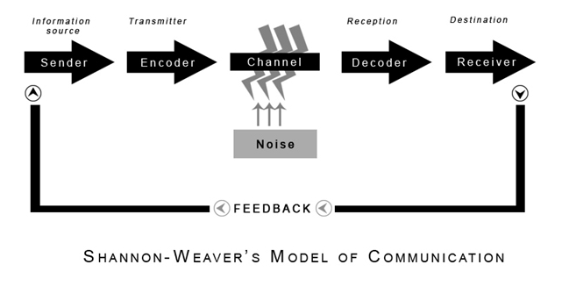
Shannon and Weaver Communication Model
Processing the Message.
Encoding the message into Signals.
Transmitted through a Channel.
Decoding the message from the Signal.
Message arrives to Destination.
Can be Noise in the Background on every call.

Slide 3
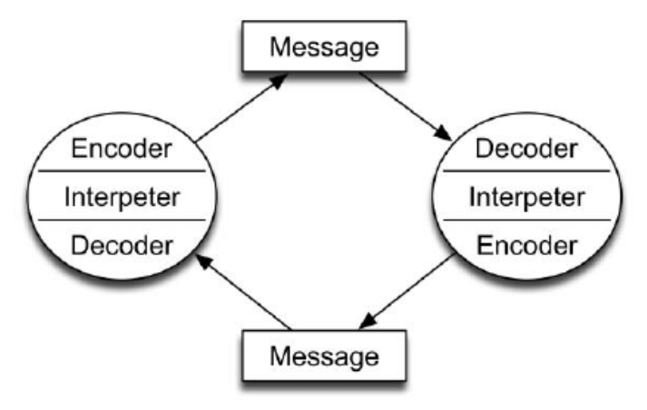
Osgood-Schramm’s Interactive Model
Encoding is very important,
Sharing your thoughts.
Decoding means understanding.
Communication can be finalized after receiving feedback.

Slide 4
What are the channels of communication used by the organisation and channels that can be used to improve communication?
Linear, interactive and transactional
Models | Pros | Cons
Linear One-way communication - mostly employed in mass communication. | Audience persuasion Propaganda Intentional results | No feedback No continuous line of communication No awareness whether communication was effective.
Transactional In communication, both the sender and the recipient play a vital role. Interpersonal – communication between two people | Simultaneous and instant feedback No discrimination | Encourages non-verbal communication More noise
Interactional New communications like internet Communication can become linear if no response | Feedback even in mass communication New communication channels | Feedback can take a very long time Sender and receiver might not know who the other person is.
(Bowman and Targowski, 1987)

Slide 5
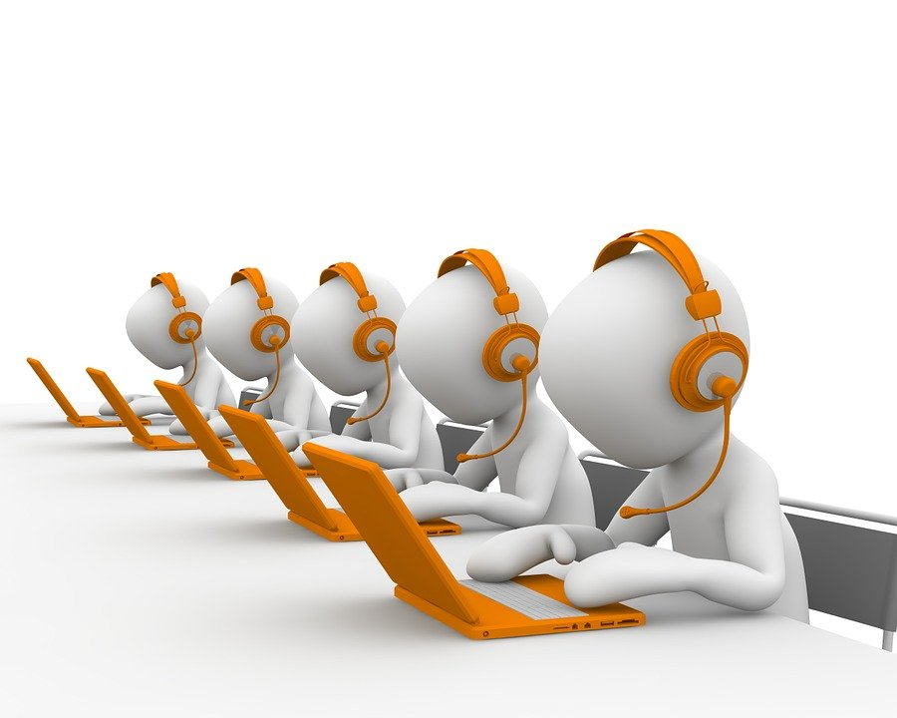
What are the channels of communication used by the organization and channels that can be used to improve communication?
What are channels of communication?
Face to face
Telephone
Video/conference
Emails
Text
Broadcast media communication
Here at Whirlpool, as customer service staff it would be useful to implement a transactional model of communication, and possibly an interactional model to collect feedback utilizing electronic forms of communication such as the internet to further improve communication

Slide 6
Customer service repair department
Online and telephone staff to support customers remotely and arrange repairs effectively.
Inhouse team who can visit customers houses to carry out repairs rather than collecting the item.
Requires transactional form of communication which includes face to face communication
Email and telephone - communication needs to be two-way dialogue
Interactional form to improve communication by using internet for feedback that can be provided anonymously via online feedback forms.
(Dato, 2021)
Notes:
Notes for presentation ; When you need to receive responses immediately, phone calls are an excellent solution. Calls are a two-way, real-time communication channel that allows you to hear the tone of the other person's voice. this channel also allows lengthy discussions to take place.
Email provides a formal channel of communication and working within the repair department, it would be highly important to relay messages and forms of communications within a professional capacity, which an email is able to offer.
To improve communications further, whirlpool can use the internet to provide customers with the opportunity in providing feedback. this feedback can be used to further improve the business.

Slide 7
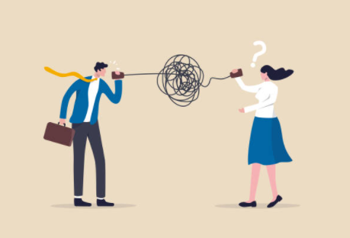
Barriers to communication
Filtering
Emotions
Information overload
Defensiveness
Language
National culture

Slide 8
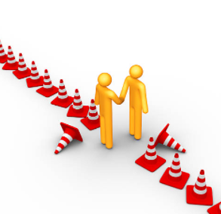
Overcoming these Barriers
Active listening
Language simplicity
Feedbacks
Emotion constraining

Slide 9
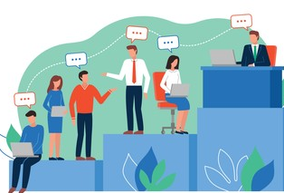
Effective communication: What is it?
Effective communication is about more than just exchanging information. It’s about understanding the emotion and intentions behind the information. As well as being able to clearly convey a message (Fielding, 2006)
Strategies for effective communication:
Focus on what is being said, not on the person talking
Be genuine rather than manipulative
Empathize rather than remain detached

Slide 10

E.C in Whirlpool Company
-Service Repair Department-
Better understanding of ideas shared which will help with the decision-making process when working on different products of clients (Benassi , 2021)
Better cooperation between members of staff from different departments
Effective distribution of information and data from one member of staff to another.

Slide 11
Teamwork Evaluation | Team responses.
Who was in your team? | Constantin Alin Daraban Khizar Fareed Cristian Gherman Florin Petrisor Zinica
What were the key strengths of your team? | Desire to succeed, Attendance , Brain Storming , Empathy, Power Point design, Insights of Company selected.
What were the challenges that you overcame as a team? | Internet Connectivity, Delay in feedbacks, Different working shift patterns.
What would you do differently if you worked as a team again? | Punctuality, established meetings to discuss the evolution of the project.
How would you rate your team working? Out of 10? | 8/10

Slide 12
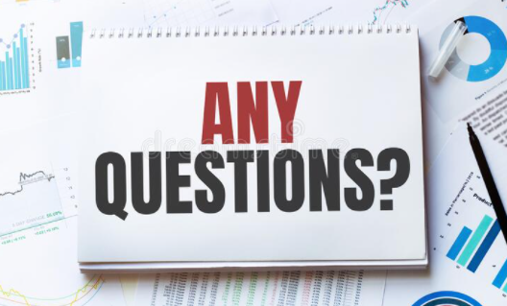


Slide 13
References
Bowman, J. and Targowski, A., 1987. Modeling the Communication Process: The Map is Not the Territory. Journal of Business Communication, 24(4), pp.21-34.
Dato, N., 2021. 7 best communication channels for a connected team.. [online] Podium. Available at: <https://www.podium.com/article/communication-channels/> [Accessed 17 November 2021].
Benassi M., Developing effective communication: how to get in touch with your family, friends, colleagues & more: Business communication skills. Independently Published.
Fielding, M., (2006), Effective communication in Organization., Juta and Company LTD. , pp: 356-360.
Paul Cobley, Peter J. Schulz, (2013) ‚‘‘Theories and Models of Communication’’, De Gruyter, pp: 201-220.
Buchanan, D, & Huczynski, A (2016), Organizational Behaviour, Pearson Education Limited, Harlow, United Kingdom. Available from: ProQuest Ebook Central.
Rayudu, C., (2009) Communication, Global Media, Mumbai. Available at: ProQuest Ebook Central. (Accessed: 16 May 2020).
Griffith, B., and Dunham, E., (2015), Working in Teams: moving from high potential to high performance, Los Angeles, SAGE Publications.
Mehrabian, A. (1981) Silent Messages: Implicit Communication of Emotions and Attitudes, Boston: Wadsworth Publishing Company

