Slide 1
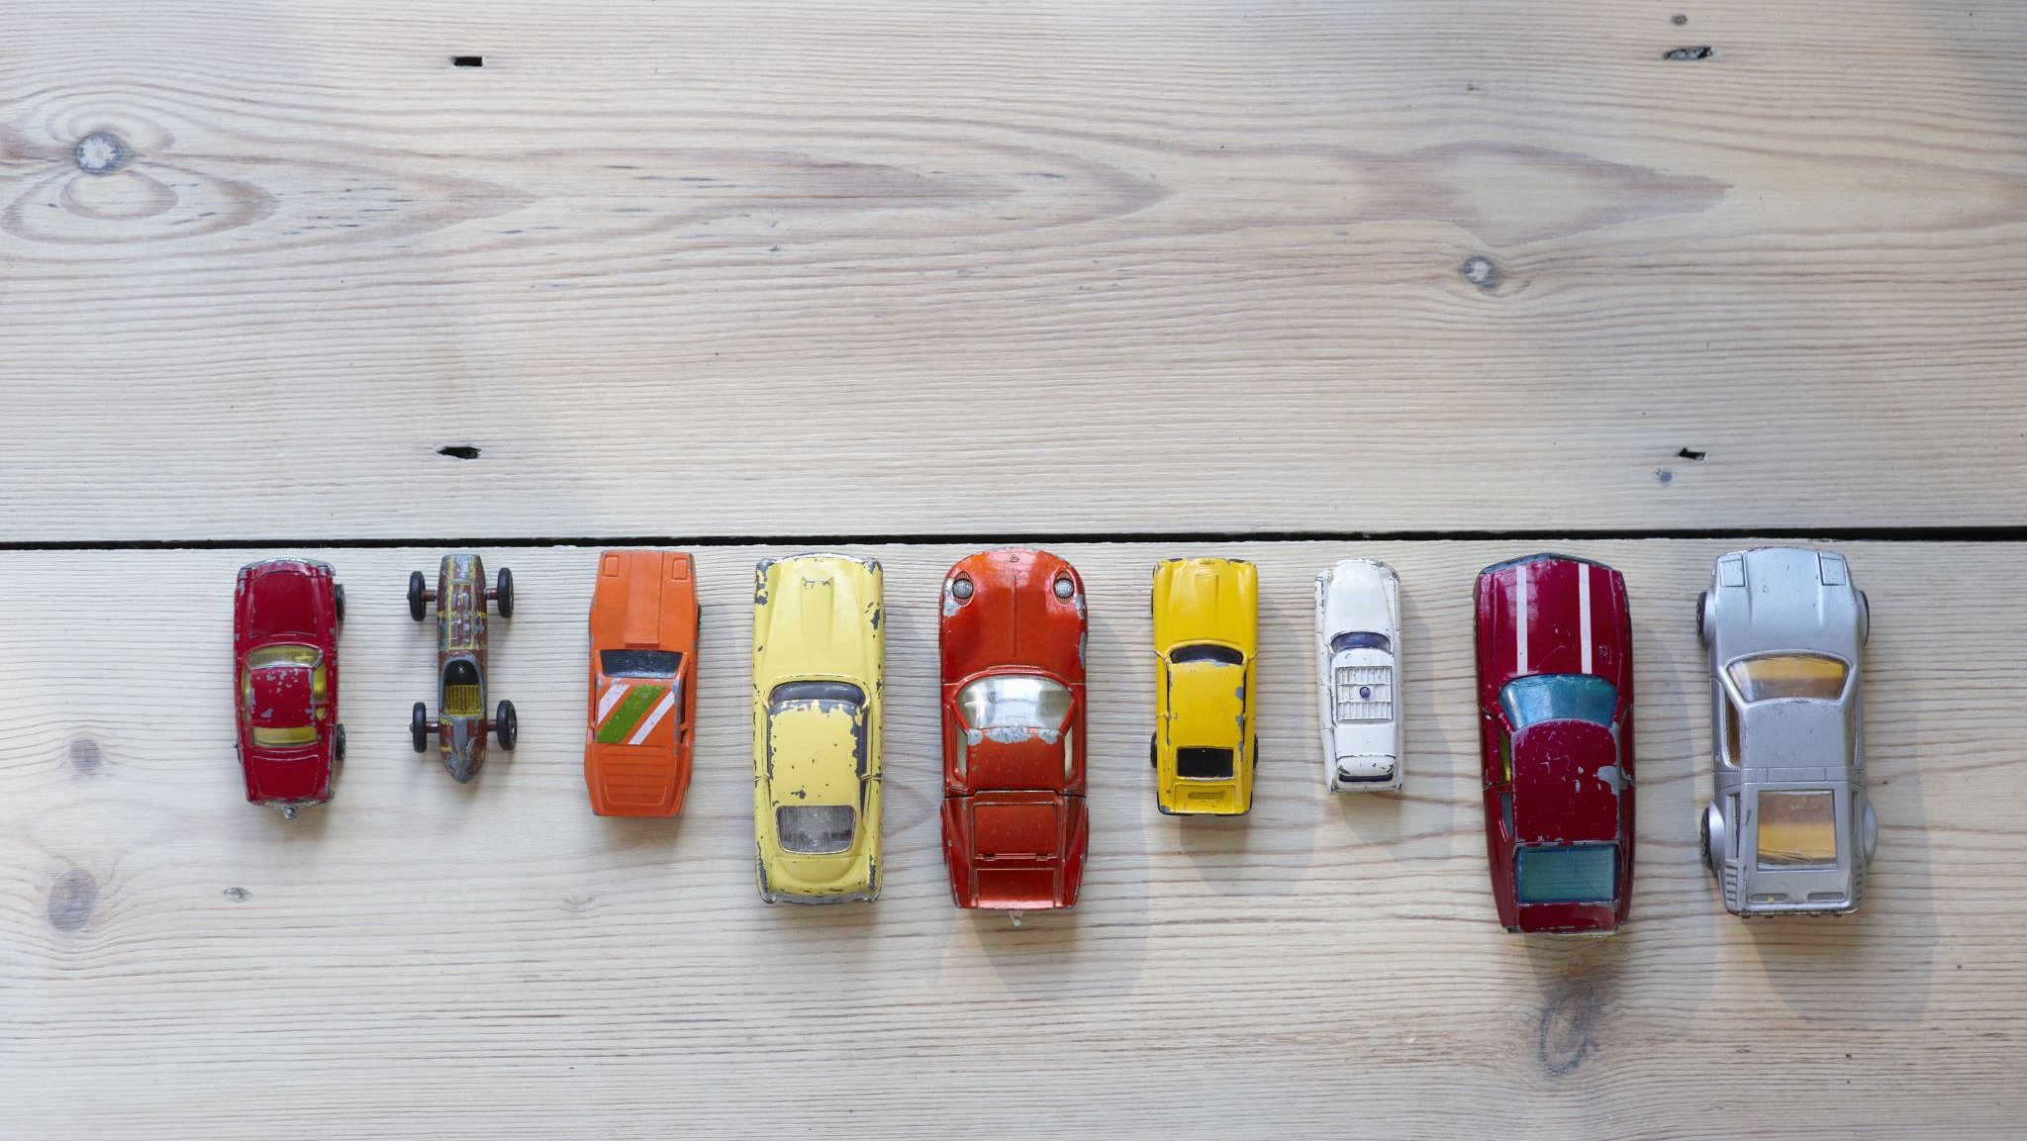
Preparing to Collect data
Dr caroline jawad 2020

Slide 2
Data collection
The whole reason you write the literature review is to be able to write your ……
Questions

Slide 6
Basics

Slide 7
Why
For a questionnaires and interviews;
Show the justification for individual questions - why do you need the data and how will it be used (analysed)?
Show the justification for choosing the respondents - how will they provide reliable, repeatable data?

Slide 8
Sampling
However, all involve the operationalisation of concepts and coding of data (whether directly or indirectly), and may also involve decisions in relation to sampling, and as such are not immune from criticisms aimed at these processes, and the subjectivity involved therein.

Slide 9
Sample and population
A range of statistical analyses of a sample can be carried out, including descriptive analyses.
However, the topic of interest/research question is typically focused on some feature of the population (e.g. whether, on average, women in the UK earn more or less than men – as opposed to whether the women in the sample in question earn more on average than the men).
Therefore statistical analyses usually involve the use of techniques for making inferences from a sample to the corresponding population.

Slide 10
Sampling error
Most pieces of quantitative social research rely on samples, but the most carefully designed sample will never provide a perfect representation of the population from which it was selected.
There will always be some
sampling error!
However, the term is used in a specific way in quantitative social research. If the sampling approach used, or patterns of non-response, result in some degree of bias in the results, this is labelled as non-sampling error, as it reflects a deficiency in the sampling approach, rather being an inevitable consequence of examining a sample.

Slide 11
Sampling error or bias?
A parameter is a quantity relating to a given variable for a population (e.g. the average (mean) adult income in the UK).
When researchers generalize from a sample they use sample observations to estimate population parameters.
The sampling error for a given sample design is the degree of error that is to be expected in making these estimations.
So the parameter estimates generated by quantitative research are equal to the population parameters, plus a certain amount of sampling error, plus any bias arising from the data ‘collection’ process.

Slide 12
Survey design issues
Form of implementation
Thinking about who or what you are researching: case, population, sample
Non-probability samples
Probability samples (‘Random samples’)
Sample size

Slide 13
Some general points…
Typically, individuals are the ‘units of analysis’. (This is not always the case though: for example in a survey of supermarkets)
Individuals, referred to as respondents, provide data by responding to questions.
The ‘research instrument’ used to gather data is often referred to as a questionnaire.
Questionnaires/‘Interview schedules’:
  collect standardised information.
  are used to elicit information to be used in analyses.

Slide 14
Three types of surveys:
Self-administered questionnaires
Including:
Mail(ed) surveys (or e-mail surveys)
Web-based surveys
Paper surveys
Web 2.0 surveys

Slide 15
Method | Advantages | Disadvantages | Tips to Remember
Self-completion | Cheap Cover wide area Anonymity protected Interviewer bias doesn’t interfere People can take their time | Low response rate (and possible bias from this) Questions need to be simple No control over interpretation No control over who fills it in Slow | Simplify questions Include covering letter Include stamped addressed response envelope Send a reminder
Telephone survey | Can do it all from one place Can clarify answers People may be relatively happy to talk on the phone Relatively cheap Quick | People may not have home phones/be ex-directory You may get wrong person or call at wrong time May be a bias from whose name is listed/who’s at home Easy for people to break off No context to interview | Because you rely totally on verbal communication – questions must be short and words easy to pronounce Minimize number of response categories (so people can remember them)
Face-to-face interview | High response rate High control of the interview situation Ability to clarify responses | Slow Expensive Interviewer presence may influence way questions are answered If there is more than one interviewer, they may have different effects | Important that interviewer is non-threatening Interviewer can clarify questions, but should be wary of elaborations that affect the content Aim to ask questions in a clear, standardized way If the list of possible responses is long, show them to the respondent for them to read while the question is read out

Slide 16
Response rate
You must keep track of the response rate, calculated as the proportion of people who are selected to take part in the survey (i.e. who are part of the ‘desired’ sample) who actually participate. For example, if you receive 75 questionnaires back from a sample of 100 people, your response rate is 75%.
  A more detailed example:
  You are studying women over 50. You stop women in the street, ask their ages, and, if they qualify, you ask to interview them.
  If you stop 30 women, but 20 are under 50 and only 10 over 50, your starting point (those qualified to take part) is thus 10.
  If 5 of these are willing to talk to you, you have achieved a 50% response rate (5/10)
  Note: it is irrelevant that you originally stopped 30 women, hence your response rate is NOT 17% (5/30) – you ignore those people who do not qualify when calculating the response rate.

Slide 17
Strengths of survey research
Useful for describing the characteristics of a large population.
Makes large samples feasible.
Flexible - many questions can be asked on a given topic.
Has a high degree of reliability (and replicability).
Is a relatively transparent process.

Slide 18
Weaknesses of survey research
Seldom deals with the context of social life.
Inflexible – cannot be altered once it has begun (therefore poor for exploratory research).
Subject to artificiality – the findings are a product of the respondents’ consciousness that they are being studied.
Sometimes weak in terms of validity.
Can be poor at answering questions where the units of analysis are not individual people,
Usually inappropriate for historical research.

Slide 19
Continued
Can be particularly weak at gathering at certain sorts of information, e.g. about:
  highly complex or ‘expert’ knowledge
  people’s past attitudes or behaviour
  subconscious (especially macro-social) influences
  shameful or stigmatized behaviour or attitudes (especially in the context of a face-to-face interview) – although survey research may nevertheless be able to achieve this in some circumstances.

Slide 20
Thinking about what you’re researching: Case, Population, Sample
Case: each empirical instance of what you’re researching
So if you’re researching “celebrities” who have been in trouble with social media PewDiePie would be a case, as would Rihanna, Adele and Clint Eastwood …
If you were interested in Fast Food companies McDonalds would be a case, Burger King would be a case, as would Subway, KFC, etc. …
If you were interested in users of a homeless shelter on a particular night, each person who came to the shelter on the specified night would be a case.

Slide 21
Thinking about what you’re researching: Case, Population, Sample
Population – all the theoretically-relevant cases (e.g. ‘Tottenham supporters’). This is also often referred to as the target population.
This may differ from the study population, which is all of the theoretically-relevant cases which are actually available to be studied (e.g. ‘all Tottenham club members or season ticket holders’).

Slide 22
Sometimes you can study all possible cases
(the total population that you are interested in)
For example:
  Post WW2 UK Prime Ministers
  Homeless people using a particular shelter on Christmas Day 2018
  National football teams in the 2018 World Cup
  Secondary schools in Carmarthen

Slide 23
Sampling
Often you cannot research the whole population
because it is too big and to do so would be too costly, too time consuming, or impossible.
For example, if your ‘population’ is:
  Voters in the UK since WW2
  All the homeless people in the UK on Christmas Day 2011
  Club and National Football teams involved in cup competitions in 2012
  Secondary schools in the UK.
On these occasions you need to select some cases to study.
Selecting cases from the total (study) population is called sampling.

Slide 24
Probability and non-probability sampling
Probability samples (‘Random samples’)
A probability sample has a mathematical relationship to the (study) population: we can work out mathematically what the likelihood (probability) is of the results found for the sample being within a given ‘distance’ of what would be found for the whole population (if we were able to examine the whole population!)
→ Such a sample allows us to make inferences about the population as a whole, based on the sample results.
Non-probability samples
Formally, these do not allow us to make inferences about the population as a whole.
However, there are often pragmatic reasons for their use, and, despite this lack of statistical legitimacy, inferential statistics are often generated (and published!)

Slide 25
Types of
Non-probability sampling:
1. Reliance on available subjects:
  Literally choosing people because they are available (e.g. approaching the first five people you see outside the library)
  Only justified if less problematic sampling methods are not possible.
  Researchers must exercise considerable caution in generalizing from their data when this method is used.

Slide 26
Types of
Non-probability sampling:
2. Purposive or judgmental sampling
  Selecting a sample based on knowledge of a population, its elements, and the purpose of the study. Selecting people who would be ‘good’ informants (individually/collectively).
  Used when field researchers are interested in studying cases that do not fit into regular patterns of attitudes and behaviours (i.e. when researching ‘deviance’).
  Relies totally on the researcher’s prior ability to determine ‘suitable’ subjects.

Slide 27
Types of
Non-probability sampling:
3. Snowball sampling
  Researcher collects data on members of the target population s/he can access, and uses them to help locate other members of the population.
  May be appropriate when members of a population are difficult to locate (and/or access).
  By definition, respondents who are located by snowball sampling will be connected to other respondents, thus respondents are more likely to share similarities with each other than with other members of the population.

Slide 28
Types of
Non-probability sampling:
4. Quota sampling
  Begin with a matrix of the population (e.g. assuming it is 50% female and 9% minority ethnic, with a given age structure).
  Data is collected from people matching the defining characteristics of each cell within the matrix.
  Each cell is assigned a weight matching its proportion of the population (e.g. if you were going to sample 1,000 people, you would want 500 of them to be female, and hence 45 to be minority ethnic women).
  The data thus provide a representation of the population.
  However, the data may not represent the population well in terms of criteria that were not used to define the initial matrix.
  You cannot measure response rates.
  And, crucially, the selection process may be biased.

Slide 29
The logic of probability sampling
Representativeness:
A sample is representative of the population from which it is selected to the extent that it has the same aggregate characteristics (e.g. same percentage of women, of immigrants, of poor and rich people…)
EPSEM (Equal Probability of Selection Method):
Every member of the population has the same chance of being selected for the sample.

Slide 30
SAMPLING
Random sampling:
Each element in the population has a known, non-zero chance of selection. ‘Tables’ or ‘lists’ of random numbers are often used (in print form or generated by a computer, e.g. in SPSS).
Sampling frame:
A list of every element/case in the population from which a probability sample can be selected.
In practice, sampling frames may not include every element. It is the researcher’s job to assess the extent (and nature) of any omissions and, if possible, to correct them.

Slide 31
Types of probability sampling:
1. Simple Random Sample
Feasible only with the simplest sort of sampling frame (a comprehensive one).
The researcher enumerates the sampling frame, and randomly selects people.
Despite being the ‘purist’ type of random sample, in practice it is rarely used.

Slide 32
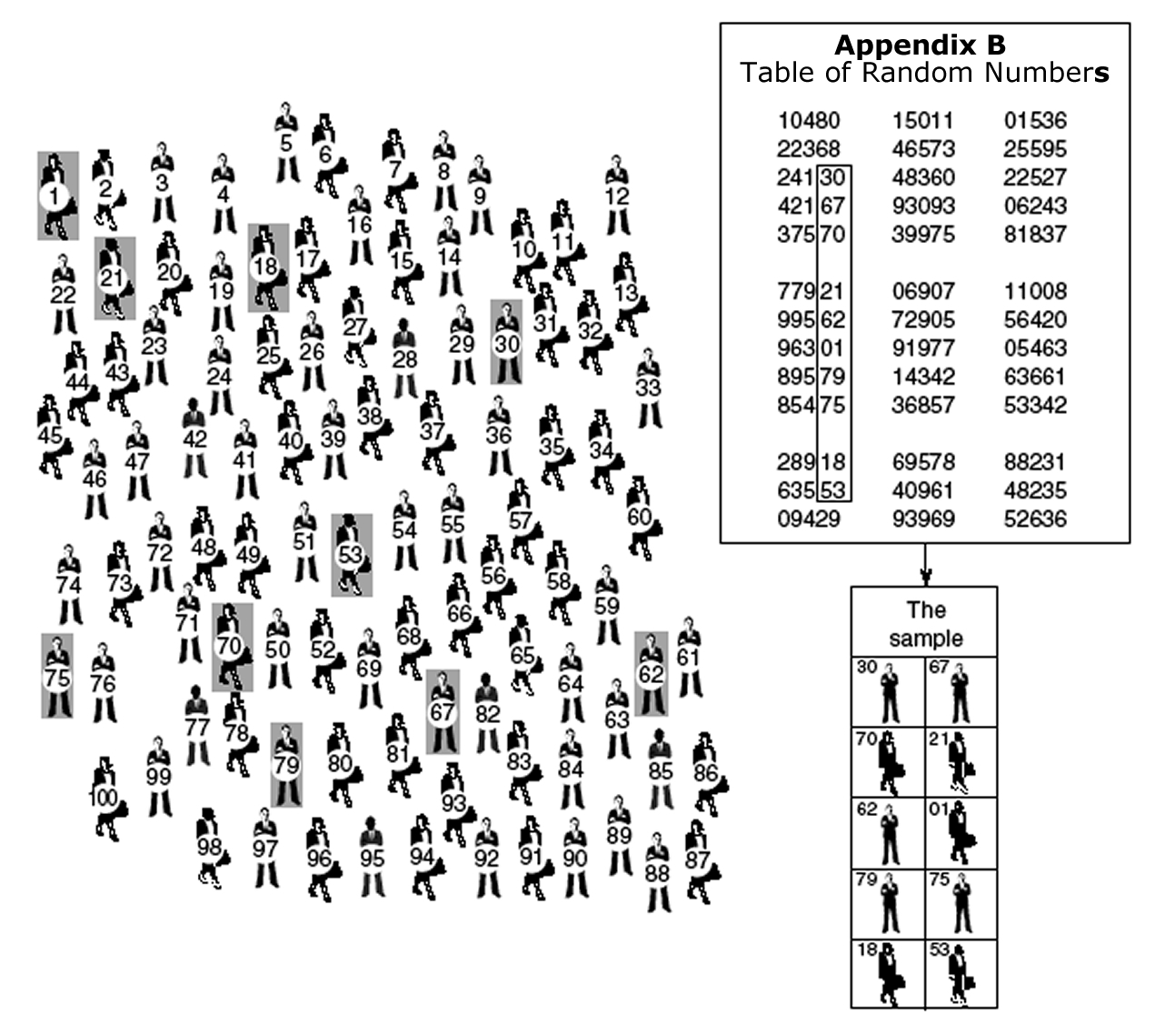
A Simple Random Sample

Slide 33
Types of probability sampling:
2. Systematic Random Sample
Uses a random starting point, with every kth element selected (e.g. if you wanted to select 1,000 people out of 10,000 you’d select every 10th person: such as the 3rd, 13th, 23rd…).
The arrangement of cases in the list can affect representativeness (e.g. if k is even, when sampling pages from a book with chapters starting on odd-numbered pages).

Slide 34
Types of probability sampling:
3. Stratified sampling
Rather than selecting a sample from the overall population, the researcher selects cases from homogeneous subsets of the population (e.g. random sampling from a set of undergraduates, and from a set of postgraduates).
This ensures that key sub-populations are represented adequately within the sample.
A greater degree of representativeness in the results thus tends to be achieved, since the (typical) quantity of sampling error is reduced.

Slide 35
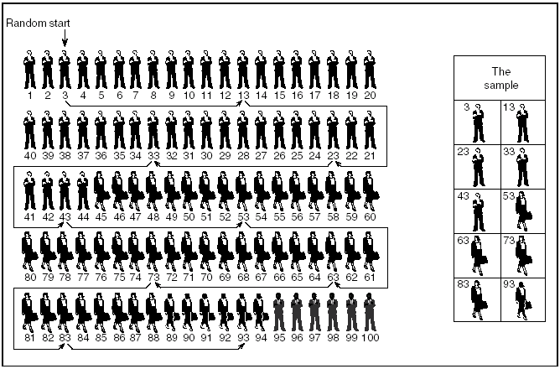
A Stratified, Systematic Sample with a Random Start

Slide 36
Types of probability sampling:
4. Multi-stage Sampling
This is often used when it is not possible or practical to create a list containing all the elements within the target population.
It involves the repetition of two basic steps: creating lists of sampling units and sampling from them.
It can be highly efficient but less accurate.

Slide 37
Example of Multi-stage Sampling
Sampling Coventry residents
Make a list of all neighbourhoods in Bridgend
Randomly select (sample) 5 neighbourhoods
Make a list of all streets in each selected neighbourhood
Randomly select (sample) 2 streets in each neighbourhood
Make a list of all addresses on each selected street
Select every house/flat [‘Cluster’ sampling!]
Make a list of all residents in each selected house/flat
Randomly select (sample) one person to interview.

Slide 38
Types of probability sampling:
5. Probability Proportional to Size (PPS) sampling
A sophisticated form of multi-stage sampling.
It is used in many large-scale surveys.
Sampling units are selected with a probability proportional to their size (e.g. in a survey where the primary sampling units (PSUs) were cities, a city 10 times larger than another would be 10 times more likely to be selected in the first stage of sampling).

Slide 39
Note
The sampling strategies used in real projects often combine elements of multi-stage sampling and elements of stratification.
See, for example, the discussion of Peter Townsend’s poverty survey on p120 of Buckingham and Saunders, 2004.
See also Rafferty, A. 2009. Introduction to Complex Sample Design in UK Government Surveys for summaries of the sample designs of various major UK surveys http://www.esds.ac.uk/government/docs/complexsampledesign.doc

Slide 40
Sample size
The sample size that is needed depends upon:
The heterogeneity of the population: the more heterogeneous, the bigger the sample needed
The number of relevant sub-groups: the more sub-groups, the bigger the sample needed
The frequency of a phenomenon that you are trying to detect: the closer to 50% (of the time) that it occurs, the bigger the sample needed
How accurately you want your sample statistics to reflect the population: the greater accuracy that is required, the bigger the sample needed.
How confident you want to be about your results!

Slide 41
Other considerations when you are thinking about sample size
The response rate – if you think that a lot of people will not respond, you need to start off by sampling a larger number of people.
Form of analysis – some forms of statistical analysis require a larger number of cases than others. If you plan on using one of these you will need to ensure that you’ve got enough cases.
Generally (given a choice): Bigger is better!
(hence the sample size often reflects costs/resources.)

Slide 42
Questionnaire design

Slide 43
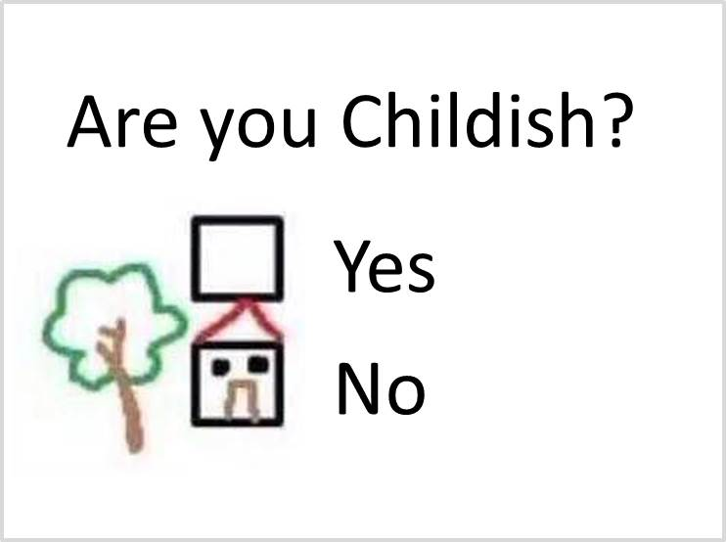

Slide 44
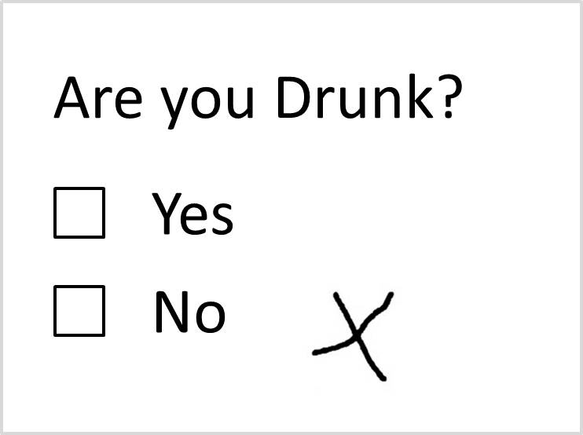

Slide 45
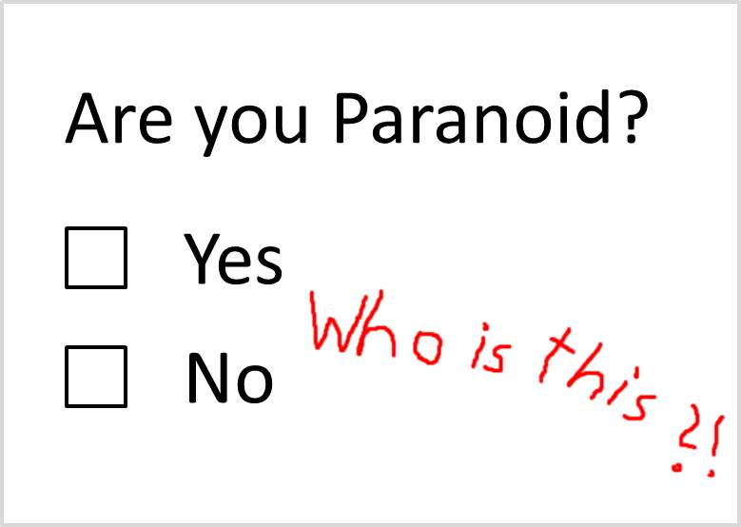

Slide 46
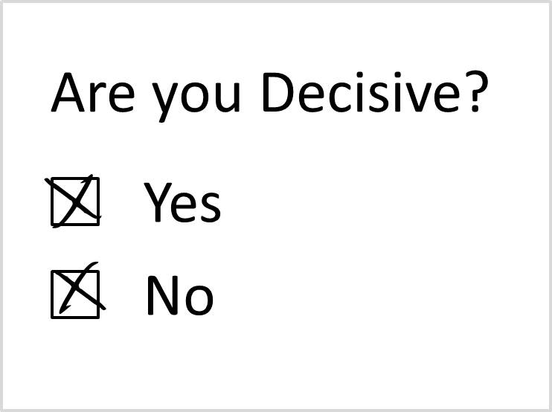

Slide 47
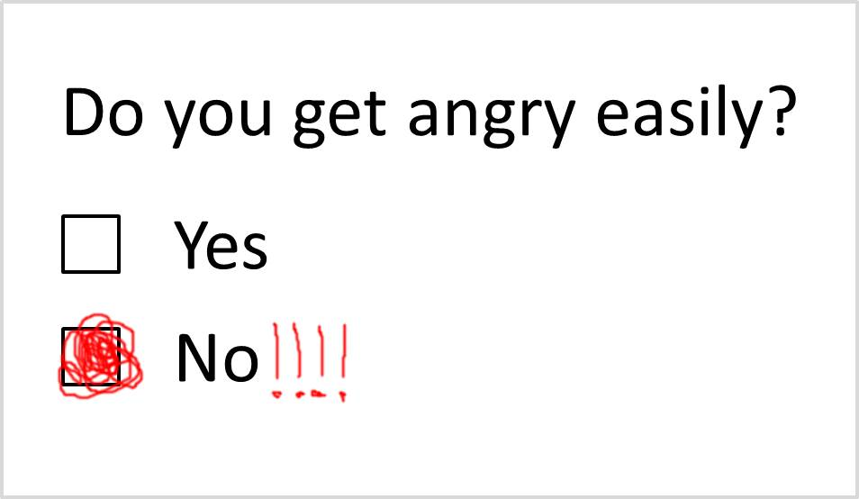

Slide 48
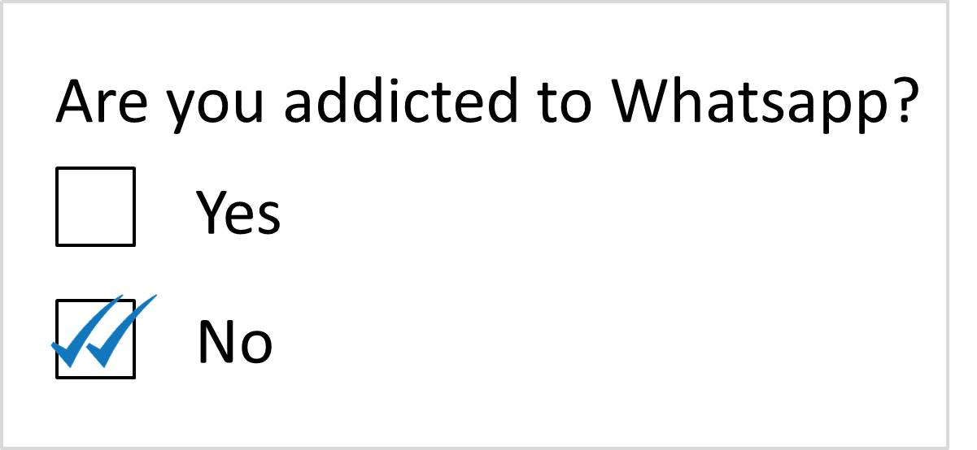

Slide 49
Questionnaire design

Slide 50
When is a questionnaire appropriate?
Have good idea of what to expect
Time to administer if not online
Interested in counts, frequencies etc.
Want to make generalisations to larger population

Slide 51
Procedure
Working out the aims of the questionnaire
Selecting the question styles
Designing the questions
Structuring the questionnaire
Piloting the questionnaire
Revising the questionnaire
Administering the questionnaire.

Slide 52
Information which can be obtained from questionnaires
Facts and Knowledge (biography/demographics)
Actions
Opinions/beliefs
Attitudes
Motives
Past Behaviour
Likely Future Behaviour

Slide 53
Choosing the questions
What type of information do you need from this question?
How will the answers serve the aims of the questionnaire?
How will you present the findings from answers to this question?
Do you need numerical scores from the answers?

Slide 54
Open questions
What do you think the Government should be doing about global warming?

Slide 55
Closed questions
1. What do you think is the most important factor to consider when buying food? Tick just ONE box
    a) Value for money ₁
    b) Hygienic processing ₂
    c) No chemical additives ₃
    d) Good flavour when cooked ₄
    e) Easy to prepare ₅

Slide 56
Interviews
What do you want out of the analysis?
Description
Substantive or formal theory
Theory testing

Slide 57
Interviews
Asking respondents a series of open-ended questions. They can generate both standardized quantifiable data, and more in-depth qualitative data.
Style
Structured
Semi-structured
Unstructured
Focus groups
Purpose
Expert information
Subject of interest or
attitudes
Pilot interviews

Slide 58
Questionnaire structure
Title
Introductory paragraph
Content questions
  In sections
  Use filter questions
  Put more difficult/onerous questions towards the end
  Do not give away answers to later questions
End, useful information and thanks

Slide 59
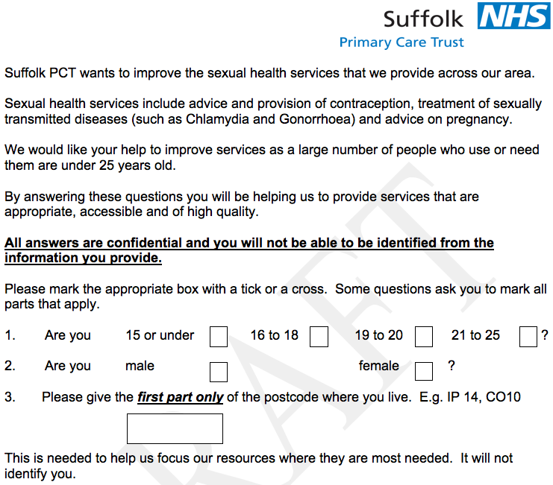

Slide 60
Layout
Allow space
Instructions (general, section, question, filter question)
Numbers for computer coding

Slide 61
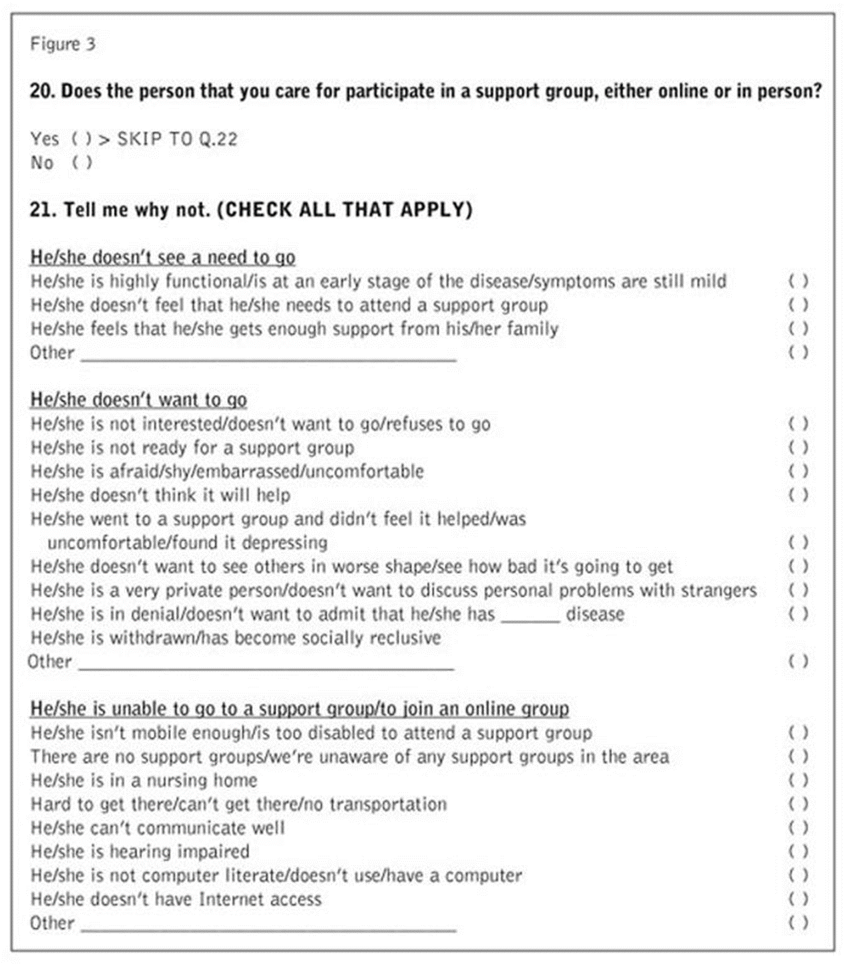

Slide 62
Telephone Questionnaires
Retention problem
= too many categories in answer to remember
use numbered scale
get direction of feeling then intensity
include in question then repeat list
Provide guides for interviewer on questionnaire – distinguish from questions
Make clear what is to be read to respondent and what is not (e.g. instructions for prompt)

Slide 63
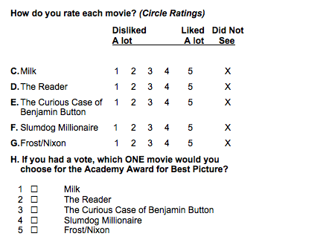
Checklists and ratings

Slide 64
Semantic Differentials
How would you rate your line manager on these scales?
Warmhearted I I I I I Coldhearted
Patient I I I I I Impatient
Self-assured I I I I I Always stressed
Unselfish I I I I I Selfish

Slide 65
Why pilot a questionnaire?
To expose the questionnaire to new forms of thinking and understanding.
To evaluate the quality of the answers provided by the questionnaire.
To assess and revise the phrasing and content of the questions.
To explore issues of questionnaire structure and question sequence.
Purposive/convenience.

Slide 66
Use Piloting to check for:
Variation in type of answer
Meaning
Redundancy
Scalability
Non-response (too much)
Acquiescent response (too much agreement with agree/disagree Q)
Flow
Filtering
Timing

Slide 67
Scaling
Needs to be
Unidimensional
Linear (equal intervals)
Reliable
Valid (esp. for standard scales)

Slide 68
Major types of scales
Thurstone
Judges rank agree/disagree items
Likert
Judges score large list of items

Slide 69
Likert Scales
 | Strongly agree | Agree | Neutral | Disagree | Strongly disagree | Not applicable
The experts are divided on global warming. |  | 
There’s not much we can do to reduce carbon dioxide emissions. |  |  | 
I worry a lot about rising sea levels. |  |  |  |  | 
New technology will stop global warming. | 

Slide 70
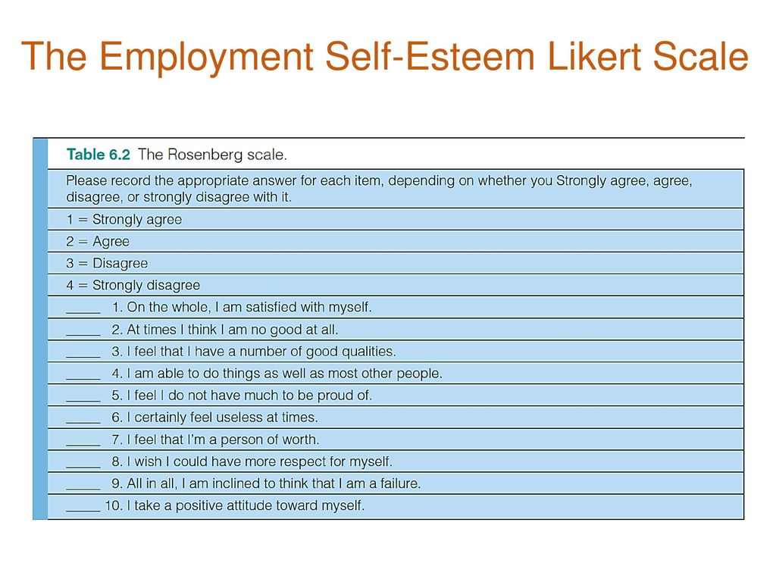

Slide 71
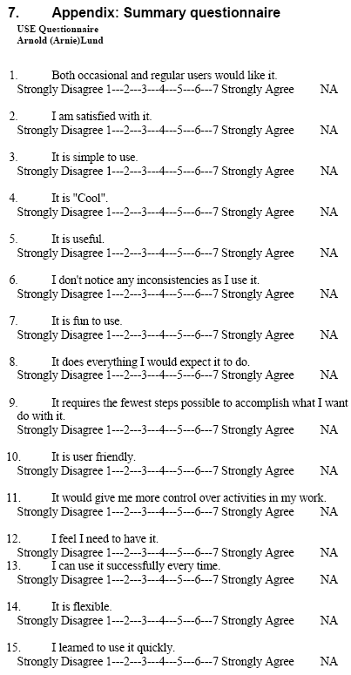

Slide 72
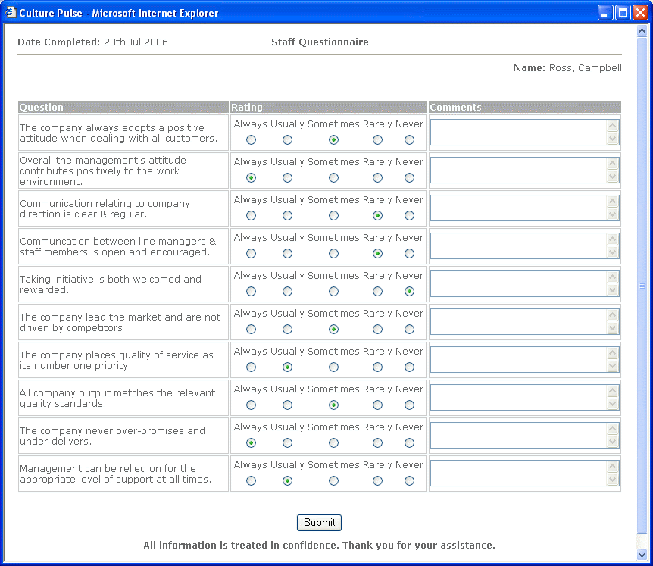

Slide 73
Some problems of question-writing:-
Leading questions:
Are you against giving too much power to trades unions?
Why don’t you go more often to the supermarket?

Slide 74
Ambiguous questions
Is your work made more difficult because you are expecting a baby?
Multiple-content questions
Have you suffered from headaches or sickness lately?

Slide 75
Simple alternatives
acquaint | inform or tell
assist | help
consider | think
initiate | begin; start
major | important; chief; main;
purchase | buy
require | want; need
reside | live
state | say
sufficient | enough
terminate | end
Over-complex vocabulary
Avoid ‘big’ words and technical terms
e.g.
Social mobility
Neutralisation
Patriarchy
Notes:
Over-complex vocabulary
Avoid ‘big’ words and technical terms
e.g.
Social mobility
Anomie
Patriarchy

Slide 76
Over-elaborate phrasing and too complex question
Has it happened to you that over a long period of time, when you practised abstinence, nor used drugs, you did not call in sick at your workplace?
Yes No
vague (what is a‘long period’
too factual (‘has it happened to you that …’)
complex - Long sentence and double negative

Slide 77
Implicit questions (based on assumptions)
How many children do you have? (Asked of all people)
How old is your car?

Slide 78
How often?
Use either:
In the last week how often .…?
On average …?
When did you last .…?

Slide 79
Embarrassing questions
e.g. Sexual mores, alcohol consumption, law breaking, taboo subjects (e.g. death)
Create permissive atmosphere by range of possible answers.
e.g. not “Does your child steal?”
but,
“Which of the following best describes your child?
He or she never steals
He or she sometimes steals (including from home)
He or she has stolen on several occasions.

Slide 80
Vague terms
e.g.
a long time
recently
near you
kind of
fairly
often
on the whole

Slide 81
Prestige bias
“Doctors say that …”
“Research has shown that …”
“Is the government right to .…”

Slide 82
Patronising tone
Avoid this:
“Answer these questions to the best of your ability”
“‘Dwelling’ means the place where you regularly live”.

Slide 83


