Slide 1
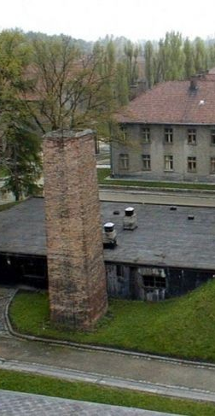
The Importance of the Concept of Authenticity in the Presentation of Heritage.
Rosie Nye
Third Year BA Archaeology Student

Slide 2
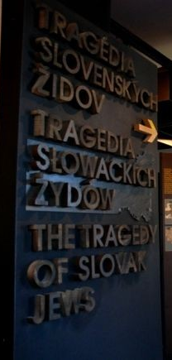
Authenticity
Important attribute of the heritage industry
Heritage thought of as genuine
Authenticity has a direct bearing on visitors
Notes:
Authenticity, or at least the perception of it, is an important attribute of the heritage industry. It provides a sense of the heritage as being genuine. The understanding of the concept of authenticity of heritage attractions is important as the presentation, interpretation and the verification have a direct bearing on the visitors’ motivations to visit and engage with heritage sites. Academics have suggested that the concept of authenticity reflects the complexity of the interacting phenomena and the cultural conflict surrounding heritage. However, in order to address the importance of the concept of authenticity within the presentation of heritage, an understanding must be formed of the different concepts that academics draw upon.

Slide 3
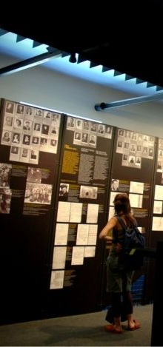
Constructed Authenticity
Presentation of heritage contrived
Authenticity a result of signs and symbols which are projected by society
Notes:
Wang in 1999, uses the term “constructive” or “symbolic authenticity to suggest that the tourists’ experiences can be considered authentic even when they are aware that the presentation of the heritage which they are visiting, has been contrived. According to Lavine and Karp in 1991, the heritage sector will inevitably draw on the cultural assumptions and resources in order to appeal to tourists; essentially making authenticity a socially and individually constructed and evaluated experience. As such, when considering the concept of constructed authenticity, authenticity is the result of the signs and symbols which are projected by the society from the understandings they already have obtained. As authenticity can be situated as a cultural construct, it seems as if the layers of authenticity can be simply wrapped around any object, irrespective of its unique past.

Slide 4
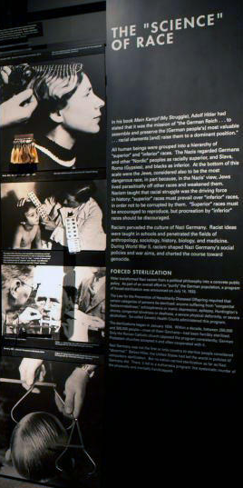
Postmodernist Authenticity
Authenticity is not a concept which is based within a genuine intellect
Authenticity gained through emotional experiences, not through genuine articles
Notes:
From a postmodernist position, which acknowledges fragmentation, imperfection and blurred boundaries, authenticity is not a concept based within a genuine intellect but instead through emotional experiences. Leigh et al, 2006, suggests that authenticity can be considered as an antecedent or input of tourist behaviour therefore implying that the concept of authenticity is one which is developed through the interaction of the visitors and the heritage industry itself. As a result, authenticity in terms of the objects being a genuine article is not the priority. Rather the perception of authenticity within the presentation of heritage seems to be given the most importance. As Casey states, people respond to what they believe is real, and the expectations are satisfied by the location, the site of the heritage provides the ideal stage for a fictionalised performance.

Slide 5
Authority and Authenticity
The problem with things is that they are dumb. Not eloquent. And, if by some ventriloquism they seem to speak, they lie”
(Crew, Sims 1991: 159).
Notes:
When looking at the importance of the concept of authenticity in the presentation of heritage, the role of authority also needs to be taken into consideration. A key quote is that by Crew and Sims, “The problem with things is that they are dumb. Not eloquent. And if by some ventriloquism they seem to speak, the lie.” In most cases, the heritage industry’s concern, especially in regards to museums is with the authentic object; a notion rooted in the habits of collecting and research the pass. Therefore, the heritage industry will carefully and subtly wrap the presentation of the past in order to support the message that they wish to convey; the messages being what the curators of such sites consider to be authentic. When tourist interact with the presentation of the heritage that they are visiting, they experience a sense of the genuine, truthfulness or the definition of authenticity that the objects seem to articulate. However, the artefacts can be easily altered depending on the context in which they are used. As a result, it can be stated that authenticity is not about factuality or reality, but about authority. Handler argues that the contact with artefacts which have been authenticated by heritage institutions and museums allows the appropriation of authenticity, incorporating it into our own personal experiences. From this, it appears that authenticity is not simply a facet of the internal essence of discrete isolate entities but rather a product of the relationship between objects and authority.

Slide 6
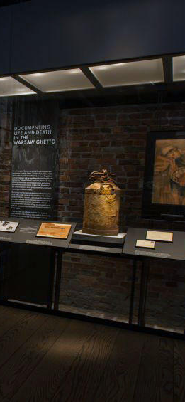
Staged Authenticity
Authenticity of objects and events are staged
Fabricated image has precedence over the real
Notes:
The final concept of authenticity which will be examined be for discussing the case studies, is that of “staged authenticity”. A number of academics, such as Boorstin, argues that the authenticity of objects and events are stages and distorted to suit the needs of both the visitors and their hosts. MacCannell in 1974 coined the phrase “staged authenticity” where the fabricated image has precedence over the real if it holds aura, magic or contributes significantly to the learning of the tourist. Authenticity of heritage sites can be, and are, staged to meet the demands of visitors. Sightseers are motivated by a desire to see life as it is really lived. Guided tours offering a staged quality that lends to an aura of superficiality which is not always perceived by tourists; they only perceive “authenticity”. The dialectic of authenticity reflects an ontological anxiety of existence about what is genuine and objectively true. As a result, tourists entering heritage sites are expecting an authentic experience; one that is most likely staged in order for the heritage industry to engage as many visitors as possible.
With the different perceptions of authenticity in mind, it is clear that the concept of authenticity, whichever concept that is, has a significant role to play in the presentation of heritage.

Slide 7
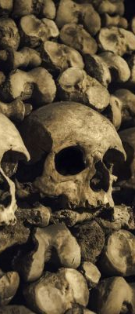
Dark Tourism
Sites of death, disaster and atrocities are an increasingly present form of heritage presentation
One of the main conventions is how sites are given dominant portrayal as being “real” or “authentic”
Notes:
Death, disasters and atrocities are becoming an increasingly present form of heritage presentation, providing tourists a way in which they are able to gaze upon real and recreated death. One of the main conventions is how sites such as Auschwitz-Birkenau, a ‘dark history’ site, are given a dominant portray as “real” or “authentic” whereas heritage attractions such as museums are, according to Stone 2016, suggested as having the tendency to romanticise and distort past dark deeds. The production and presentation of dark tourism is driven by consumer tastes; bringing two types of authenticity to the forefront. Both the ideas of constructed and staged authenticity play a role according to Seaton in 1999. For example, the product and experiences at the death camp site of Auschwitz-Birkenau are conceivably darker than the one that the visitors will engage with at the US Holocaust Memorial Museum in Washington DC. However, this does not make the US Holocaust Memorial Museum any less authentic that Auschwitz-Birkenau, but it will clearly demonstrate the different concepts of authenticity at play within the presentation of heritage; something which is about to be discussed.

Slide 8
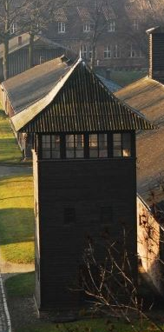
Auschwitz-Birkenau
Authenticity, in literal sense, serves primarily as a function for education
Authenticity is embedded in the idea of the location being real
Concept of authenticity considered important
Notes:
When examining Auschwitz-Birkenau, it is clear that authenticity, in the most literal sense of the word, serves primarily as a function for education, generating credibility and presenting historical documentary and emotional meaning of the objects. Walter Benjamin suggests that the authenticity of such as site is embedded with the idea of the location being real; it is the knowledge that you are at a site of such death ad atrocity which creates the idea of authenticity. Nonetheless, the concept of authenticity at Auschwitz-Birkenau is one that is continually referred to as important, you just have to go onto the website to see the word repeatedly applied to the museum and the memorial.
What is most striking about the museum is that the interiors of the blocks have morphed from the buildings where intense suffering occurred to museum exhibitions, even though they are still encased within the same shell. There is a distinct shift in the type of authenticity used in the presentation of dark heritage. The blocks are no longer in their original format; the literal authenticity not playing a role. Instead, the idea of constructed authenticity, as proposed by Wang, is more appropriate when examining the museum.

Slide 9
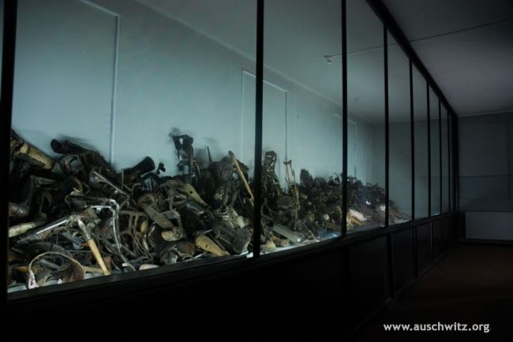
Block 5
Artificial limbs on display in Block 5 (Sawicki 2018).
Notes:
One clear example of constructed authenticity can be seen in Block 5 of the Museum. The showcase is filled with the artificial limbs of the victims’ is what takes precedence in the room. The rest of the room is bare. The display, and its presentation would have as striking impact on visitors, even more so as the artificial limbs are the genuine article. However, although the limbs are authentic in the literal sense, their location and how they are arranged are all a result of the curators attempting to construct a site for visitors to engage with. Crew and Sim’s idea that objects can only speak the messages that the figures of authority wish them to have applies significantly to these exhibitions. Each display has been carefully constructed, the rooms have been changed to represent the views of those running the museum.

Slide 10
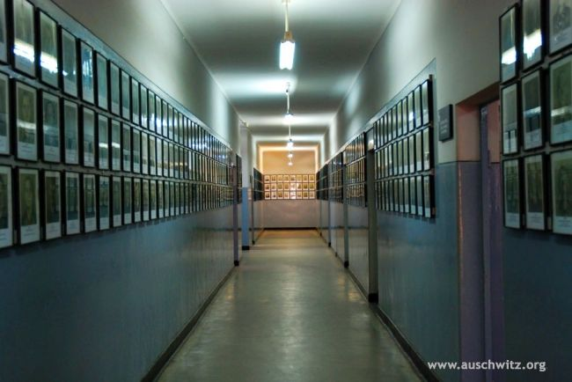
Block 6
Photographs of registered prisoners in Block 6 (Sawicki 2018).
Notes:
This can be seen in other blocks at the site. Here in block 6, it is clear that it is a very different corridor to that that would have been experience during the Holocaust itself. The corridor has been constructed to create an impact on the people who enter the exhibition. Therefore, although the items being put on display are the genuine article, with the importance of authenticity being evident due to lack of replicas, how the items are displayed are a clear example of, as has been mentioned, constructed authenticity. People arrive to Auschwitz-Birkenau with preconceived ideas of what to expect; the curators drawing on these cultural assumptions to create a site that people would visit and engage with. However, this doesn’t draw away from the importance of authenticity at this site. It is the different concepts which vary in importance rather than authenticity as a whole.
There is a stark contrast between the presentation of heritage at sites of dark heritage and sites which have little connection to the locations of such dark heritage sites, for example the US Holocaust Memorial Museum.

Slide 11
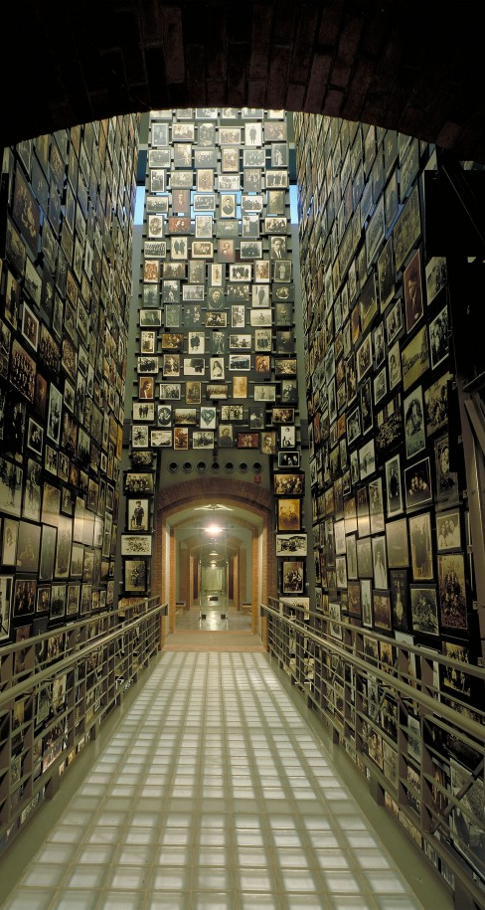
US Holocaust Memorial Museum
Argument of authority over authenticity can be applied
Purpose of museum is to prove the reality of events be creating distinctions between authentic and inauthentic
“almost Americanized by the US Government to infer greater meaning to the predominantly American visitors” (Lennon and Foley, 1999: 49).
Notes:
Notwithstanding the gravity of its subject matter, neither the site of the US Holocaust Memorial Museum, nor many of its displays have, according to Lennon and Foley, an authentic connection with the Holocaust. The Holocaust was a predominantly European affair, having almost been, as Lennon and Foley put it “almost Americanized by the US Government to infer greater meaning to the predominantly American visitors”. Here, as with the museum at Auschwitz, authenticity is subject to authority. Especially as the US government remains the ultimate authority and influence regarding the museum, maintain control over the individuals involved with the presentation of the Holocaust.
However, Ochsner, 1995, states that the US Holocaust Memorial Museum retains a high standard of authenticity required to refute Holocaust revisionism. The one purpose of the museum being to prove the reality of the events which occurred by creating a clear distinction between authentic, in the most literal sense, artefacts and reconstructions. Here authenticity, by its very definition is critical for the museum. However, despite the concept of authenticity in its most literal sense being important, it does not negate the value of other concepts of authenticity within the presentation of heritage. For example, “authentic replicas” and the concept of staged authenticity, are seemingly overlooked. Yet, objects that are considered inauthentic, for example replicas of items from the Holocaust, can still evoke the horror and violence of the event and can therefore contribute to the learning of visitors; becoming an involuntary solidification of the authenticity of the genuine objects.

Slide 12
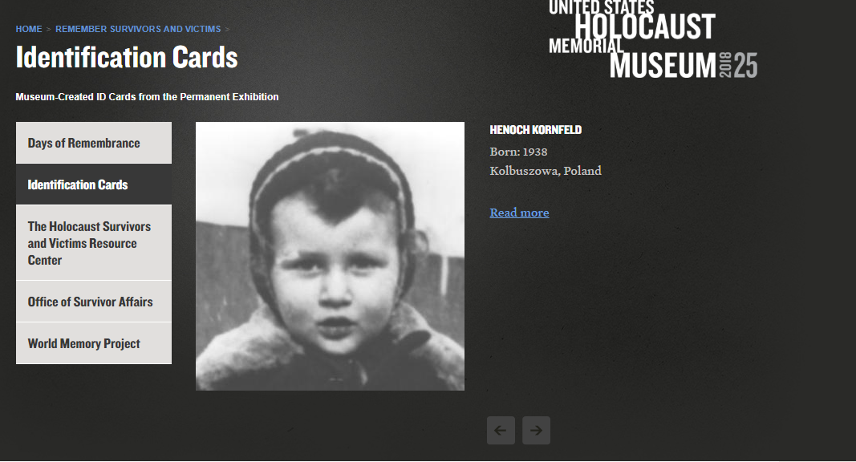
“the irony is that many Jews during the Holocaust scrambled to acquire false papers in order to survive the war…there is a reverse principle at work here, as if everyone were expected to enter the Museum as an American and leave as a Jew” (Rosen, in Young 1993: 343).
Screenshot of the US Holocaust Memorial Museum Website which provides information about the ID cards used in the Museum (US Holocaust Memorial Museum, 2018).
Notes:
There are a variety of exhibitions and artefacts presented in the museum which could be discussed, however, what will be examined in this presentation will be the Identity Cards which are presented to the visitors as they enter the US Holocaust Museum.
ID cards are presented to visitors upon entering the Permanent Exhibition. Whilst in possession of these cards, visitors are able to follow the lives of the people on the ID cards through four sections, discovering whether they lived or died, making visitors engage with artefacts and imagery in the exhibitions. Young states that the issuing of the ID cards turns the visitors into victims of the Holocaust for the day. Not only does this make the Holocaust, a predominantly European affair in the mid-20th Century, more real to visitors, but the experience provides a sense of authenticity for the individuals. As Rosen states in Young’s 1993 work, “the irony is that many Jews during the Holocaust scrambled to acquire false papers in order to survive the war…there is a reverse principle at work here, as if everyone were expected to enter the Museum as an American and leave as a Jew”. The issuing of the ID cards gives the visitors a feeling of authenticity. They are now the people who suffered during the Holocaust, they have that connection. The use of ID cards within the museum also reiterates the statements already made by Crew and Sims referring to authenticity shaping the authenticity of heritage to suit the presentation of the events which curators wish to put forward. It gives the exhibition more validation by putting forward that authentic experience for visitors to engage with. As such, the presence of authenticity, in whatever form or concept it takes, highlights the importance placed upon it in the presentation of heritage.

Slide 13
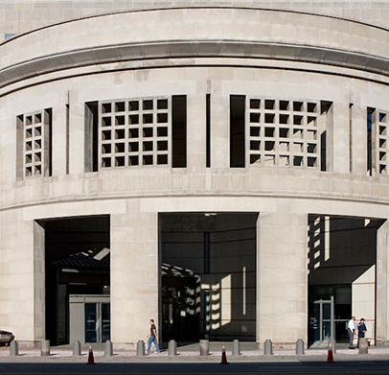
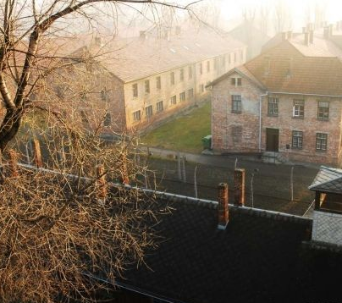
Comparison
Variety of differences between the importance placed on the concepts of authenticity at both sites
Locations create displays and exhibitions to convey messages
Both sites show that authenticity is an important concept
Notes:
There are a variety of differences between the importance placed on the concepts of authenticity when comparing the museum at Auschwitz-Birkenau and the US Holocaust Museum. The authenticity of the location of the sites is the first example of the differences between the two sites that will be examined. As has already been discussed, the US Holocaust Memorial Museum is located at a site which has little or no connection with the events of the mid-20th Century in Europe. In contrast, Auschwitz-Birkenau is located on the site where all of the atrocities occurred. The genuine authenticity, which is sought by both sites, in terms of location, can only be achieved by the one. However, what is most interesting is that both sites lean more towards MacCannell’s idea of “staged authenticity”. Both locations create displays and exhibitions to convey messages to visitors; regardless of claims of the sites being genuinely authentic. It would be almost impossible to state that either heritage site could be labelled as authentic when using the definition of the word. Both sites have been altered and modelled to what the individuals in authority desire. What should also be drawn upon is the idea of the authentic experience as the factor which draws individuals to the site. When comparing the sites to consider how important authenticity is in the presentation of heritage, both sites demonstrate that authenticity, regardless of which definition it is being given, or which form is being used to examine the presentation of heritage, it is an important concept.

Slide 14
Conclusion
Authenticity, regardless of its concept, is of significant importance when presenting heritage
The different ways in which authenticity is considered by academic world, each play a role in the presentation of heritage
It provides a mechanism to encourage visitors to make the trips to heritage sites
Notes:
When taking into consideration the importance of the concepts of authenticity in the presentation of heritage, it is evident that authenticity, regardless of its concept is of significant importance when presenting heritage to the public. There are a number of different concepts of authenticity, which have been discussed, all of which are of varying levels of importance when providing the mechanism to encourage visitors to make trips to sites of, as in this case, dark tourism. What can be concluded, as a result of the two case studies which have been examined, is that the concept of authenticity is clearly of importance in the presentation of heritage.

Slide 15
Bibliography
Ames, K. L. 1985. Introduction. In Axelrod, A. (ed) The Colonial Revival in America. Wilmington Del: Henry Francis du Pont Winterthur Museum.
Auschwitz-Birkenau. 2018. Memorial and Museum: Auschwitz-Birkenau. Former German Nazi Concentration and Extermination Camp. http://auschwitz.org/en/ accessed 27/4/2018.
Belhassen, Y., and Caton, K. 2006. Authenticity Matters. Annals of Tourism Research. Vol 33. No 3. Pp 853-856.
Benjamin, W. 1985. Illumination. New York: Hannah Arendted Schochen Books.
Boniface, P., and Fowler, P. 1993. Heritage and Tourism in the Global Village. London: Sage.
Boorstin, D. 1991. The Image: A Guide to Psuedo-Events in America. New York: Vintage.
Bryce, D., Curran, R., O’Gorman, K., and Taheri, B. 2015. Visitors’ engagement and authenticity: Japanese heritage consumption. Tourism Management. Vol 46. Pp 571-581.
Casey. V. 2003. The Museum Effect: Gazing from object to performance in the contemporary cultural-history museum. Ecole de Louvre. Pp 1-21.
Chhabra, D., Healy, R., and Sills, E. 2003. Staged Authenticity and Heritage Tourism. Annals of Tourism Research. Vol 30. No 3. Pp 702-719.
CNN Staff. 2017. Are Museums Still Relevant? https://edition.cnn.com/travel/article/are-museums-still-relevant/index.html accessed 27/4/2018.
Cohen, E. 1988. Authenticity and commoditisation in tourism. Annals of Tourism Research. Vol 15. No 3. Pp 371-386.
Costa, J, A., and Bamossy, G. J. 2001. Le Parc Disney: Creating an “Authentic” American Experience. Advances in Consumer Research. Vol 28. Pp 398-402.
Crew, S. R., and Sims, J. E. 1991. Locating Authenticity: Fragments of Dialogue. In Karp, I., and Lavine, S. D. (eds) Exhibiting Cultures: The Poetics and Politics of Museum Display. Washington and London: Smithsonian Institution Press.
Culler, J. 1981. Semiotics of Tourism. American Journal of Semiotics. Vol 1. No 1. Pp 127-140.
Dalton, D. 2009. Encountering Auschwitz: A Personal Reumination on the Possibilities and Limitations of Witnessing/Remembering Trauma in Memorial Space. Law Text Culture. Vol 13. Pp 187-226.
Handler, R. 1986. Authenticity. Anthropology Today. Vol 2. No 1. Pp 2-4.
Jamal, T., and Hill, S. 2004. Developing a Framework for Indicators Authenticity: The Place and Space of Cultural and Heritage Tourism. Asia Pacific Journal of Tourism Research. Vol 9. No 4. Pp 353-371.
Jensen, O., and Lindberg, F. 2001. The consumption of tourist attraction: a modern, post-modern and existential encounter perspective. In Beckmann, S. C., and Elliot, R. C. (eds) Interpretive Consumer Research. Copenhagen: Copenhagen Business School Press.
Jones, S. 2009. Experiencing authenticity at heritage sites: some implications for heritage management and conservation. Conservation and Management of Archaeological Sites. Vol 11. No 2. Pp 133-147.
Kolar, T., and Zabkar, V. 2010. A consumer-based model of authenticity: An oxymoron of the foundation of cultural heritage marketing? Tourism Management. Vol 31. Pp 652-664.
Kontogeorgopoulos, N. 2004. Ecotourism and mass tourism in Southern Thailand: Spatial interdependence, structural connections, and staged authenticity. Geo Journal. Vol 6. Pp 1-11.
Lavine, S. D., and Karp, I. 1991. Museums and Multiculturalism. In Karp, I., and Lavine, S. D. (eds). Exhibiting Cultures: The Poetics and Politics of Museum Display. Washington and London: Smithsonian Institution Press.

Slide 16
Bibliography
Leigh T. W., Peters, C., and Shelton, J. 2006. The consumer quest for authenticity: the multiplicity of meanings within the MG subculture of consumption. Journal of the Academy of Marketing Science. Vol 34. No 4. Pp 481-493.
Leite, N., and Graburn, N. 2009. Anthropological interventions in tourism studies. In Jamal, T., and Robinson, M. (eds) The SAGE Handbook of Tourism Studies. Los Angeles and London: SAGE.
Lennon, J. J., and Foley, M. 1999. Interpretation of the unimaginable: the US Holocaust Memorial Museum, Washington D.C. and “Dark Tourism” Journey of Travel Research. Pp 46-50.
Lopuska, A. 2016. Authenticity vs Accessibility. The Borders of Compromise in the Preservation of Auschwitz-Birkenau Site. Oswiecim: Auschwitz-Birkenau State Museum.
MacCannell, D. 1974. Staged authenticity: arrangements of social space in tourist settings. American Journal of Sociology. Vol 79. No 3. Pp 589-603.
MacCannell, D. 1976. The Tourist: A New Theory of the Leisure Class. Los Angeles and London: University of California Press.
Macdonald, S. 1997. A People’s Story: Heritage, Identity and Authenticity. In Rojek, C., and Urry, J. (eds). Touring Cultures. London: Routledge.
Miles. W. F. S. 2000. Auschwitz: Museum Interpretation and Dark Tourism. Annals of Tourism Research. Vol 29. No 4. Pp 1175-1178.
Ochsner, J. K. 1995. Understanding the Holocaust through the US Holocaust Memorial Museum. Journal of Architectural Education. Vol 48. No 4. Pp 240-249.
Olsen, K, H. 2002. Authenticity as a concept in tourism research: the social organisation of the experience of authenticity. Tourist Studies. Vol 2. No 2.
Oxford Dictionary. 2008. Definition of “authenticity”. https://en.oxforddictionaries.com/definition/authentic. Accessed 24/4/2018.
Pye, E. 2001. Caring for the Past. Issues in conservation for archaeology and museums. London: James and James.
Rosen, J. 1991. America’s Holocaust. Forward. 12th April. In Young, J. E. 1993. The Texture of Memory: Holocaust Memorials and Meaning. New Haven and London: Yale University Press.
Ryan, C. 2000. Tourist experiences, phenomenographic analysis, post-positivism and neural network software. International Journal of Tourism Research. Vol 2. No 2. Pp 119-131.
Sawicki, P. 2018. Artificial limbs on display in Block 5. In Auschwitz-Birkenau. 2018. Memorial and Museum: Auschwitz-Birkenau. Former German Nazi Concentration and Extermination Camp. http://auschwitz.org/en/ accessed 27/4/2018.
Sawicki, P. 2018. Photographs of registered prisoners in Block 6. In Auschwitz-Birkenau. 2018. Memorial and Museum: Auschwitz-Birkenau. Former German Nazi Concentration and Extermination Camp. http://auschwitz.org/en/ accessed 27/4/2018.
Seaton, A. V. 1999. War and Thantourism: Waterloo 1815-1914. Annals of Tourism Research. Vol 26. Pp 130-158.
Stone, P. R. 2006. A dark tourism spectrum: Towards a typology of death and macabre related tourist sites, attractions and exhibitions. Tourism. Vol 54. No 2. Pp 145-160.
US Holocaust Memorial Museum. 2018. Identification Cards: Museum-Created ID Cards from the Permanent Exhibition. https://www.ushmm.org/remember/id-cards accessed 27/4/2018.
Wang, N. 1999. Rethinking authenticity in tourism experience. Annals of Tourism Research. Vol 26. No 2. Pp 349-370.
Weinberg, J. 1993. “From the Director”. In Berenbaum, M. (ed). The World Must Know: The History of the Holocaust as told in the United States Holocaust Memorial Museum. Boston: Brown.
Young, J. E. 1993. The Texture of Memory: Holocaust Memorials and Meaning. New Haven and London: Yale University Press.
Zhu, Y. 2012. Performing Heritage: Rethinking authenticity in tourism. Annals of Tourism Research. Vol 39. No 3. Pp 1495-1513.

